Slide 1

NORDIC ID
RF-6xx Development Kit
GETTING STARTED

Slide 2
NORDIC ID
Contents:
Register PLServer.ocx
Preparing PC-Emulator
Run sample application
RETAIL
This presentation describes steps to get started with PC-Emulator and sample programs.

Slide 3
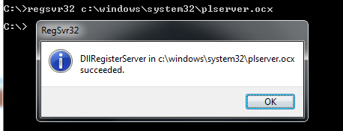
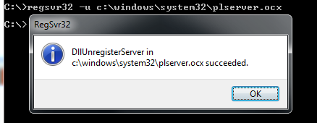
Registering PLServer.ocx
Before PLServer can be used, it must be register to Windows registration database. You may want your setup program to register the PLServer when it is installed. RegSvr32.exe can be used to register PLServer.ocx. - Use command prompt window for using regsvr32.exe - When making installer for your app, make sure PLServer.ocx installed and registered
Example: PLServer.ocx stored to C:\Windows\System32 folder
Registering…. Unregistering….

Slide 4
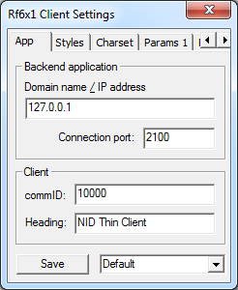
Preparing PC-Emulator
Installing: Run NIDThinClientPC 1.2.exe from PC-Emulator folder
After installation, run emulator from: Start→Programs→Nordic ID→Nordic ID Thin Client
Use Right mouse click to open popup menu
Select settings ( password: ”1234” )
Use following settings:
Press ”Save” to exit

Slide 5
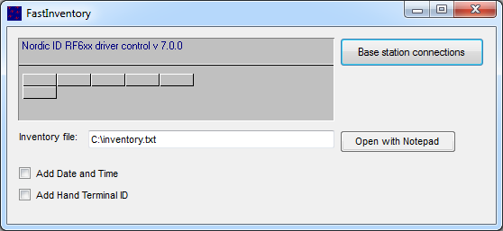
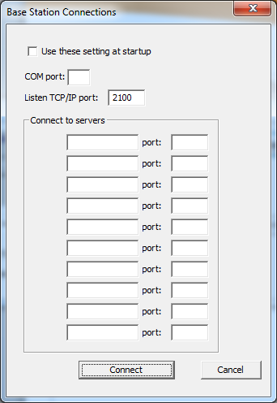
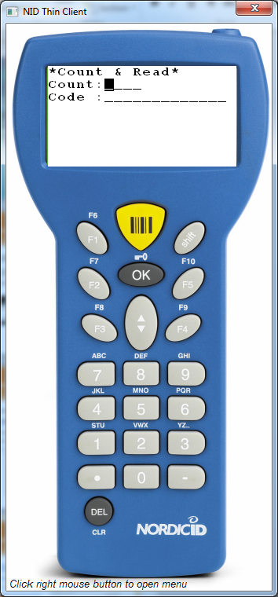
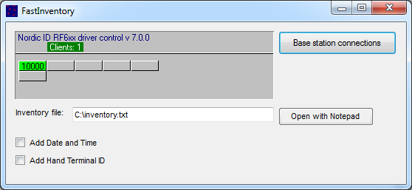
Run sample application
Run sample application FastInventory.exe from folder: ..\RFSeriesDevKit\RF6xxSamples\FastInventory\bin\Release
Click ”Base station connections” button
Set ”Listen to TCP/IP port” to 2100 and press connect
Allow firewall to communicate with this application
Use any F-Key from PC-Emulator to communicate (or OK-Button)

