Slide 1
RF-Series
Software-Development basics
Ari Pöyhönen

Slide 2
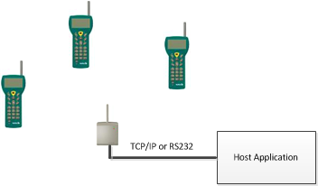
SW-Development for RF-Series devices
System operation
The system consists of radio hand terminals, which are used to communicate
wireless with the host system via a receiver device using a very simple but flexible
communications protocol.
Single transaction:
Hand held user initiates transaction by scanning barcode or pressing F-key or OK-key in input field
Base station receives hand held message and passes it to host application
Host application process message and sends answer back to hand held.
Typical transaction time is < 100ms

Slide 3


SW-Development for RF-Series devices
Development Tools
Nordic ID provides:
PLServer.ocx ActiveX control component for Windows
RF-Series system developers guide
PC-emulator of hand held (NID Thin client)

Slide 4
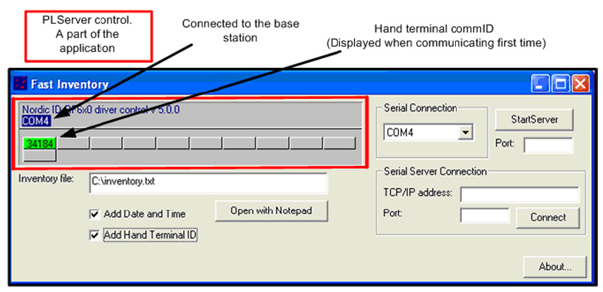
SW-Development for RF-Series devices
PLServer
The PLServer makes HOST system software development easy by doing all the dirty work for you. The use of PLServer provides a lot of functionality and code that you don’t have to write or debug. All you have to do is to figure out the entry points and how to use them.

Slide 5
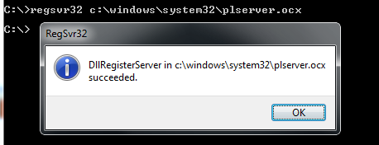
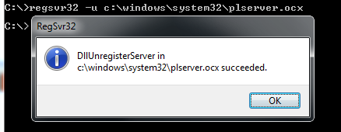
SW-Development for RF-Series devices
Registering PLServer.ocx
Before PLServer can be used, it must be register to Windows registration database. You may want your setup program to register the PLServer when it is installed. RegSvr32.exe can be used to register PLServer.ocx.
-Use command prompt window for using regsvr32.exe
-When making installer for your app, make sure PLServer.ocx installed and registered
Example:
-PLServer.ocx stored to C:\Windows\System32 folder
Registering…. Unregistering….

Slide 6
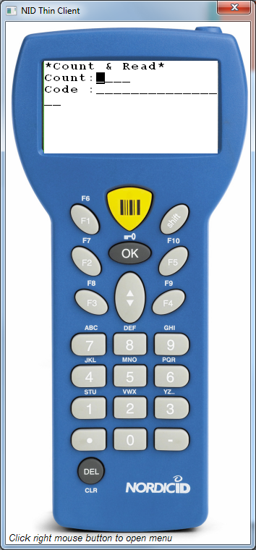
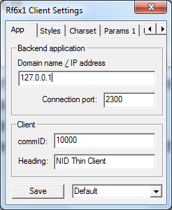
SW-Development for RF-Series devices
PC-Emulator
PC-Emulator is windows software which act’s as a real hand held device.
Possible to start host application development without need of real hardware
Connects to host app via TCP/IP
Can be used for personnel training.
Barcode scanner emulation with input field where user type code contents

Slide 7
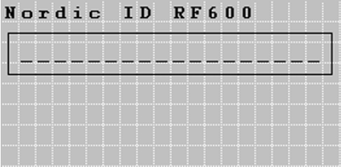
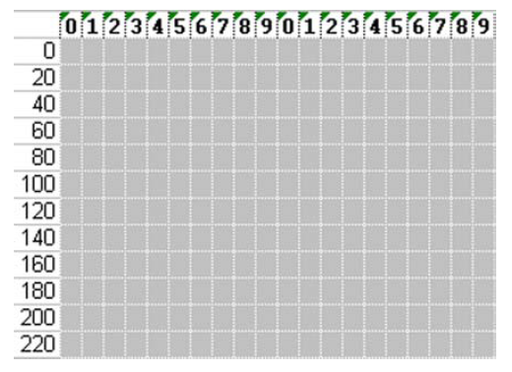
SW-Development for RF-Series devices
Hand held display
The Hand terminal has a virtual display page of 12 x 20 characters.
The actual display size is 8 x 20 characters, so that two third of the virtual page can be viewed at one time.
All UI-elements are addressed by positions. Position 0 is upper left corner and position 239 is down right corner.
Screen after reset

Slide 8
SW-Development for RF-Series devices
All Nordic ID handsets support RF-protocol
Single host application can serve all Nordic ID hand terminal types:
RF6x1 hand terminals
Nordic ID Morphic
Nordic ID Merlin

Slide 9
SW-Development for RF-Series devices
You can start host app developing now !
No costs
Microsoft Visual Studio Express is free !
http://www.microsoft.com/express/Windows/

