Slide 1
OvS for p2mp in NSM
About Open vSwitch in general
and for p2mp in NSM in particular
2022-06-23 lars.g.ekman@est.tech

Slide 2
Open vSwitch
An OpenFlow enabled virtual switch on Linux with many bells and whistles
Can run in the kernel or user-space (DPDK)
Can utilize HW offload with a smart-nic
In SDN many OpenFlow switches are handled by a “controller” but in this demo we set flows manually

Slide 3
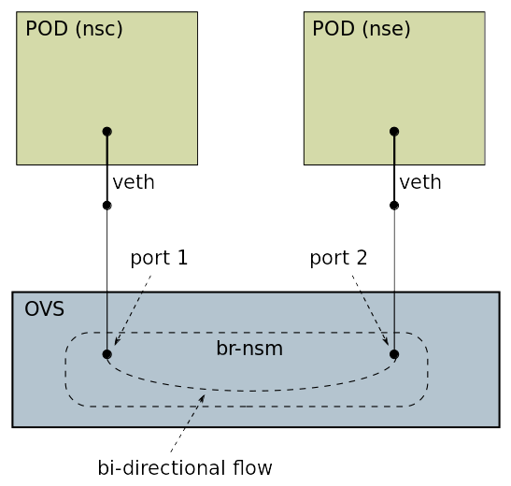
NSM forwarder-ovs
A working OvS is assumed on the host
Only p2p (not L2)
A bi-directional flow is setup with ovs-ofctl
For remote connections a VXLAN tunnel is used (remote NSEs are not covered in this presentation)

Slide 4
Demo – local p2p
Start cluster without K8s but with OvS
PODs == network namespaces. Check veth’s
Create a “nsm-br” OvS bridge (not L2)
Attach the veth’s and test ping
Create the bi-directional flow and test ping

Slide 5
NSM p2mp
Only the data-plane is described in this presentation
The BIG question is to choose between the vNSE Model and the IP Subnet Model
There will be an explosion of bridges, one per NSC, dynamically created/deleted (now it’s only one per node)
Implementations briefly discussed

Slide 6
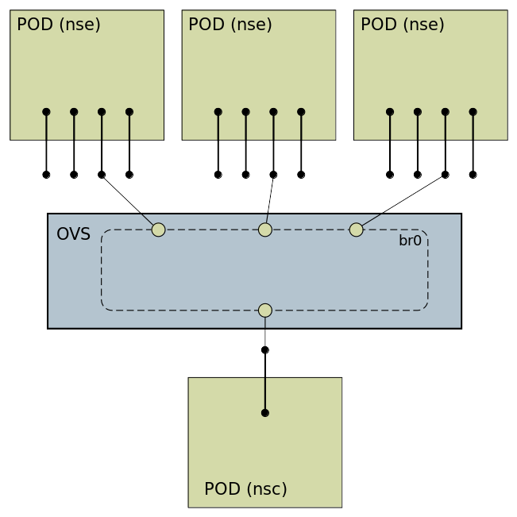
NSM p2mp new NSC
Create an OvS bridge
Inject interfaces and connect all NSEs and the (one) NSC
Setup flows (vNSE) or ECMP in the NSC (IP subnet)

Slide 7
IP Subnet Model – L2 switch
Can be implemented with other forwarders than OvS
NSCs must be aware of multiple NSEs (ECMP?)
Is it really better than the “proxy”?

Slide 8
vNSE Model
The function may only be possible with OvS. Does it matter?
NSCs only see one NSE address (if any). Load-balancing between NSEs is done by OvS
The same MAC+IP is shared among all NSEs. This causes problems (non-VIP IPs may not be needed)

Slide 9
Problems with same MAC+IP
How to configure/set them in NSM (control-plane)
ARP (neighbor discovery) should be disabled
IPv6 DaD must be disabled
IPv6 generated link-local address should be disabled
Since OvS doesn’t care about the MAC address we can use the same MAC everywhere (Linux cares though)

Slide 10
Demo – OvS load-balancing
Start cluster. Show “PODs”
Create a bridge (the bridge interface (br0) emulates the NSC)
Attach POD (nse) interfaces (already injected) to the bridge. Check MACs
Setup load-balancing (quite complicated)
Add VIP addresses and route (differs from the NSE setup)
Add return flows p2p POD→br0 (NSE→NSC)
Test with mconnect

Slide 11
References
Jan and Ed's investigation
Xcluster ovl/ovs
Nsm-test repo on github (where this presentation is stored)

