Slide 1
Virtual Routing and Forwarding
VRF in Linux
2023-03-20 lars.g.ekman@est.tech

Slide 2
VRF v.s. Source based routing
VRF exist in HW routers
We currently use source based policy routing to route traffic from a VIP address to a certain GW
VRF can set an alternative default route, and accomplish the same thing … sort of
Applications doing an outgoing connect will not have to make a bind (but they can if they are “VRF aware”)
A program can be bound to a VRF

Slide 3
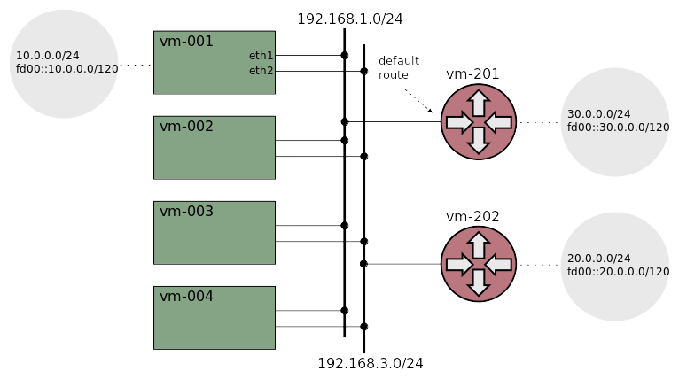
Test network setup

Slide 4
Demo
Start cluster and show routes and addresses
Ping 20.0.0.0 with direct route and source based policy route
Add a VRF and ping 20.0.0.0. Bind a shell to the VRF and test ping again. Run tcpdump on vm-202
Show isolation and the loopback problem
If time permits: Policy routing on uid an oif

Slide 5
Conclusion
VRF isolates “too much” for our application
Source based policy routing seems to be the best option (the one we currently use)

Slide 6
References
linux/Documentation/networking/vrf.rst
VRF CNI-plugin
Question about VRF and loopback

