Slide 1
SR-IOV in QEMU VMs and K8s
Develop SR-IOV applications in virtual environment
(Not using sr-iov to accelerate networking in VMs)
2023-02-15 Lars.G.Ekman@est.tech

Slide 2
What is SR-IOV
An extension to the PCI Express (PCIe bus) specification (not only network devices)
Allows a Physical Function (PF), like a NIC, to create Virtual Functions (VF) of itself
Has nothing to do with DPDK. But since DPDK takes over a device, SR-IOV can be used to let the PF continue working (e.g. eth0) while giving a VF to DPDK

Slide 3
Develop and use sriov in VMs
Until now the only option has been to use real HW. A HW cluster is hard to use and expensive to maintain
SR-IOV is supported in qemu 7.x
An emulated sr-iov capable NIC is on it’s way and can be used now if you build your own qemu

Slide 4
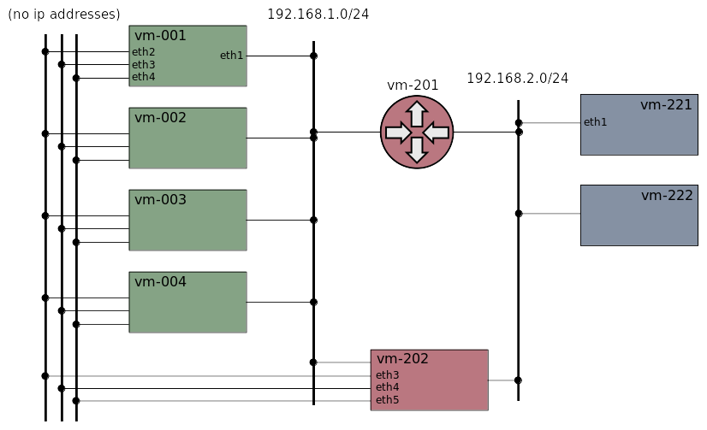
Network test setup

Slide 5
DEMO – The igb NIC in qemu
Use a local built kvm (qemu)
Start cluster
Load igb modules
Check device files in /sys
Create a VF
lspci

Slide 6
SR-IOV in Kubernetes
VFs are K8s “resources”, managed by the sriov device-plugin
A POD using sriov must both allocate the resource and request the interface by a multus annotation
PODs allocating a resource will be scheduled to nodes where the resource exist

Slide 7
DEMO – K8s device plugin
Start a cluster with multus and the sriov CNI-plugin
Check allocatable resources
Create VF devices
Deploy the sriov device plugin and check allocatable resources again
Create a Network Attachment Definition (NAD)
Create a deployment and check the PODs

Slide 8
References
Clone of qemu with igb device support
Kubernetes device plugins
Xcluster ovl/qemu-sriov e.g. how to build qemu
K8s sr-iov device plugin

