Slide 1
MPTCP
Multipath TCP
2023-05-23 uablrek@gmail.com

Slide 2
Multipath TCP
Adds “multihoming” for TCP to allow redundancy and higher throughput
Impact on client and server code is minimal (or none)
For network infra structure it looks like multiple normal TCP connections
Is prepared for NAT (as opposed to multihomed SCTP)
Support in Linux (and iproute2) is fairly new. Used by Apple for some time (iPhone)
In Telco it can perhaps become a modern alternative to SCTP? (Diameter can be carried on TCP, why not MPTCP)
Support in go is planned to v1.21 (August 2023)

Slide 3
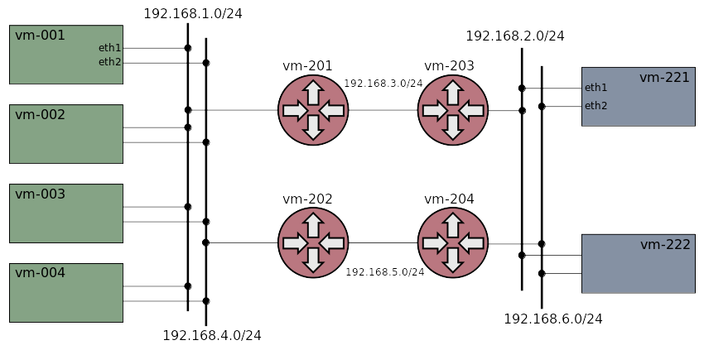
Network topology

Slide 4
Demo
Start cluster. Show (destination-) routing on paths (ping)
Setup endpoints and traffic with mptcp.c. Check sockets. Tcpdump on routers, and block the upper path (failover)
Use “mptcpize” (LD_PRELOAD) to enforce mptcp on a mptcp-unaware program. (show the “nc” pitfall)
Use a systemtap program to enforce mptcp on ctraffic (LD_PRELOAD can’t be used for statically linked (go) programs)

Slide 5
References
Wikipedia Multipath TCP
rfc8684
Support in go v1.21
How to setup and configure mptcp on Ubuntu
Xcluster ovl/mptcp (this demo)

