Slide 1
SCTP introduction and demo
Stream Control Transmission Protocol
Focus on multihoming and load-balancing
2021-08-12 lars.g.ekman@est.tech

Slide 2
What, Why?
Secure, connection (association) oriented but packet based
SCTP was intended as a SS7 over IP. SS7 is/was a main telco protocol
Very many telco applications requires SCTP
Multhoming is required for transparent fail-over
Implemented in the Linux kernel (lksctp) or in user-space (usrsctp)

Slide 3
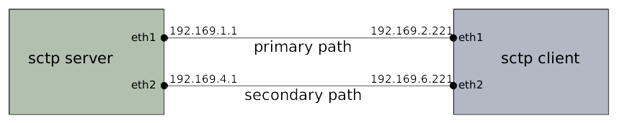
Multihoming
Addresses are exchanged on connection setup (INIT) but can be altered later
Any mix of IPv4 and IPv6 can be used
Paths are monitored by heart-beat (HB) messages
Addresses are different for all paths but port numbers are the same
Variations exist. See refs and search the net

Slide 4
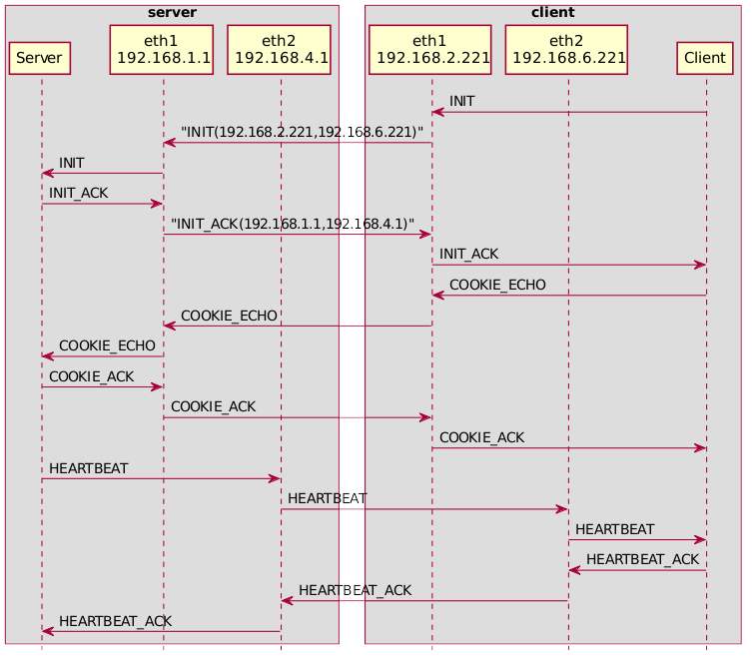
Connection setup

Slide 5
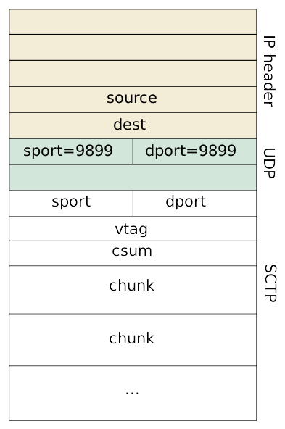
UDP encapsulation
Allows user-space implementations
When network elements doesn’t support SCTP (NAT?)
Supported in linux-5.11
Supported in nfqlb with the “--sctp_encap=9899” option

Slide 6
NAT
SCTP without multihoming can be setup without caring about addresses in the setup messages and works fine
SCTP multihoming does not go well with NAT
In rfc3257: “the NAT can have internal Application Layer Gateway (ALG) which will intelligently translate the IP addresses in the INIT and INIT ACK chunks”
Multihoming does not work in K8s services whatever they claim
UDP encapsulation is recommended in NAT environments but the addresses in the IP packet and in the INIT chunk still differs(?)

Slide 7
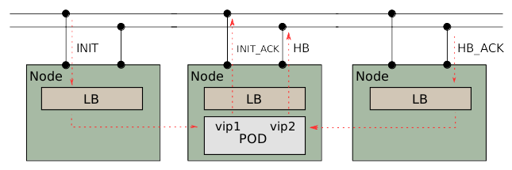
Load balancing and multihoming
An unexlored(?) and difficult area
A SCTP proxy may be an alternative
A stateless LB can hash on ports only
NAT can not ne used. Use DSR

Slide 8
Demo
Demo setup
Initiate traces (tcpdump)
Setup load-balanced multihomed associations with a IPv4/IPv6 mix
Disable/enable the primary path
Show routing setup
Peek at UDP encapsulation if time permits

Slide 9
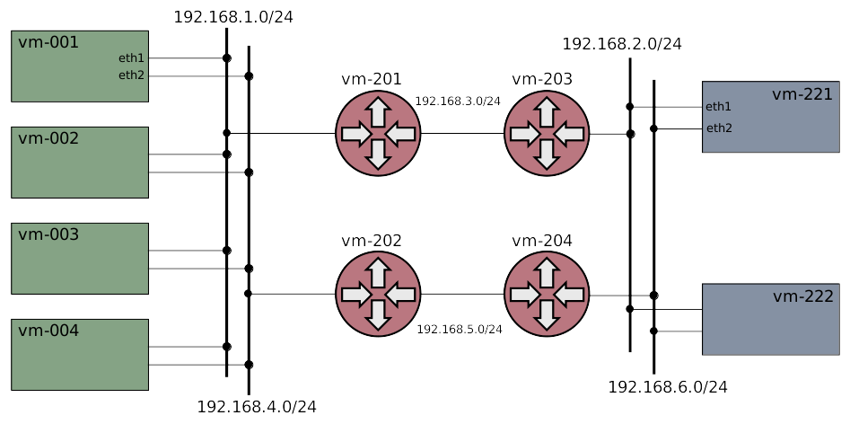
Demo network topolgy

Slide 10
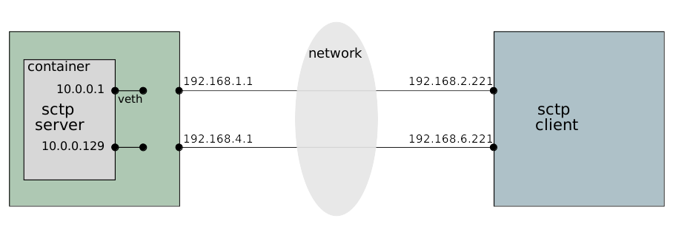
Demo container

Slide 11
References
rfc4960 the main SCTP rfc
rfc6951 UDP encapsulation
Usrsctp
Xcluster ovl/sctp
“man 7 sctp”
SCTP init trace (pcap)
SCTP Wikipedia
Nfqlb

