Slide 1
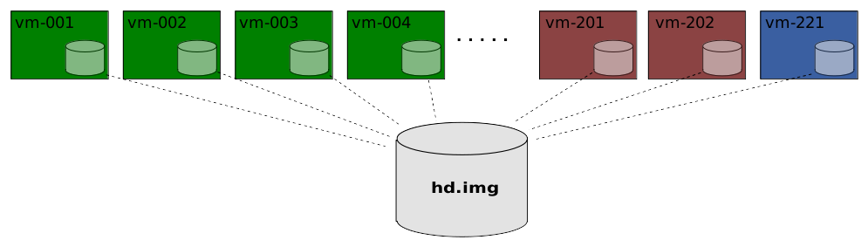
Xcluster
https://github.com/Nordix/xcluster
A very lightweight and configurable cluster environment primarily intended for development and test of network functions.

Slide 2
Features
Easy to install and run on Ubuntu 18 and 19
Fast. A 6 VM cluster start-to-shell-prompt < 4s
Lightweight. Can start 100 VMs on a 16G RAM laptop
Always starts from the same state (important for testing)
Set-ups can be easily saved and shared as “overlays” or (one) image. A very important feature IMHO!
Kubernetes support

Slide 3
Kubernetes on Xcluster
Great for test and development of network related functions on K8s, e.g CNI-plugins, dual-stack, external connectivity, ingress-controllers, etc.
NOT good for general application development. There are better alternatives, e.g. K3s, microk8s, minikube, KinD

Slide 4
Demo
A simple IP load-balancer using ECMP (ovl)
Kubernetes dual-stack (ovl)
WoW with xcluster

Slide 5
Summary
For experimenting with network functions on Linux xcluster may be one of the best tools. For instance; XDP/ePBF, tunnels, routing suites (bird, frr, gobgp), your own great invention.
The ability to preserve set-ups for future use and for sharing with others shall not be underestimated
For Kubernetes xcluster is great for networks functions, but use another tool for application development.

