Slide 1
Algorithms and data structures
Lesson 9
Mikhail Elantcev

Slide 2
Algorithms and data structures
course
Algorithms
Data structures

Slide 3
What is algorithm?
Algorithm is a step-by-step procedure, which defines a set of instructions to be executed in a certain order to get the desired output.
Properties:
Unambiguous, Finiteness, Feasibility, Independent
Example “Buy a coffee”
Go to cafe
Read menu
If your money >= coffee price
True: buy a coffee
False: Sorry, no coffee :(
Go back to home

Slide 4
How to record algorithm?
Natural language
2. Flowchart
3. Pseudocode
Programming language
Begin
Turn left
1. TurnLeft()
2. MoveForward(100)
3. TurnRight()
4. MoveForward(50)
5. GoBack()
void task(){
TurnLeft();
MoveForward(100);
TurnRight();
MoveForward(50);
GoBack();
}
“Turn left, move forward for 100 meters, turn to right, move forward for 50 meters, then go back”
Move forward (100 meters)
Turn right
Move forward (50 meters)
Go back
End

Slide 5
What is algorithm’s complexity?
Algorithmic complexity is a measure of how long an algorithm would take to complete given an input of size n.
Complexity is calculated asymptotically as n approaches infinity
Time and space complexity
Complexity:
O(1)
O(log(log(N)))
O(log(N))
O(N^{C}), 0 < C < 1
O(N)
O(N log(N))
O(N^{C}), C > 1
O(C^{N}), C > 1
O(N!)

Slide 6
How to define your own function?
Return type
Arguments
Name of function
int
sum
(
int a
,
int b
){
int r = a + b;
Body of function
return r;
Returning result of function
}

Slide 7
Example of algorithms
Searching:
Linear search – O(N)
Binary search – O(log(N))
Lookup table – O(1)
Sorting:
Bubble sort – O(N²)
Selection sort – O(N²)
Insertion sort – O(N²)

Slide 8
How to create algorithm to solve task?
Complex algorithm
Algorithm templates:
Select on of two
Swap variables
Iterating through a collection
Do something with every element in collection
Check if any element of collection meets condition
Find specific element in collection
Calculation based on elements of collection
Iterating through two collections
Sorting
Simple
algorithm 1
Algorithm
Simple
algorithm 2
Simple
algorithm 3

Slide 9
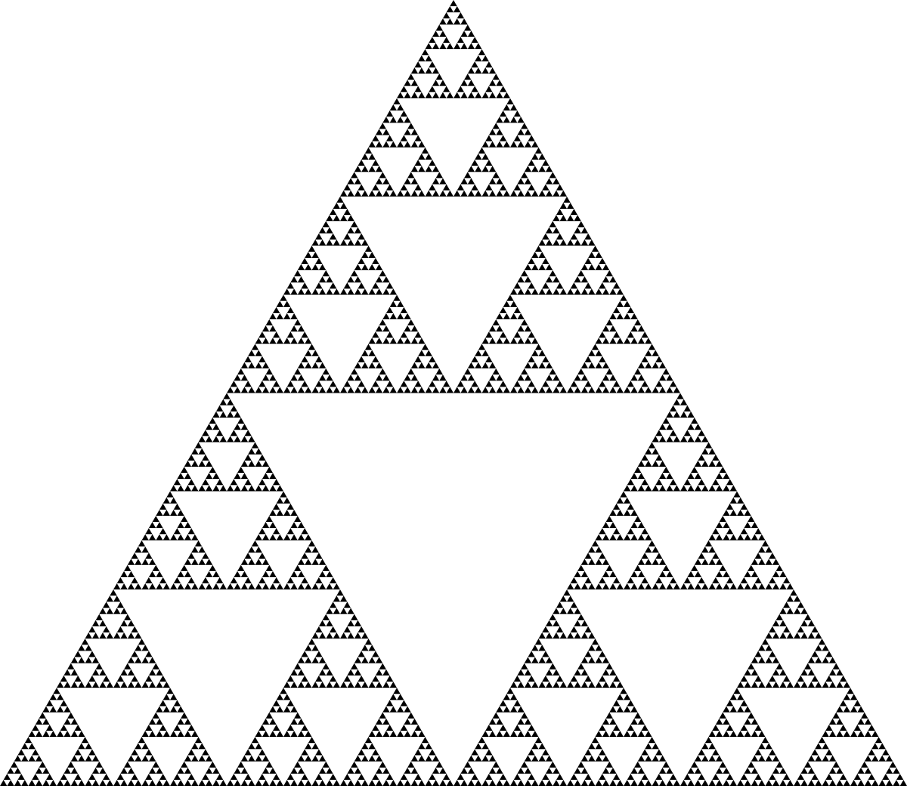
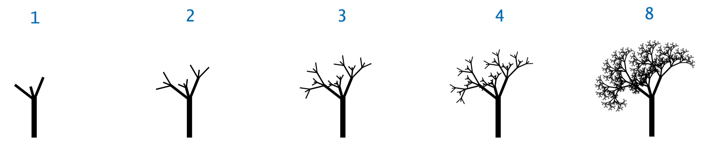
What is recursion?
Recursion in computer science is a method of solving a problem where the solution depends on solutions to smaller instances of the same problem (as opposed to iteration).
5! = 1 ∙ 2 ∙ 3 ∙ 4 ∙ 5
4! = 1 ∙ 2 ∙ 3 ∙ 4 =>
5! = 4! ∙ 5 =>
F(x) = F(x – 1) ∙ x

Slide 10
What is data structure?
In computer science, a data structure is a data organization, management and storage format that enables efficient access and modification
More precisely, a data structure is a collection of data values, the relationships among them, and the functions or operations that can be applied to the data
Basic structures:
Array:
int arr[10]
Struct:
struct S{
int x;
char c;
};

Slide 11
How to create your own structure?
Plain C
C++
struct Time{
int seconds;
int minutes;
int hours;
};
int main(){
struct Time t;
// Time: 10:20:30
t.hours = 10;
t.minutes = 20;
t.seconds = 30;
}
typedef struct {
int seconds;
int minutes;
int hours;
} Time;
int main(){
Time t;
// Time: 10:20:30
t.hours = 10;
t.minutes = 20;
t.seconds = 30;
}
struct Time{
int seconds;
int minutes;
int hours;
};
int main(){
Time t;
// Time: 10:20:30
t.hours = 10;
t.minutes = 20;
t.seconds = 30;
}

Slide 12
Examples of data structures
Stack:
push()
pop()
top()
Queue:
enqueue()
dequeue()
front()
Linked list:
insert()
remove()
push()
pop()
front()
top()
3
1
2
3
2
1
2
3
insert()
remove()
1
dequeue()
enqueue()

Slide 13
Dynamic memory
The memory is allocated at runtime and the allocation of memory space is done dynamically within the program run and the memory segment is known as a heap or the free store.
In this case, the exact space or number of the item does not have to be known by the compiler in advance
typedef struct {
int x, y;
} P;
P *point = (P*) malloc(sizeof(P));
point->x = 1;
point->y = 2;
free(point)

Slide 14
Working with files
A file is a collection of data stored in one unit, identified by a filename. It can be a document, picture, audio or video stream, data library, application, or other collection of data
// <stdio.h>
FILE * fopen(char *filename, char * mode);
// mode:
// r – readonly
// w – writeonly, recreate file
// r+ - read and write
// w+ - read and write, recreate file
// a – append
// Plus:
// t – text mode
// b – binary mode
fscanf(FILE* f, char *format, …)
fprintf(FILE* f, char *format, …)
fclose(FILE* f)

