Slide 1
Hybrid evolutionary algorithm and gradient-based algorithm for multi-objective optimization
2023 Fall Group project
Zhang Kenneth
Guizheng Wang
Kuangjie Xu
Notes:
Good afternoon, professor, let‘s begin our presentation. I am …，and my teammate is ….
Our topic is …

Slide 2
Outline
Background
Multi-objective optimization
Evolutionary algorithm
Gradient-based algorithm
Basic ideas
Timeline
Evaluation methods
Notes:
Here is our outline

Slide 3
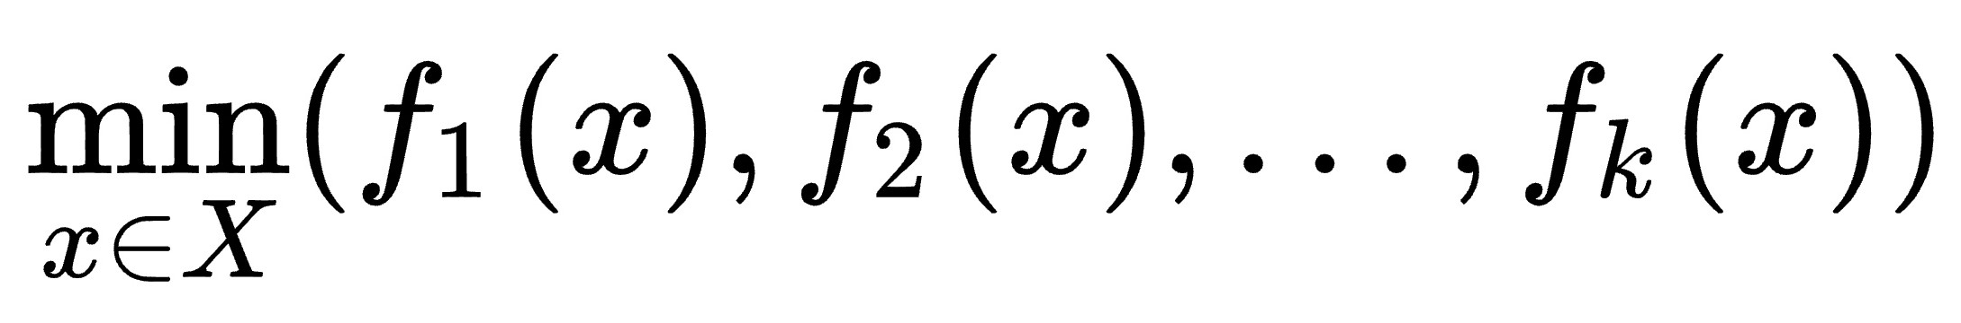
Background
Multi-objective optimization
Optimization problem that involves multiple objective functions to be optimized simultaneously.
(Different from single-objective optimization) multi-objective optimization aims to obtain a set of trade-off optimal solutions.
In math terms,
where the integer k is the number of objectives and the set X is the feasible set of solutions, which is typically defined by some constraint functions. In addition, f is the vector-valued objective function.
Notes:
1.
2. (Different from single-objective optimization), which aims to maximize/minimize a single objective and obtains one optimal solution, multi-objective optimization aims to obtain a set of trade-off optimal solutions.

Slide 4
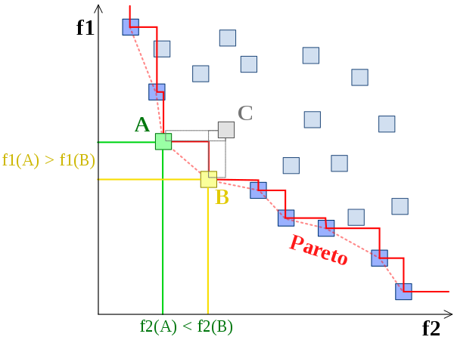
Background
Multi-objective optimization
Aims to obtain a set of trade-off optimal solutions
Focus on the Pareto-optimal (non-dominated) solutions
Try to approach the Pareto front
Example of a Pareto front
Both A and B dominate C, and not dominated
by other solutions.

Slide 5
Background
Evolutionary algorithm and gradient-based algorithm have been applied to solve multi-objective optimization problems.
In this project, we will try to develop an efficient algorithm by hybridizing evolutionary algorithms and gradient-based algorithms. Then, the developed algorithm will be tested on benchmark problems and real-world applications (e.g, multi-task learning, multi-objective reinforcement learning).

Slide 6
Background
Evolutionary algorithm
Dominance-based: NSGA-II
Decomposition-based: MOEA/D
Indicator-based: SMS-EMOA
Gradient-based algorithm
Dominance-based: MGD
Decomposition-based: PSL
Indicator-based: HV gradient
… …

Slide 7
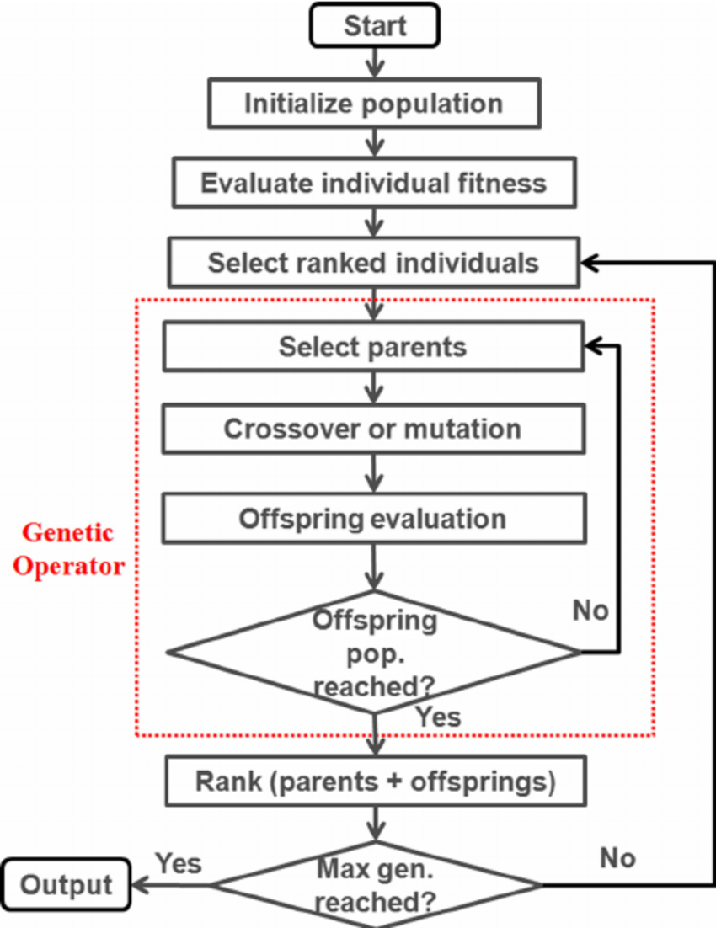
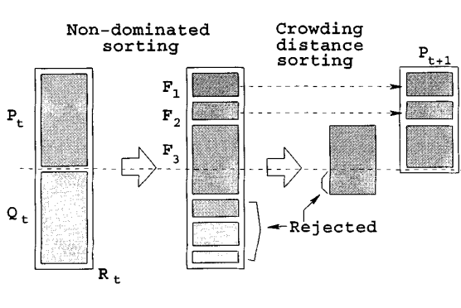
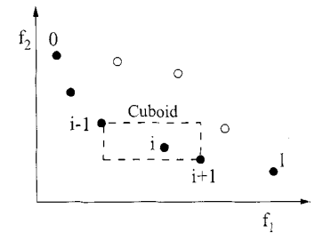
Background
NSGA-II
crowding distance

Slide 8

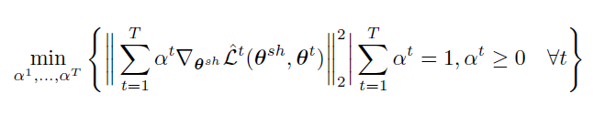
Background
Multiple Gradient Descent
KKT condition
Optimization
Solution is 0, otherwise gives the descent direction that improves all objectives

Slide 9
Background
Why hybrid
Gradient-based
Directional, gradient (direction of optimization) guided
Converge faster
EMO
Better at complicated problems (e.g. noisy objective function)
Diversity of solutions
e.g. lots of work in hybridizing MCDM (multi-criteria decision making) and EMO (evolutionary multi-objective optimization)
A local search operator is mainly used to enhance the rate of convergence of EMO algorithms.
Notes:
Different hybrid methods exist, but let’s take a successful example, hybridizing MCDM (multi-criteria decision making) and EMO (evolutionary multi-objective optimization). A hybrid algorithm in the context of multi-objective optimization is a combination of algorithms/approaches from these two fields. Hybrid algorithms of EMO and MCDM are mainly used to overcome shortcomings by utilizing strengths. Several types of hybrid algorithms have been proposed in the literature, e.g. incorporating MCDM approaches into EMO algorithms as a local search operator and to lead a DM to the most preferred solution(s) etc. A local search operator is mainly used to enhance the rate of convergence of EMO algorithms.

Slide 10
Basic ideas
The idea of generating a continuous solution set model in the gradient-based algorithm PSL (Pareto Set Learning Algorithm) can be applied to evolutionary algorithms.
Simple combination of Hypervolume EA and Hypervolume gradient algorithms: when the effect of EA no longer improves substantially, use the gradient algorithm to improve the HV of the solution set.

Slide 11
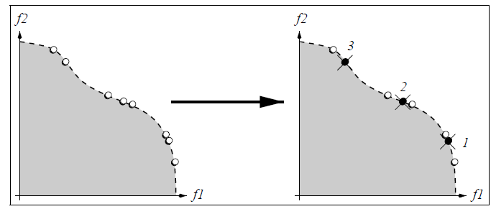
Key concepts:
Elitism
NSGA-II’s elitist approach
SPEA-II’s archive truncation strategy

Slide 12
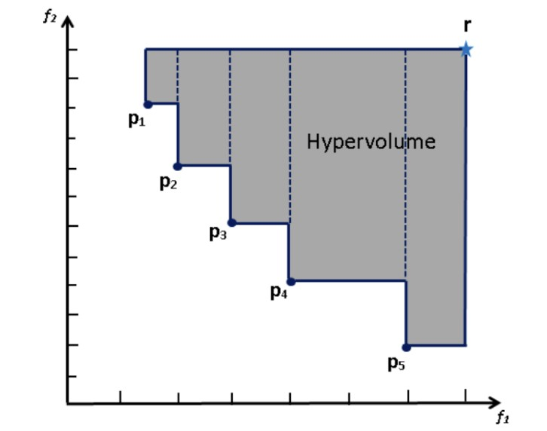
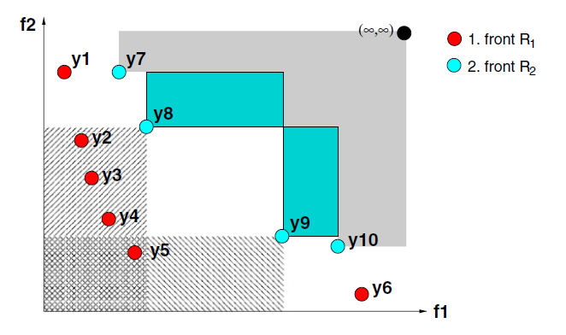
Key concepts:
Hypervolume
Definition of Hypervolume
SMS-EMOA uses hypervolume to leverage delta performance

Slide 13
Our presented algorithm
Sub-population migration (guided by non-dominated individual gradient)
Local search + Group migration
Uses Hypervolume as a performance indicator
Uses Gradient information as a heuristic algorithm
Direction of Gradient Descent

Slide 14
Evaluation methods
Solution Evaluation
Convergence:GD & IGD
The distance between the solution set and the real Pareto Front.
Evenness:Spacing
The uniformity of individual distribution in the solution set.
Spread:Hypervolumn
The distribution of the entire solution set in the target space.
Algorithm Evaluation
Time
Space
other
Notes:
To be done soon

Slide 15

Evaluation methods
Generational Distance & Inverted Generational Distance
(GD & IGD)
The GD of a set A is defined as the distance between each point a∈A and the closest point r in a reference set R, averaged over the size of A. Formally：
where the distance is the Euclidean distance.
The inverted generational distance (IGD) is calculated as IGD_{p}(A,R)=GD_{p}(R,A), where the reference set R is the true Pareto optimal set.
Notes:
To be done soon

Slide 16
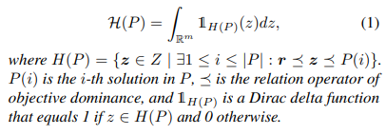
Evaluation methods
Hypervolume
If solution set A dominates solution set B,
we have HV(A) > HV(B);
still works if IGD cannot be obtained (when the true Pareto optimal cannot be obtained).
Notes:
To be done soon

Slide 17

Evaluation methods
Spacing
di means the minimum distance from the di th solution to the other solutions in P.
Notes:
To be done soon

Slide 18
Timeline
Week 1
begin
Week 7
first inspection
Week 12
second inspection
Week 18
final inspection
Phase 1
Phase 2
Phase 3
Phase 1
-Learn the background of MOO, Evolutionary algorithm and Gradient-based algorithm
-Brainstorm ideas about the hybrid algorithm
Phase 2
- Implement and try to improve the algorithm.
- Test the performance of all the different methods.
Phase 3
- Further optimization.
- Thesis writing.

Slide 19
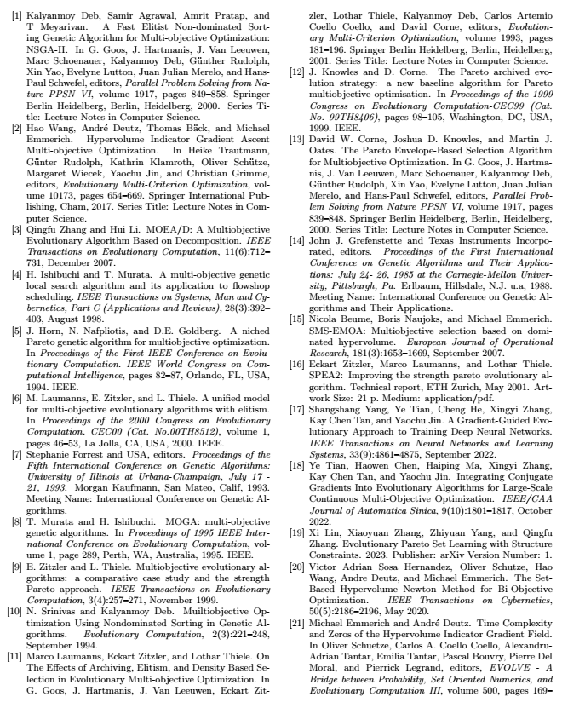
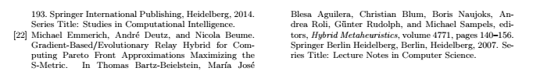
References

