Slide 1
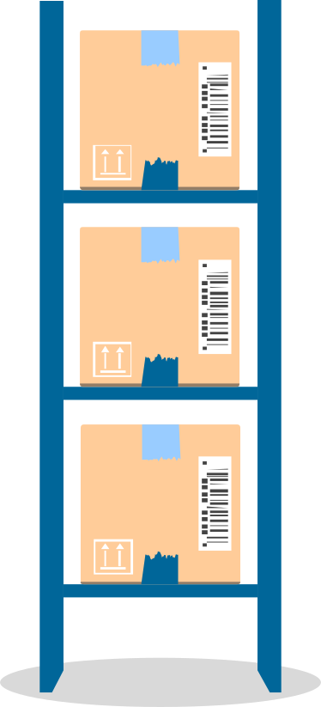

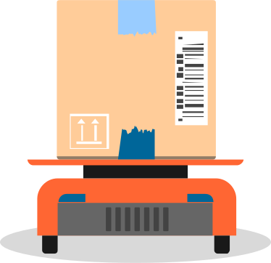
STOCKARRIER
Stock Management System

Slide 2


Overview
STOCKARRIER powers up inventory management and improves logistics for businesses. Featuring real-time stock tracking and instant visibility into inventory, it sends automated reorder notifications to prevent stockouts and overstocking.

Slide 3
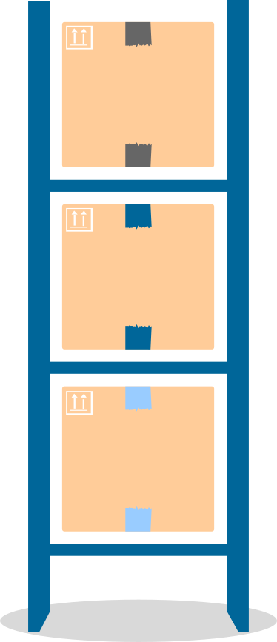

Problems to be solved
Traditional way of noting using paper
01
Some storage management systems are slow and less efficient
02
Loss track of products, overloaded storage
03

Slide 4



Features
Add item
Search item
Log-in
Log-out
Update item
Delete item
Change password
Display Storage

Slide 5

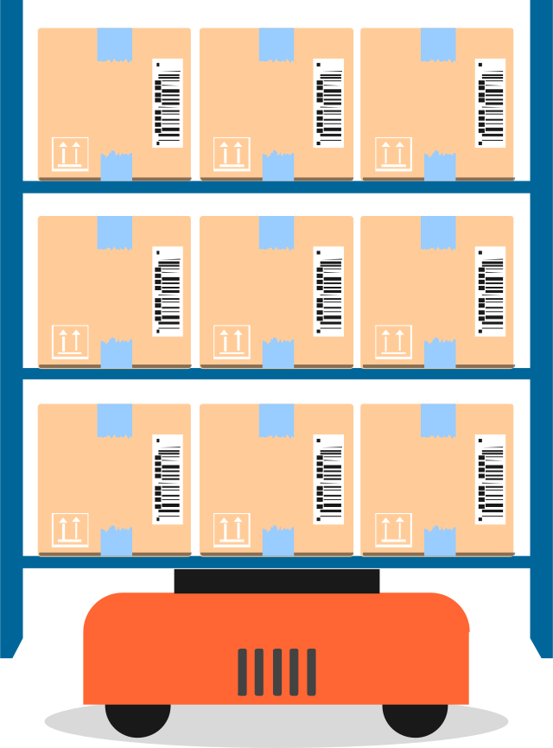
04
Thank You

Slide 6
References
The design is inspired by Code First with Hala (a YouTube channel), video: Python Excel App - Excel Viewer & Data Entry Form [Tkinter, openpyxl] Python GUI Project
Theme use: from GitHub: Forest-ttk-theme
Slide: https://slidesgo.com/theme/inventory-control-tools-consulting#search-storage&position-6&results-9&rs=search

