Slide 1

CANTEEN AUTOMATION SYSTEM IN ANDROID
Done by: Noreen V
Roll no: 25
Batch: B (S4) MCA
Under the guidance of:
Ms. Manju Joy
Scrum master:
Dr. Sujesh P Lal

Slide 2

CONTENT
Relevance of the topic.
Objective.
Existing system.
Proposed system.
User characteristics.
Modules.
System design.
References.
1

Slide 3
RELEVANCE OF THE TOPIC
This system relieves the burden on the canteen’s end, as the entire method of taking orders is computerized.
Once an order is placed on the android phone, it is entered into the database and then retrieved, in pretty much real-time.
Within this application, all items in the order are displayed, along with their equivalent options and supply details, in a summarizing and easy to read manner.
This allows canteen staffs to speedily go through the orders placed by scanning the QR code and produce the needed items with minimal delay and confusion.
2

Slide 4
OBJECTIVE
Canteen automation is the system where customers order their food and receive food in the canteen.
This system aims to accelerate customer orders and system used by employees to accept customer order.
The system requires very fewer time factors as compared to manual system.
The system will provide fast and efficient automated environment instead of slow and error prone manual system, thus reducing both time and manpower spent in running system.
3

Slide 5
EXISTING SYSTEM
Lack of security of data.
More man power.
Time consuming.
Needs manual calculations.
No direct role for the higher officials.
4

Slide 6
PROPOSED SYSTEM
The aim of proposed system is to develop a system of improved facilities. The proposed system can overcome all the limitations of the existing system. The system provides proper security and reduces the manual work.
Security of data.
Minimize manual data entry.
Minimum time needed for the various processing.
Greater efficiency.
Better service.
User friendliness and interactive.
Minimum time required.
5

Slide 7
USER CHARACTERISTICS
There are mainly 3 user characteristics in this system:
Admin
Canteen
Student
6

Slide 8
Admin
Admin login with username and password.
Add canteen with basic details.
View / add / delete canteen.
View student details
7

Slide 9
Canteen
Canteen login with username and password.
Add food items with details like Food name, description, cost, time to get ready. etc..
View, edit, delete food items, set food item availability by disable the selected food.
View new order by the students.
View previous order history by filtering with date.
Add food menu with date.
8

Slide 10
Student
Student login with username and password.
View food by selecting a canteen from registered canteens.
View food menu of selected date.
Order food item.
Generate QR code for the order.
View previous orders and transactions.
9

Slide 11
MODULES
There are mainly 5 modules:
Registration management.
Login management.
Food management.
Order management.
Payment management.
10

Slide 12
Registration management
There are two registration for student and canteen with basic details.
Login management
There are login for three users- admin, canteen and student. Each users deals with username and password.
Food management
In this module it contain type management where customer can choose breakfast, lunch or snacks based on this the student choice of food.
Order management
This module performs the actions of managing order in the system. Customer can make order. We can perform the following task such as add order, update existing, order details and view the order details.
Payment management
In this module where payment process happens after ordering food. After, payment a bill will be generated for student to view details of order etc.
11

Slide 13
SYSTEM DESIGN
Software Specification
● Tool: Android studio, Python
● Operating System: Windows 11
● Front End : Android
● Back end: Django
Hardware Specification
❖ Processor: i5
❖ RAM: 12GB (Minimum)
❖ Hard Disk: 500GB or above
12

Slide 14
REFERENCES
https://www.freeprojectz.com/free-android-project-source-code-download/canteen-management-system
https://www.irjet.net/archives/V8/i4/IRJET-V8I41003.pdf
https://1library.net/document/zgxv858q-mobile-application-for-canteen-automation-system-using-android.html
https://www.slideshare.net/100008381806318/canteen-automation-system-updated-revised
https://www.irjet.net/archives/V5/i1/IRJET-V5I1320.pdf
https://ijcrt.org/papers/IJCRT2005289.pdf
13

Slide 15
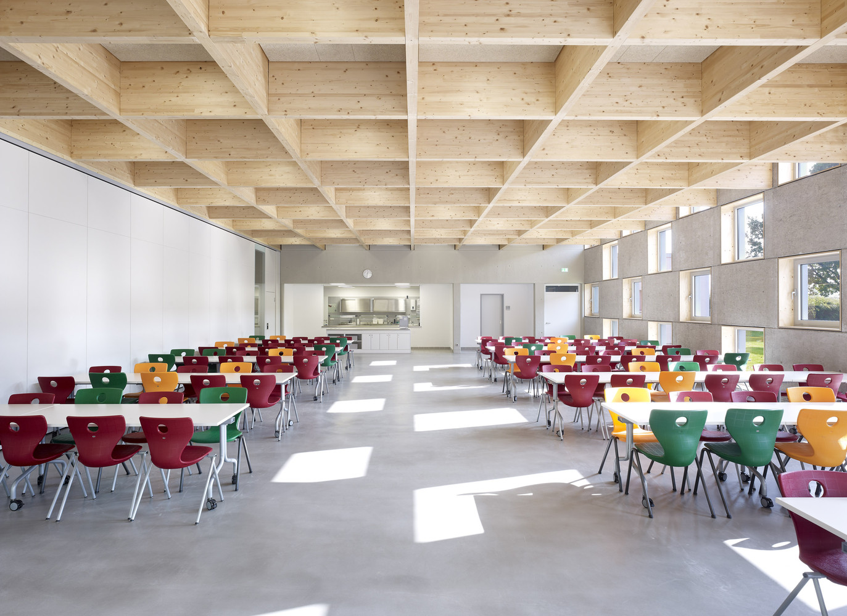
THANK YOU

