Slide 1

CANTEEN AUTOMATION SYSTEM IN ANDROID
Done by: Noreen V
Under the Guidance of,
Ms. Manju Joy
Scrum Master: Dr. Sujesh P Lal

Slide 2

RELEVANCE OF THE TOPIC
This system relieves the burden on the canteen’s end, as the entire method of taking orders is computerized. Once an order is placed on the android phone, it is entered into the database and then retrieved, in pretty much real-time, by a desktop application on the canteen’s end. Within this application, all items in the order are displayed, along with their equivalent options and supply details, in a summarizing and easy to read manner. This allows canteen staffs to speedily go through the orders placed by scanning the QR code from student’s android phone and produce the needed items with minimal delay and confusion.

Slide 3
OBJECTIVE
Canteen automation is the system where customers order their food and receive food in the canteen. This system aims to accelerate customer orders and system used by employees to accept customer order.
The system requires very fewer time factors as compared to manual system.
The system will provide fast and efficient automated environment instead of slow and error prone manual system, thus reducing both time and manpower spent in running system.
The system will have GUI interface and very less user training is required to learn it.

Slide 4
EXISTING SYSTEM
In the existing system the exams are done only manually but in proposed system we have to computerize the exams using this application.
Lack of security of data.
More man power.
Time consuming.
Needs manual calculations.
No direct role for the higher officials.

Slide 5
PROPOSED SYSTEM
The aim of proposed system is to develop a system of improved facilities. The proposed system can overcome all the limitations of the existing system. The system provides proper security and reduces the manual work.
Security of data.
Minimize manual data entry.
Minimum time needed for the various processing.
Greater efficiency.
Better service.
User friendliness and interactive.
Minimum time required.

Slide 6
USER CHARACTERISTICS
There are mainly 3 characteristics in this system:
Admin
Canteen
Student

Slide 7
Admin
Admin login with username and password.
Add canteen with basic details.
View / add / delete canteen.
View student details

Slide 8
Canteen
Canteen login with username and password.
Add food items with details like Food name, description, cost, time to get ready. etc..
View, edit, delete food items, set food item availability by disable the selected food.
View new order by the students.
Update order status.
View previous order history by filtering with date.
Add food menu with date.

Slide 9
Student
Student login with username and password.
View food by selecting a canteen from registered canteens.
View food menu of selected date.
Order food item.
Generate QR code for the order.
View previous orders and transactions.

Slide 10
MODULES
There are mainly 4 modules:
Canteen management.
Food management.
Orders management.
Sales management.

Slide 11
Canteen management.
It has been developed for managing the canteen. We can add, edit, delete.
Food management.
In this module it contain type management where customer can choose breakfast, lunch or snacks based on this the student choose the food.
Order management.
This module performs the actions of managing order in the system. Customer can make order. We can perform the following task such as add order, update existing order details, and view the order details.
Sales management.
Sales operations will be managed by this module. It includes payment mode such as QR code, net banking system.

Slide 12
SYSTEM DESIGN
Software Specification
● Tool: Android studio, Python
● Language: Java, Python
● Operating System: Windows 11
● Front End : Android ,HTML,CSS
● Back end: Django
Hardware Specification
❖ Processor: i5
❖ RAM: 12GB (Minimum)
❖ Hard Disk: 500GB or above

Slide 13
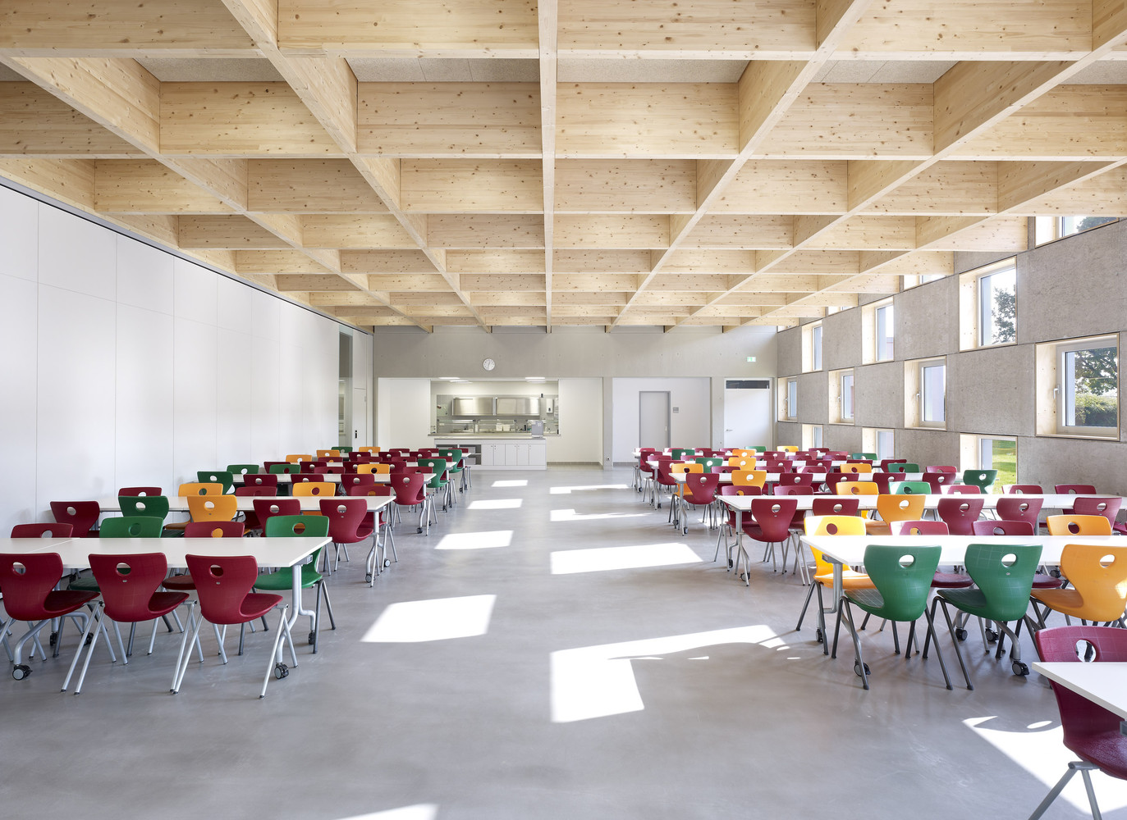
THANK YOU

