Slide 1
LSMA : Project Tracking - Week 1
RACHIDI Inass
MARONE Mamadou

Slide 2

TASKS
Data preparation
Data preprocessing
Feature extraction
MRI type separation

Slide 3
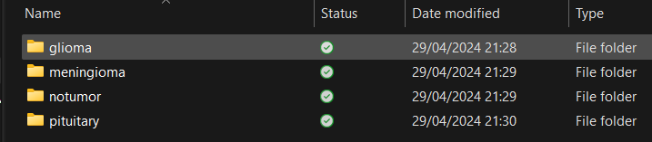
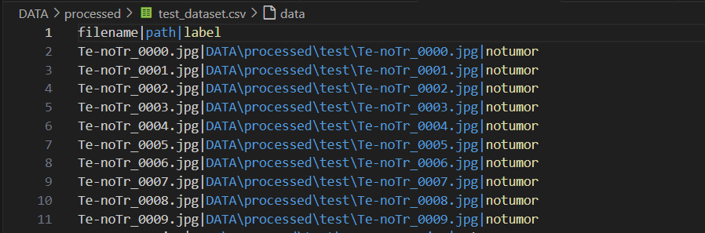
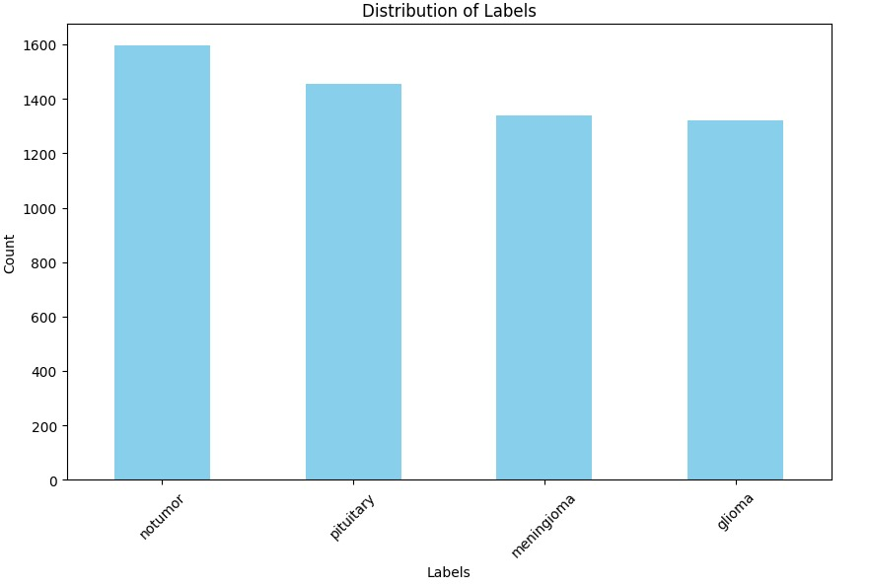
Preparation

Slide 4
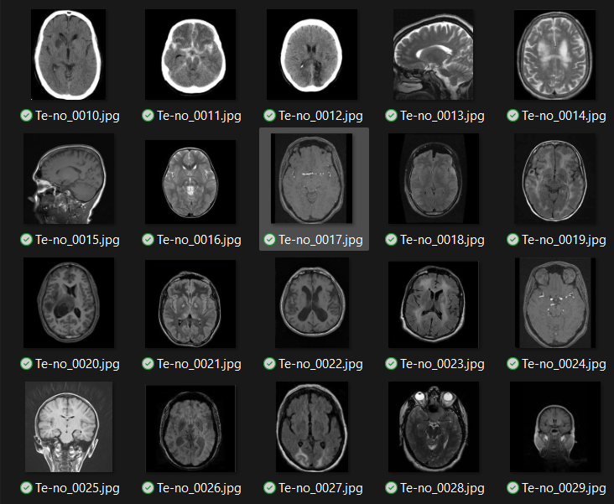
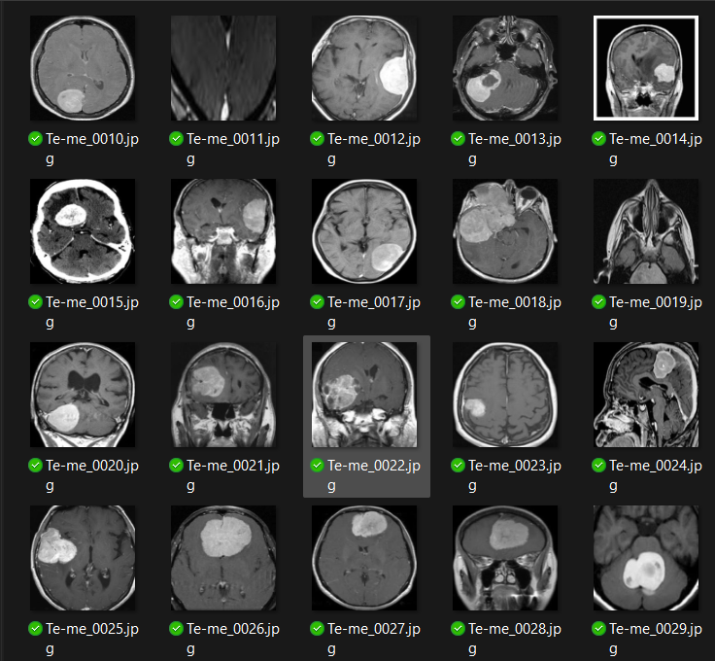
Data Preprocessing
Cropping
Resizing

Slide 5
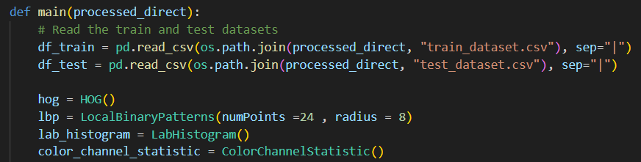
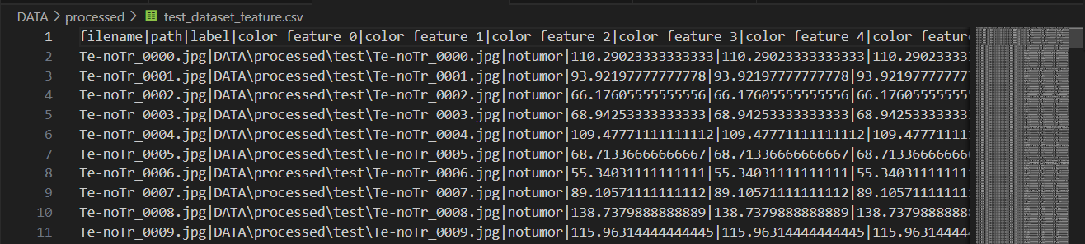
Feature extraction
Features
HOG:(Histogram of Oriented Gradients)
Local Binary Pattern
Lab Histogram
Color channels statistic

Slide 6
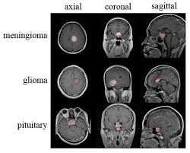
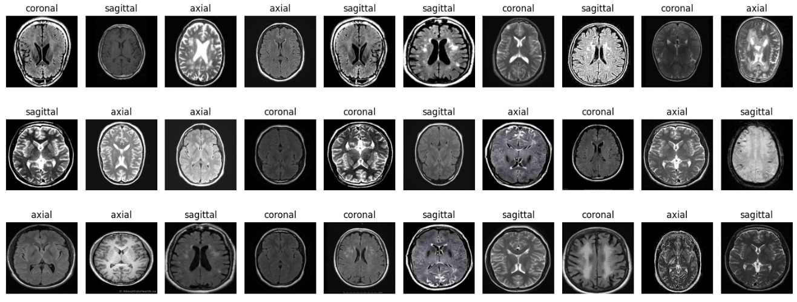
MRI type separation
Techniques:
Unsupervised learning to cluster:
Feature extraction
Dimensionality reduction
clustering
Correct the clustering : handcrafted

Slide 7
Try finding a labeled dataset that has the type of MRI
Explain more the resizing
Test different features
Take the direction into account
=>
Tabular variable as another dataset

