Slide 1
LSMA : Project Tracking - Week 2
RACHIDI Inass
MARONE Mamadou

Slide 2
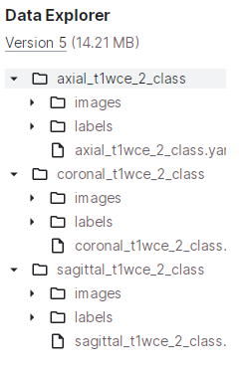
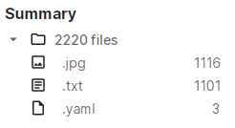
MRI type separation
Step1: Resizing the images using the cv2.resize() function from the OpenCV library.
Step2: Finding a dataset with labeled images:

Slide 3
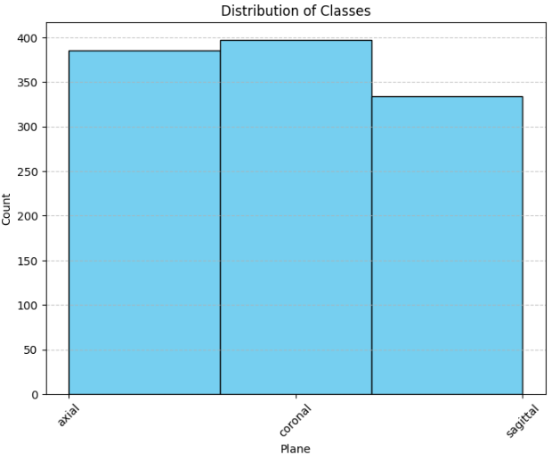

Slide 4
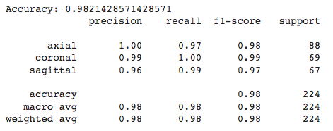
Step3: Training a SVM model for classifying the planes:
Loading and preprocessing the images
Training and testing SVM Model
Evaluation

Slide 5
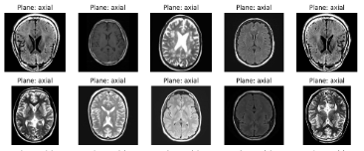
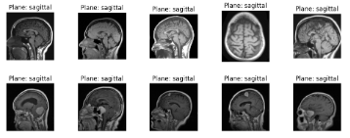
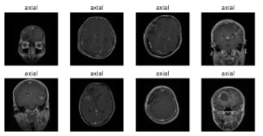
Step4: Using the pre-trained model to classify our unlabeled data:

Slide 6
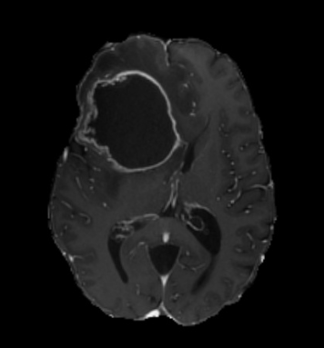
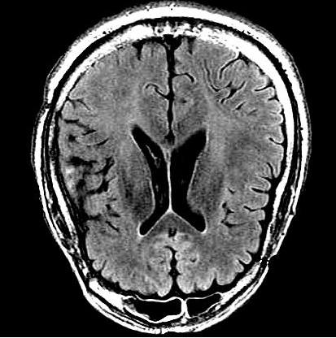
axial

Slide 7
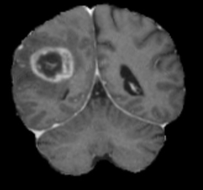
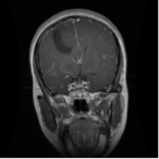
coronal

Slide 8
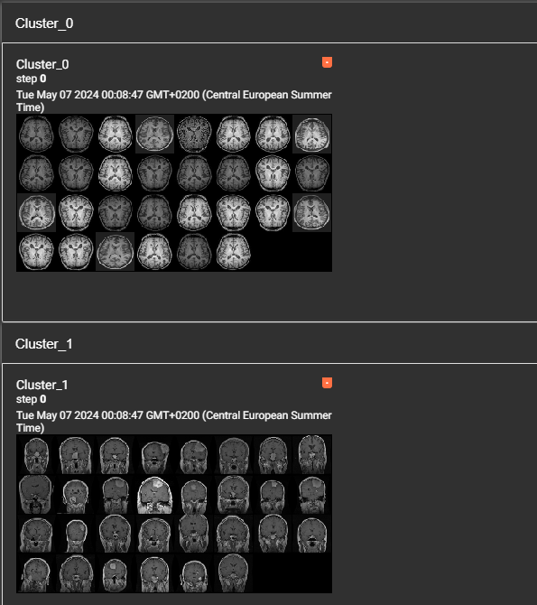
Unsupervised learning for data labelling
STEPS:
Feature extraction: ResNet10 / HOG
PCA
Clustering : Kmeans

Slide 9
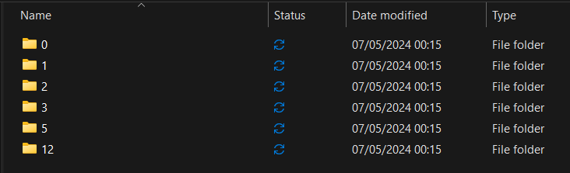
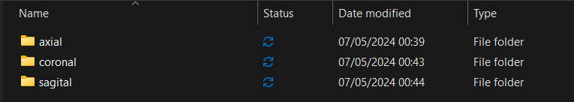
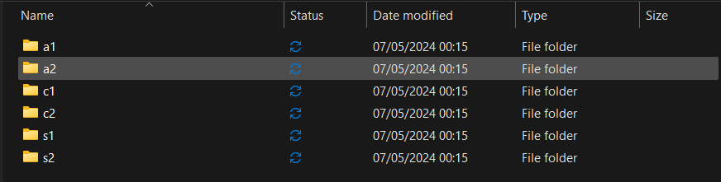
Labeling

Slide 10
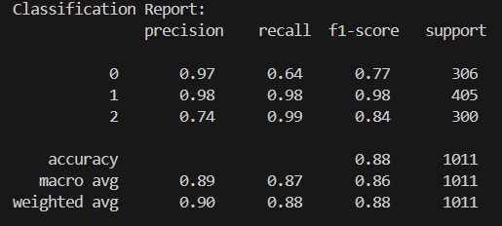
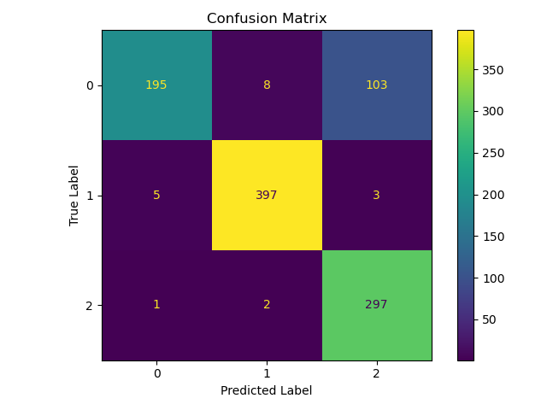
Experiment with Random Forest ➔ 1st insight

