Slide 1
Bio-Inspired Learning: Predicting Smart Grid Stability
Mamadou MARONE
mamadou.marone@alumnos.upm.es
Inass RACHIDI
inass.rachidi@alumnos.upm.es

Slide 2
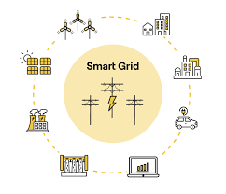
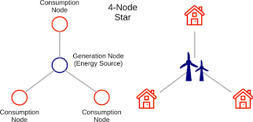
Introduction
https://link.springer.com/article/10.1007/s42979-021-00463-5
https://sotysolar.es/blog/smart-grids

Slide 3
Methodology

Slide 4
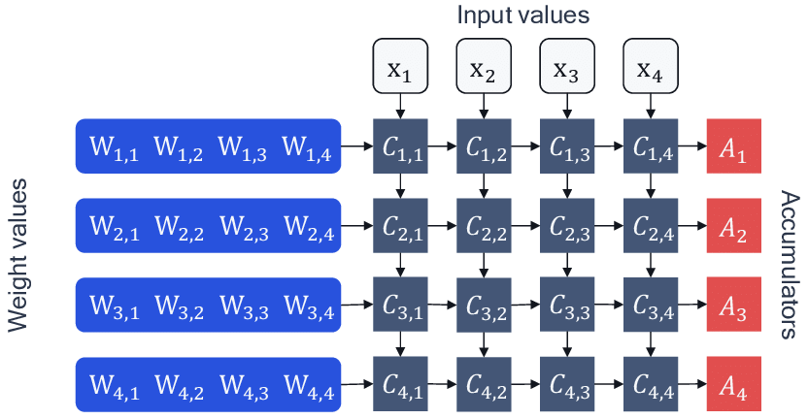
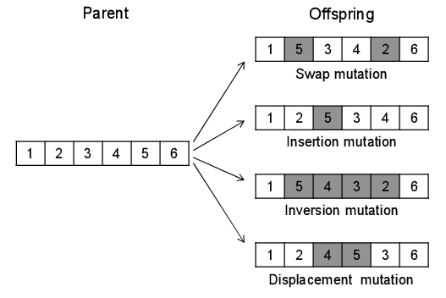
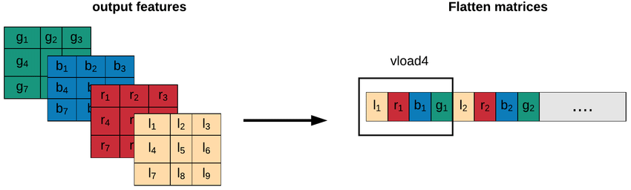
Deep Learning with Genetic Algorithm (GA)
Layer of neural network
Genetic Algorithm

Slide 5
Objectives
Optimize Neural Network Architecture
Evaluate Genetic Algorithm Parameters
Analyze Computational Efficiency
Improve Model Accuracy with hyperparameter tuning

Slide 6
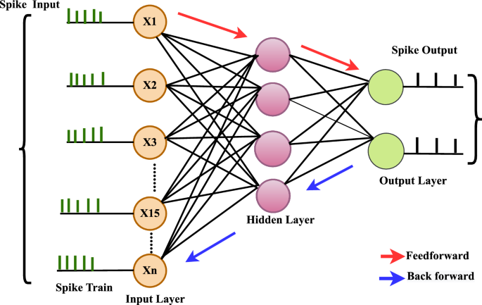
Spiking Neural Networks

Slide 7
Implementation

Slide 8
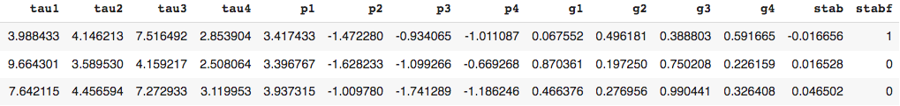
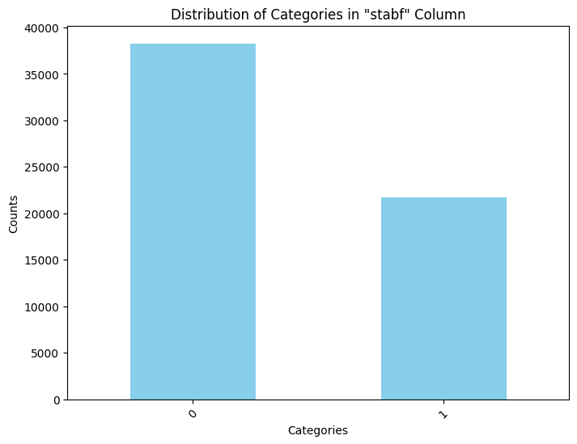
Dataset
tau1' to 'tau4': the reaction time of each network participant.
'p1' to 'p4': nominal power produced (positive) or consumed (negative) by each network participant. As the total power consumed equals the total power generated, p1 (supplier node) = - (p2 + p3 + p4);
'g1' to 'g4': price elasticity coefficient for each network participant.

Slide 9
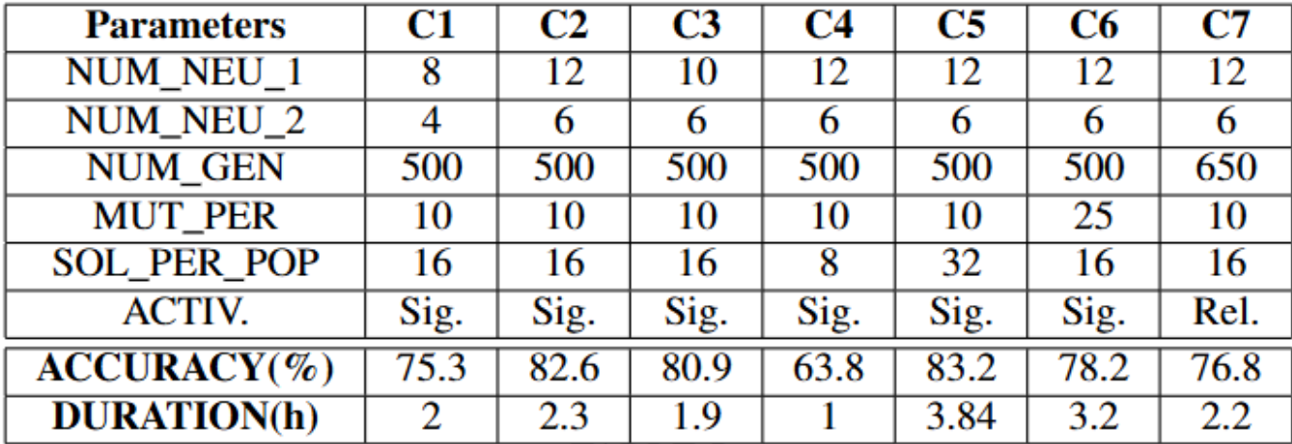
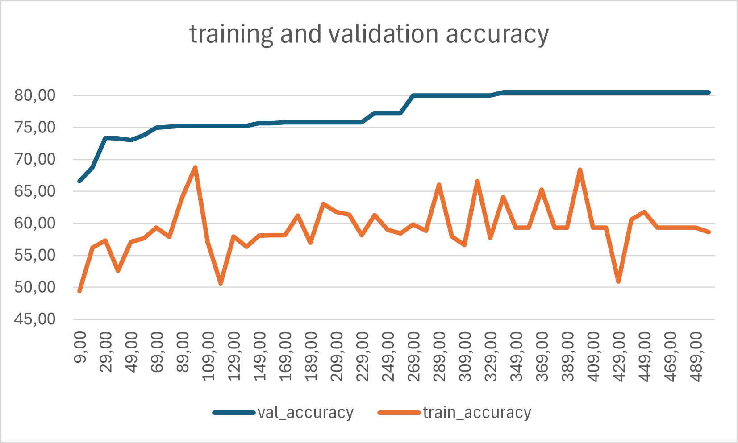
Deep Learning with Genetic Algorithm (GA)
Parameters
Size of the NN architecture
Offspring size
Mutation probability
Activation function

Slide 10
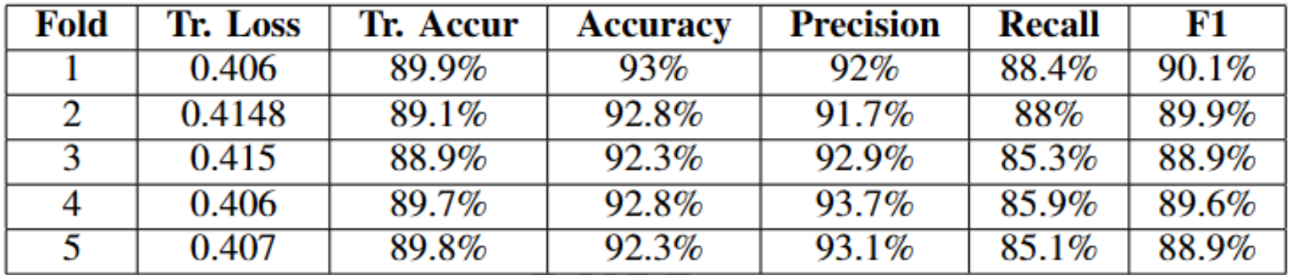
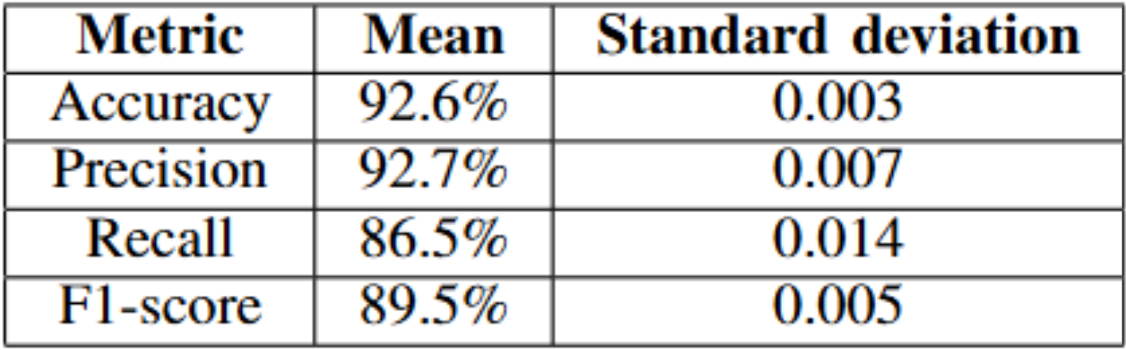
Spiking Neural Networks
Data preprocessing
Model Architecture
Model Training
Model Evaluation

Slide 11


