Slide 1
Bio-Inspired Learning Report Temaplate
Prof. Juan Ignacio Godino Llorente
ignacio.godino@upm.es
Prof. Luis A. Hernández Gómez
luisalfonso.hernandez@upm.es

Slide 2
Bio-Inspired Learning: Grading
Breakdown of the class grade:
30% : A practical project applying classical BINL algorithms (working in pairs)
30%: Theoretical report on advanced uses of bio-inspired ideas (reporting your ideas after reading and debating a paper as the ones we referenced in today slides)
20%; Participation in class: active attendance, presentations and debate.
20%: Final test (short basic questions)

Slide 3
Template for your Report
You can get used to follow templates common in scientific publications.
IEEE article templates are an excellent reference to us:
https://template-selector.ieee.org/secure/templateSelector/publicationType
Choose one of the templates you think more interesting (Word or Latex)

Slide 4
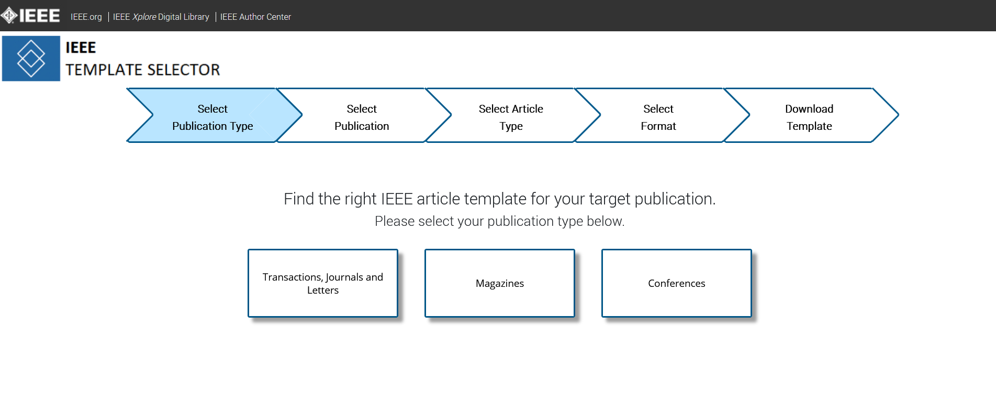

Slide 5
