Slide 1
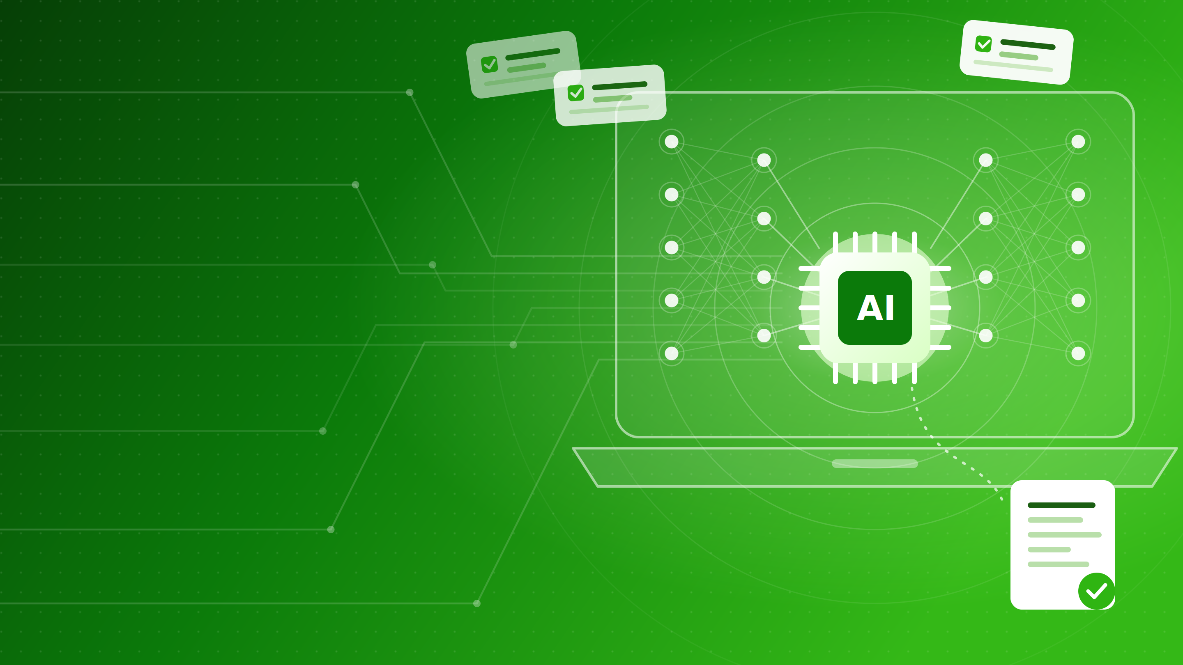

TraceForge
Find the code behind any ticket, with AI that stays on your laptop.
Team G

Slide 2
The idea
Why do we need it?
How it works
Where it helps
TraceForge features
Demo
What do we have today
Summary
Agenda
.

Slide 3


The idea
Stop searching. Ask and get answers from Local AI.
Without TraceForge
With TraceForge
✕
Search tasks, wikis and code by hand
✓
Ask one question, get one answer within a minute
✕
Docs are outdated
✓
Docs generated from the real project
✕
New people need days to get started
✓
New people get up to speed faster
✕
Cloud AI is not an option
✓
AI runs on your laptop
.

Slide 4




Why do we need it?
Starting a task is the slow part
Finding information takes time
Documentation falls behind
New people get lost
Work items and wikis describe the goal, not where it lives in the project.
The README no longer matches the real project.
Joining a project means days of reading unfamiliar code and not knowing what to do next.
The application is designed to never leave your machine.
Notes:
~1 min. Ask the room: "Who has opened a ticket and spent the first hour just finding the right files?" That is the everyday pain. Then the twist: AI tools are great at this, but many companies are not allowed to paste code into ChatGPT or a cloud agent, so they get no AI help at all.

Slide 5
How it works?
Three steps, all on your computer
1
2
3
Reads the ticket
Collects the facts
Writes the report
Gets the task and its comments from Azure DevOps.
Searches the related files, history and tasks.
A local AI model turns those facts into a clear summary.
Runs on any laptop (NPU, GPU or CPU). Nothing is posted back to the ticket unless you say yes.
Notes:
~1 min. The tool collects the facts itself and the AI only writes: small local models are far more accurate with real data. It picks the fastest chip automatically. If asked: Foundry Local runs qwen3-4b; the ticket is read read-only through the official Azure DevOps MCP server; the NPU path is unit-tested but not yet run on real Copilot+ hardware.

Slide 6




Where it helps?
Useful at every stage of the work
Starting a new task
Onboarding
See the related code before you begin
Fresh project docs written from the real code
Questions about code
In your tools
Ask in plain words, get answers from the repo
Terminal, VS Code, scripts and CI
Notes:
~40 sec. Starting a task uses Investigate, onboarding uses Generate docs, questions use Ask. Also works in VS Code tasks, scripts and CI, and can serve its repo tools to Copilot or Claude through MCP.

Slide 7







TraceForge features
Everything in one menu
Investigate a work item
Generate repository docs
Ask about this code
Finds the code behind a ticket and writes a report
Onboarding overview from real files and history
Plain questions, it reads, searches and checks the repo
Set up this repository
Connect Azure DevOps
Pick the Azure DevOps org and project, or paste its URL
Save your email and access token once, for every repo
Check system health
Enable NPU / GPU acceleration
Verifies tools, local AI and the Azure DevOps connection
Installs chip runtimes so the AI runs faster
Notes:
~40 sec. Top row = the three main jobs. Bottom row = one-time setup and helpers. Investigate always asks before posting a comment back to the ticket. If something is missing (repo not set up, not signed in), the menu offers to fix it right there. Every menu item is also a CLI command for scripts and CI. This is the menu you'll open in the demo next.

Slide 8
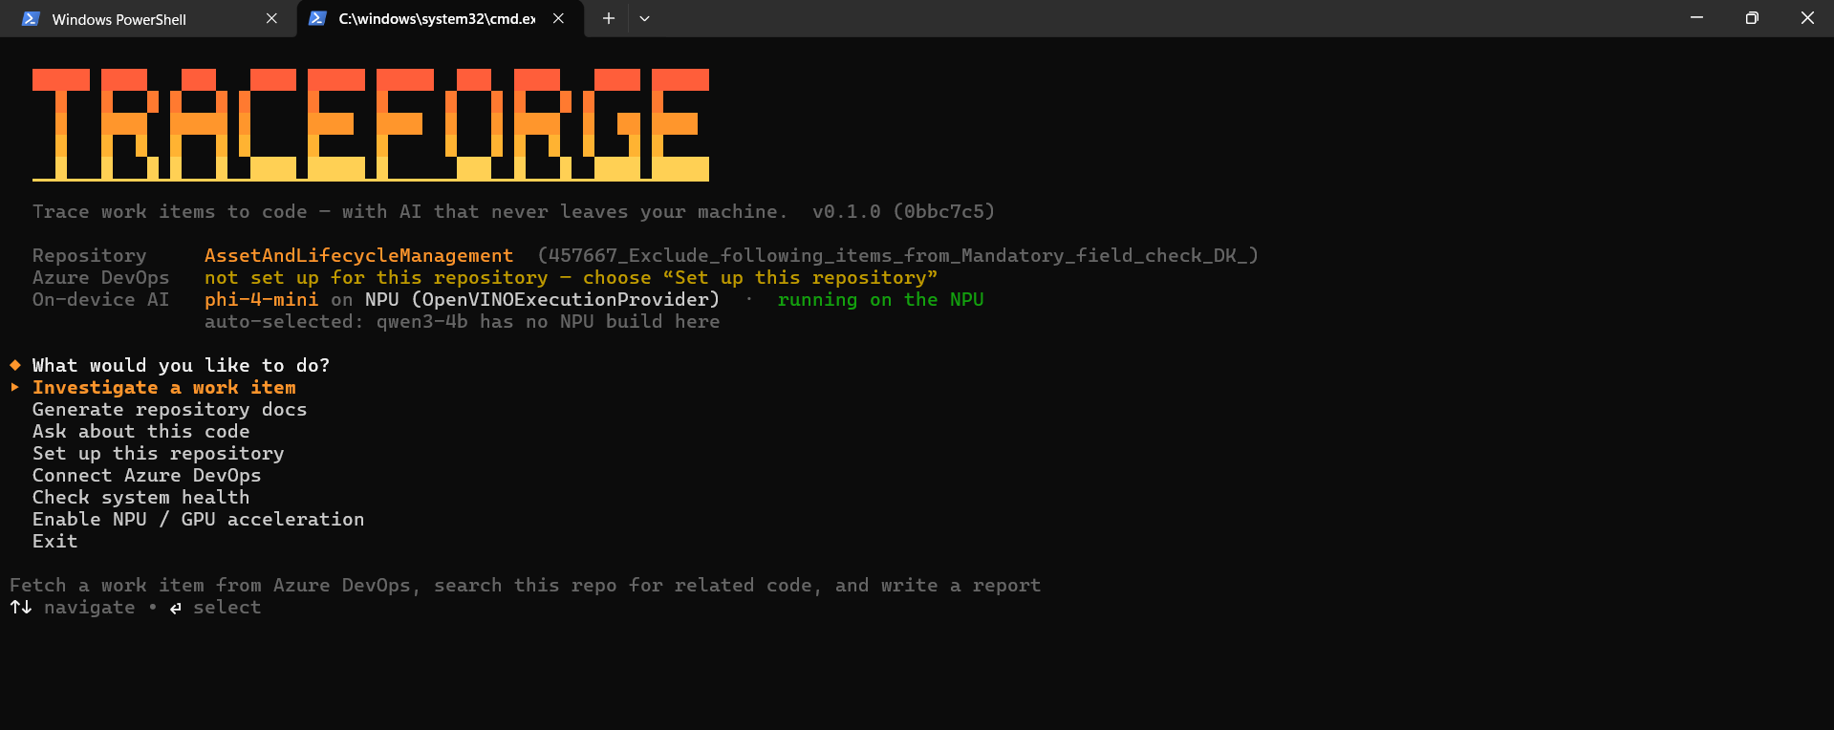
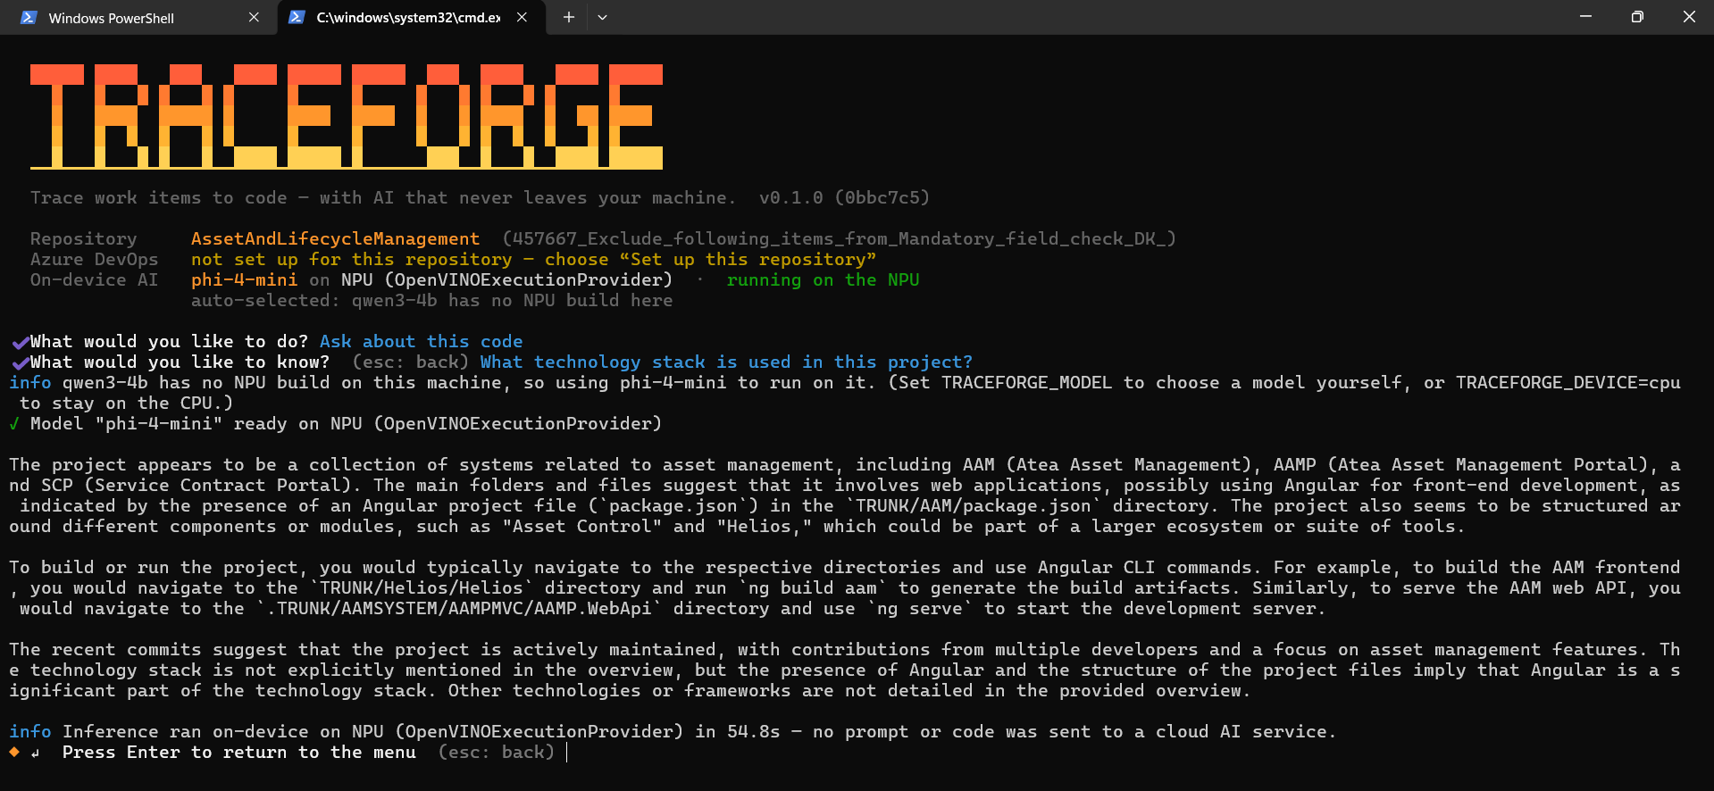
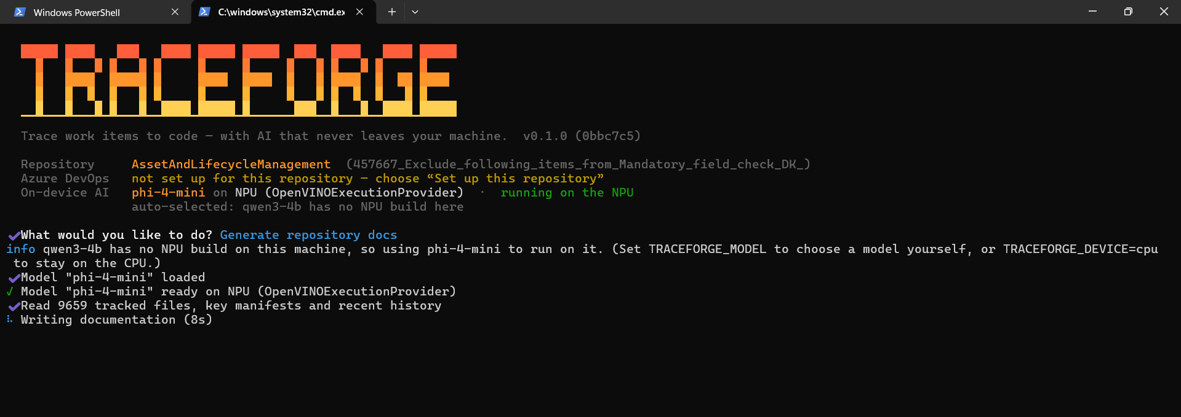
Demo
From question to answer in one command
Notes:
~3 min, the core of the pitch. 1) Open the menu, show the status panel. 2) Investigate a real ticket and open the report. 3) Point at the last line of output: it states which chip ran the AI and that nothing was sent to a cloud AI service. 4) One ask question if time allows. On CPU a report takes about a minute or more, so have pre-generated reports open as a backup.

Slide 9
What do we have today
What works today, what's next
Works today
Known limits
Next
Investigation of docs and ask
Runs locally on NPU, Copilot+PC
VS Code tasks and MCP server
Can use Git tools
Small model can make mistakes
Token window is not so big
Sometimes it might take long time to generate answer on big repo
Bigger, smarter local models
More features
Notes:
~40 sec. Be honest: the small model can make small mistakes, and the model is swappable for a bigger one. NPUs make bigger local models practical.

Slide 10
Summary
TraceForge in four answers
What?
Why?
A local AI assistant for understanding any project, from work items and wikis to code.
From "new here" to "I get it", with AI that never leaves your machine.
Starting tasks is slow, and cloud AI isn't allowed everywhere
Where?
Is it safe?
Teams using Azure DevOps and git, in the terminal and VS Code
The AI runs on your own computer, code never leaves it
github.com/Norfo4ik/TraceForge
Notes:
~40 sec. Read the four answers out loud, one line each, say thank you, and leave this slide up during questions. Requirements if asked: Node.js 20+, git, an Azure DevOps Personal Access Token.

