Slide 1
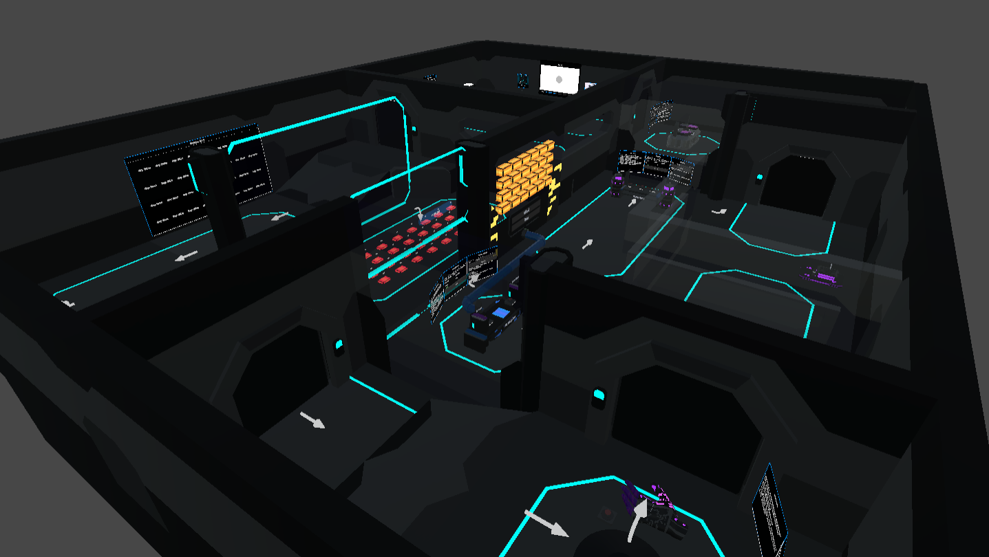
Creating Novel Virtual Reality Interfaces for Teaching Computer Architecture
Priyansh Nayak
Supervisor: Gareth W. Young
MSc Computer Science - Augmented and Virtual Reality
Trinity College Dublin

Slide 2
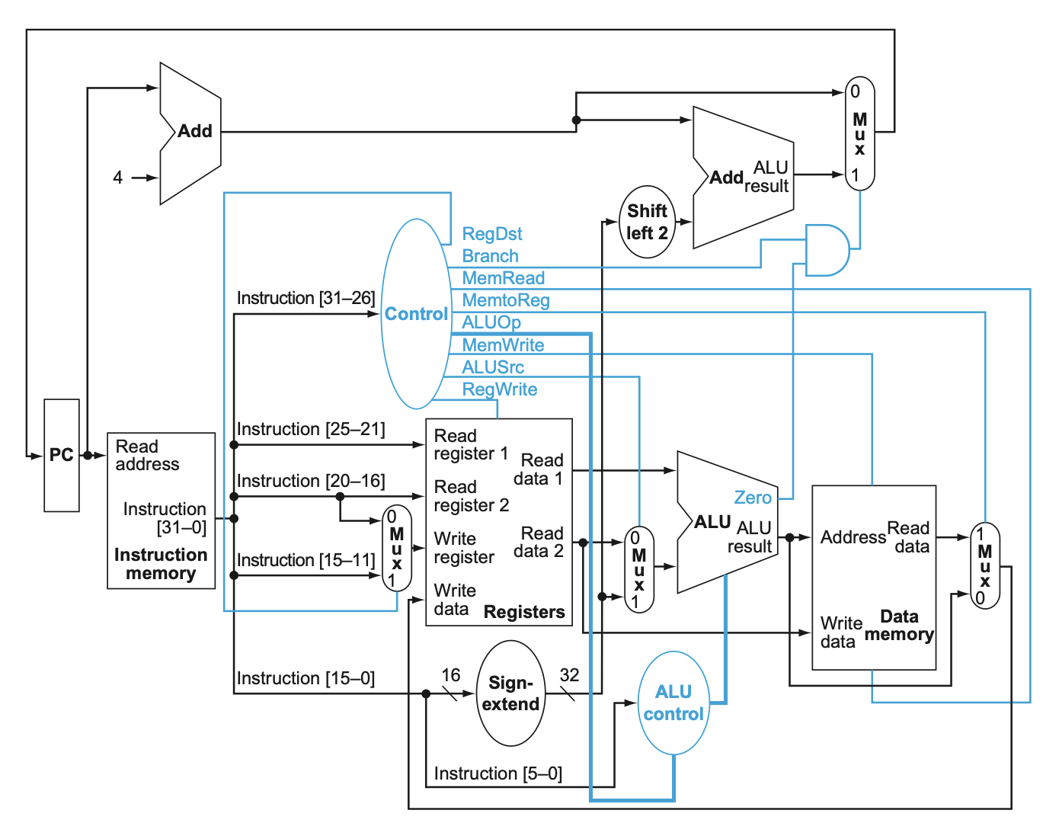
Why Computer Architecture Is Difficult to Learn
Computer architecture is difficult to learn because its key processes are largely invisible:
Students must understand how registers, control signals, the ALU, memory, and the program counter work together during instruction execution.
These processes are dynamic and abstract, yet they are often taught using static, two-dimensional diagrams.
Traditional tools may help students reach the correct answer but often do less to build an intuitive understanding of how information flows through the processor.
Notes:
Computer architecture is difficult to learn because many important processes are dynamic, abstract, and invisible during execution.
Students often struggled with datapath flow, control signals, and value movement.

Slide 3
Existing Research and Design Implications
VR in Computer Science Education Research suggests that VR can make abstract and invisible processes more tangible through interaction, spatial representation, and guided exploration. Studies commonly report benefits in engagement, presence, and conceptual understanding. Pirker et al., 2020; Pirker et al., 2021; Agbo et al., 2021; Janani et al., 2026
Computer Architecture Learning Previous systems have explored experiential learning, simulations, and serious games for teaching processor organisation and related concepts. However, this remains a relatively small area of research. Dascalu et al., 2017; Tlili et al., 2016; Tan et al., 2023
Lessons from Existing Work Immersion alone does not guarantee effective learning. Clear visualisation, intuitive interaction, appropriate guidance, and careful management of cognitive load remain essential. Cook et al., 2019; Korkut & Surer, 2023
Remaining Gap Existing research demonstrates the potential of VR for computer science education, but focused tools that help students trace instruction execution, data values, and control signals through a processor datapath remain limited. Many existing examples are proof-of-concept systems, broad investigations, or adjacent educational tools rather than structured experiences specifically designed around instruction execution.
Notes:
prior VR research suggests immersive interaction can make abstract processes more tangible. prior work in architecture learning exists, but remains relatively limited.
immersion alone is not enough, so the system needed clarity, guidance, and careful control of cognitive load.

Slide 4
Research Question and Learning Outcomes
“To what extent does an immersive virtual reality-based learning environment improve students' understanding of abstract computer architecture concepts compared to traditional teaching methods?”
By completing the experience, learners should be able to:
Decode the relevant fields of a supported single-cycle MIPS instruction.
Explain the role of the major datapath components involved in instruction execution.
Trace an instruction and its data through the major stages of a single-cycle datapath.
Select the correct operands and control-facing choices needed to execute an instruction.
Predict the architectural state changes caused by a supported instruction.
Compare how different instruction classes change datapath behavior.
Complete a supported instruction walkthrough with reduced or no guidance.
Notes:
The experience was designed so learners can decode instructions, trace execution, make correct decisions, predict state changes, compare instruction classes, and eventually complete the flow independently.

Slide 5
System Overview and Scope
The prototype is a self-paced VR learning environment for exploring instruction execution through a single-cycle MIPS datapath.
Learners progress through dedicated stations representing Instruction Fetch, Instruction Decode, Execute, Memory Access, Write-Back, and PC Update.
The lesson environment supports Learning, Practice, and Test modes.
The project focuses on a selected set of supported instructions rather than attempting to recreate a complete processor simulator.
Its scope is guided by explicit learning outcomes centered on decoding, tracing, decision-making, and reasoning about state changes.

Slide 6

Progressive Learning Modes
Learning Mode
Guided instruction walkthroughs
Explicit prompts and explanatory scaffolding
Immediate corrective feedback
Practice Mode
Reduced guidance
Learner must decode the instruction independently
Limited hints and limited attempts
Test Mode
No lesson panel or hint panel
Minimal tolerance for mistakes
Functions as the strict assessment version of the same lesson flow

Slide 7
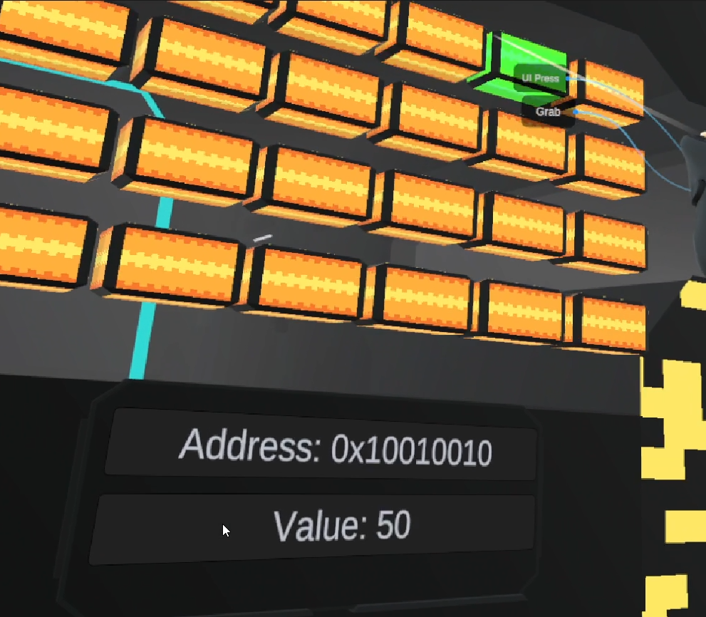
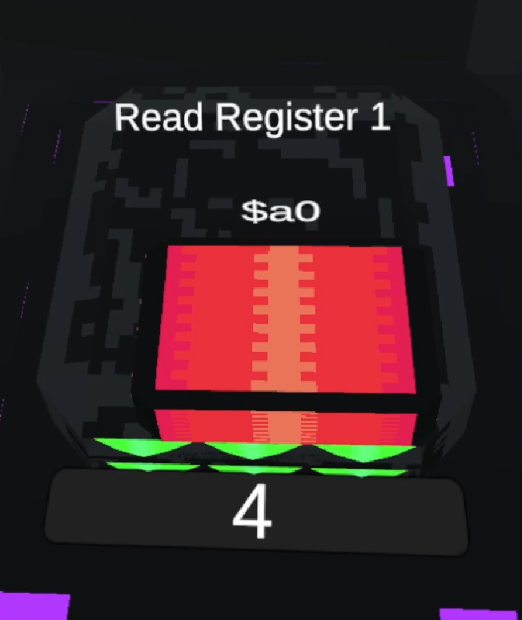
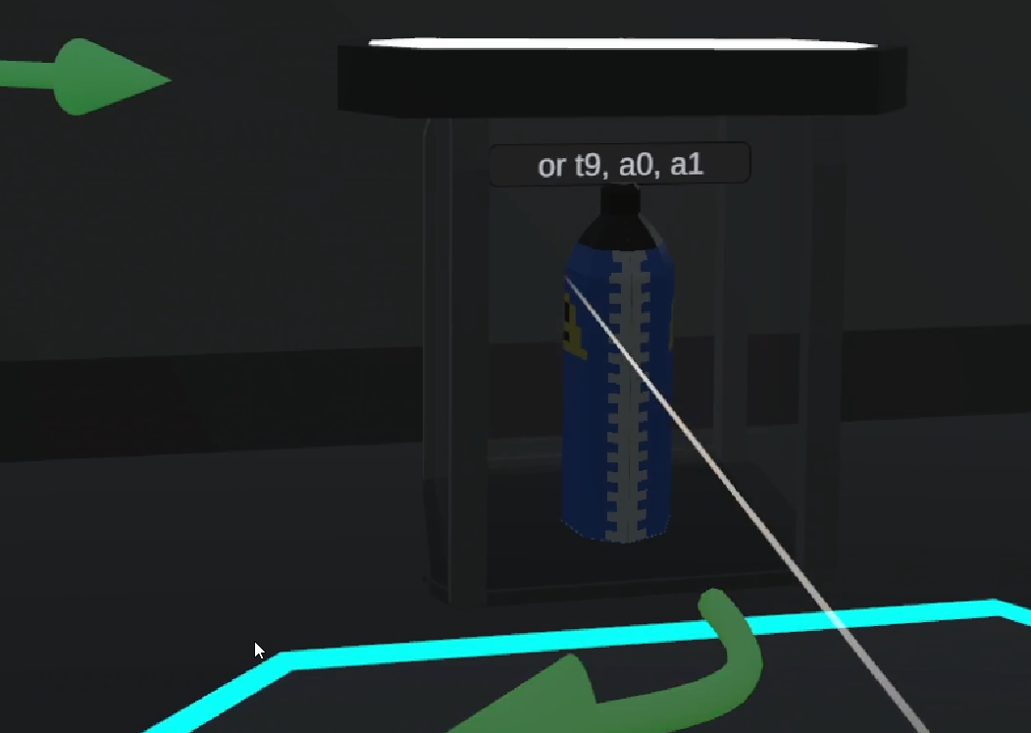
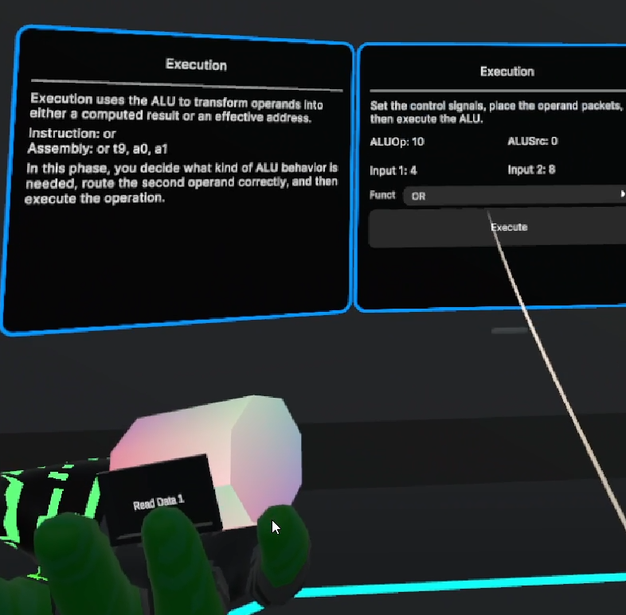
Core Interaction Design
How Spatial Interaction Can Improve Understanding:
Instructions are physically fetched and transferred through the opening lesson flow.
Register scanning and data-packet movement make operand selection and value flow visible.
Each major datapath phase is represented as a dedicated station in the environment.
World-space UI panels provide prompts, validation, reference support, and feedback.
Interactions were simplified whenever additional realism would have added friction without improving learning value.

Slide 8
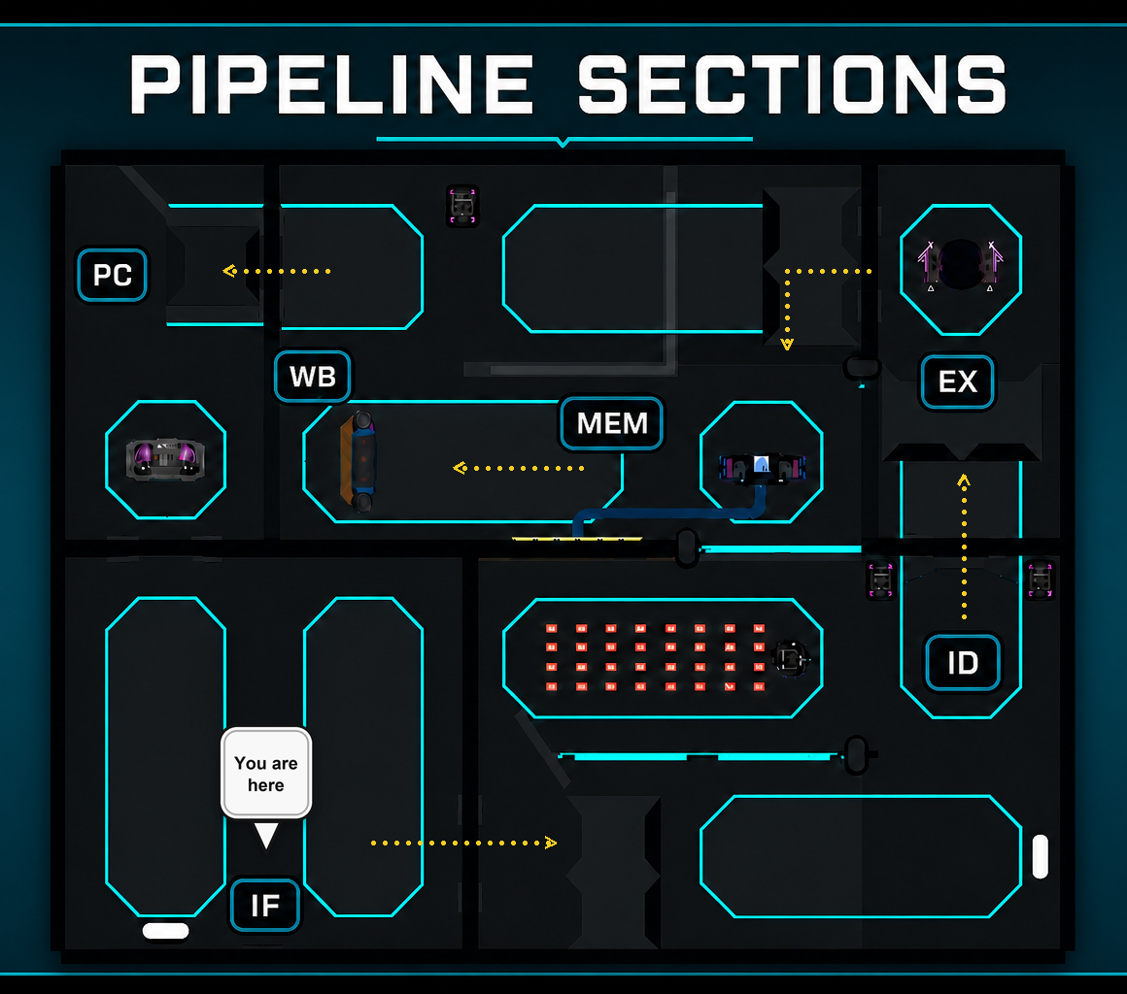
Instruction Walkthrough
The Learner Traces an Instruction from Fetch to Architectural State Change:
Fetch and transfer the instruction.
Decode its fields and identify the required operands.
Retrieve the correct register values and any required immediate.
Make the relevant control-facing decisions during execution.
Complete memory access or write-back as required by the instruction.
Confirm the resulting register, memory, and PC changes.

Slide 9
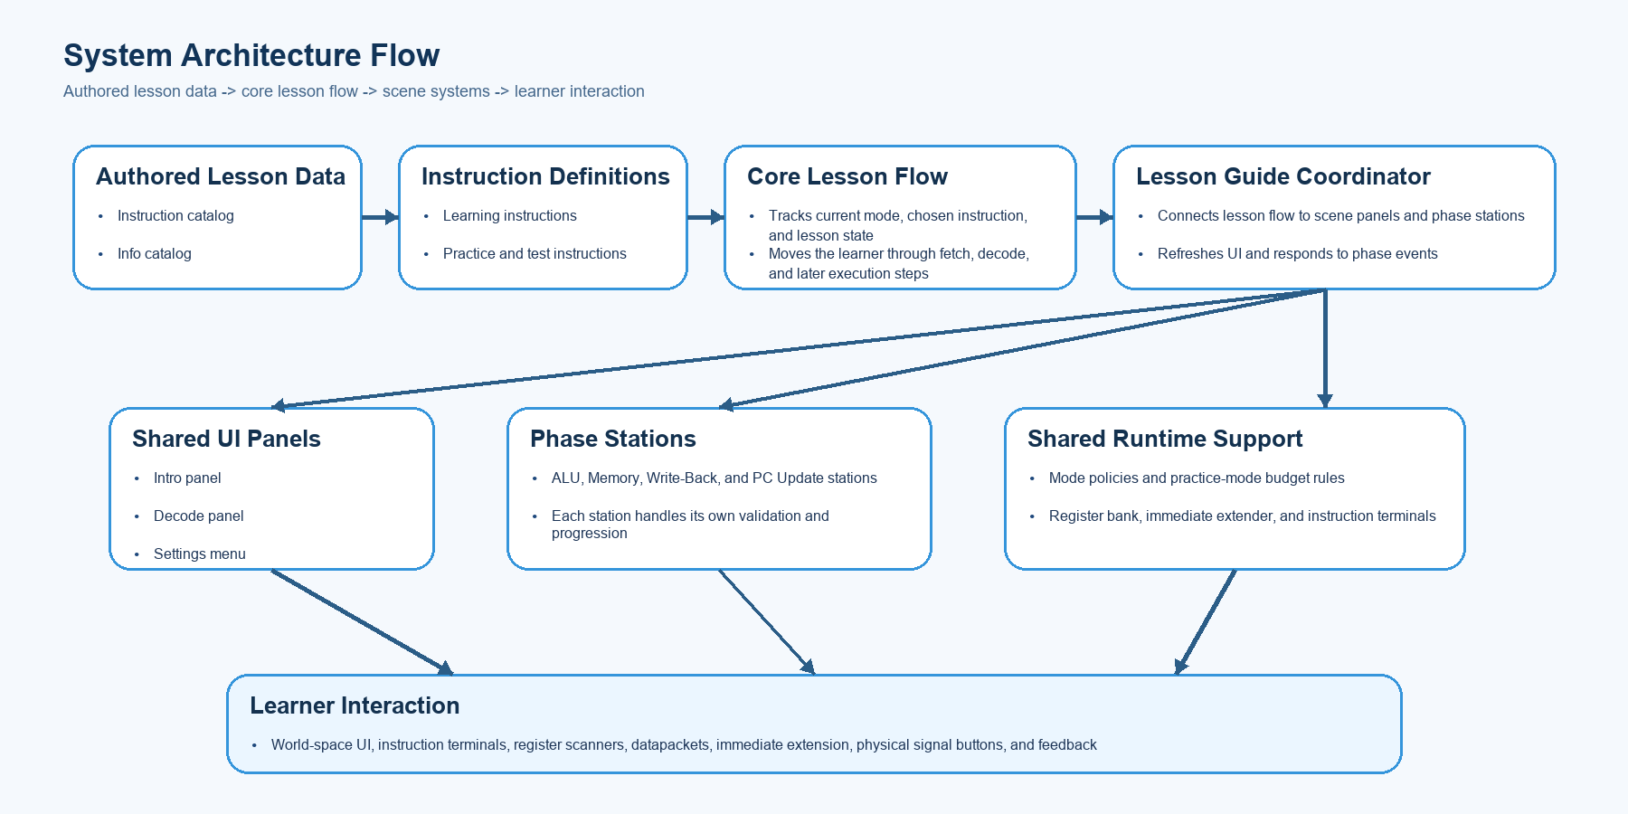

Slide 10

Research Study
Consent + Screening: Information Leaflet, Consent Form, Background Questions
Tailored Briefing: Refresher on assembly, instruction flow, and datapath stages
VR Session: Complete selected Learning and Practice instructions
Post-session Evaluation: System Experience ratings, Knowledge Check, and open-ended feedback responses
Notes:
Participants first read the information material, sign consent, and complete background questions. A tailored refresher is then given on assembly, instruction flow, and datapath stages. Participants complete selected Learning and Practice instructions in VR with minimal intervention unless genuinely stuck. Afterwards, they complete system-experience ratings, a knowledge check, and open-ended feedback, while observation notes are also recorded.

Slide 11
Design Decisions and Scope Control
The prototype was scoped as a single-cycle MIPS learning environment, not a full architectural simulator, to keep the experience teachable, testable, and stable.
Instruction Decode was narrowed to operand preparation: learners identify the instruction fields and gather the operands actually read at that stage, while destination selection is deferred to Write-Back.
Control-signal decisions were distributed across later phases instead of being fully resolved in Decode, so EX, MEM, and WB each retain meaningful learner interaction rather than becoming passive confirmation steps.
Register selection and value flow were separated: learners choose physical registers in Decode, while later phases operate on emitted datapackets, making value movement easier to track through the datapath.

Slide 12
Limitation and Future Work
The prototype is intentionally limited to a single-cycle MIPS datapath, so it does not yet cover multicycle execution, pipelining, stalls, or hazards.
Instruction support is broad enough for the study but still bounded to a focused subset rather than a full MIPS implementation.
The current evaluation is centered on short-session participant testing, so it does not yet address long-term retention, repeated use, or wider classroom deployment.
Extend the environment beyond the single-cycle baseline into multicycle execution and pipelined behavior, including stalls, hazards, and overlapping instructions.
Expand instruction coverage further, especially the rest of the jump/control-flow family such as jal and jr.
Refine learner-support systems with clearer onboarding, better route guidance, and optional adaptive guidance based on learner performance.
Continue the research through larger participant groups, stronger comparative evaluation, and retention-focused follow-up studies.

Slide 13
Thank You Questions ?
Notes:
The project’s contribution is a focused VR environment that allows learners to step through datapath execution spatially, physically, and progressively.

