Slide 1
Comment bien coder SOLID pattern
Vos collègues vont vous aimer
Notes:
https://www.freecodecamp.org/news/solid-principles-explained-in-plain-english/
https://medium.com/backticks-tildes/the-s-o-l-i-d-principles-in-pictures-b34ce2f1e898
https://www.baeldung.com/solid-principles
https://essential-dev-skills.com/poo/principe-solid
https://williamdurand.fr/2013/07/30/from-stupid-to-solid-code/

Slide 2
SOLID Principles
Code maintenable
Flexible
réutilisable
compréhensible

Slide 3
SOLID Principles
Single Responsibility
Open/Closed
Liskov Substitution
Interface Segregation
Dependency Inversion

Slide 4
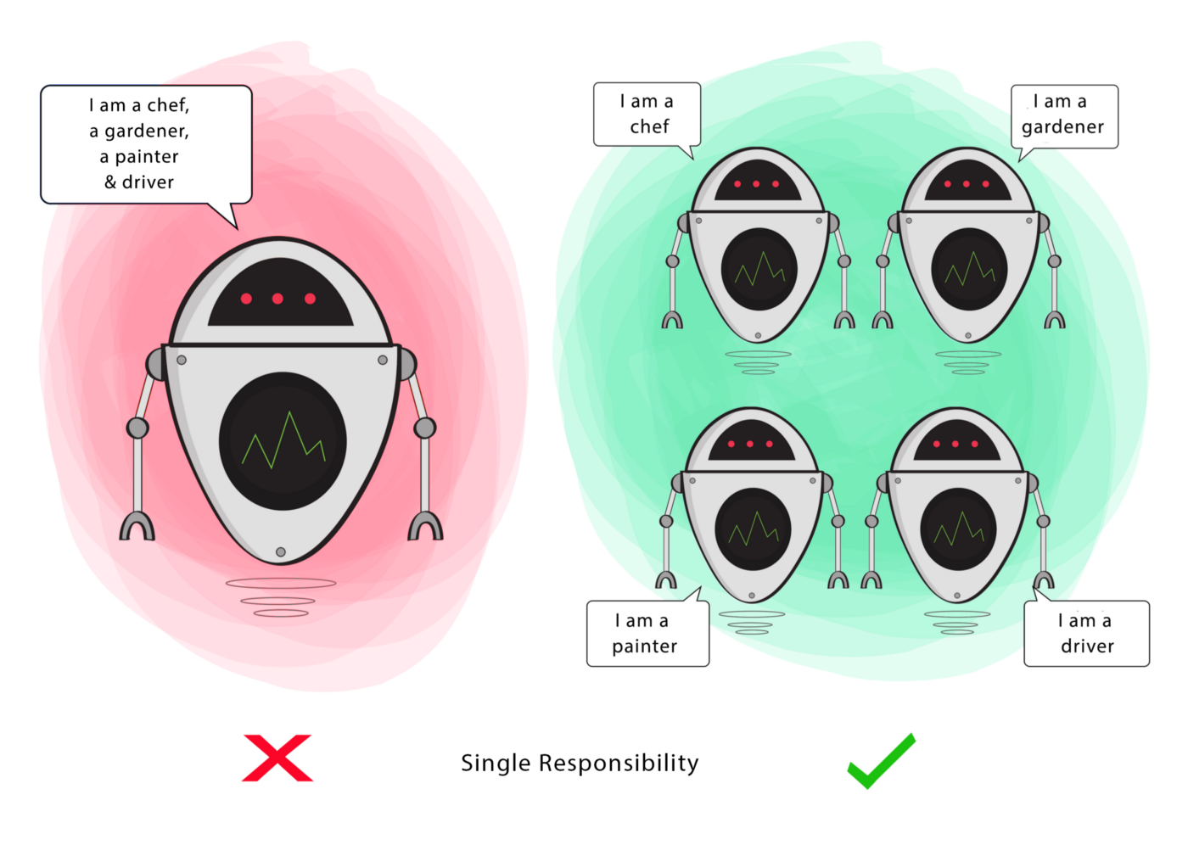
Single responsability
Si une classe a de nombreuses responsabilités, on augmente le risque de bug parce que faire un changement pour l’une d’entres elles pourrait affecter une autre sans que vous le sachiez
Il vaut mieux séparer les comportements, pour qu’un bug suite à une de vos modifications n’affecte que cette partie.

Slide 5
Exercice:
import java.awt.print.Book;
public class Invoice {
private Book book;
private int quantity;
private double taxRate;
private double total;
public Invoice(Book book, int quantity, double taxRate) {
this.book = book;
this.quantity = quantity;
this.taxRate = taxRate;
this.total = this.calculateTotal();
}
public double calculateTotal() {
double price = ((book.price) * this.quantity);
double priceWithTaxes = price * (1 + taxRate);
return priceWithTaxes;
}
public void printInvoice() {
System.out.println(quantity + "x " + book.name + " " +
book.price + "$");
System.out.println("Tax Rate: " + taxRate);
System.out.println("Total: " + total);
}
public void saveToFile(String filename) {
// Creates a file with given name and writes the invoice
}
}

Slide 6
Solution
public class InvoicePrinter {
private Invoice invoice;
public InvoicePrinter(Invoice invoice) {
this.invoice = invoice;
}
public void print() {
System.out.println(
invoice.quantity + "x " +
invoice.book.name + " " +
invoice.book.price + " $");
System.out.println(
"Discount Rate: " +
invoice.discountRate);
System.out.println(
"Tax Rate: " +
invoice.taxRate);
System.out.println(
"Total: " + invoice.total + " $");
}
}

Slide 7
Solution
public class InvoicePersistence {
Invoice invoice;
public InvoicePersistence(Invoice invoice) {
this.invoice = invoice;
}
public void saveToFile(String filename) {
// Creates a file with given name and writes the invoice
}
}

Slide 8
Open for Extension, Closed for Modification
On doit être capable d’ajouter de nouvelle fonctionnalité sans toucher au code existant d’une class.
Modifier du code existant, c’est prendre le risque de casser quelque chose qui fonctionnait jusqu’ici.
Astuce: C’est souvent une question d’interfaces

Slide 9
Exercice:
public class InvoicePersistence {
Invoice invoice;
public InvoicePersistence(Invoice invoice) {
this.invoice = invoice;
}
public void saveToFile(String filename) {
// Creates a file with given name and writes the invoice
}
public void saveToDatabase() {
// Saves the invoice to database
}
}

Slide 10
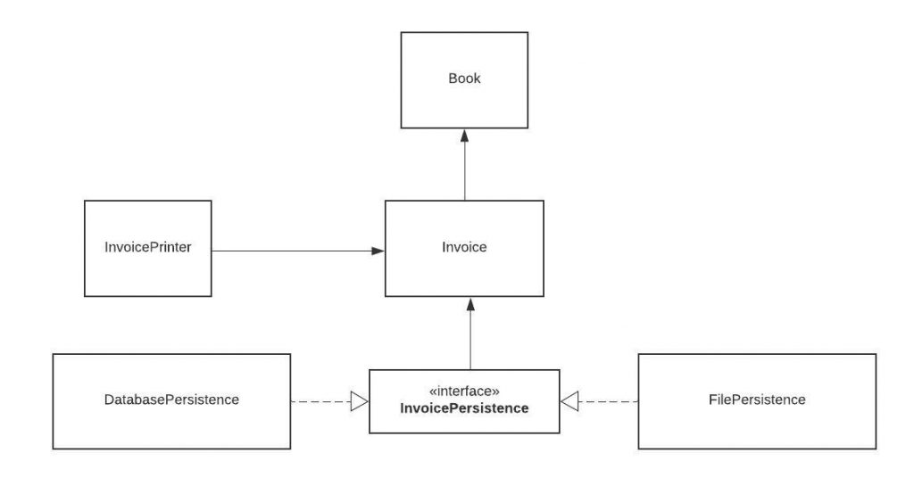
Solution

Slide 11
Implémentation
interface InvoicePersistence {
public void save(Invoice invoice);
}
public class DatabasePersistence implements InvoicePersistence {
@Override
public void save(Invoice invoice) {
// Save to DB
}
}
public class FilePersistence implements InvoicePersistence {
@Override
public void save(Invoice invoice) {
// Save to file
}
}

Slide 12
Liskov Substitution
Loi: Une sous classe doit pouvoir se substituer à sa classe parent.
Un enfant peut enrichir le comportement de son parent mais pas ajouter des contraintes.

Slide 13
Exercice
class Rectangle {
protected int width, height;
public Rectangle() {}
public Rectangle(int width, int height) {
this.width = width;
this.height = height;
}
public int getWidth() { return width; }
public void setWidth(int width) { this.width = width; }
public int getHeight() { return height; }
public void setHeight(int height) { this.height = height; }
public int getArea() {
return width * height;
}
}

Slide 14
Problème
class Square extends Rectangle {
public Square() {}
public Square(int size) {
width = height = size;
}
@Override
public void setWidth(int width) {
super.setWidth(width);
super.setHeight(width);
}
@Override
public void setHeight(int height) {
super.setHeight(height);
super.setWidth(height);
}
}

Slide 15
Problème
class Test {
static void getAreaTest(Rectangle r) {
int width = r.getWidth();
r.setHeight(10);
System.out.println(
"Expected area of " + (width * 10) + ", got " + r.getArea());
}
public static void main(String[] args) {
Rectangle rc = new Rectangle(2, 3);
getAreaTest(rc);
Rectangle sq = new Square();
sq.setWidth(5);
getAreaTest(sq);
}
}

Slide 16
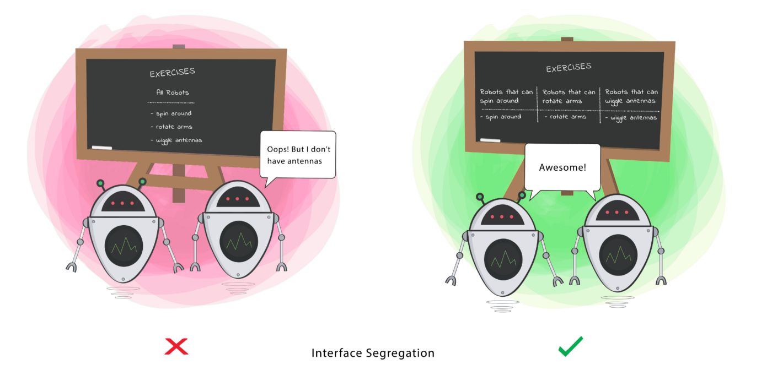
Interface Segregation
Un client ne devrait pas être forcé de dépendre de méthodes qu’il n’utilise pas
=> Séparez vos interfaces en plus petites

Slide 17
Exercice
public interface ParkingLot {
void parkCar();// Decrease empty spot count by 1
void unparkCar(); // Increase empty spots by 1
void getCapacity();// Returns car capacity
double calculateFee(Car car); // Returns the price based on number of hours
void doPayment(Car car);
}
class Car {
}

Slide 18
Problème
public class FreeParking implements ParkingLot {
@Override
public void parkCar() {}
@Override
public void unparkCar() {}
@Override
public void getCapacity() {}
@Override
public double calculateFee(Car car) {
return 0;
}
@Override
public void doPayment(Car car) {
throw new Exception("Parking lot is free");
}
}

Slide 19
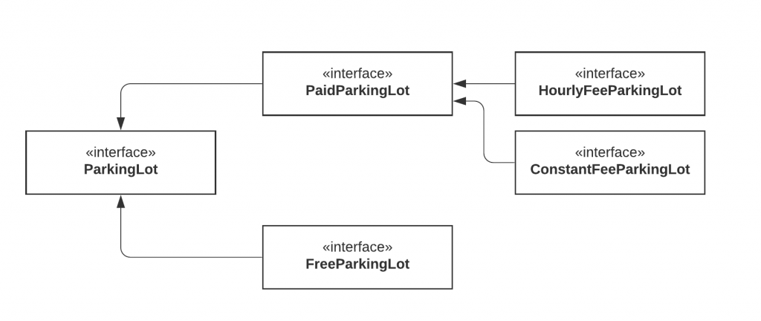
Solution

Slide 20
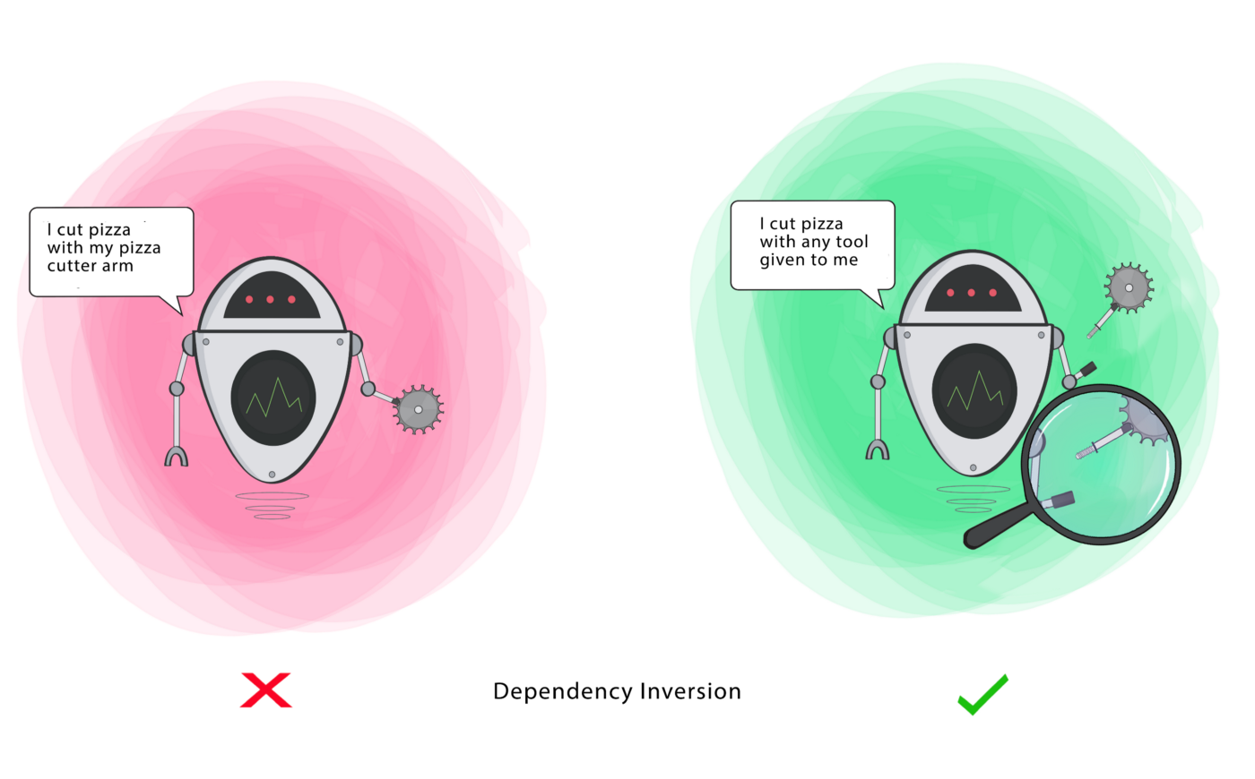
Dependency injection
Les modules haut niveau ne devraient pas dépendre de modules bas niveau. Ils devraient tous les deux dépendre d’abstractions
Les abstractions ne devraient pas dépendre des détails. Les détails devraient dépendre des abstractions.
Ce principe permet de découpler vos objets entre eux
Ne pas confondre avec l’inversion de dépendance

Slide 21
Exemple
public class Windows98Machine {
private final StandardKeyboard keyboard;
private final Monitor monitor;
public Windows98Machine() {
monitor = new Monitor();
keyboard = new StandardKeyboard();
}
}
public class Windows98Machine{
private final Keyboard keyboard;
private final Monitor monitor;
public Windows98Machine(Keyboard keyboard, Monitor monitor) {
this.keyboard = keyboard;
this.monitor = monitor;
}
}
public interface Keyboard { }
public class StandardKeyboard implements Keyboard { }

