Slide 1
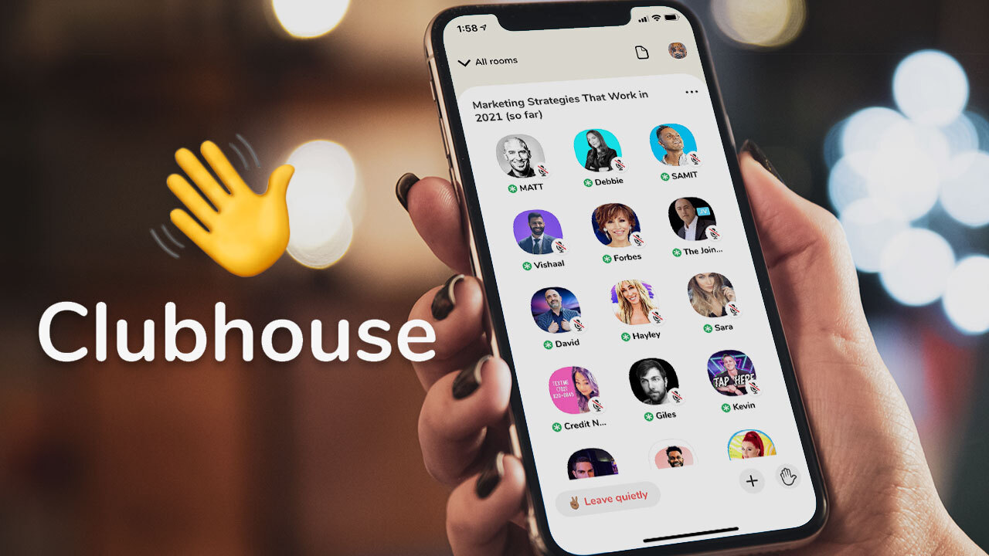
#
Real-time Twitter Hashtag Tracker
For Big Data Case Study

Slide 2






Near Real-Time Data Pipeline
Source
Collect
Processing
Visualizations
Storage
Reply

Slide 3
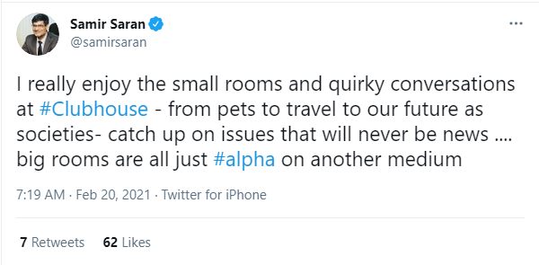
Data retrieved from tweets
username | samirsaran | string
tweet_id | 1362995389712932864 | string
tweet_text | I really enjoy the small.. | string
tweet_create | 2021-02-20 | Date
tweet_retweets | 7 | Integer
tweet_favorites | 62 | Integer
user_location | New Delhi | string
user_verified | TRUE | Boolean
user_followers | 68833 | Integer
user_friends | 1108 | Integer
user_n_status | 15196 | Integer
user_create | 2009-08-23 | Date
tweet_source | Twitter for iPhone | string
feedback | positive | string

Slide 4
Challenges

Slide 5
snscrape
snscrape is a scraper for social networking services (SNS). It scrapes things like user profiles, hashtags, or searches and returns the discovered items, e.g. the relevant posts.
The following services are currently supported:
Facebook: user profiles, groups, and communities (aka visitor posts)
Instagram: user profiles, hashtags, and locations
Reddit: users, subreddits, and searches (via Pushshift)
Telegram: channels
Twitter: users, user profiles, hashtags, searches, threads, and list posts
VKontakte: user profiles
Weibo (Sina Weibo): user profiles

Slide 6
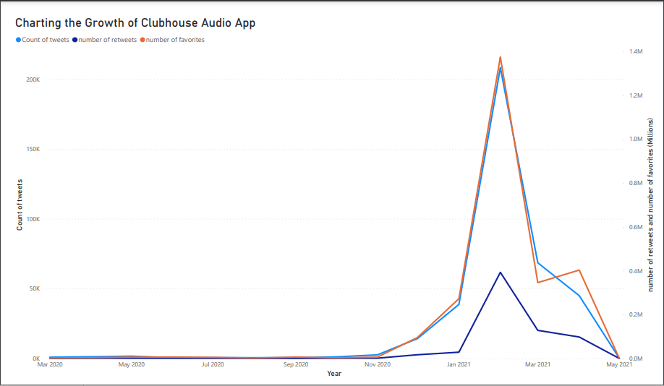
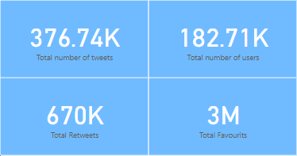

Slide 7
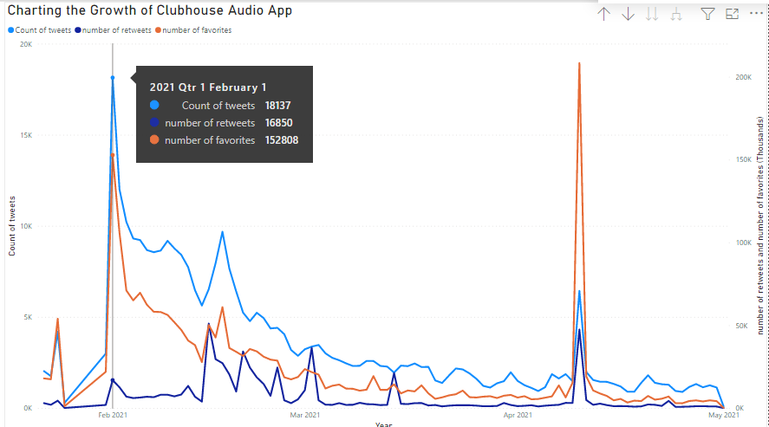

Slide 8
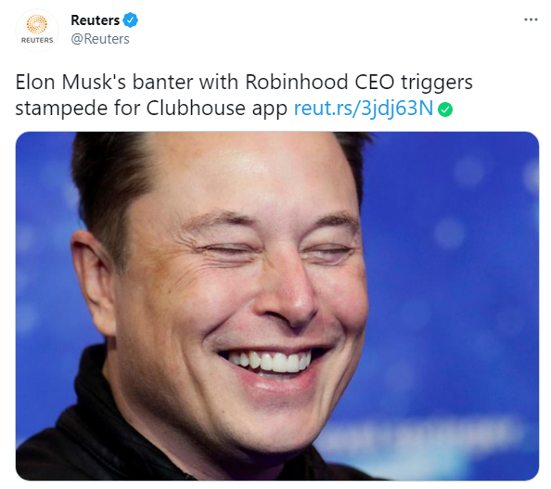
What happened at 1/2/2021 ?

Slide 9
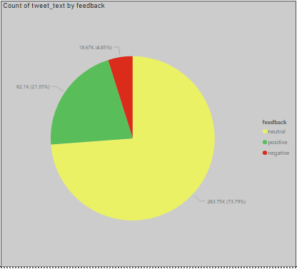
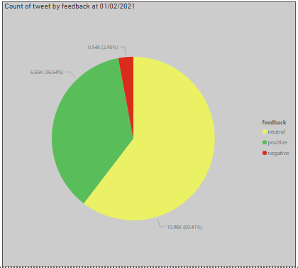
Tweets impressions at 01/02/2021

Slide 10
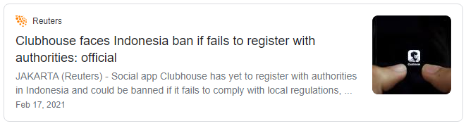
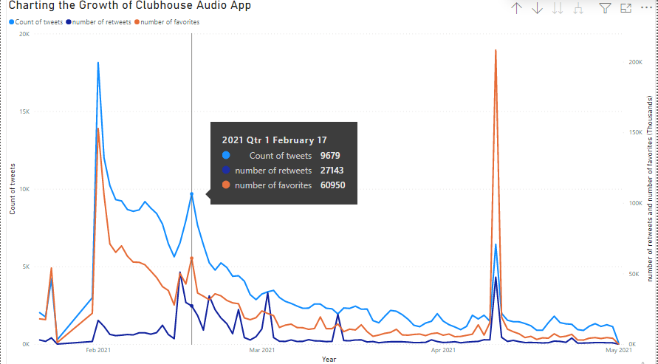
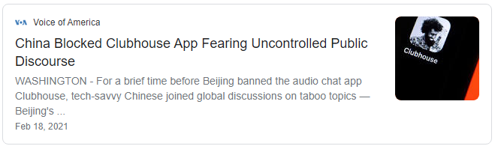
What happened at 17/2/2021 ?

Slide 11
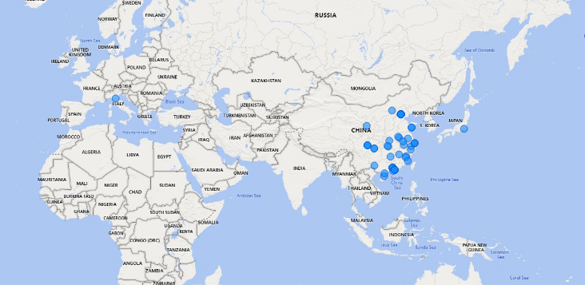
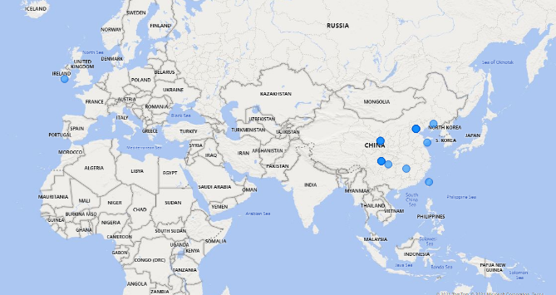
China before and after banning Clubhouse

Slide 12
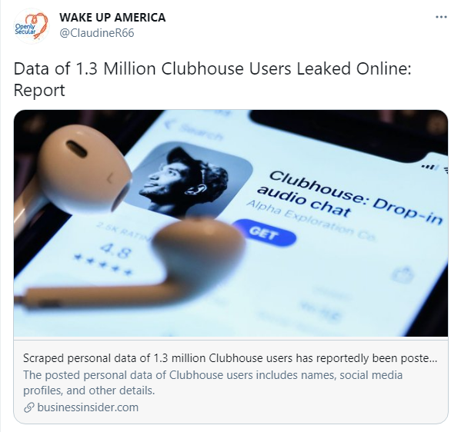
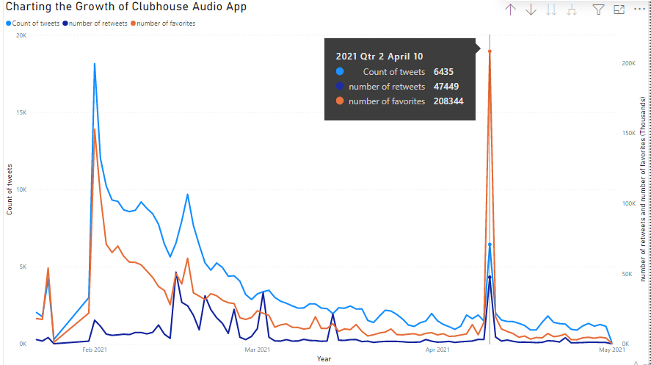
What happened at 10/4/2021 ?

Slide 13
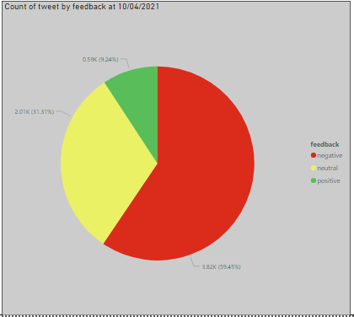
Tweets impressions at 10/04/2021

Slide 14
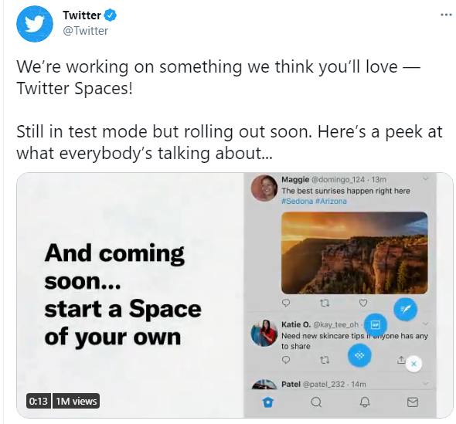
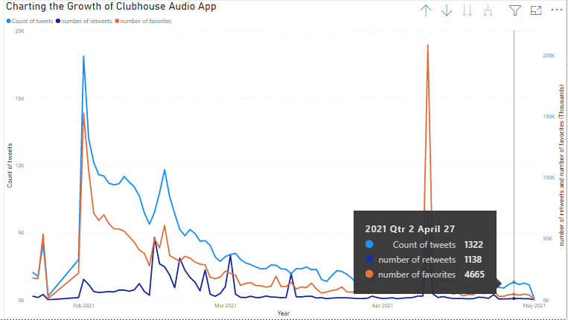
What happened after 10/4/2021?

Slide 15
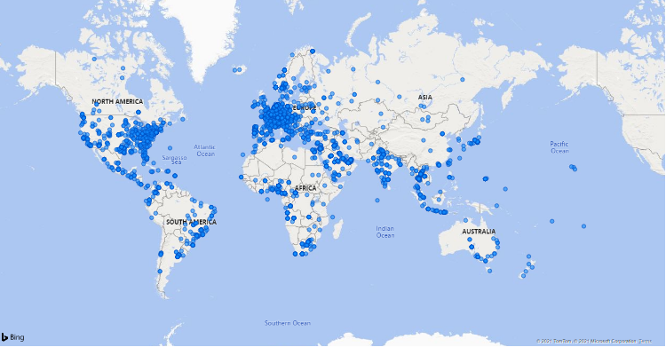
People talking about Clubhouse from..?

Slide 16
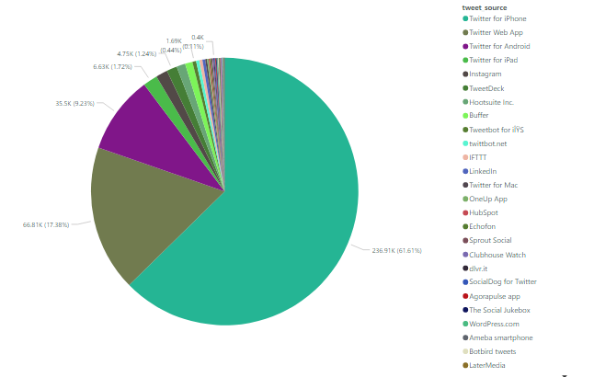
People talking about Clubhouse via..?

Slide 17
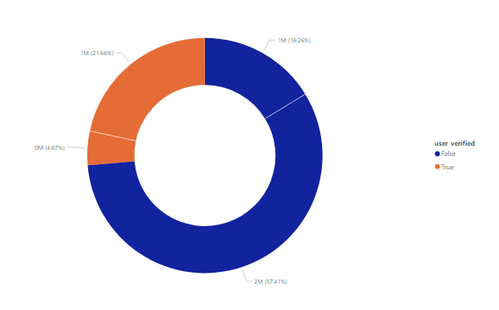
People talking about Clubhouse from verified account?

Slide 18
