Slide 1



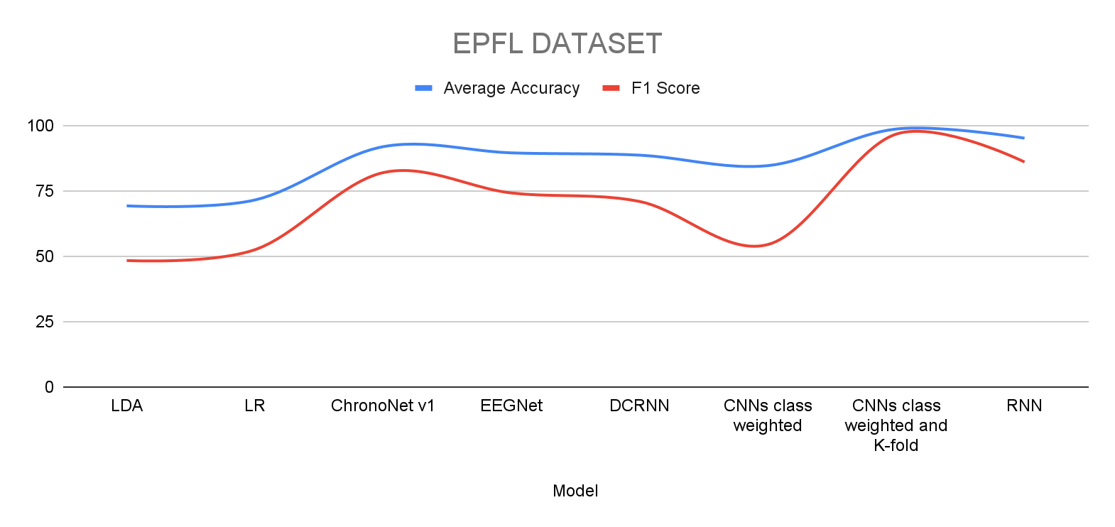
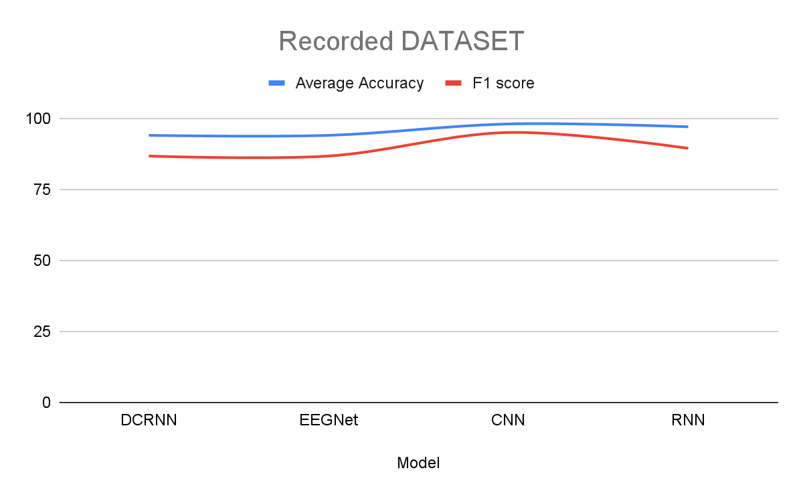
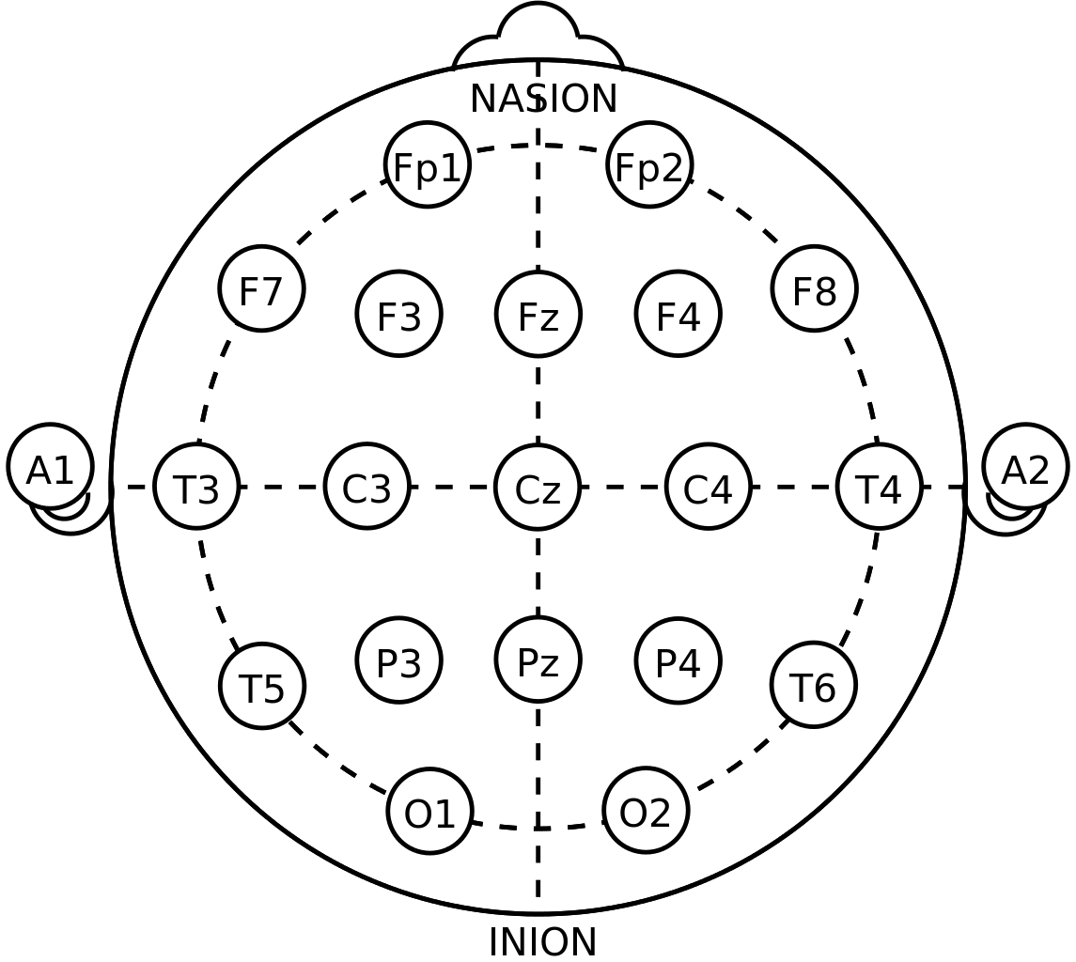
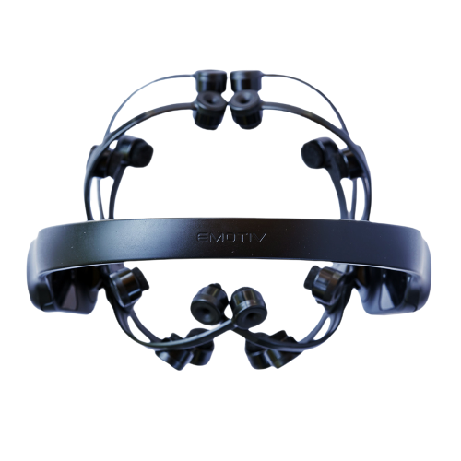
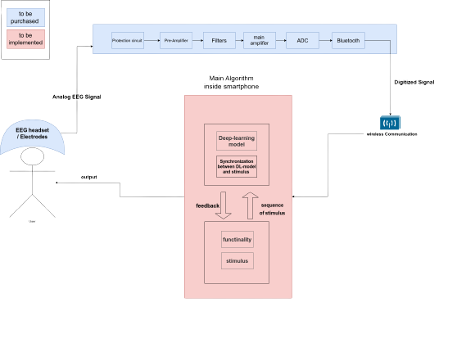
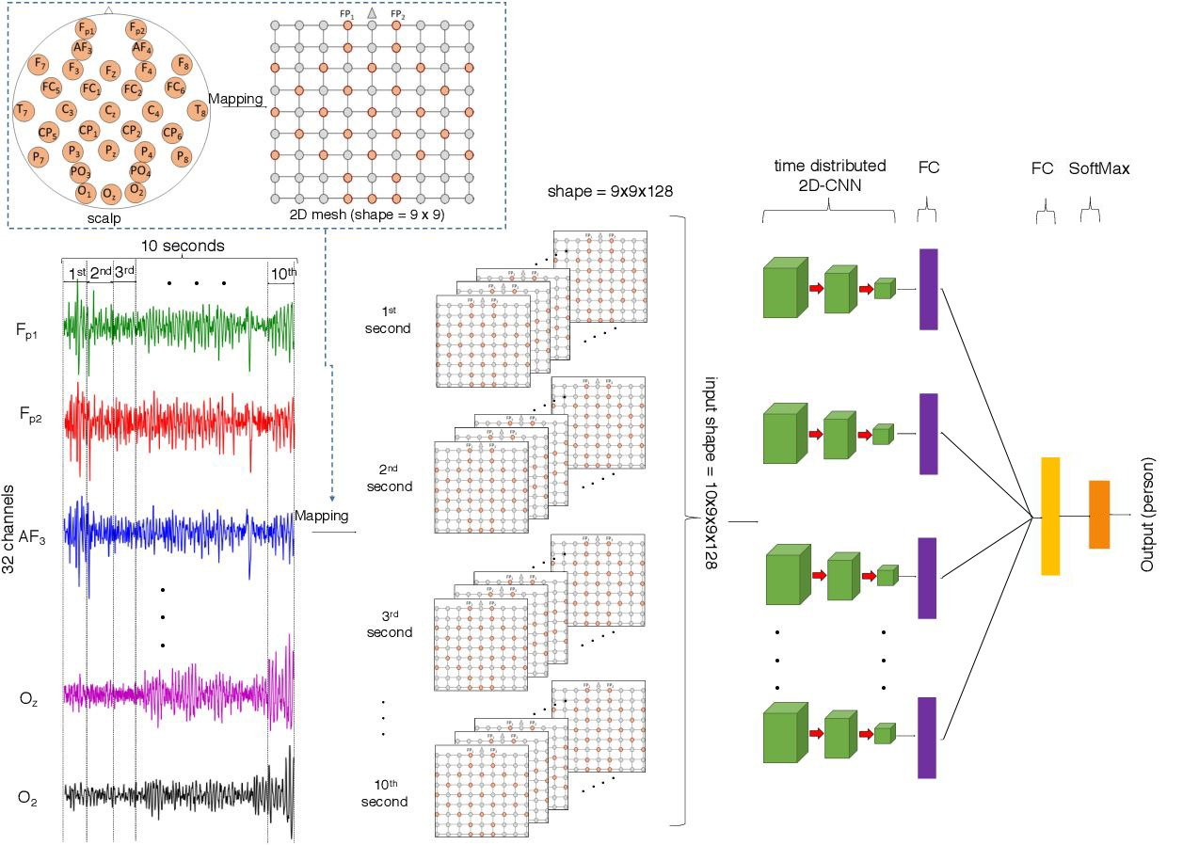

Neurophone Real-Time Brain Mobile Phone Interface
Abdelrahman sayed, Nora Ekramy, Nour Kamaly, Mohammed Nour, Norhan Abdelkarim, Ayman Hassan
Scientific Computing Department, Faculty of Computer and Information Sciences,
_{Ain Shams University}
Electroencephalography (EEG) signals have gained significance in neurological disorders and brain-computer interfaces (BCIs).
Deep learning models applied to EEG data show promising results in analysis and understanding. This academic poster presents a comprehensive study on the architecture and performance of deep learning models such as ChronoNet, EEGNet, DCRNN, and others.
The poster covers methodology, experimental results, real-time applications with a focus on brain-mobile phone interfaces, future work, and the importance of in-house hardware implementation.
This research contributes to advancing EEG analysis for enhancing brain-mobile phone interfaces applications.
Experimental Results
Introduction
EPFL Dataset
Recorded Dataset
On EPFL Dataset the best model averaged on all 9 subjects was CNNs class weighted and K-fold with average Accuracy of 96.75% and F1 score of 96.68%
On the Recorded Dataset the best model was CNN was the best model with average Accuracy of 98% and F1 score of 95%
solution Architecture
Performance graphs
Datasets
Data Preprocessing
Data segmentation: Each segment contains an event.
Referencing: Average signal from mastoid electrodes used for referencing.
Filtering: Signal filtered with a Butterworth filter (order 3), range: 1-12 Hz.
Downsampling: Signal downsampled by 64 Hz.
Normalization: Minmax and z-score normalization techniques applied.
Windsorizing: Extreme values replaced with less extreme values within a range.
Scaling: Samples from each electrode scaled to [-1, 1].²
Machine & Deep Learning Models
ML Models: SVM, Logistic Regression, and LDA.
DL Models: CNNs, RNNs, ChronoNet, EEGNet, DCRNN
Best-performing DL model: CNN with weighted classes and k-fold CV
Realtime Application
EPFL P300 dataset contains data from 5 disabled and 4 able-bodied subjects, who completed four recording sessions each. Each session consisted of six runs, one run for each of the 6 images. The images were flashed in random sequences, one image at a time. Each flash of an image lasted for 100 ms, followed by a 300 ms interval with no images. The EEG was recorded at 2048 Hz sampling rate from 32 electrodes placed at the standard positions of the 10-20 international system.¹
Recorded dataset using EMOTIV Headset from 14 channels
Development of a Brain-Mobile Phone Interface for real-time EEG signal analysis.
Integration of the trained deep learning models into a mobile application.
Users can interact with the interface using their brain signals captured by the mobile device.
Potential applications: brain-controlled mobile gaming, mental state monitoring, cognitive training, etc.
1020 system
Future Work
Exploration of transfer learning techniques for EEG signal analysis.
Investigation of model interpretability for better understanding of EEG signal patterns.
Integration of other modalities (e.g., eye-tracking, fMRI) for multimodal analysis of brain activity.
Emotiv Headset
Development of techniques to handle independent subjects in EEG analysis, enabling better generalization and personalized models.
Continued implementation of hardware in-house to enhance the acquisition and processing of EEG signals.
System overview
Conclusion
In conclusion, this academic poster has explored the potential of deep learning models for EEG analysis and brain-computer interfaces. The study focused on the architecture and performance of ChronoNet, EEGNet, DCRNN, RNN and other models, showcasing their ability to extract meaningful features from EEG signals and achieve high classification accuracy. The real-time application of brain-mobile phone interfaces demonstrated the feasibility of integrating EEG-based systems with mobile devices for a wide range of applications. Moreover, the poster highlighted future directions, including the exploration of improved methods for handling independent subjects and the continuation of in-house hardware implementation. These advancements have the potential to significantly impact the diagnosis and treatment of neurological disorders and pave the way for more accessible and user-friendly brain-computer interfaces.
Refrances
Project Repository
[1] P300 dataset from Hoffmann et al 2008 : https://www.epfl.ch/labs/mmspg/research/page-58317-en-html/bci-2/bci_datasets/ [2] MNE : https://mne.tools/stable/index.html#
[3] EMOTIV : https://www.emotiv.com/
CNN architecture

