Slide 1
A02: Type Polar – Interactive Poster

Slide 2

Hidden vs Exposed
Image Source

Slide 3

1
A static version of L

Slide 4

1
Initial L – Hidden
As the mouse moves to the positive x the L will appear gradually

Slide 5


1

Slide 6


1

Slide 7

1Video

Slide 8
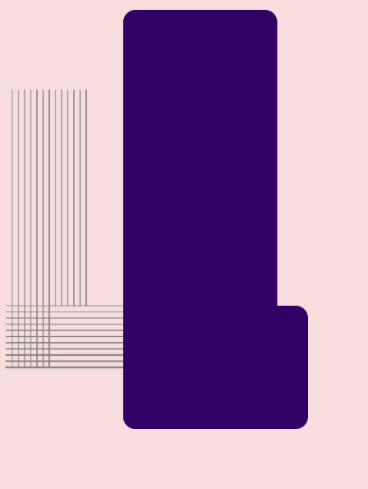
2
Hidden vs Exposed
Static Version

Slide 9

2
Hidden vs Exposed
Static Version 2

Slide 10
Movement
10
The Lined L is hidden behind the Bold L
With positive mouse movements, the hidden L gradually fades, and the L on top get bolder – more exposed.

Slide 11

2 Video

Slide 12
Hidden vs Exposed
Image Source

Slide 13

The power of communication

Slide 14
Overcoming nervousness
Confidence-building strategies

Slide 15
Engaging the audience
15
Make eye contact with your audience to create a sense of intimacy and involvement
Weave relatable stories into your presentation using narratives that make your message memorable and impactful
Encourage questions and provide thoughtful responses to enhance audience participation
Use live polls or surveys to gather audience opinions, promoting engagement and making sure the audience feel involved

Slide 16

Selecting visual aids
Enhancing your presentation

Slide 17
Effective delivery techniques
Voice modulation is a powerful tool in public speaking. It involves varying pitch, tone, and volume to convey emotion, emphasize points, and maintain interest.
Pitch variation
Tone inflection
Volume control
Effective body language enhances your message, making it more impactful and memorable.
Meaningful eye contact
Purposeful gestures
Maintain good posture
Control your expressions

Slide 18
Navigating Q&A sessions
Maintaining composure during the Q&A session is essential for projecting confidence and authority. Consider the following tips for staying composed:
Stay calm
Actively listen
Pause and reflect
Maintain eye contact
Know your material in advance
Anticipate common questions
Rehearse your responses

Slide 19

Speaking impact
Your ability to communicate effectively will leave a lasting impact on your audience
Effectively communicating involves not only delivering a message but also resonating with the experiences, values, and emotions of those listening

Slide 20
Dynamic delivery
Learn to infuse energy into your delivery to leave a lasting impression
One of the goals of effective communication is to motivate your audience
Metric | Measurement | Target | Actual
Audience attendance | # of attendees | 150 | 120
Engagement duration | Minutes | 60 | 75
Q&A interaction | # of questions | 10 | 15
Positive feedback | Percentage (%) | 90 | 95

Slide 21
Our competition
Seek feedback
Reflect on performance
Explore new techniques
Set personal goals
Iterate and adapt
Consistent rehearsal
Practice makes perfect, so strengthen your familiarity with the presentation
Refine delivery style
Pacing, tone, and emphasis
Timing and transitions
Aim for seamless, professional delivery
Practice audience
Enlist colleagues to listen & provide feedback

Slide 22
Speaking engagement metrics
Impact factor | Measurement | Target | Achieved
Audience interaction | Percentage (%) | 85 | 88
Knowledge retention | Percentage (%) | 75 | 80
Post-presentation surveys | Average rating | 4.2 | 4.5
Referral rate | Percentage (%) | 10 | 12

Slide 23
Thank You
Brita Tamm
502-555-0152
brita@firstupconsultants.com
www.firstupconsultants.com

