Slide 1
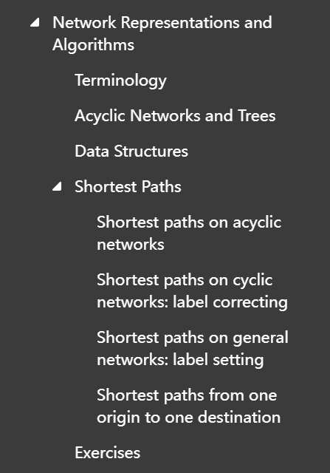
W6,Fyp
《Transportation Network Analysis》
Wenhui He

Slide 2
Difference between STA and DTA model:
Different network condition
Congestion
Equilibrium

Slide 3
Shortest Path Algorithms
Shortest paths on acyclic networks
Shortest paths on cyclic networks: label correcting
Shortest paths on general networks: label setting
Shortest paths from one origin to one destination

Slide 4
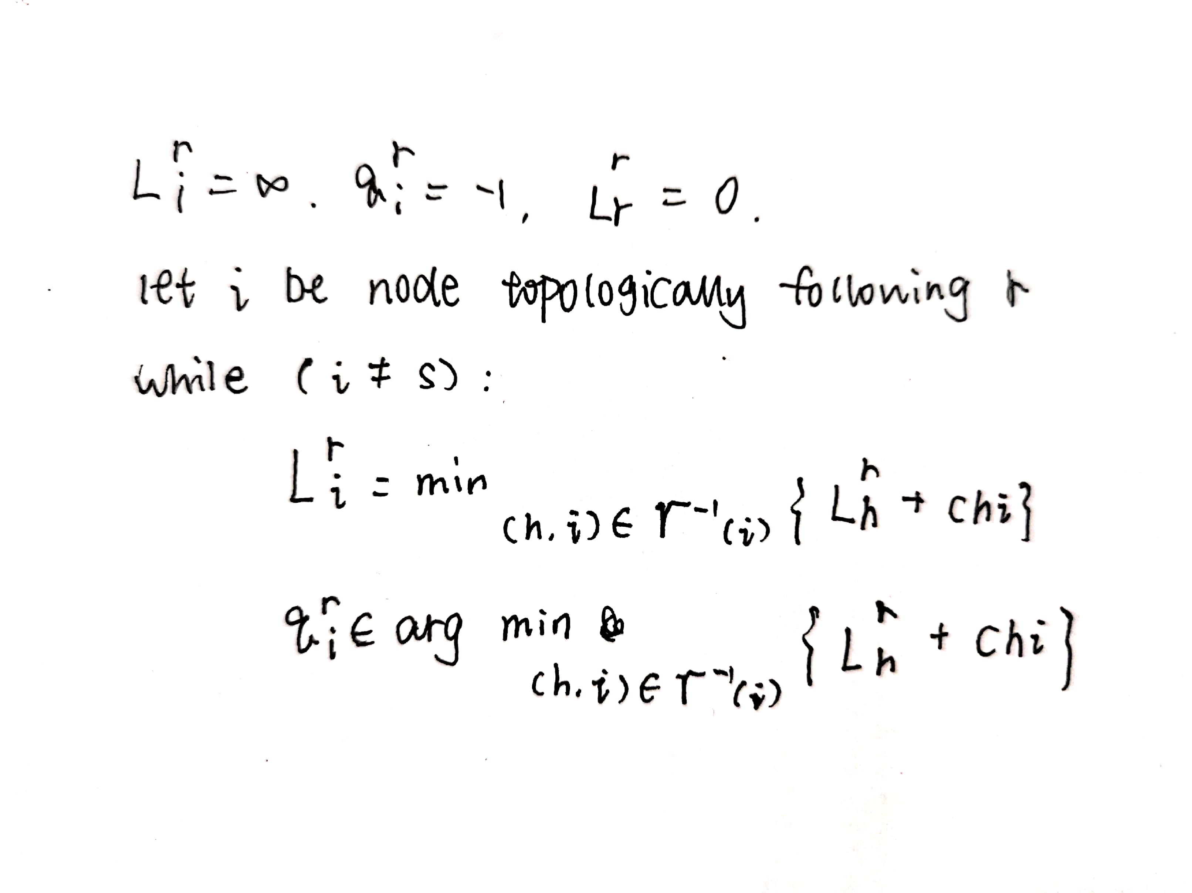
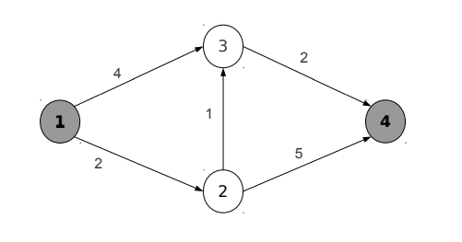
Shortest paths on acyclic network

Slide 5
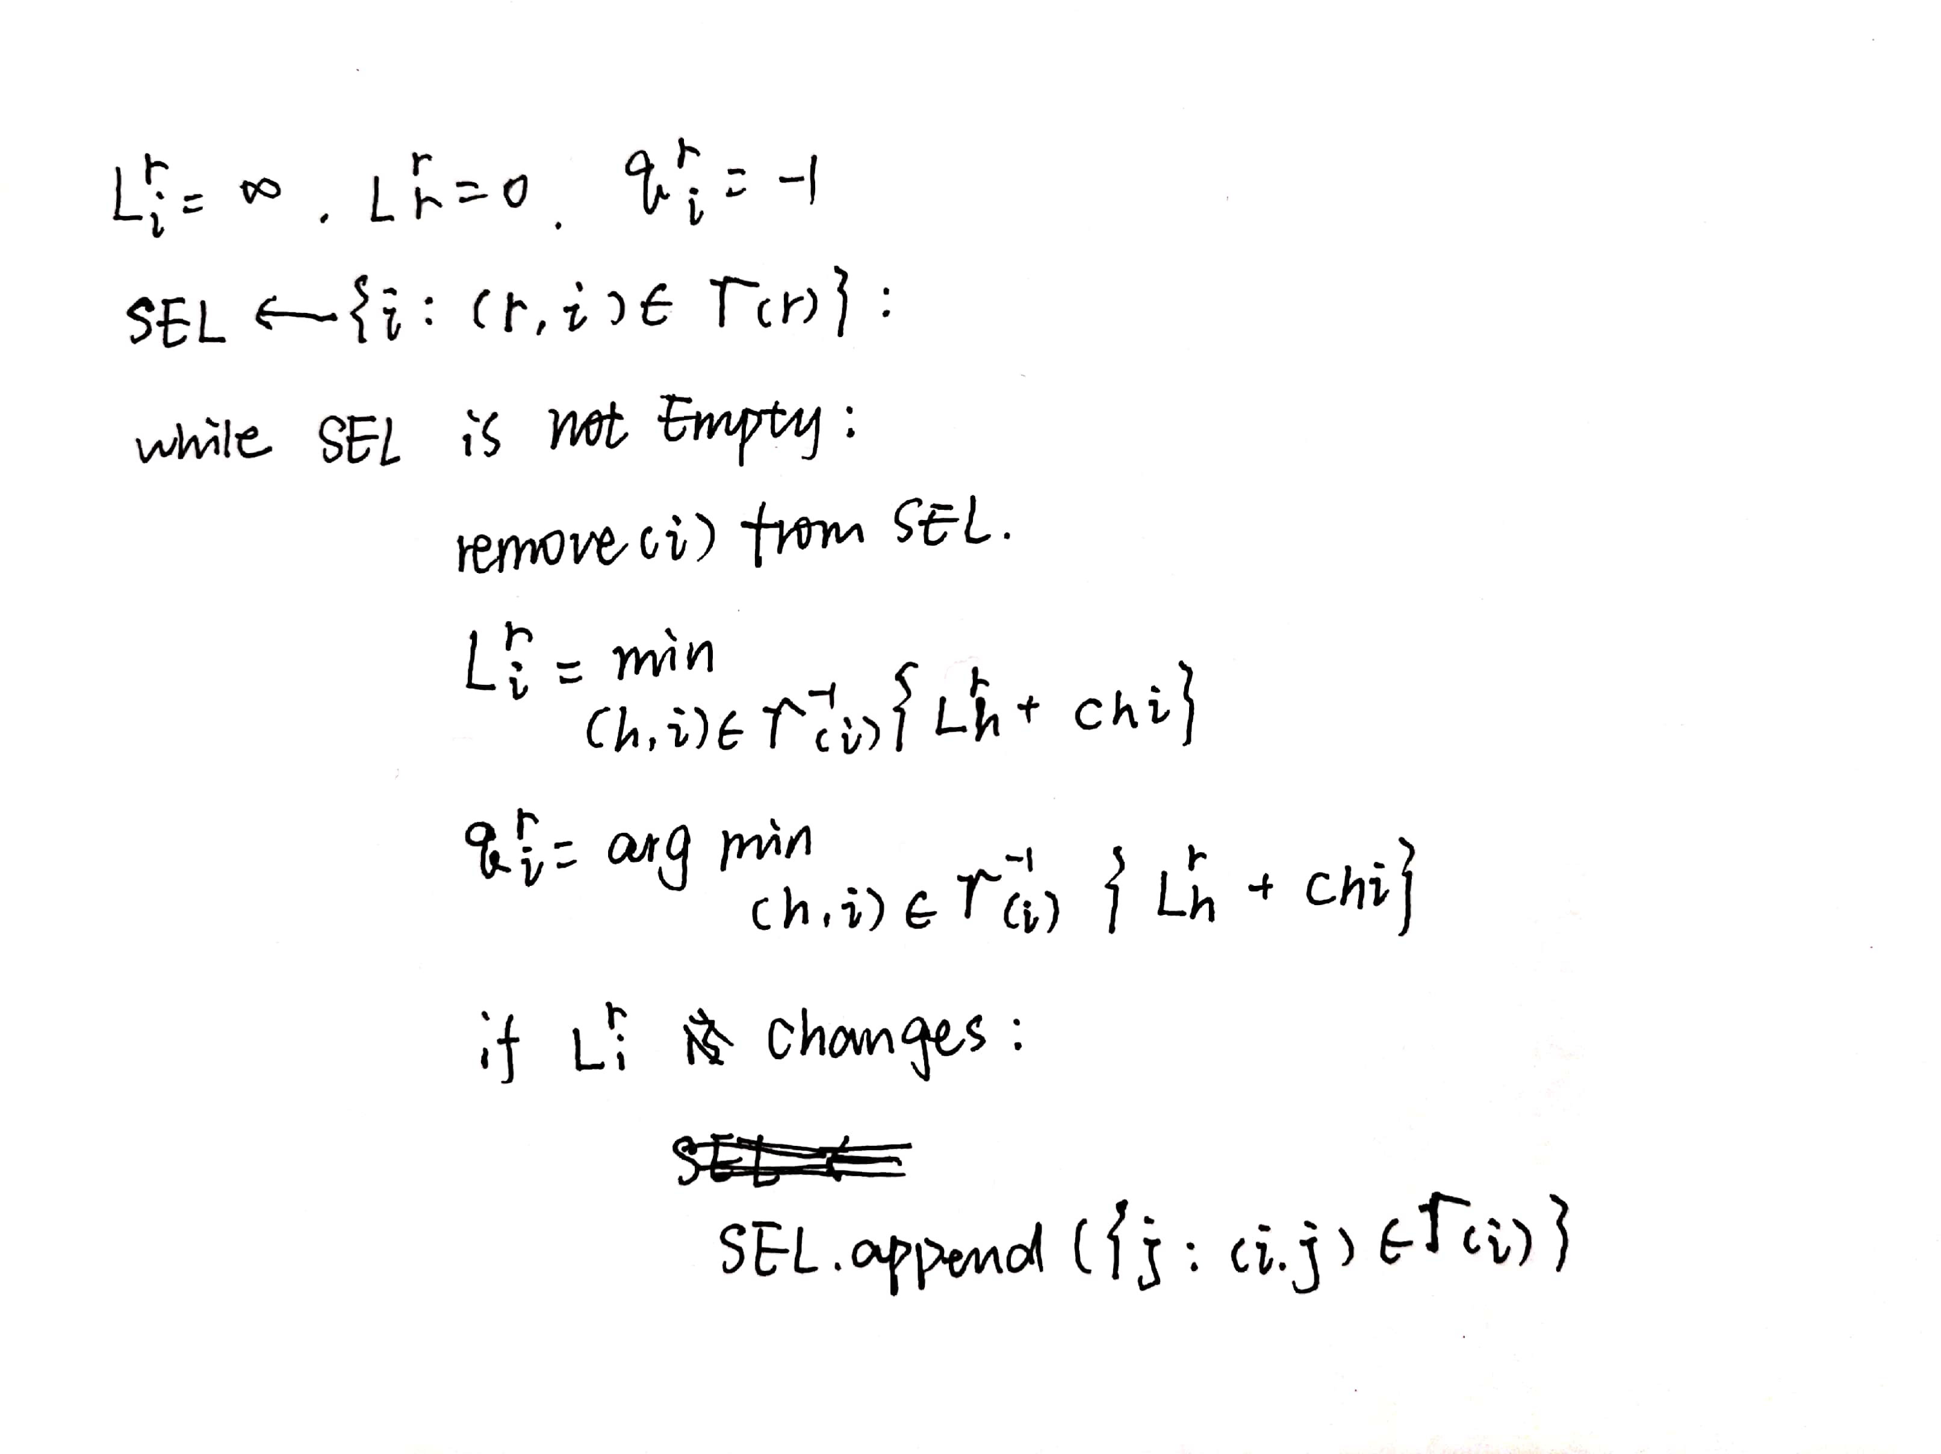
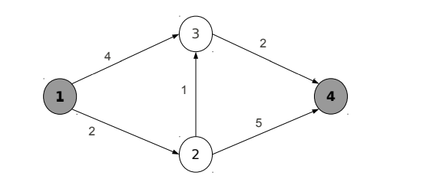
Shortest paths on cyclic networks: label correcting
Bellman-ford algorithm

Slide 6
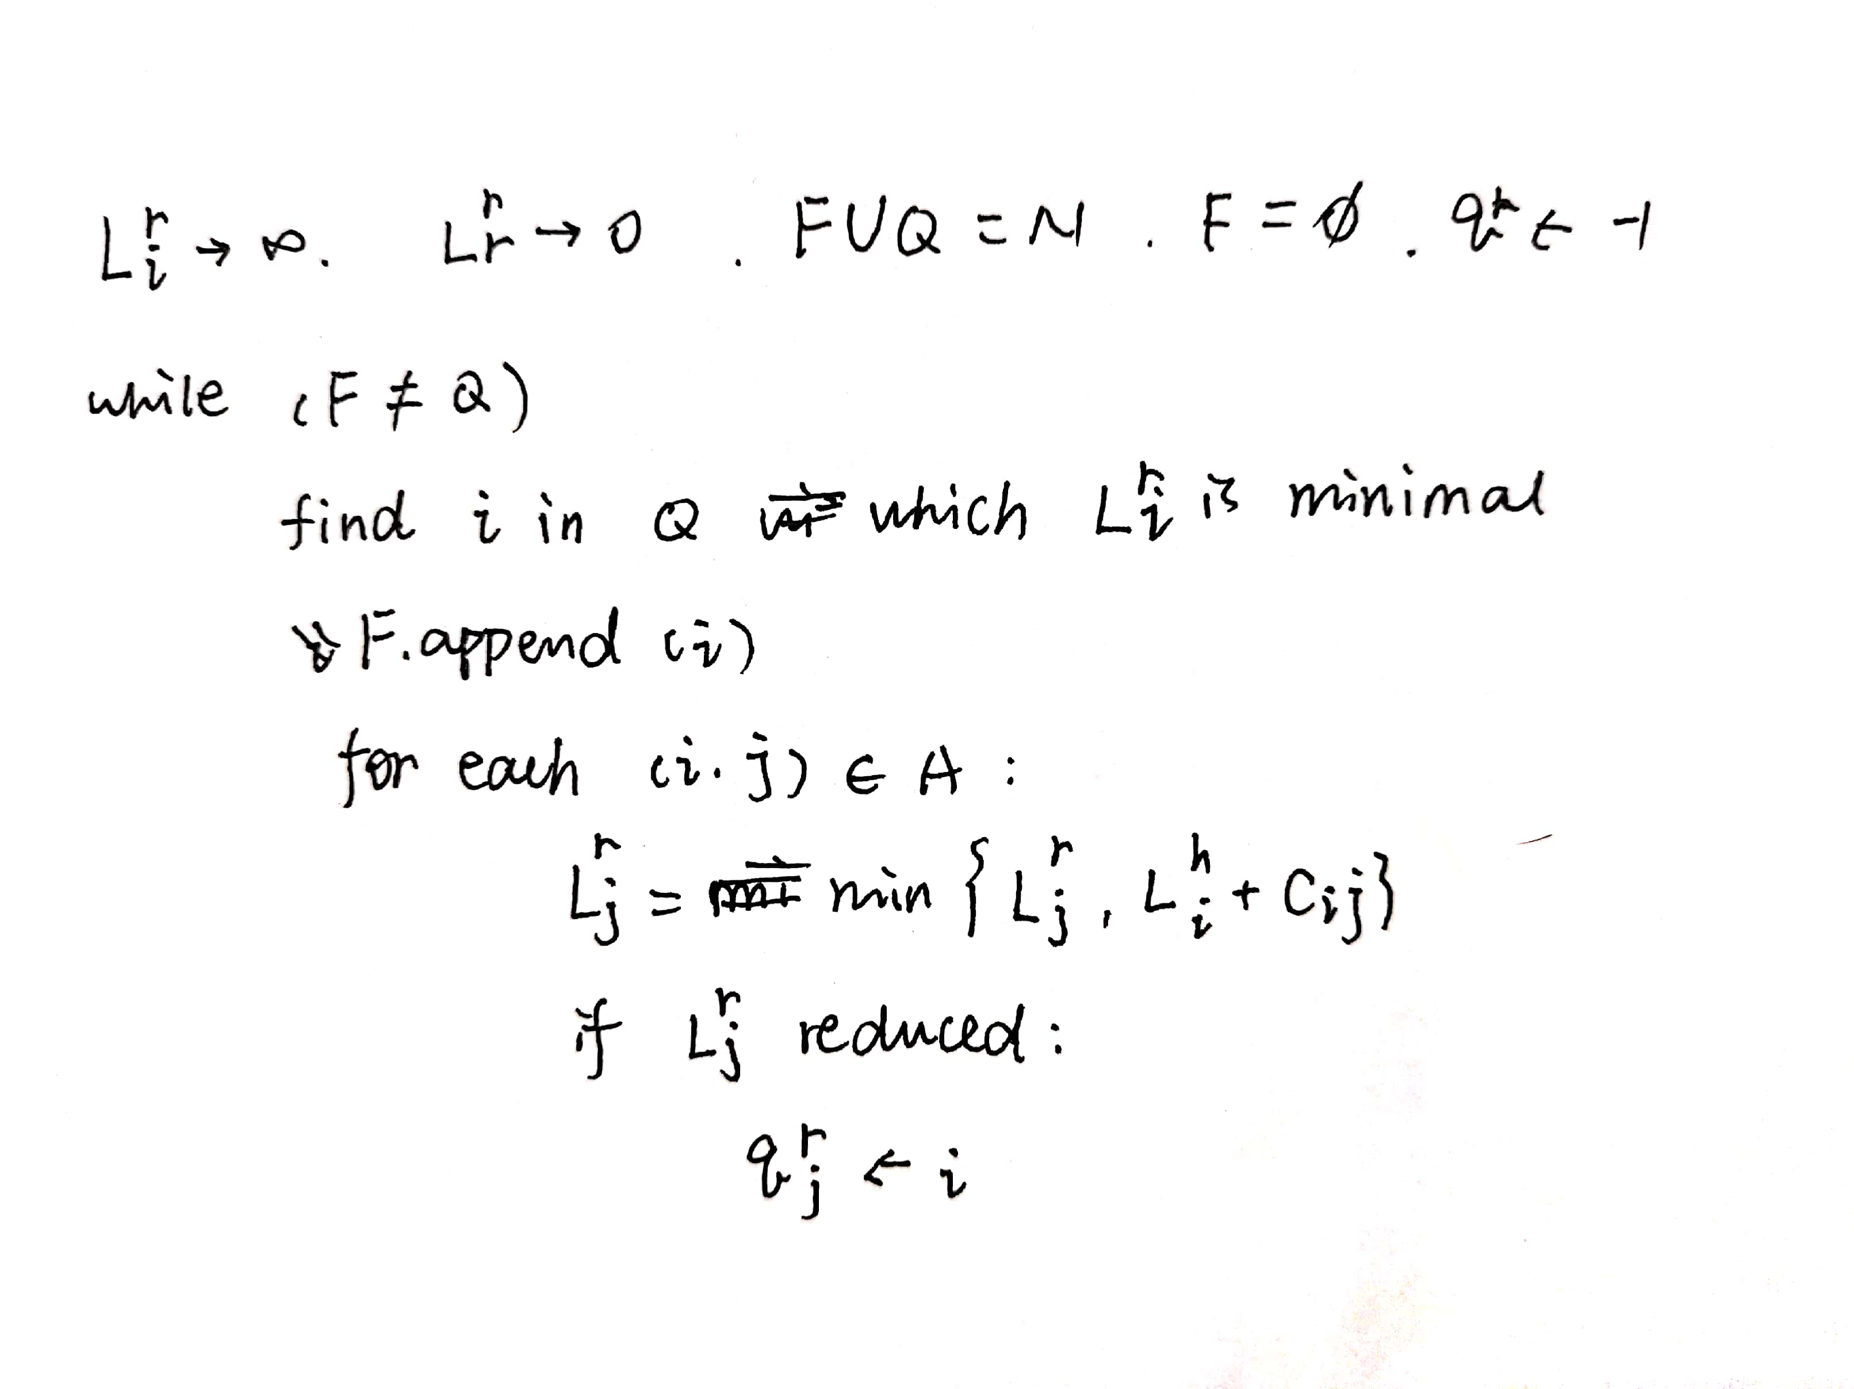
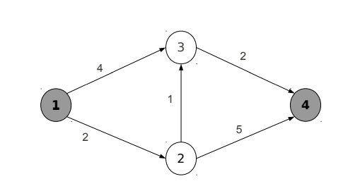
Shortest paths on general networks: label setting
Shortest paths from one origin to one destination
Dijkstra algorithm
A* algorithm,
In line 3 of figure above, g(i,s) + L(r,i) will be considered

