Slide 1
Traffic Flow Prediction in presence of Autonomous Vehicles with Consideration of Dynamic Traffic Assignment Model
Wenhui He 2021.10.12

Slide 2
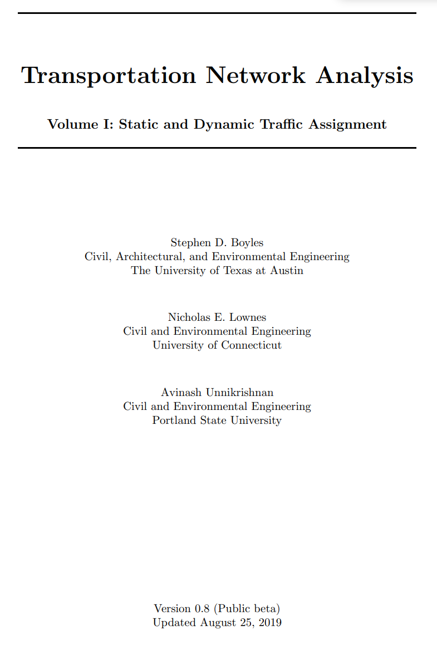
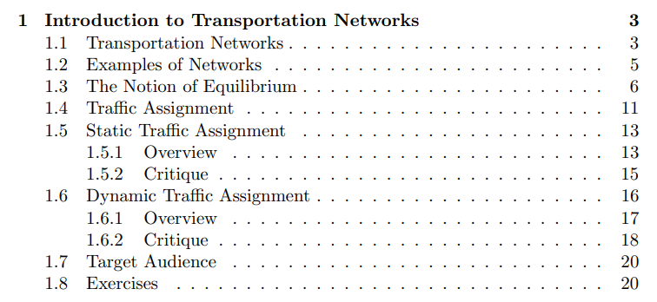

Slide 3
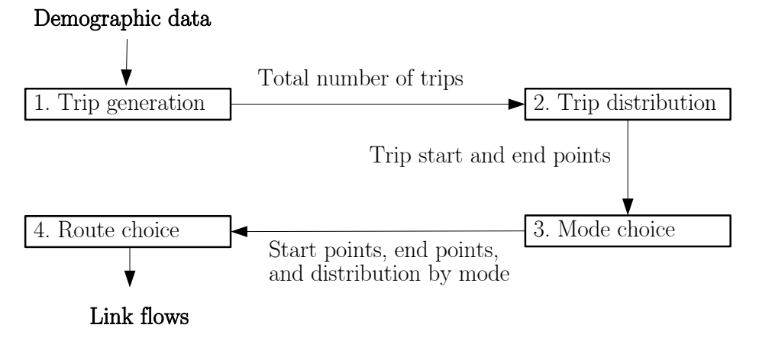
Planning model
Traffic assignment
Figure: schematic of the four-step process
Goal: predict how many drivers are going to use each roadway segment
Further: can estimate congestion, emissions, toll revenue etc..
The key idea: equilibrium
Traffic assignment

Slide 4
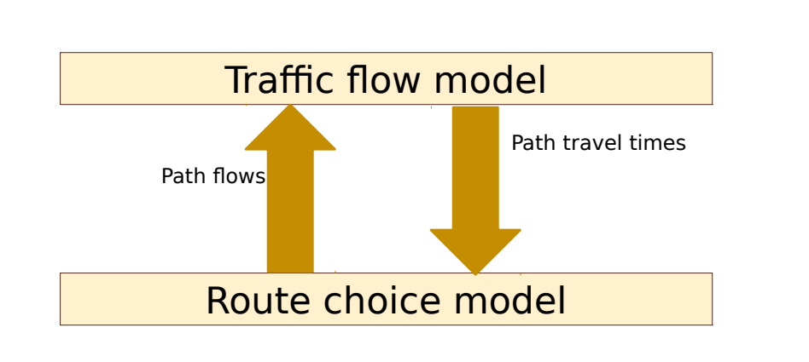
Good prediction: mutually consistent in the sense that all of the systems should ‘agree’ with the prediction (such a consistent solution is termed an equilibrium)
Properties: uniqueness, existence, efficiency
equilibrium

Slide 5
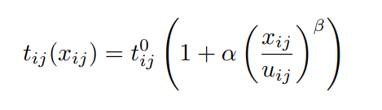
assumption: network conditions are at steady-state
traffic flow model: based to link performance functions:
User equilibrium: all used paths between the same origin and destination have equal and minimal travel times
advantage of using link performance functions: user equilibrium and system optimum states can be found with relative ease
Static Traffic Assignment Model

Slide 6
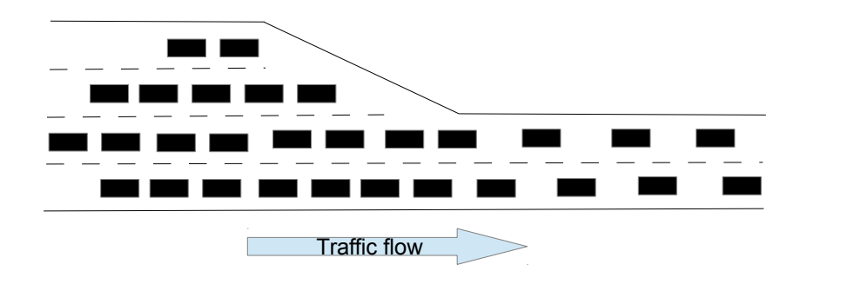
do not monitor how network conditions
an increase in flow on the link is assumed to increase the travel time of all vehicles
lower-capacity links have higher travel times under the same demand
When to use: when there is considerable uncertainty in the input data or when running a large number of scenarios is more important than detailed congestion information
Static Traffic Assignment Model

Slide 7
represent changes in congestion and demand patterns over the course of several hours or a day
More realistic in portraying congestion
are inherently mode-specific
track changes → the locations of vehicles → address some or all of the shortcomings of link performance functions
dynamic user equilibrium: All paths used by travelers departing the same origin, for the same destination, at the same time, have equal and minimal travel times.
When to use: when travel conditions are changing rapidly during analysis period, and input data are known with high certainty
Dynamic Traffic Assignment Model

Slide 8
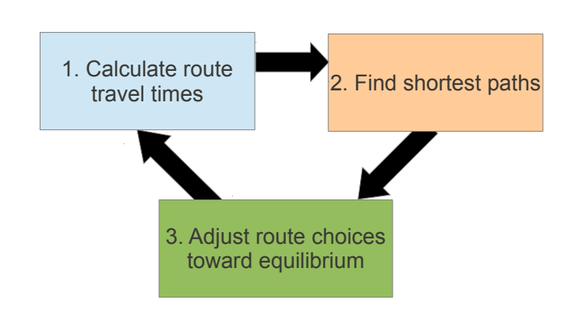
DTA is an iterative process:
route choices are updated at each iteration until an (approximate) dynamic user equilibrium solution has been found
Disadvantage:
- more computational time and memory
- more input data for calibration
- requiring more input data
- Proving convergence of iterative schemes is also more difficult
Dynamic Traffic Assignment Model

