Slide 1
Application Overview
React.js
ES6
Functional Programming
Immutable Data Structures
http://www.ahuka.com/?page_id=1116

Slide 2
Agenda
Live Application
Template
Dependencies
Dev Dependencies
Syling
Firebase
Testing
Questions

Slide 3
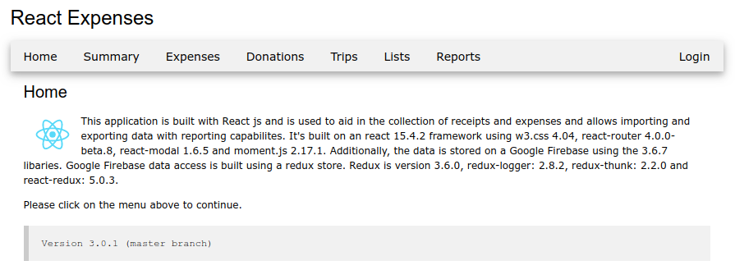
Live Application

Slide 4
Template
create-react-app
jest
surge.sh
folder structure

Slide 5
Dependencies
react-router
react-modal
firebase
immutability-helper
react-google-maps
react-toggle
redux
redux-logger
redux-thunk
react-redux
moment
react-moment

Slide 6
Dev Dependencies
eslint
jest
babel

Slide 7
Styling
w3.css
style attributes

Slide 8
Firebase
NoSQL
Real time
Database layout
Rules
Authentication

Slide 9
Testing
Jest
toMatchSnapshot
testing components

