Slide 1
Application Overview
A React.js application built using ES6, Redux and Firebase that provides a way to enter financial records by tax year.
Notes:
I been working on this in my spare time for over a year after building an almost identical application using Ember-cli
Build on an Ubuntu 16.04 LTS desktop image

Slide 2
Agenda
Live Application
Template
Dependencies
Dev Dependencies
Styling
Firebase
Testing
Left Undone
Questions
Notes:
First let me show you how it work before we go into the details:

Slide 3
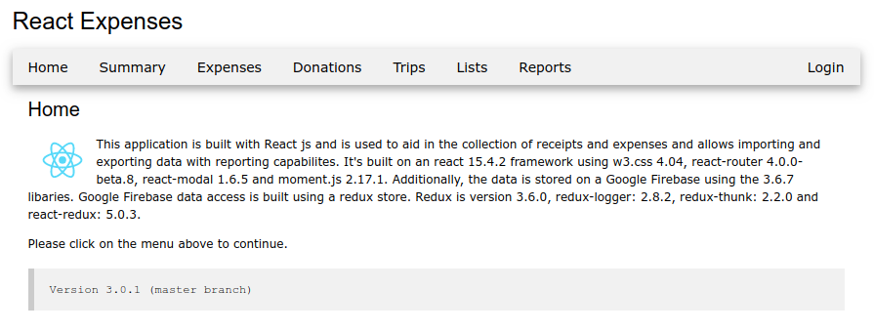
Live Application
Notes:
http://expenses-cli.surge.sh/
http://react-expenses.sh/

Slide 4
Template
create-react-app
jest
surge.sh
folder structure
Notes:
I used a create-react-app application framework so I wouldn’t have to learn the intricacies of webpack, etc.
I publish the website to surge.sh
Provides a testing (jest) framework
Folder structure

Slide 5
Dependencies
react-router
react-modal
firebase
immutability-helper
react-google-maps
react-toggle
redux
redux-logger
redux-thunk
react-redux
moment
react-moment
Notes:
router
uses version 4 of react-router
has authenticated and unauthenticated routes
redirects if unauthenticated
show application.js menu layout
redux
uses react-redux, redux-thunk and redux-logger
show actions and reducers
explain immutable
explain asynchronous nature of Firebase
show HOC’s
show how we initialize data and how we update data changes
explain isLoaded flag
show console logs
modal
uses react-modal
show modal popup
collect some data
show common pattern for onChange
show common pattern for validation
toaster
uses react-toaster, notifications?
where is lives in the application
show updates on screen
show how it integrates with redux
show console logs
maps
explain both location and distance
show components (trips, places and place)
immutable-helper – deep array
high level google reference
google map API in index.html and unique key
show new place and new trip

Slide 6
Dev Dependencies
eslint
jest
babel
Notes:
Babel and jest is probably part of the create-react-app framework. Added eslint linter.

Slide 7
Styling
w3.css
Inline style attributes
Notes:
Used w3.css which is smaller and faster than bootstrap but doesn’t has any jQuery or JavaScript libraries
Used inline style attributes throughout.
Struggled to understand CSS in a component context.
Passed className sometimes where it made sense but the jury is still out

Slide 8
Firebase
NoSQL
Real time
Database layout
Rules
Authentication
Notes:
Firebase is delightful to use and program against.
Real-time – give demonstration
Constructed redux to use asynchronous calls through redux-thunk
Firebase uses simple email authentication but also provides federated providers such as Facebook, GIT, etc.

Slide 9
Testing
Jest
toMatchSnapshot
testing components

Slide 10
Left Undone
Functional programming
Immutable data structures
Decomposition

Slide 11
Questions

