Slide 1
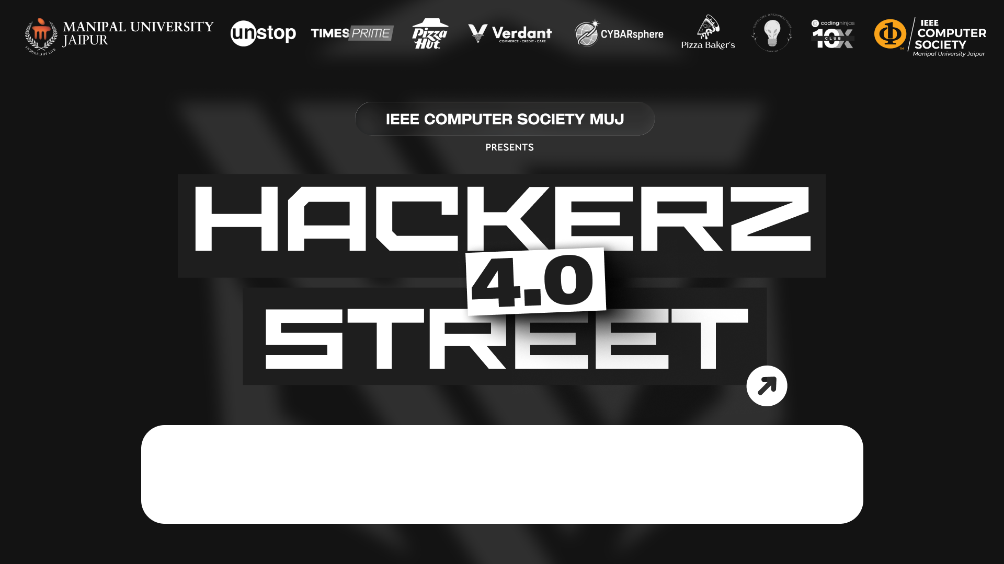
Sudo Bring Me Pipeline Punch
FINTECH - PROBLEM #1: Smart Expense Tracking System

Slide 2

PROPOSED SOLUTION
SoberSpend is an AI-powered personal finance app that intercepts your UPI payments in real-time, analyzes your spending patterns, and roasts you into making smarter financial decisions — *before you pay, not after.*

Slide 3
TECHNICAL APPROACH
Frontend: React Native (Expo) · TypeScript
State Management: Zustand
Backend: Nuxt.js (API server)
Database & Auth: Supabase (PostgreSQL)
AI: Qwen 3 — receipt parsing & AI budget advisor
Device Features: Expo Camera (QR scanning) · UPI Deep-link integration

Slide 4
METHODOLOGY
User Flow:
1. User scans a QR code or receipt.
2. AI extracts merchant, amount & category.
3. Decision Engine calculates a Risk Level: BROKE → DANGER → WASTED → WARNING → SUS → SAFE → CHILL
4. Risk banner shown with roast message.
5. User confirms or cancels the payment.
6. Transaction saved to Supabase.
7. Insights page updates: Spending Trends · Pattern Detection · Savings Goals.

Slide 5
METHODOLOGY
Flowchart:
Scan QR / Receipt
↓
AI Parses Data (Qwen 3.5)
↓
Decision Engine → Risk Score
↓
Risk Banner + Roast Message
↓
User Pays via UPI Deep-link
↓
Data saved to Supabase
↓
Insights Page Updates

Slide 6
FEASIBILITY AND VIABILITY
Feasibility:
Fully functional working prototype on a production-grade stack-
Supabase handles real authentication + database
Qwen 3.5 is live and integrated for receipt analysis
UPI deep-linking works on Android
Potential Challenges:
UPI ecosystem fragmentation across different apps
AI misclassifying handwritten or unclear receipts
Getting users to trust the app before payment is made
Strategies to Overcome:
Multi-app UPI deep-link support for major apps (GPay, PhonePe, Paytm)
Manual entry fallback when AI scanning fails-
Gamified "roast" system builds habit loop and trust over time

Slide 7
CONCLUSION
GitHub (App): github.com/NormVg/SoberSpend.app
Stack: Expo · Nuxt.js · Supabase · Ollama(Qwen3.5)
*Category:* FinTech /AI
Key Differentiator:* Intervenes at the point of payment — not just tracking after the damage is done

