Slide 1
AI+BD ML Lab. Day 3
March 24th, 2021
MLP & Regularization (Batch Norm. / Dropout)
YoungIn Kim <youngkim21@postech.edu>

Slide 2
Today’s Goals
MLP (Multi Layer Perceptron)
Make model with nn.Module Class
Make more deep!
Regularization
Look inside of network
Batch Normalization
Dropout

Slide 3
Make model with nn.Module class
Before we start,
let’s remind yesterday’s code
Base .ipynb :
https://git.io/aibd-mlp-3

Slide 4
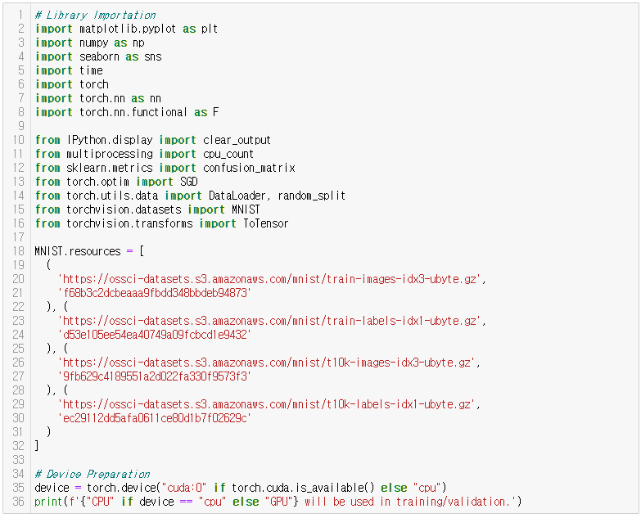
Make model with nn.Module class
Library Importation
& Device Preparation

Slide 5
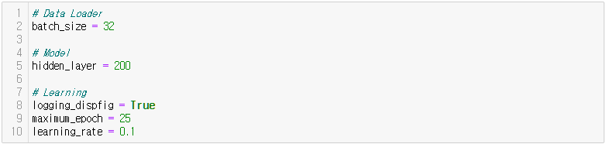
Make model with nn.Module class
2. Hyper-Parameters

Slide 6
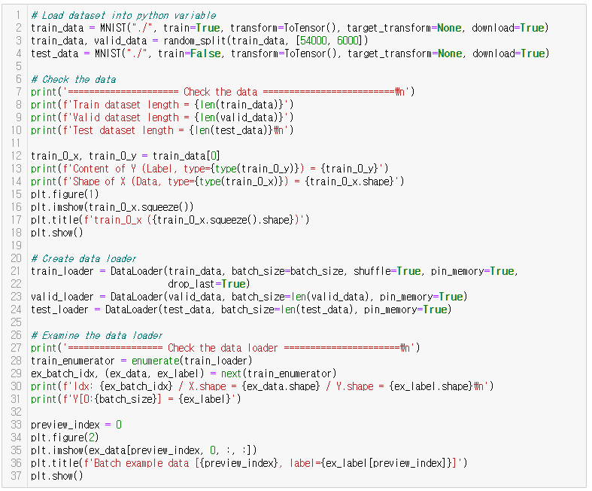
Make model with nn.Module class
3. Data Load
& Preprocessing

Slide 7
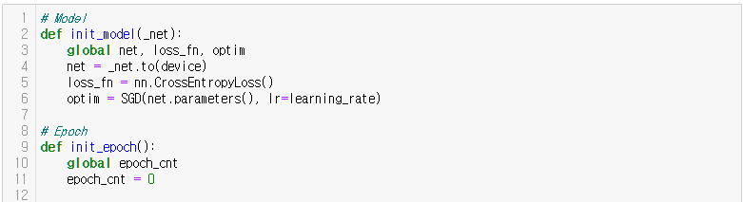
Make model with nn.Module class
4. Function Definitions

Slide 8
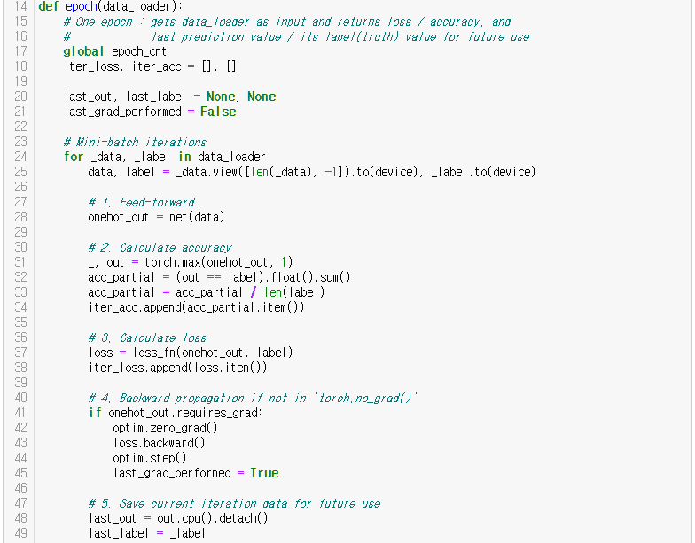

Make model with nn.Module class
4. Function Definitions
(continue)
IMPORTANT!

Slide 9
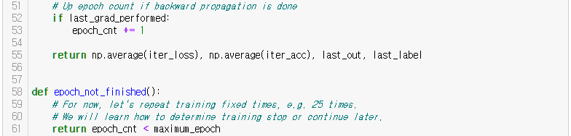
Make model with nn.Module class
4. Function Definitions
(continue)

Slide 10
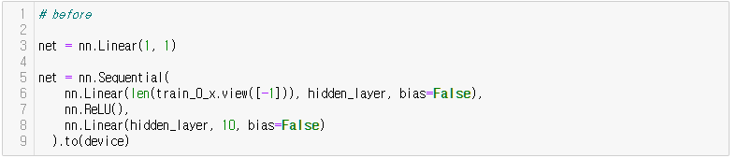
Make model with nn.Module class
5. Model Architectures
(before)

Slide 11
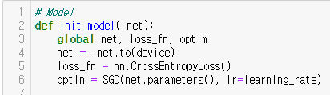
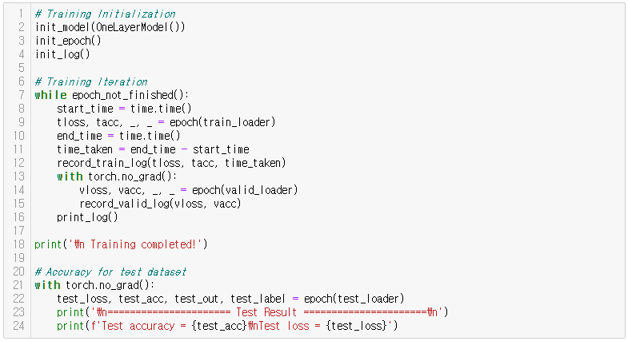
Make model with nn.Module class
6. Training Iteration
& Test Result

Slide 12
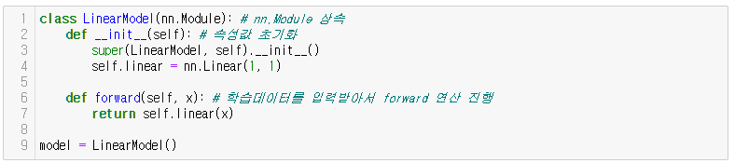
Make model with nn.Module class
5. Model Architectures
(Back again)

Slide 13
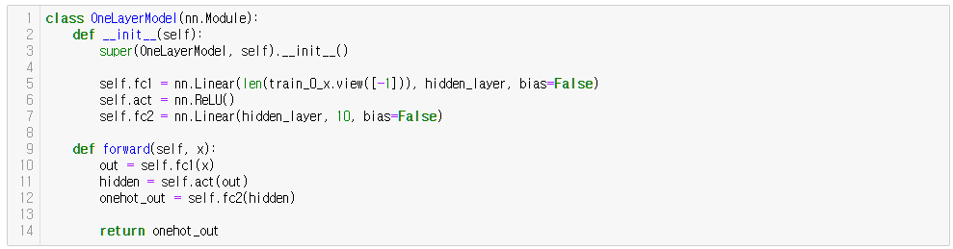
Make model with nn.Module class
5. Model Architectures
(Back again)

Slide 14
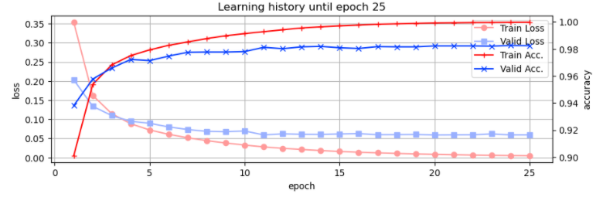

Make model with nn.Module class
6. Training Iteration
& Test Result

Slide 15
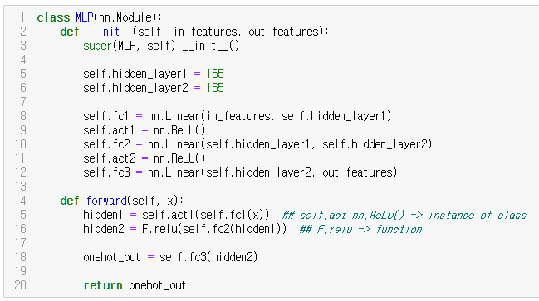


Make more Deep!
6-1. Training Iteration
& Test Result
(MLP)

Slide 16
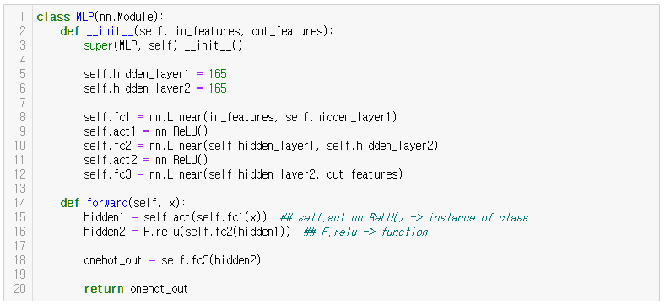
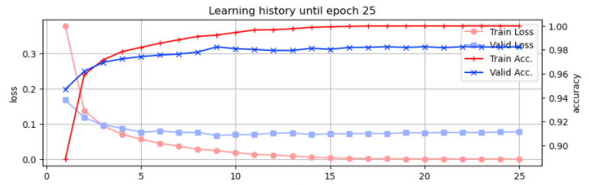

Make more Deep!
6-1. Training Iteration
& Test Result
(MLP)

Slide 17
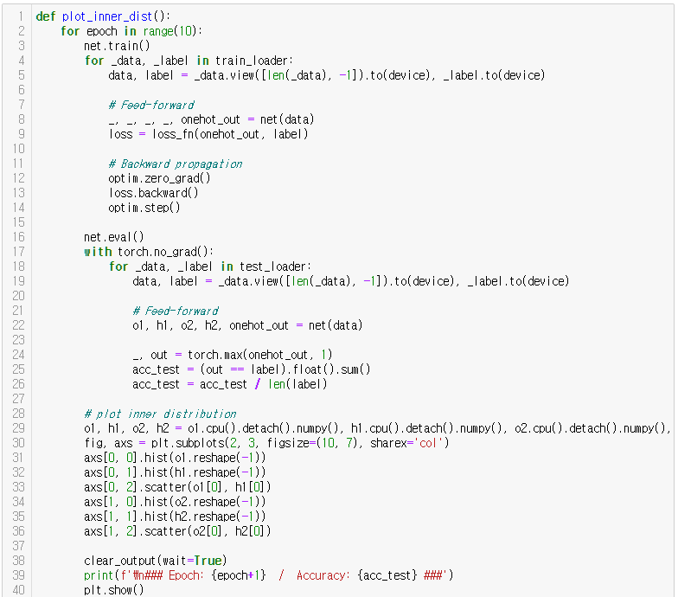
Batch Normalization – Look inside of network

Slide 18
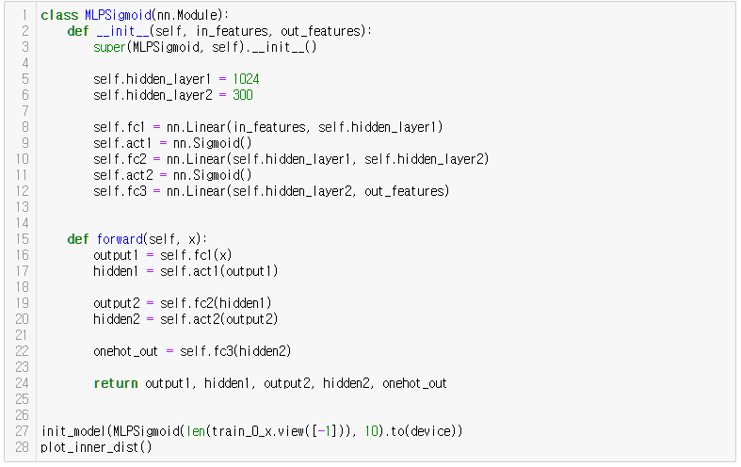
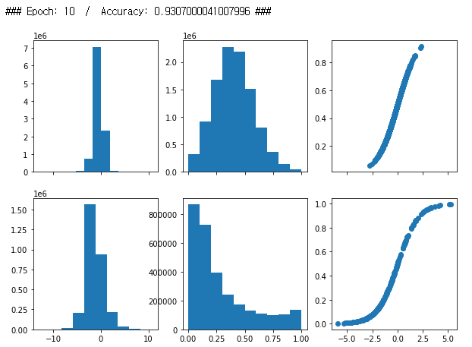
Batch Normalization – Look inside of network

Slide 19
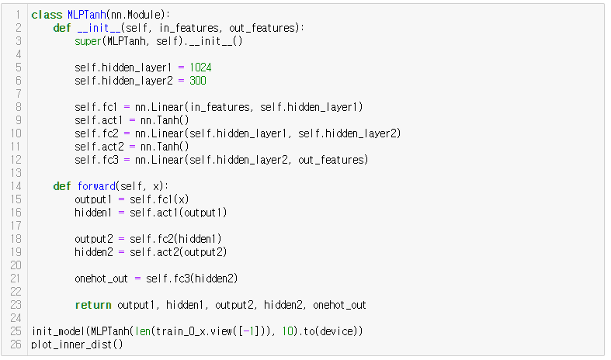
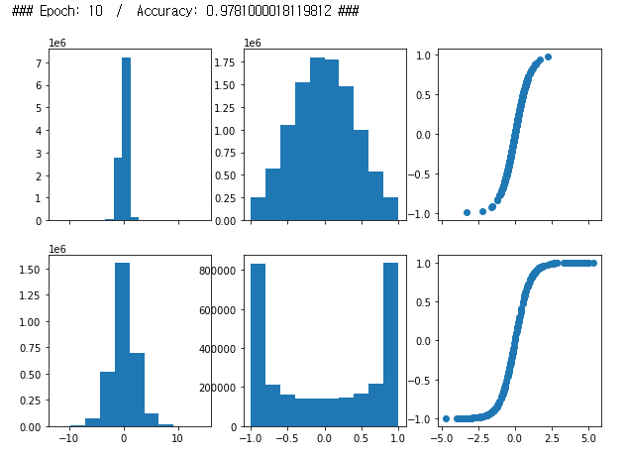
Batch Normalization – Look inside of network

Slide 20
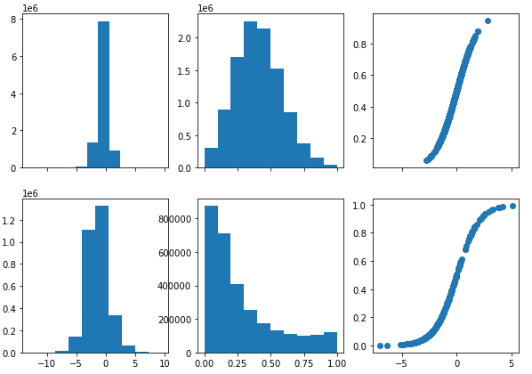
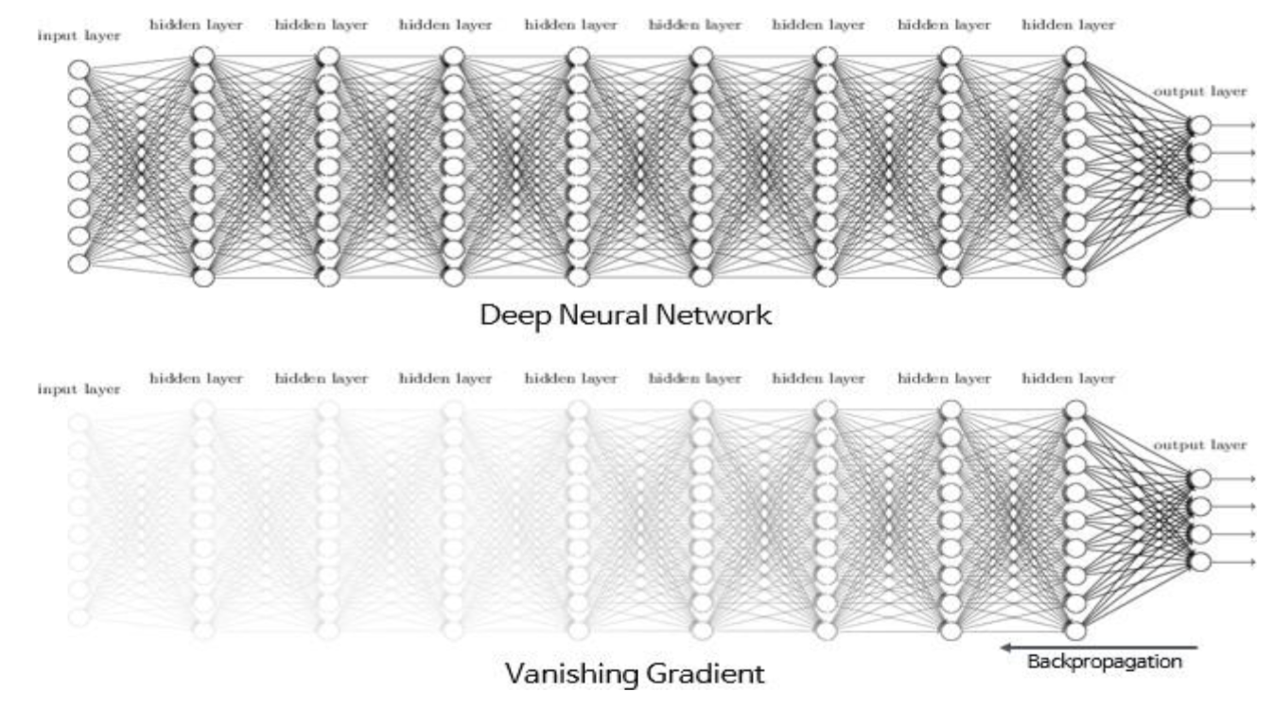
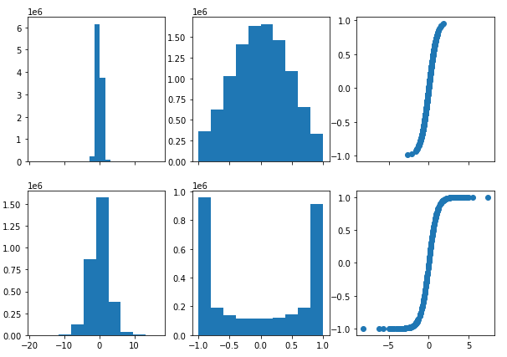
Batch Normalization – Look inside of network
Internal Covariate Shift
Sigmoid
tanh

Slide 21
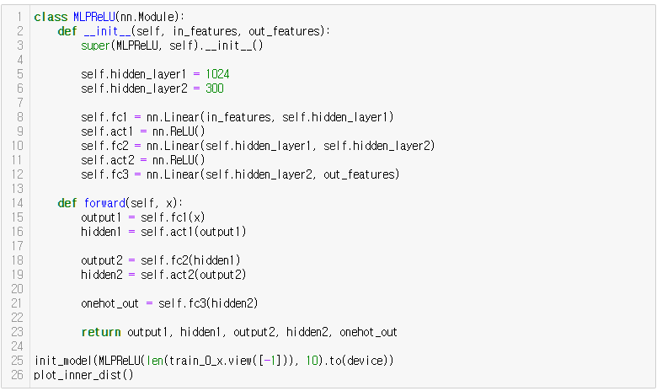
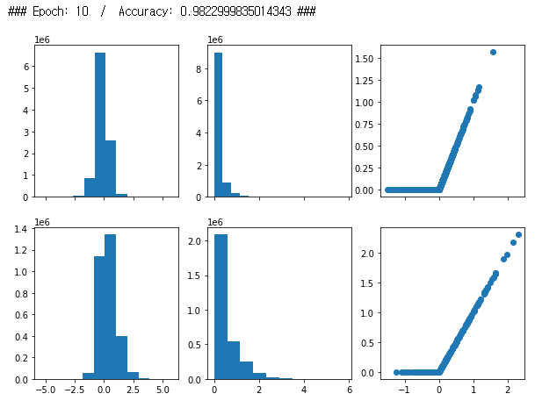
Batch Normalization – Look inside of network

Slide 22
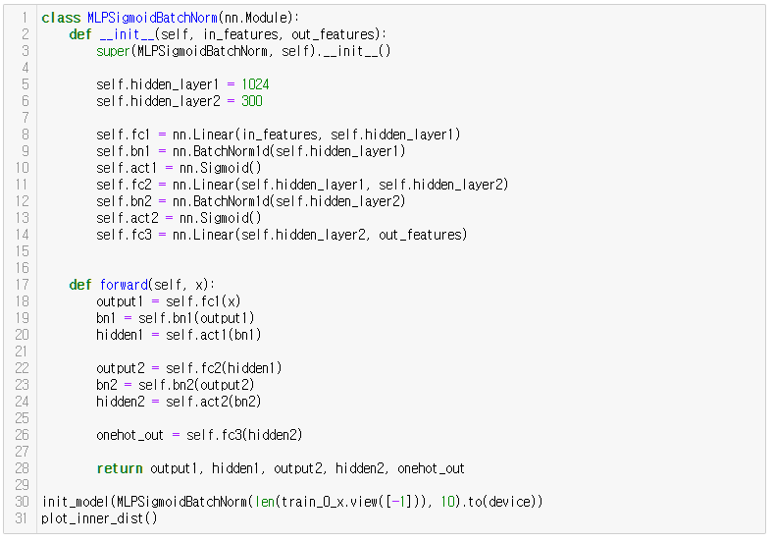
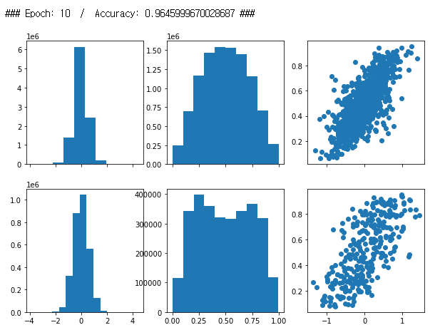
Batch Normalization

Slide 23
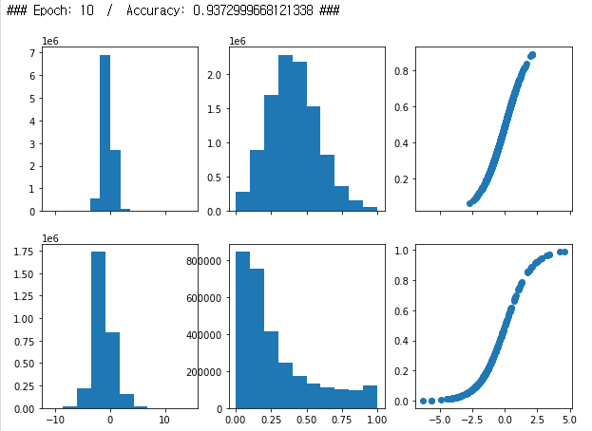
Batch Normalization

Slide 24
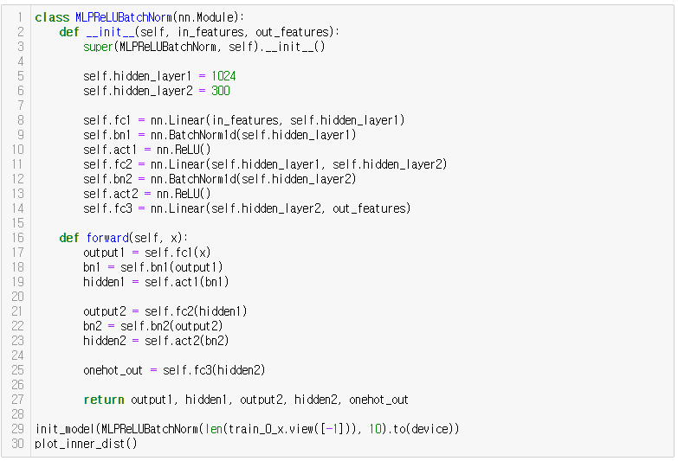
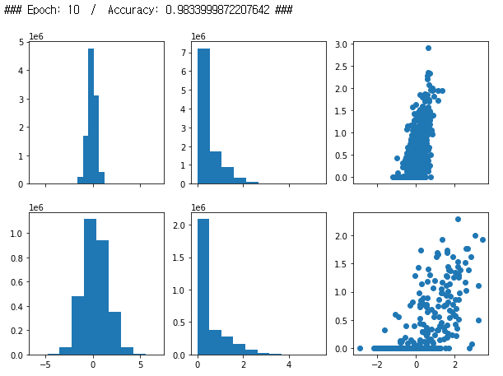
Batch Normalization

Slide 25
Batch Normalization

Slide 26
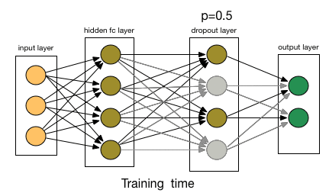
Dropout

Slide 27
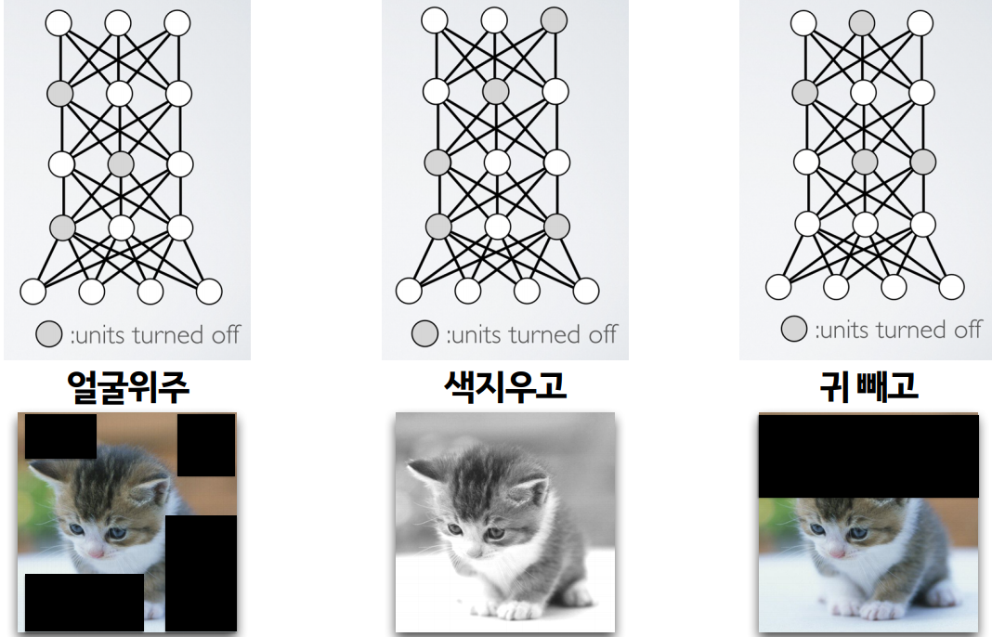
Dropout

Slide 28
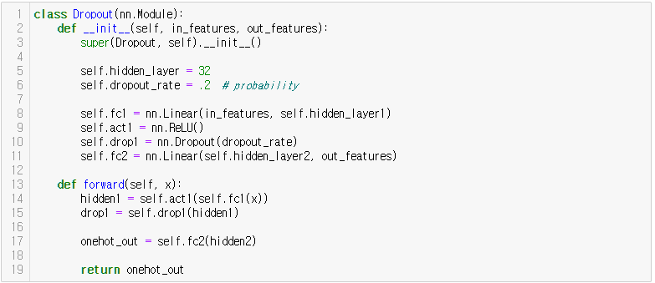
Dropout

Slide 29
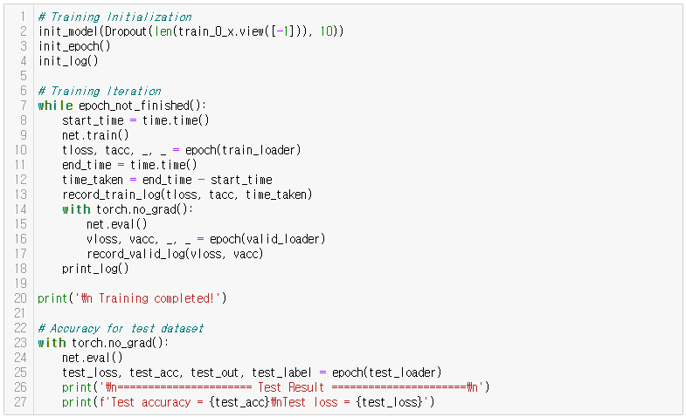
Dropout

Slide 30
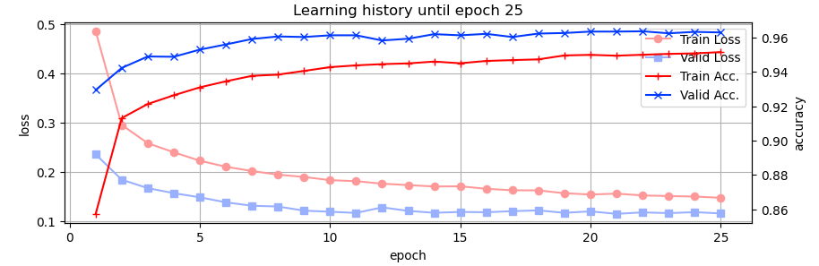

Dropout
Anything Strange?

Slide 31
Batch Normalization + Dropout
Make your own Model !

Slide 32
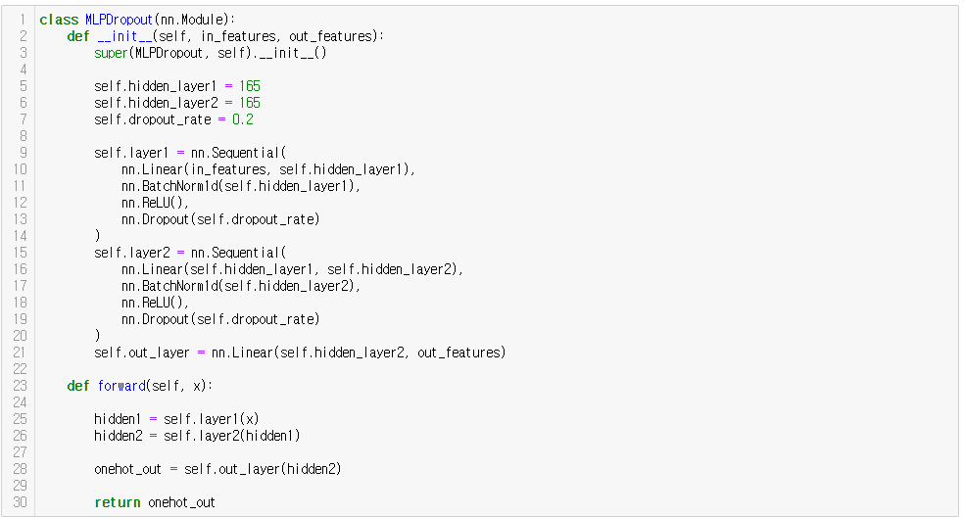
Batch Normalization + Dropout
Make your own Model !

Slide 33
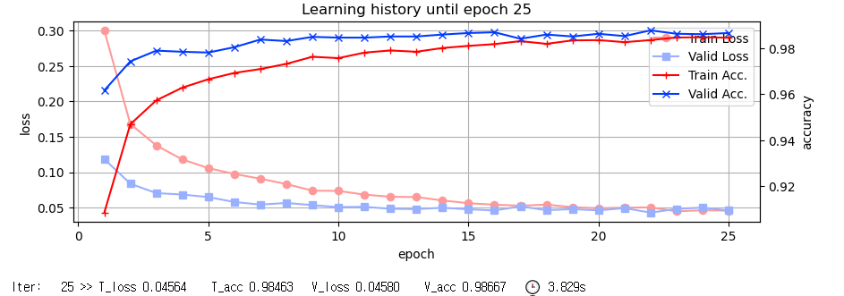
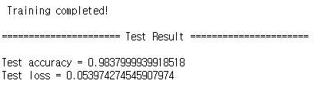
Batch Normalization + Dropout
Base .ipynb :
https://git.io/aibd-mlp-3
Better?

Slide 34
Batch Normalization + Dropout
Full code :
https://git.io/aibd-mlp-3-full

