Slide 1
AI+BD ML Lab. Day 1
June 9, 2021
PyTorch Tutorial & Linear Regression
Youngin Kim <youngkim21@postech.edu>

Slide 2
Week Outline
Installation
Anaconda, Jupyter notebook
Python package
PyTorch Tutorial
Linear Regression in 3 ways
Numpy
Sklearn
PyTorch

Slide 3
Week Outline
DAY 1 | PyTorch Tutorial & Linear Regression Installation How to handle Tensor Linear Regression in 3 ways
DAY 2 | Basic Flow of Deep Learning & Logistic Regression
DAY 3 | Method to make Deep Model & Regularization
DAY 4 | Convolution Neural Network (CNN)
DAY 5 | PyTorch Practical Tips & TEST

Slide 4
Week Outline
DAY 1 | PyTorch Tutorial & Linear Regression
DAY 2 | Basic Flow of Deep Learning & Logistic Regression Understanding basic flow of deep learning & code Logistic regression model with mini-batch SGD weight initialization Hyper-parameters tuning to get fast convergence speed
DAY 3 | Method to make Deep Model & Regularization
DAY 4 | Convolution Neural Network (CNN)
DAY 5 | PyTorch Practical Tips & TEST

Slide 5
Week Outline
DAY 1 | PyTorch Tutorial & Linear Regression
DAY 2 | Basic Flow of Deep Learning & Logistic Regression
DAY 3 | Method to make Deep Model & Regularization Make Multi Layer Perceptron(MLP) with Python Class Regularization 1 – Batch Normalization Regularization 2 – Drop out
DAY 4 | Convolution Neural Network (CNN)
DAY 5 | PyTorch Practical Tips & TEST

Slide 6
Week Outline
DAY 1 | PyTorch Tutorial & Linear Regression
DAY 2 | Basic Flow of Deep Learning & Logistic Regression
DAY 3 | Method to make Deep Model & Regularization
DAY 4 | Convolution Neural Network (CNN) Image Classification with CNN Exercise. Align Data to Model
DAY 5 | PyTorch Practical Tips & TEST

Slide 7
Week Outline
DAY 1 | PyTorch Tutorial & Linear Regression
DAY 2 | Basic Flow of Deep Learning & Logistic Regression
DAY 3 | Method to make Deep Model & Regularization
DAY 4 | Convolution Neural Network (CNN)
DAY 5 | PyTorch Practical Tips & TEST Transfer Learning? Early stopping? Cross Validation? Test………? Class Participation?

Slide 8



Installation
Open Source
for scientific computing
of Python & R
Web application
with Interactive computing
Deep Learning
Framework
with GPU

Slide 9
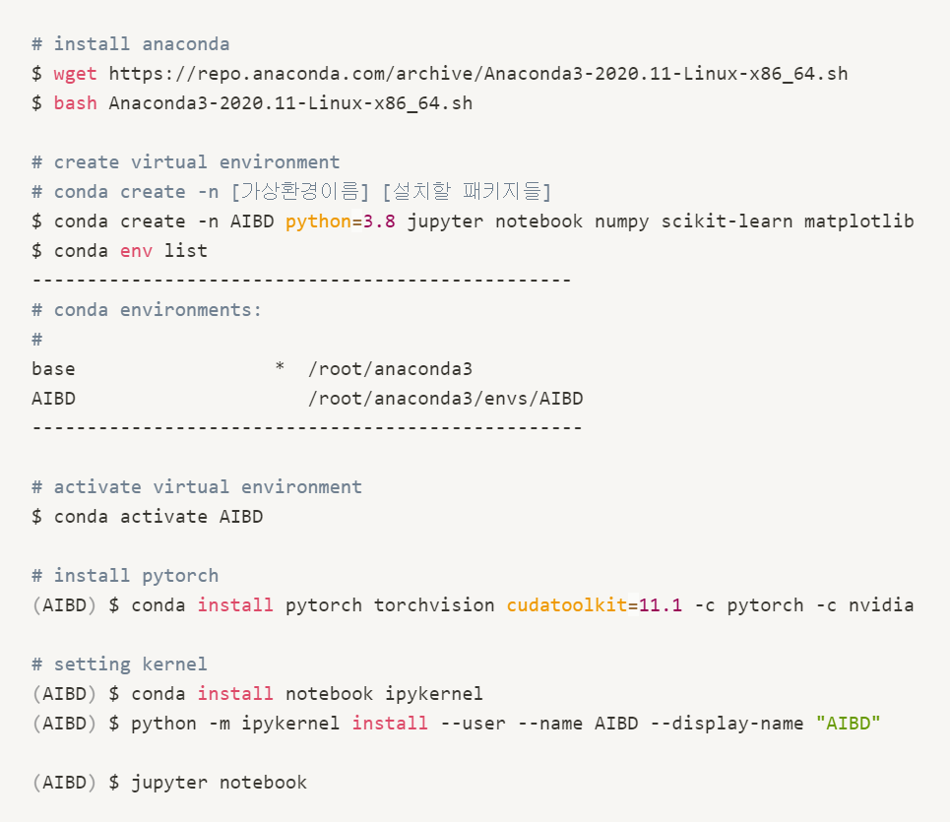
Installation
Installation Code :
https://git.io/aibd-install-ubuntu

Slide 10
PyTorch Tutorial
Tutorial Code :
https://git.io/aibd-pytorch-tutorial

Slide 11
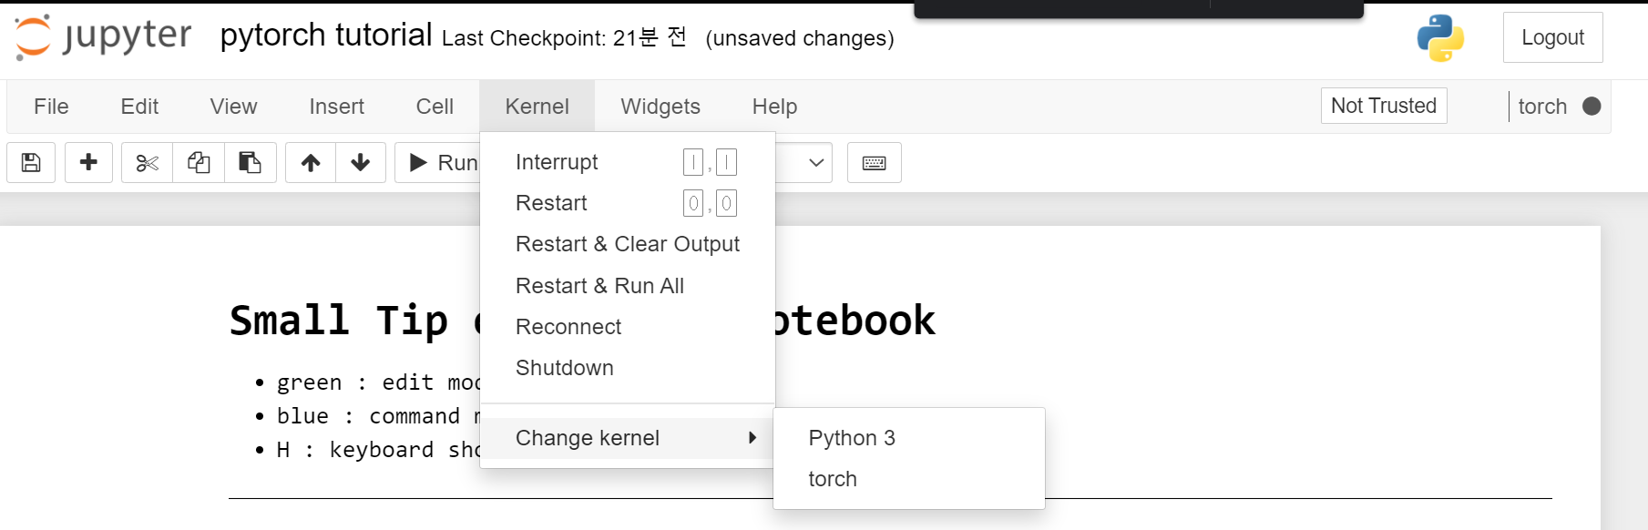
PyTorch Tutorial

Slide 12
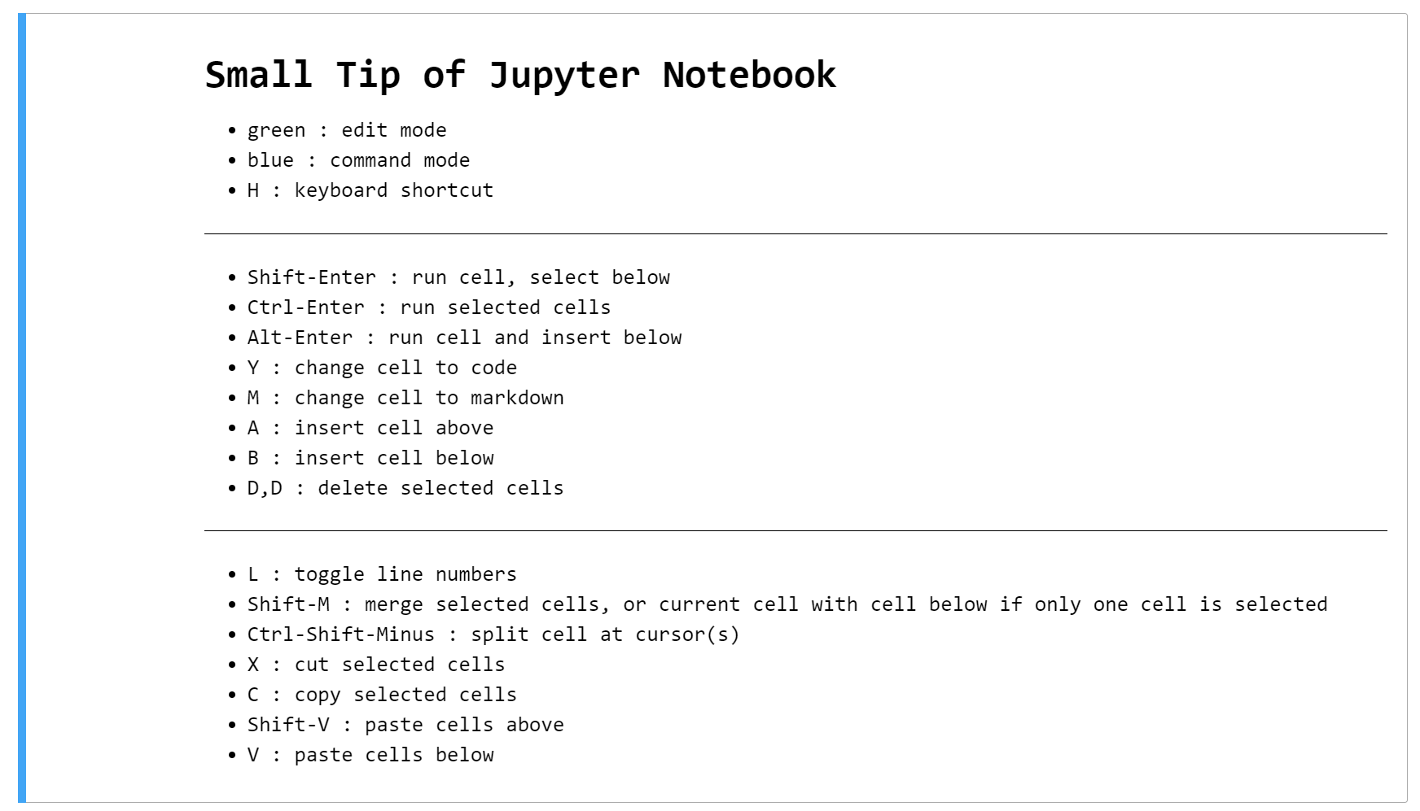
PyTorch Tutorial

Slide 13
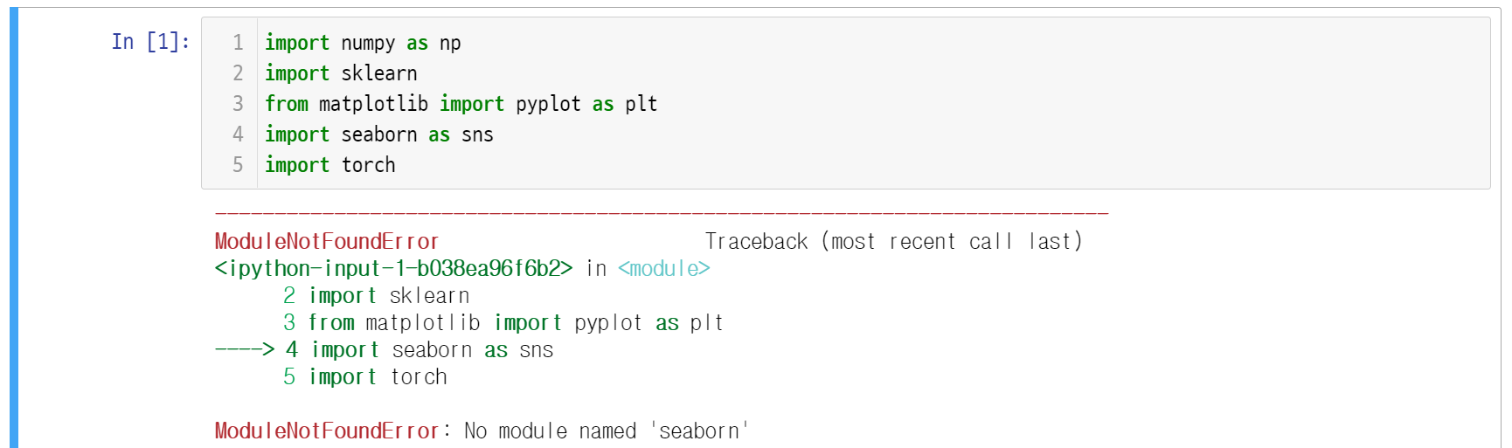
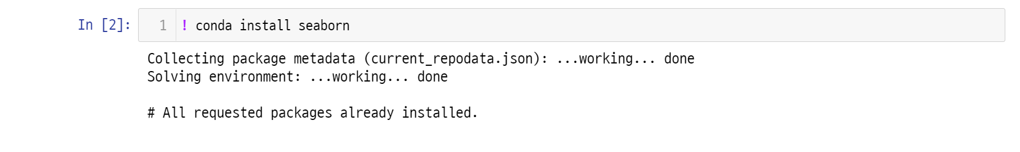
PyTorch Tutorial

Slide 14
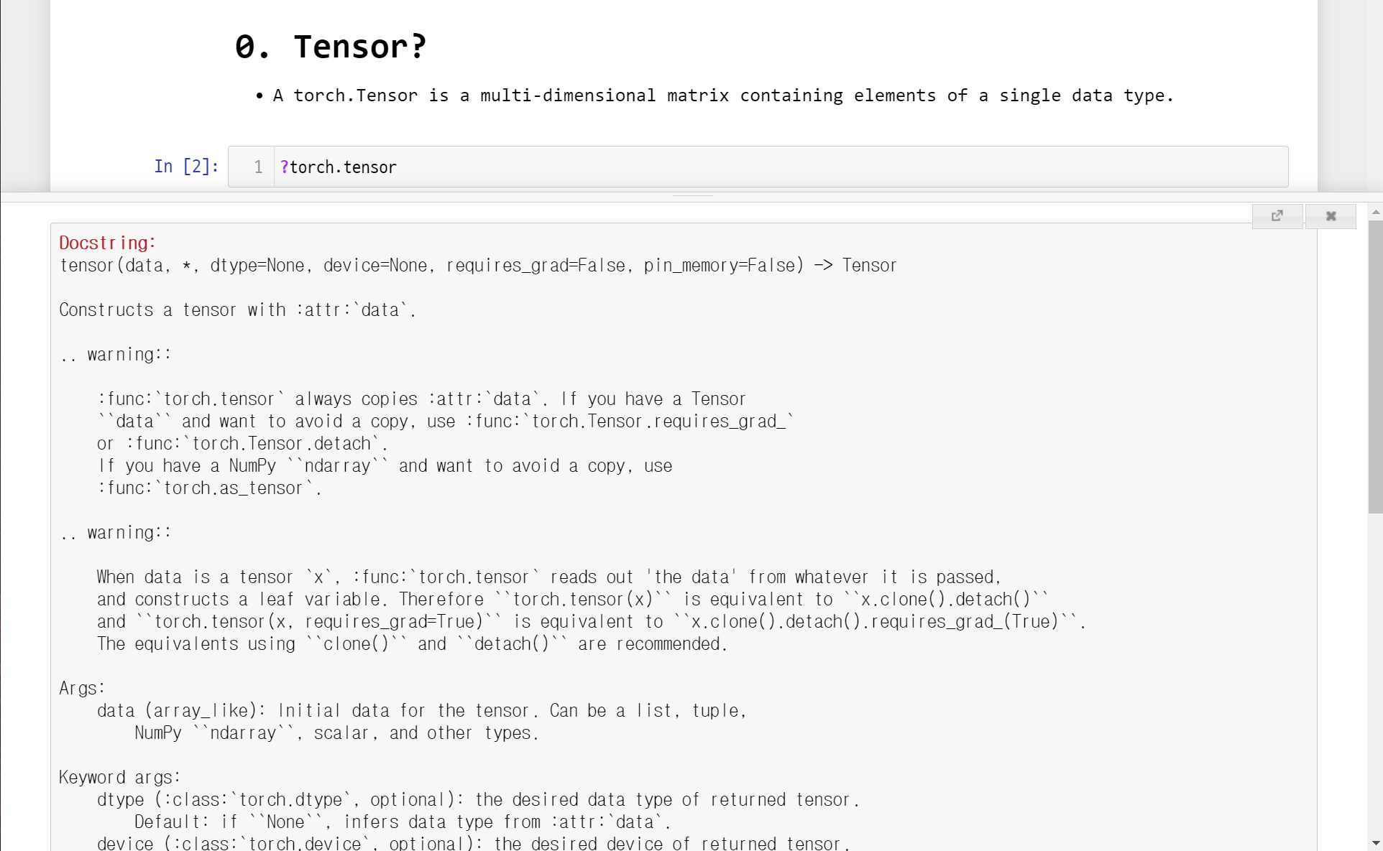
PyTorch Tutorial

Slide 15
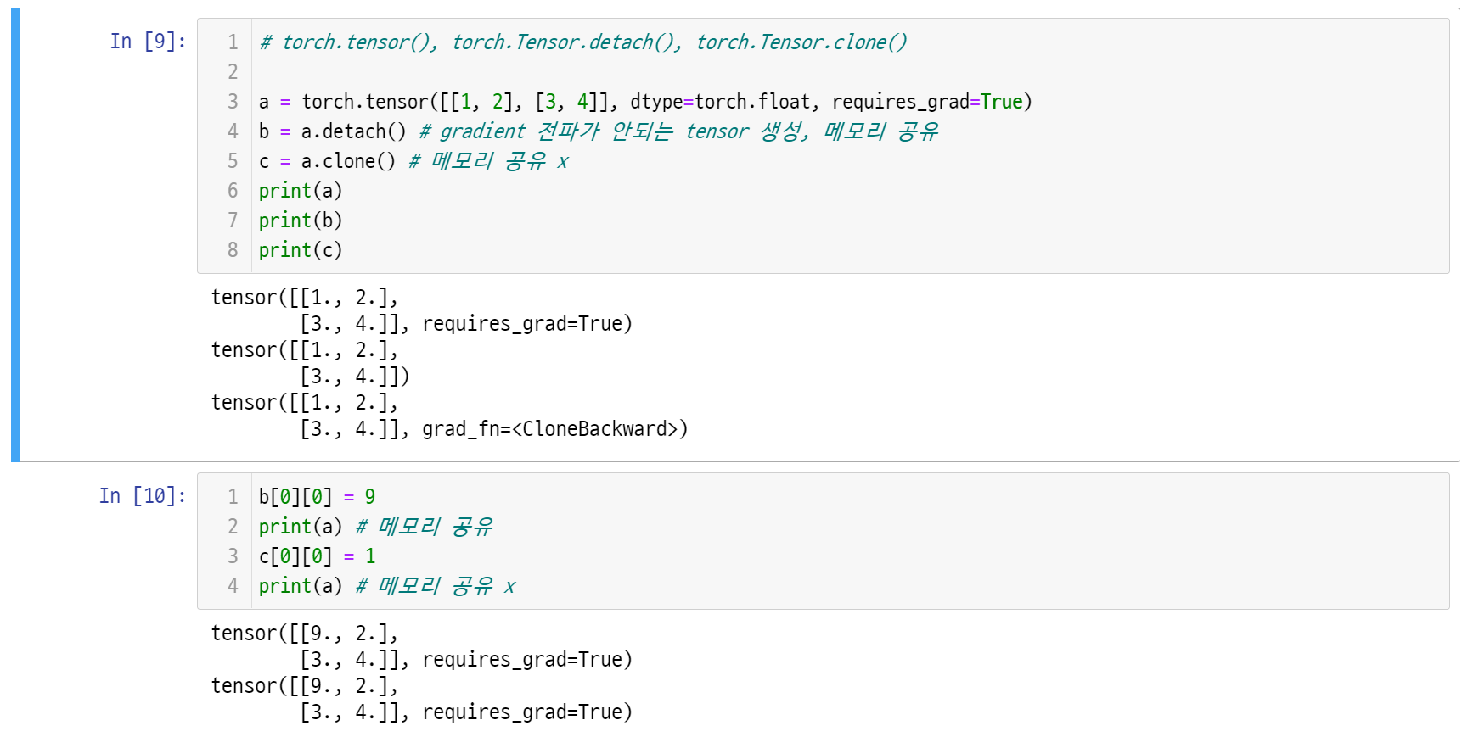
PyTorch Tutorial

Slide 16
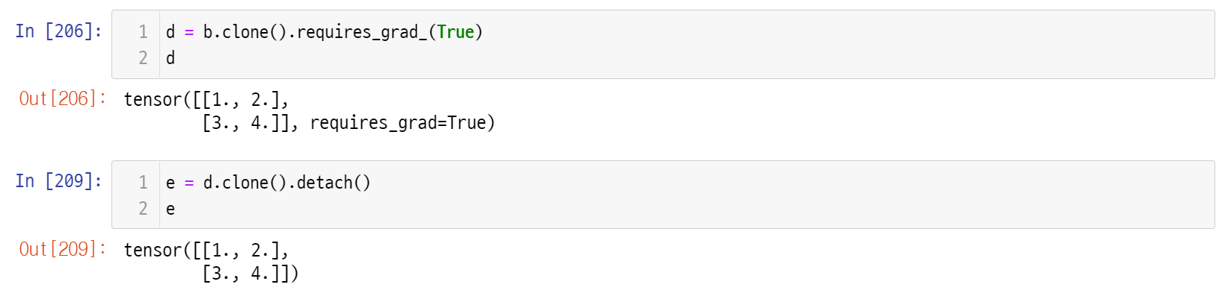
PyTorch Tutorial

Slide 17
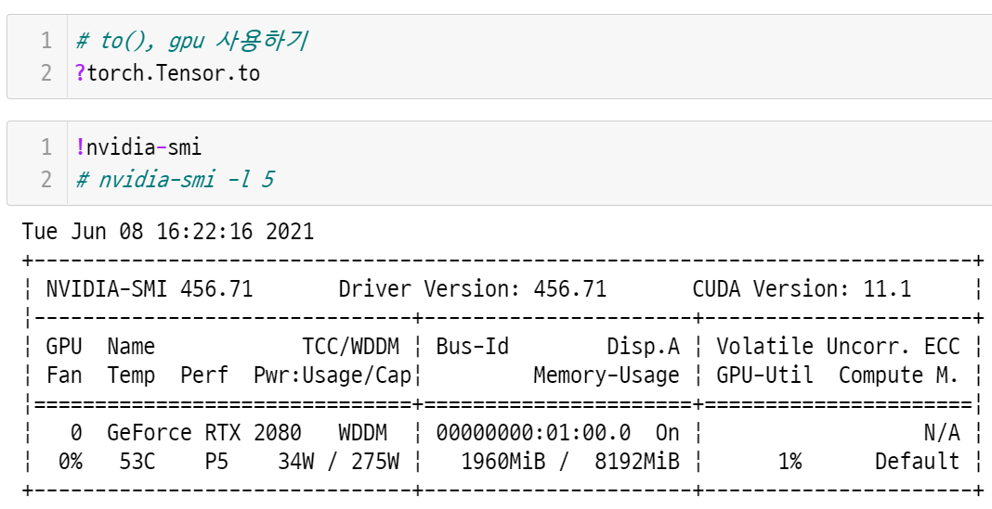
PyTorch Tutorial

Slide 18
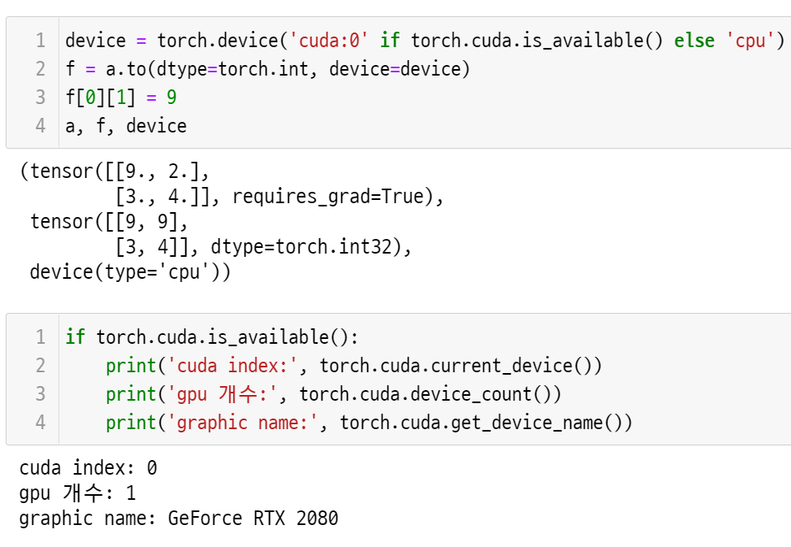
PyTorch Tutorial

Slide 19
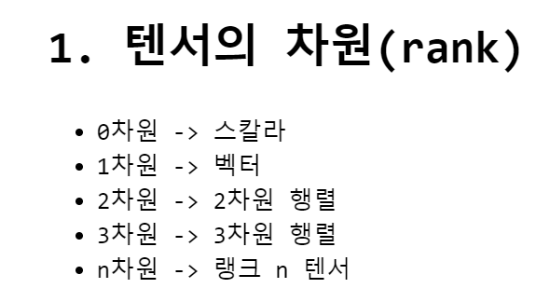
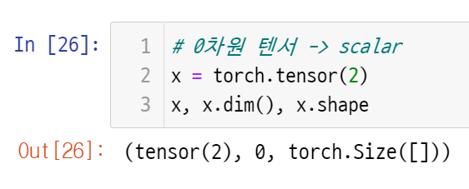
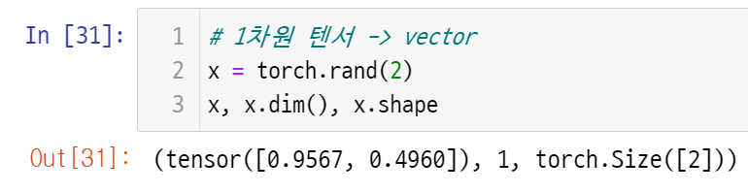
PyTorch Tutorial

Slide 20
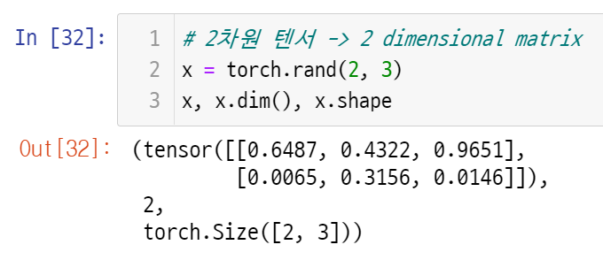
PyTorch Tutorial

Slide 21
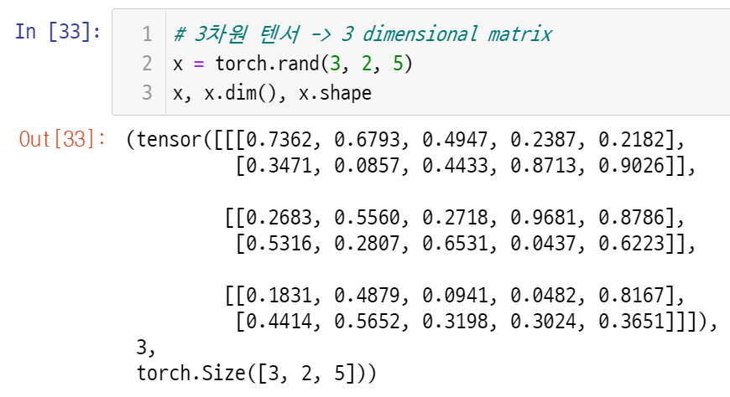
PyTorch Tutorial

Slide 22
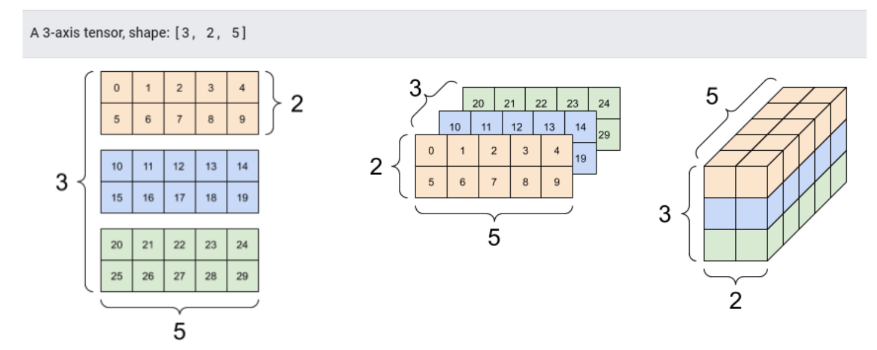
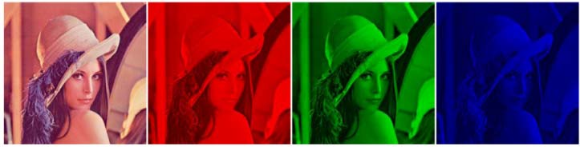
PyTorch Tutorial

Slide 23
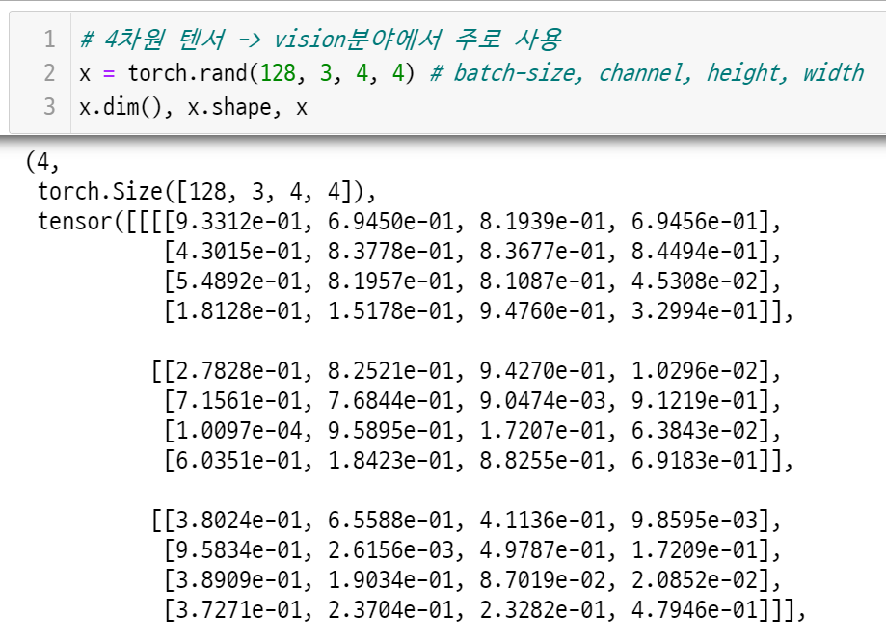
PyTorch Tutorial

Slide 24
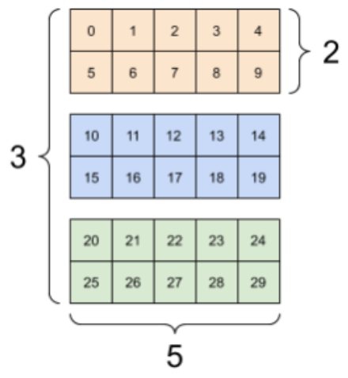
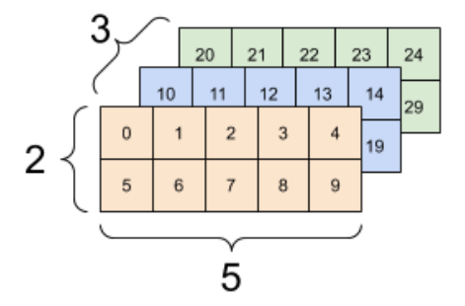


PyTorch Tutorial

Slide 25
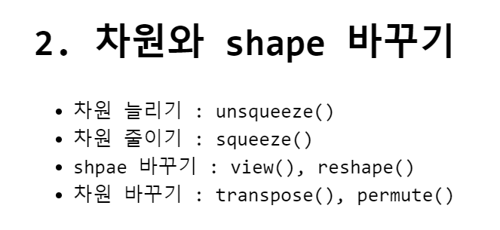
PyTorch Tutorial

Slide 26
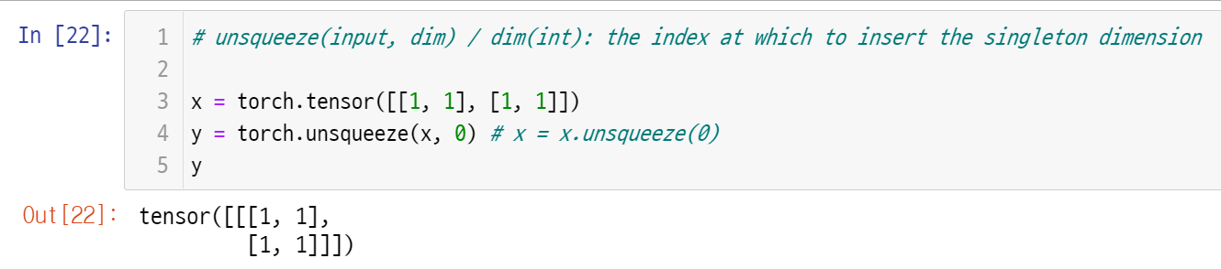
PyTorch Tutorial
What is the difference between x and y?

Slide 27
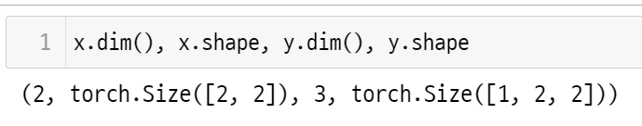


PyTorch Tutorial
What is the difference between x and y?

Slide 28
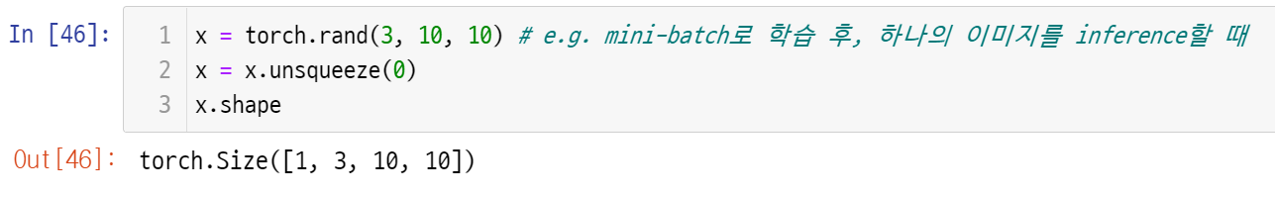
PyTorch Tutorial

Slide 29
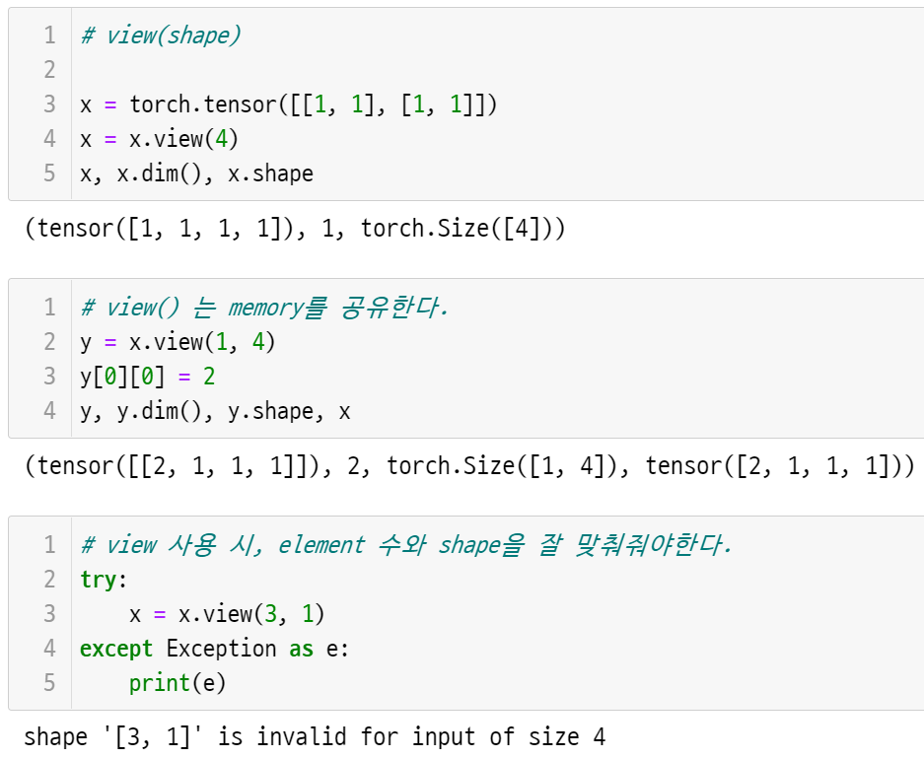
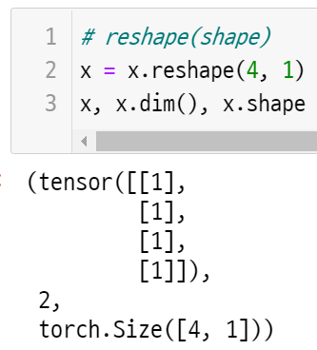
PyTorch Tutorial

Slide 30
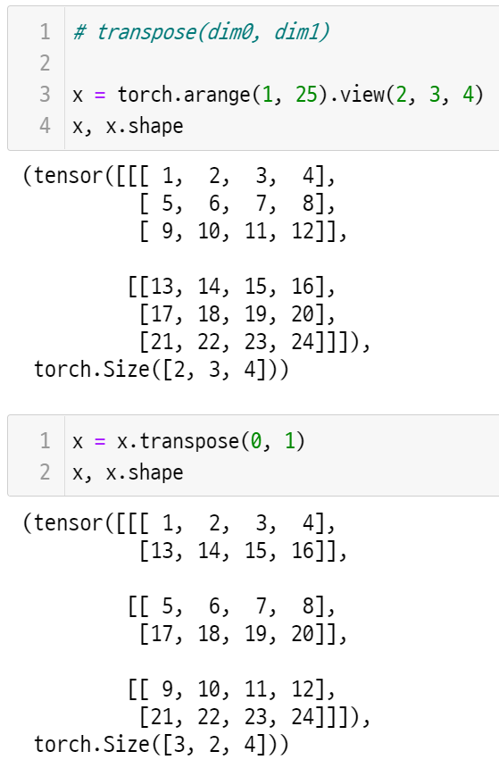
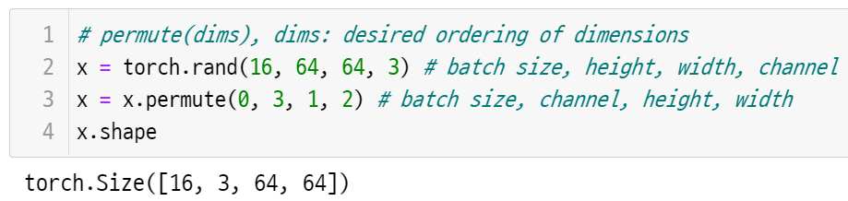
PyTorch Tutorial

Slide 31
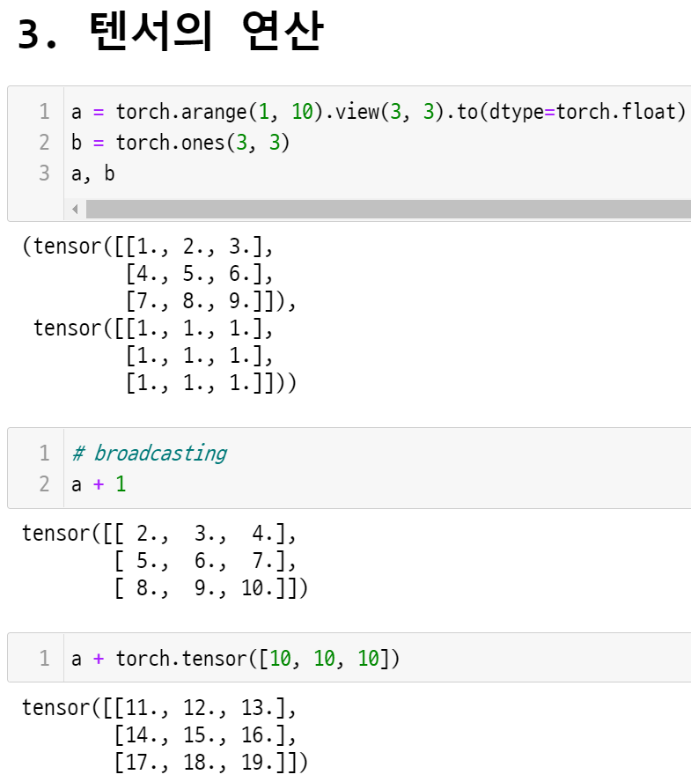
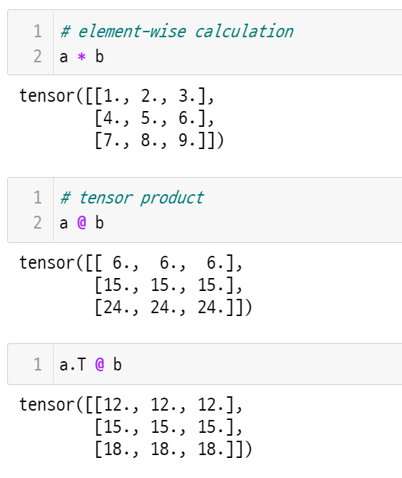
PyTorch Tutorial

Slide 32
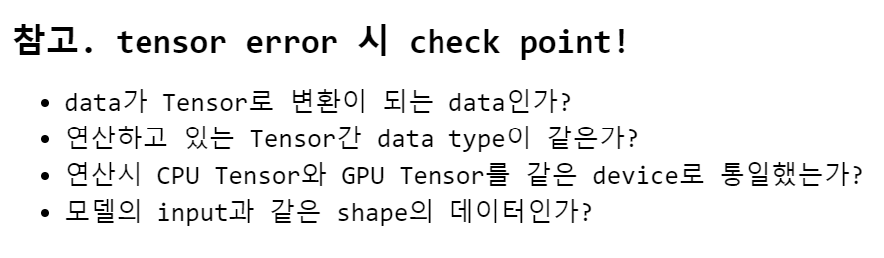
PyTorch Tutorial

Slide 33
PyTorch Tutorial
4. AUTOGRAD
The reason why we use PyTorch.

Slide 34
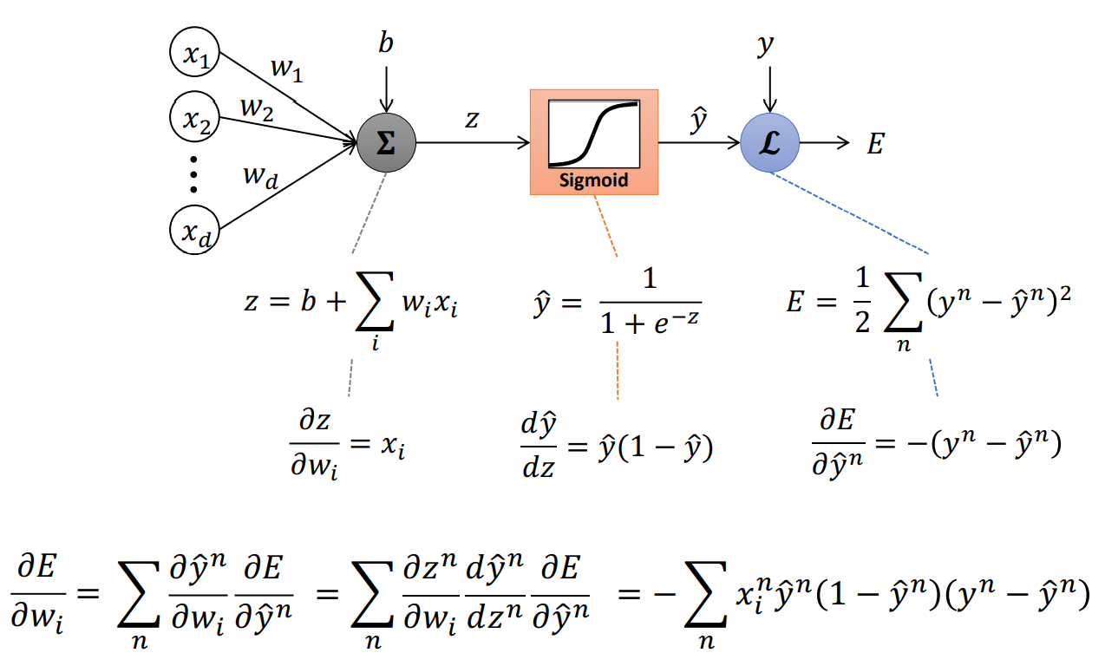
PyTorch Tutorial
perceptron

Slide 35
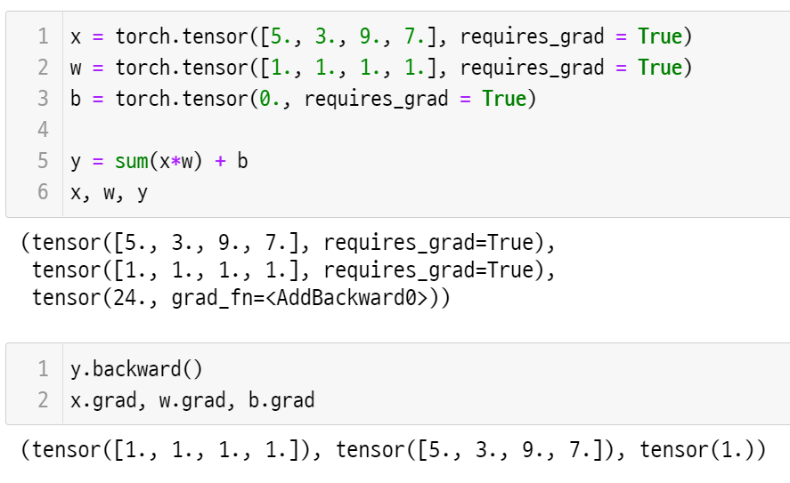
PyTorch Tutorial

Slide 36
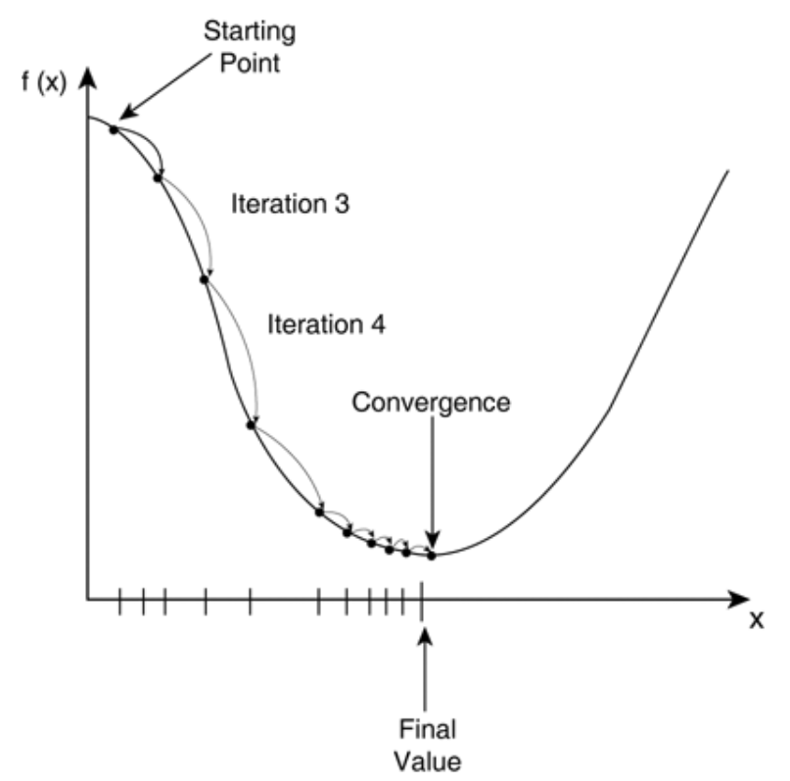
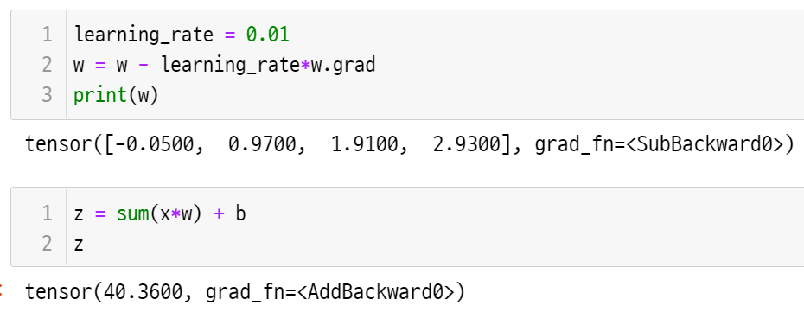
PyTorch Tutorial
E
w

Slide 37
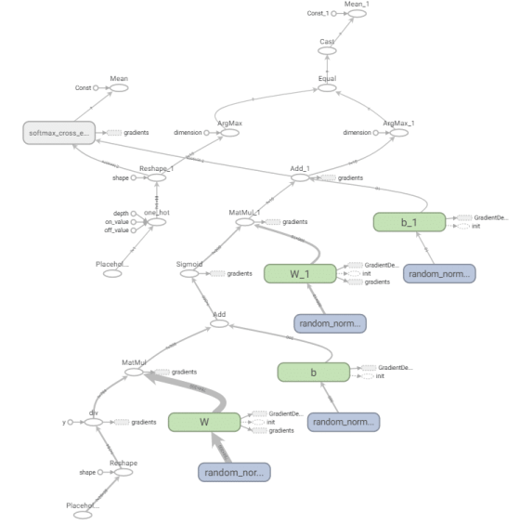
PyTorch Tutorial

Slide 38
Linear Regression in 3 ways ( + Lidge, Lasso)
Linear Regression Code :
https://git.io/aibd-lr-3-student

