Slide 1
AI+BD ML Lab. Day 5
March 26th, 2021
Transfer Learning
YoungIn Kim <youngkim21@postech.edu>

Slide 2
Goals
Understanding Transfer Learning
Understanding more about CNN Deep model
Make Code!

Slide 3
Backgrounds
For your information & reminding

Slide 4
Transfer Learning
More Data,
High Intelligence

Slide 5
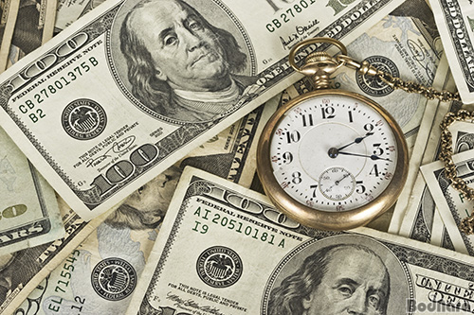
Transfer Learning
Collecting data is
the most difficult thing

Slide 6
Transfer Learning
Collecting data is
the most difficult thing
How to solve?

Slide 7
Transfer Learning
Collecting data is
the most difficult thing
How to solve?
Transfer Learning
Self-supervised Learning
Semi-supervised Learning
…

Slide 8
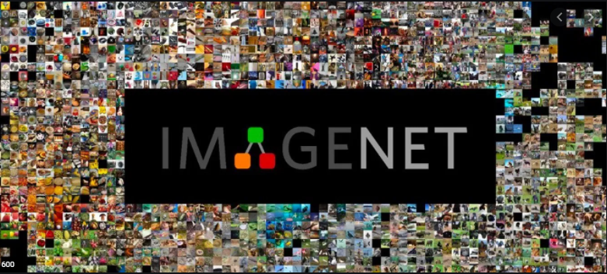
Transfer Learning
1000 Class, 14 million Data

Slide 9
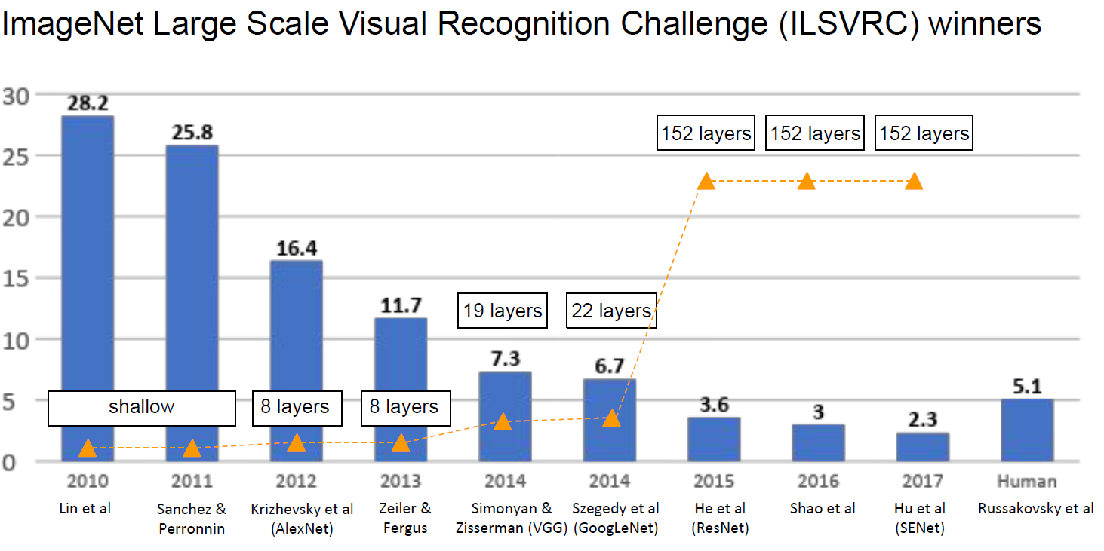
Transfer Learning

Slide 10

Transfer Learning
Why don’t we REUSE this model?

Slide 11
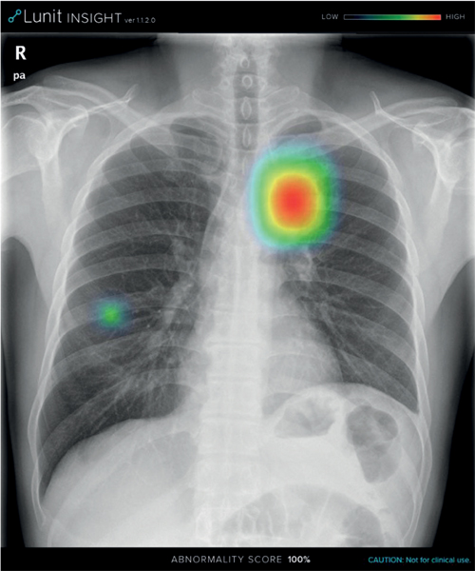
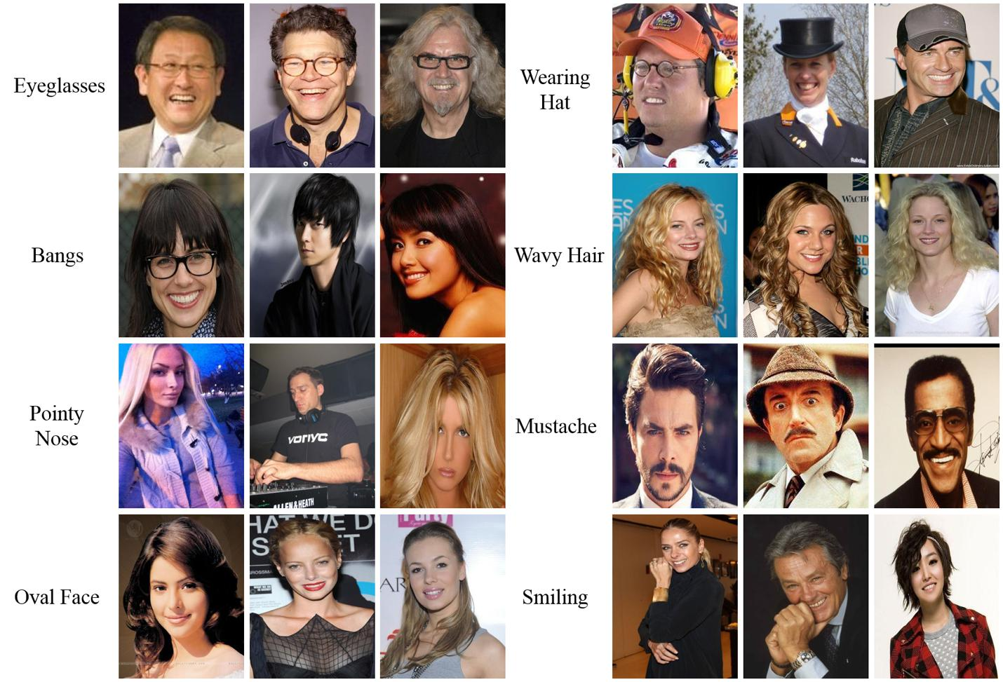
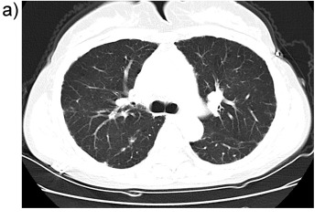
Transfer Learning
Why don’t we REUSE this model?

Slide 12

Transfer Learning
Why don’t we REUSE this model?
Fine Tuning!

Slide 13
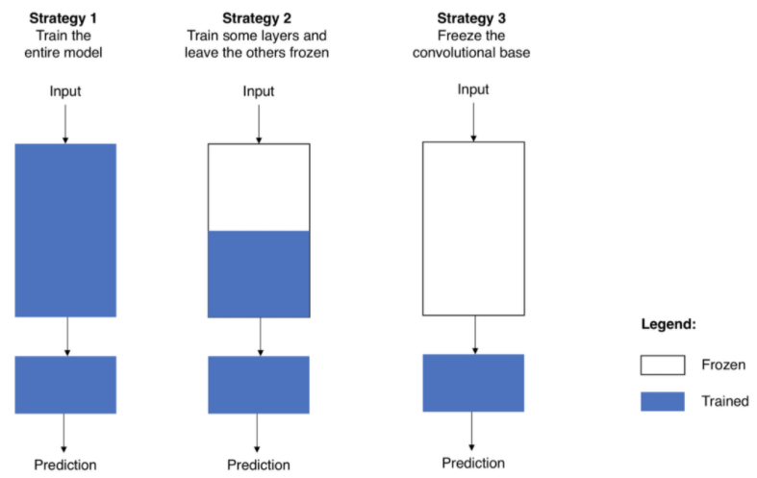
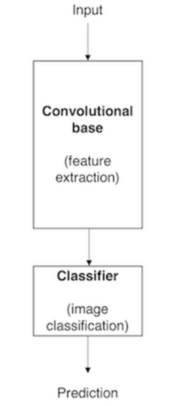
Transfer Learning
Pretrained model
Fine Tuning
https://towardsdatascience.com/transfer-learning-from-pre-trained-models-f2393f124751

Slide 14

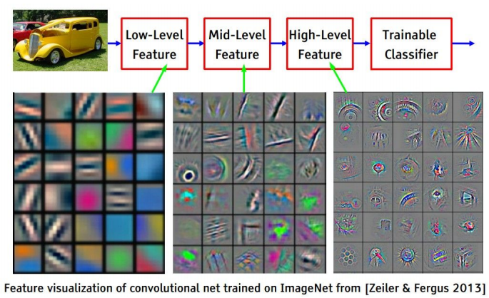
Transfer Learning
CNN Architecture
Low
High
https://yosinski.com/deepvis

Slide 15
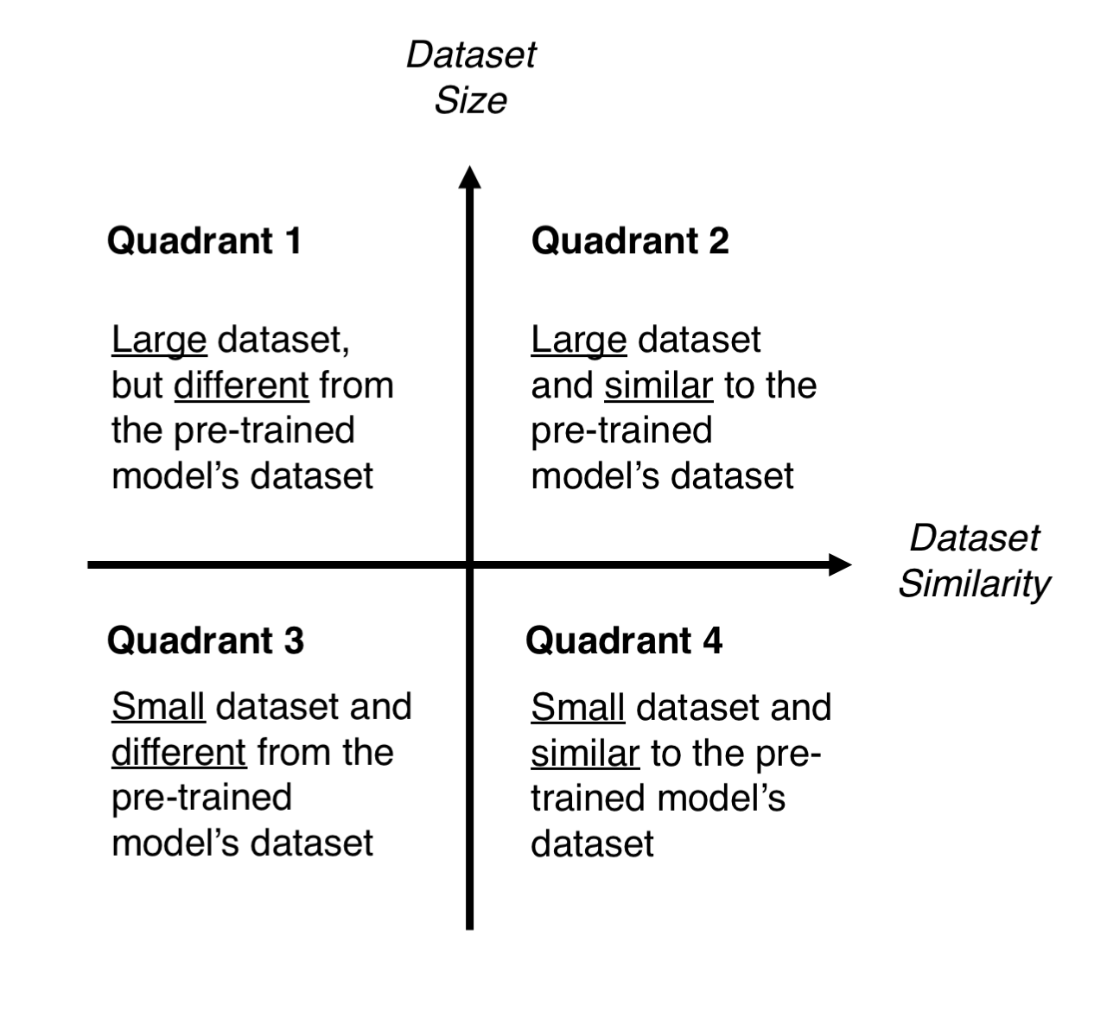
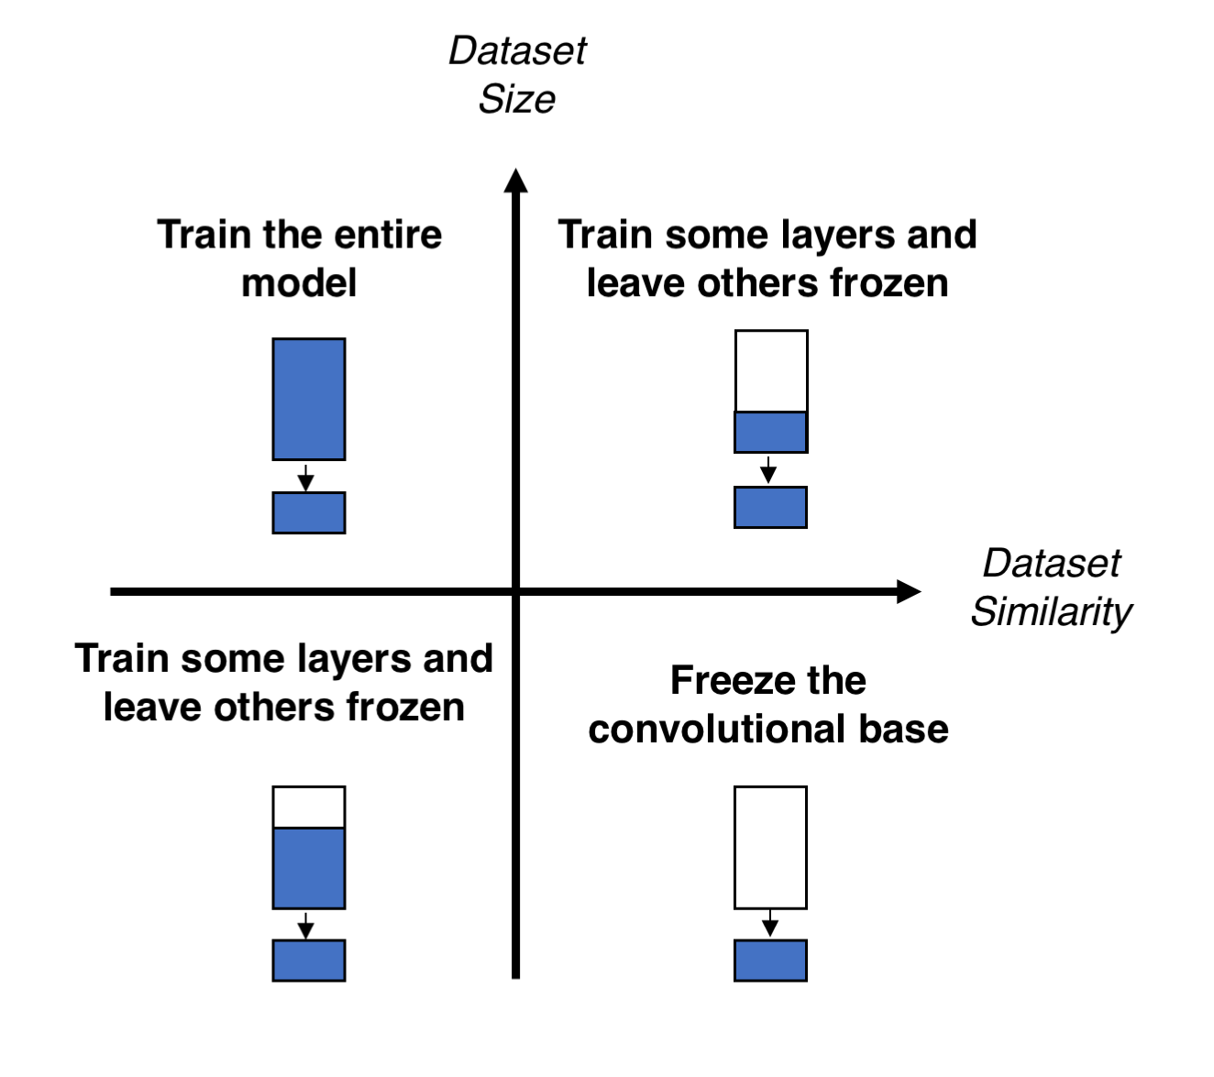
Transfer Learning

Slide 16
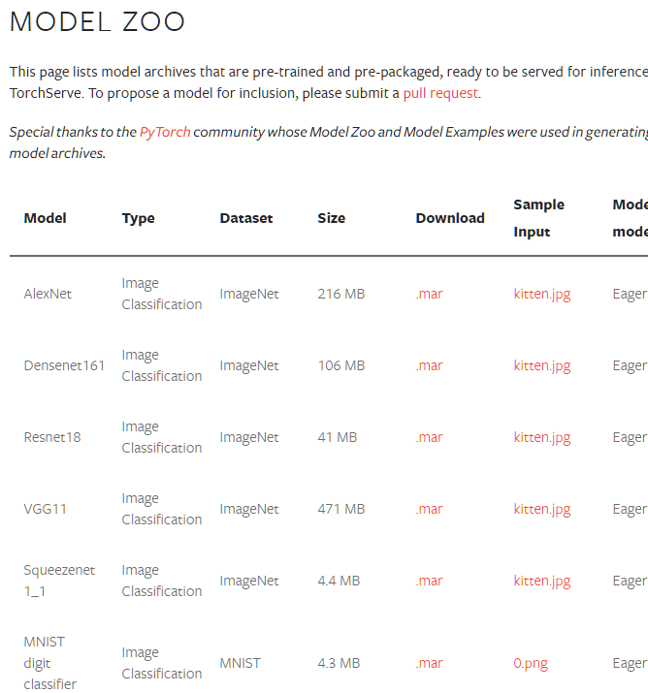
Transfer Learning
https://pytorch.org/serve/model_zoo.html

Slide 17
It’s coding time
Let’s fill the I.P.Y.N.B

Slide 18
Full code
Full code :
https://git.io/aibd-tl-5-full

Slide 19

Full code
https://pytorch.org/vision/stable/models.html

Slide 20
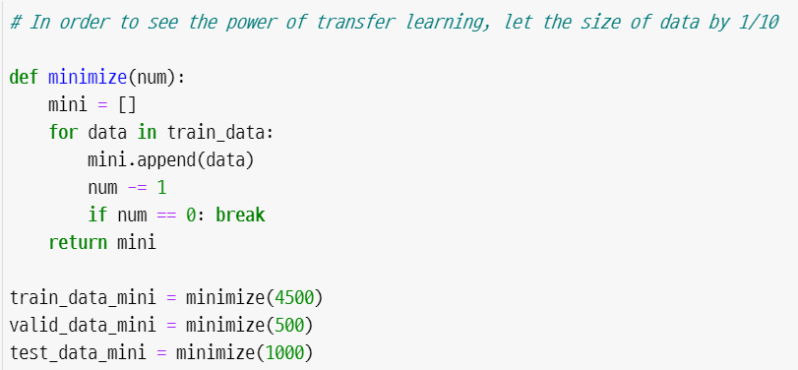
Full code

Slide 21
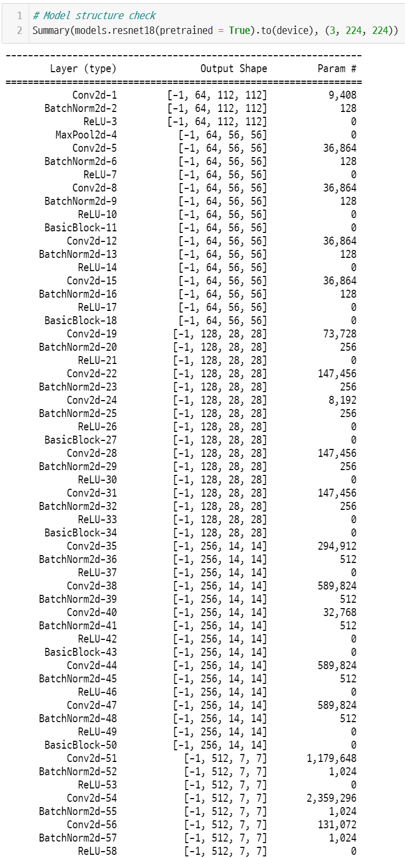
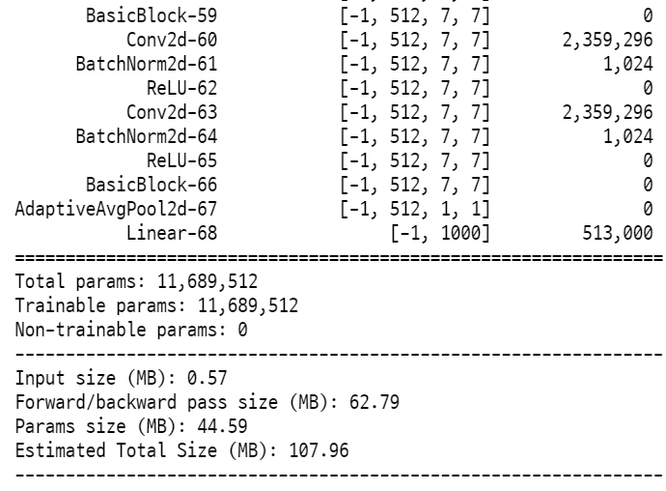
Full code

Slide 22
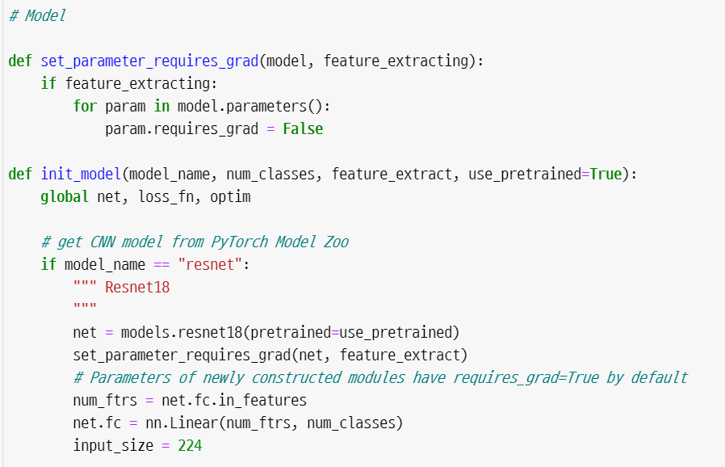
Full code

Slide 23


Full code

