Slide 1
AI+BD ML Lab. Day 3
March 24th, 2021
MLP & Regularization (Batch Norm. / Dropout)
YoungIn Kim <youngkim21@postech.edu>

Slide 2
Today’s Goals
MLP (Multi Layer Perceptron)
Make model with nn.Module Class
Make more deep!
Regularization
Look inside of network
Batch Normalization
Dropout

Slide 3
Preparation
Base .ipynb :
https://git.io/aibd-mlp-3

Slide 4
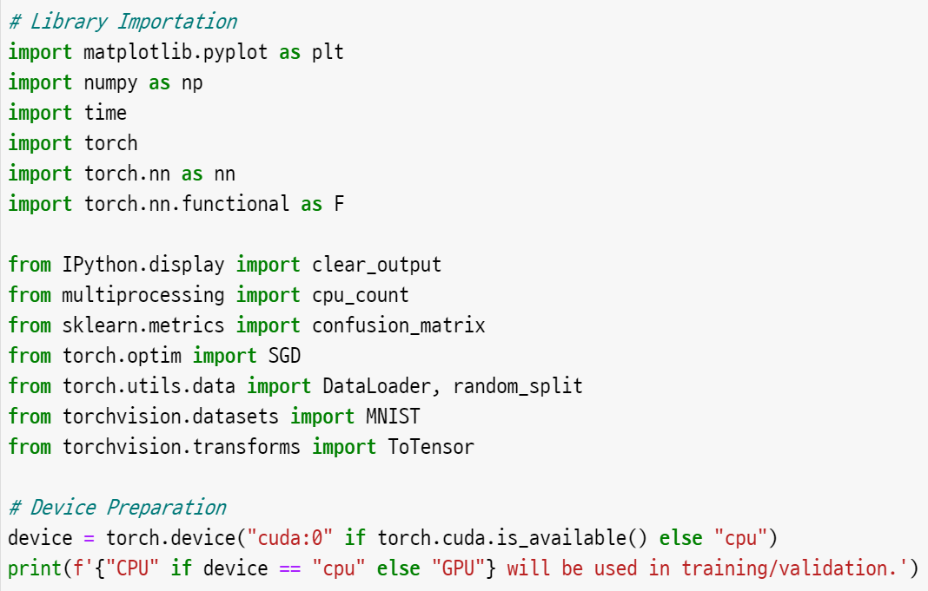
Reminding
Library Importation
& Device Preparation

Slide 5
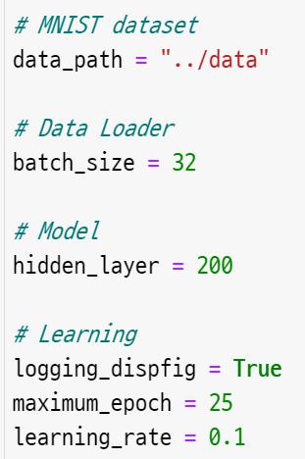
Reminding
change it to your own path
2. Hyper-Parameters

Slide 6
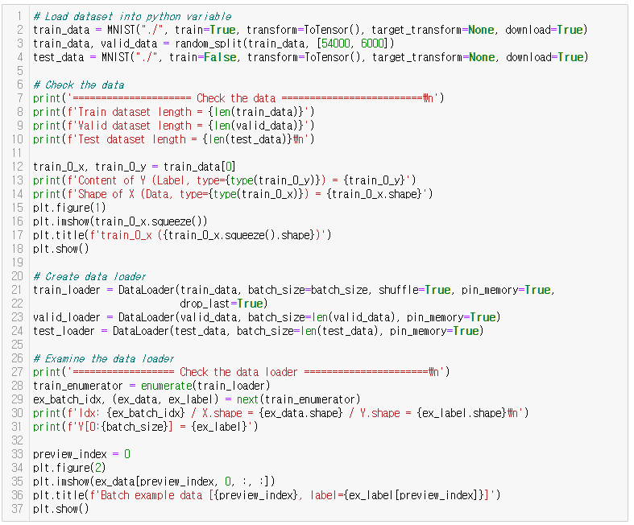
Reminding
3. Data Load
& Preprocessing
Same as before

Slide 7
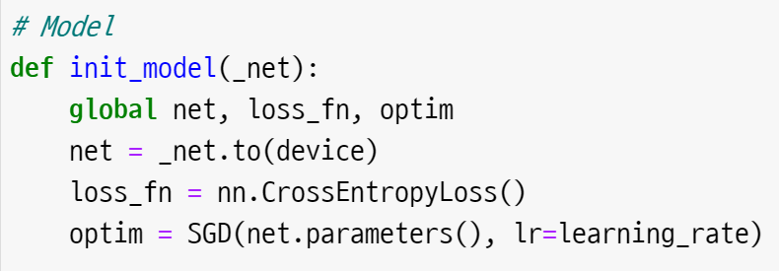
Reminding
4. Function Definitions

Slide 8
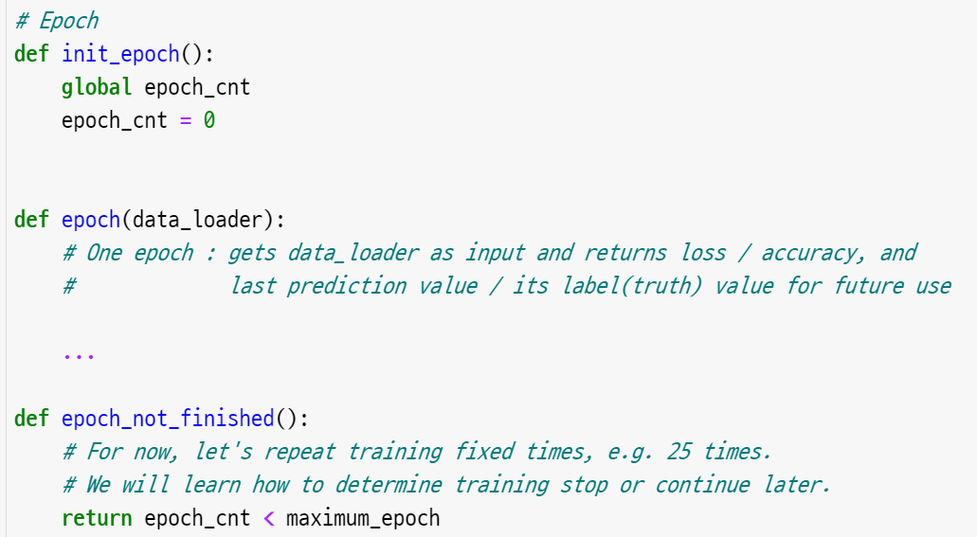
Reminding
4. Function Definitions
(continue)
Same as before

Slide 9

Reminding
4. Function Definitions
(continue)
IMPORTANT!

Slide 10
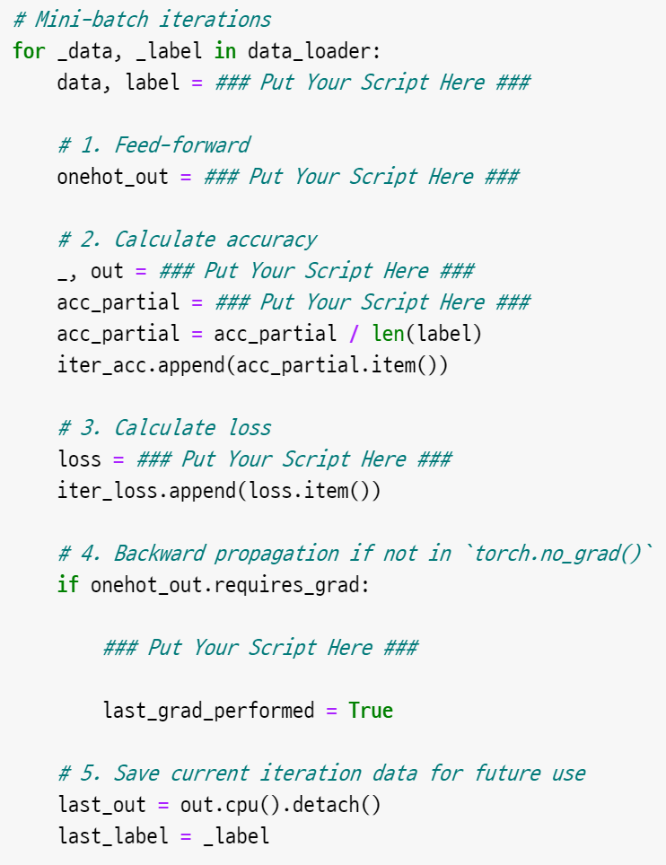
Reminding
4. Function Definitions
(continue)
Same as before
BUT try it by yourself.
Put your Script on the blank

Slide 11
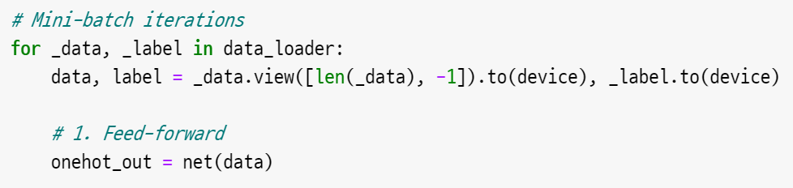
Reminding
4. Function Definitions
(continue)

Slide 12
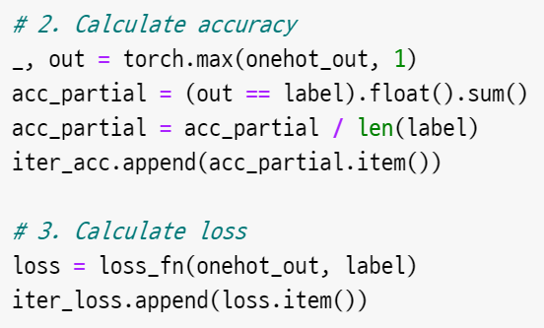
Reminding
4. Function Definitions
(continue)

Slide 13
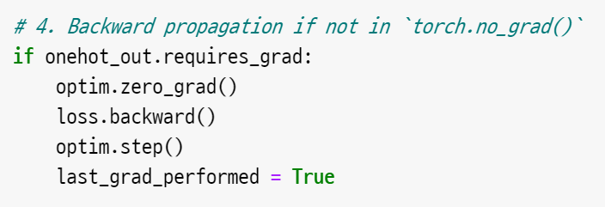
Reminding
4. Function Definitions
(continue)

Slide 14
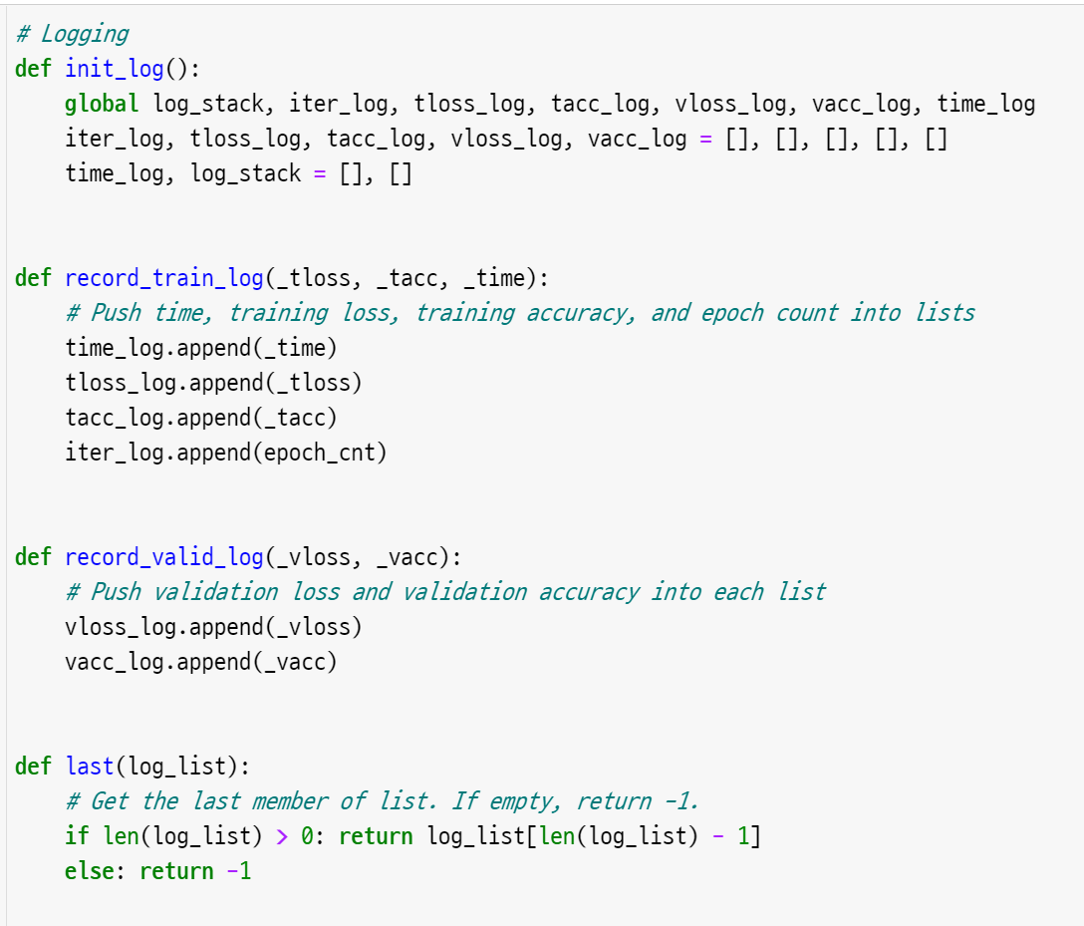
Reminding
4. Function Definitions
(continue)
Same as before

Slide 15
MLP
Multi Layer Perceptron with nn.Module

Slide 16
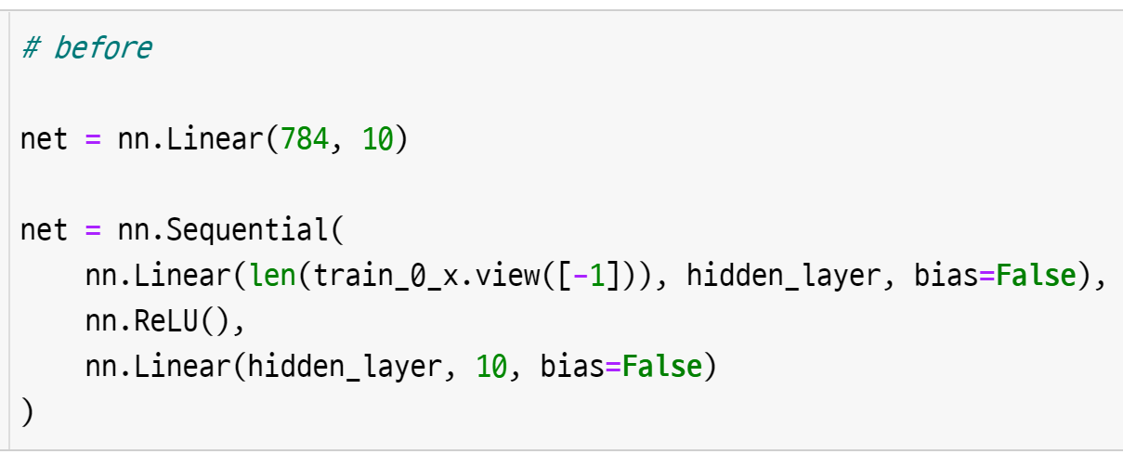
Make model with nn.Module class
5. Model Architectures
(before)
How we implement model more fancy way?

Slide 17
Make model with nn.Module class
5. Model Architectures
(before)
How we implement model more fancy way?
use Python ‘Class’ with nn.Module!

Slide 18

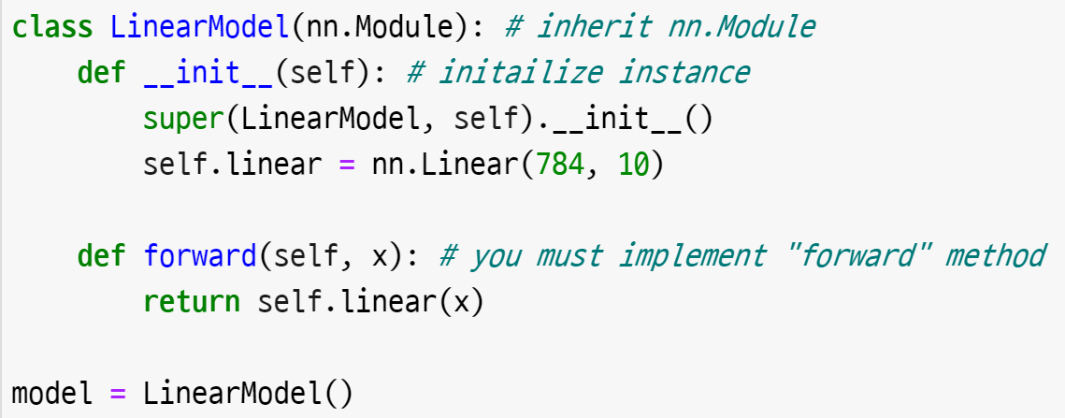
Make model with nn.Module class
5. Model Architectures
(after)

Slide 19
Make model with nn.Module class
5. Model Architectures
(after)
IMPORTANT!

Slide 20
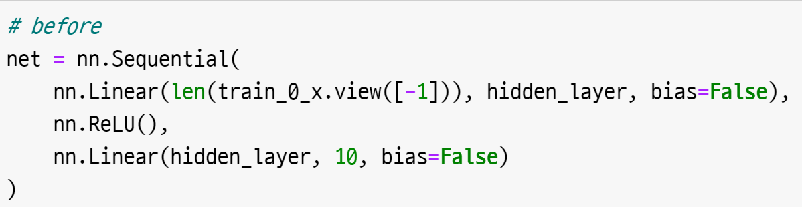
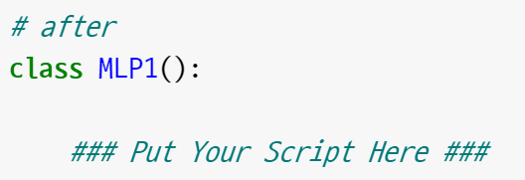
Make model with nn.Module class
5. Model Architectures
(after)

Slide 21
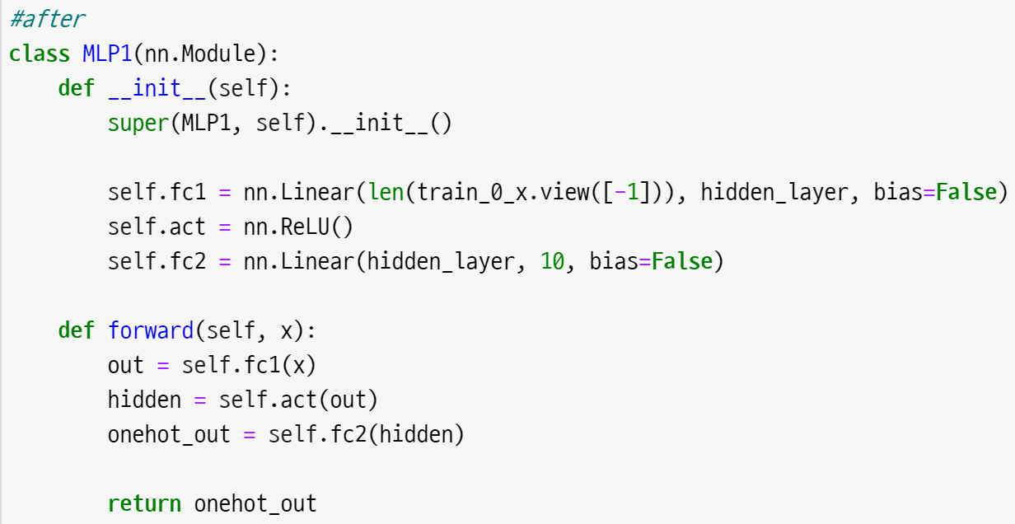
Make model with nn.Module class
5. Model Architectures
(after)

Slide 22
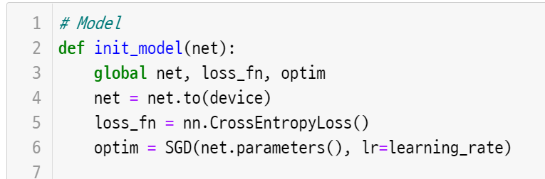
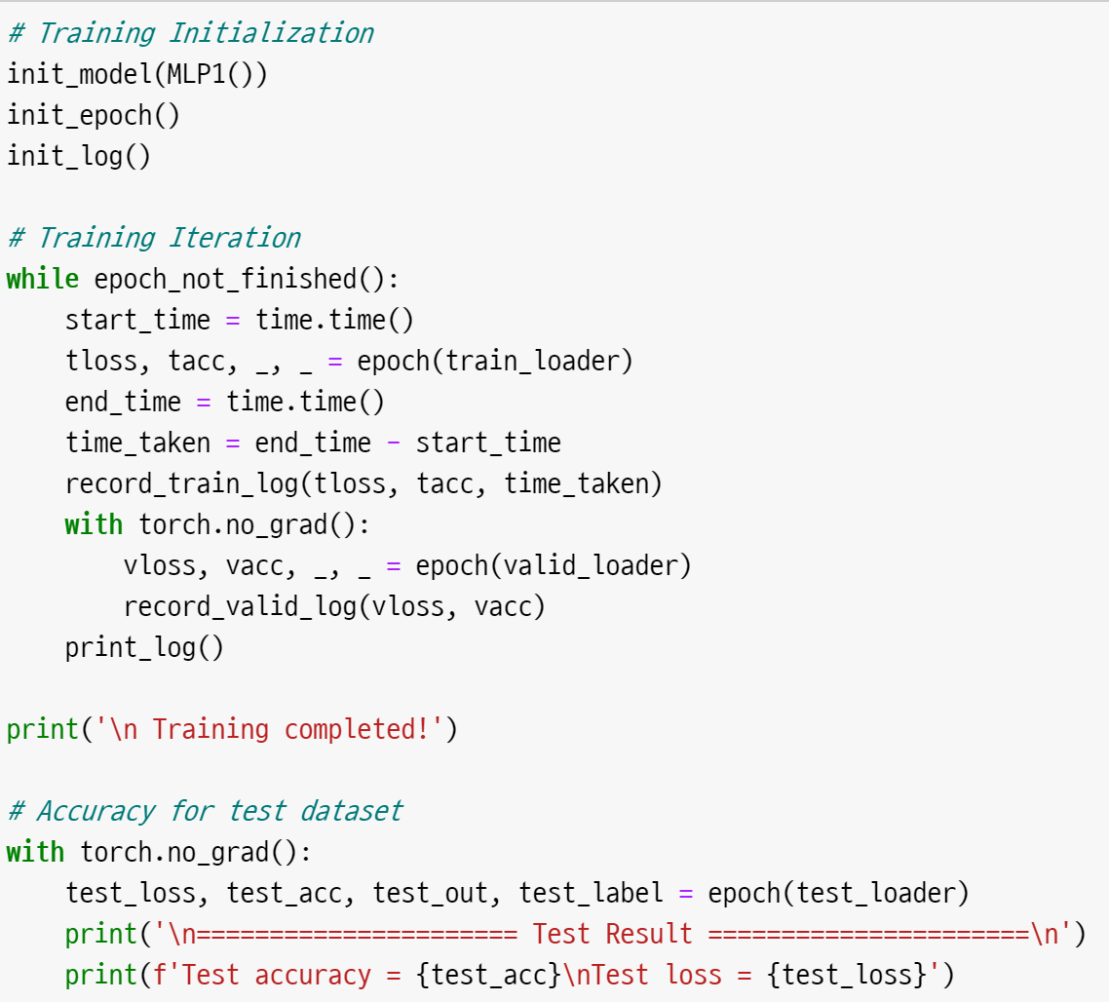
Make model with nn.Module class
6. Training Iteration
& Test Result

Slide 23
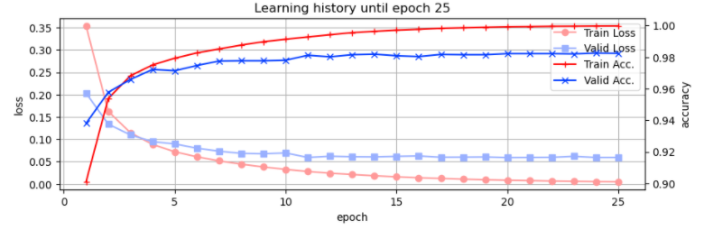

Make model with nn.Module class
6. Training Iteration
& Test Result
Test Acc. : 98.02 %

Slide 24
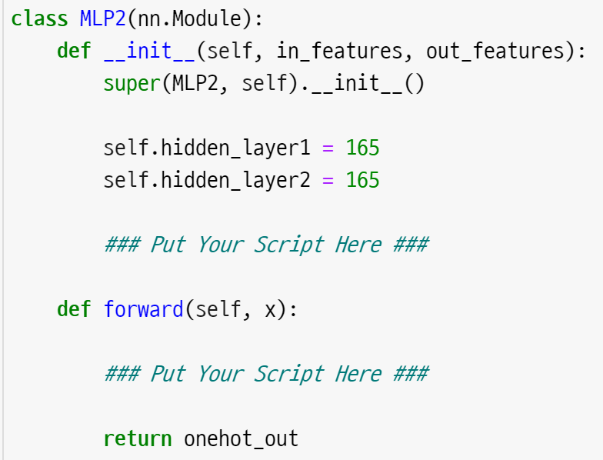
Make more Deep!
6-1. Training Iteration
& Test Result
(MLP2)

Slide 25
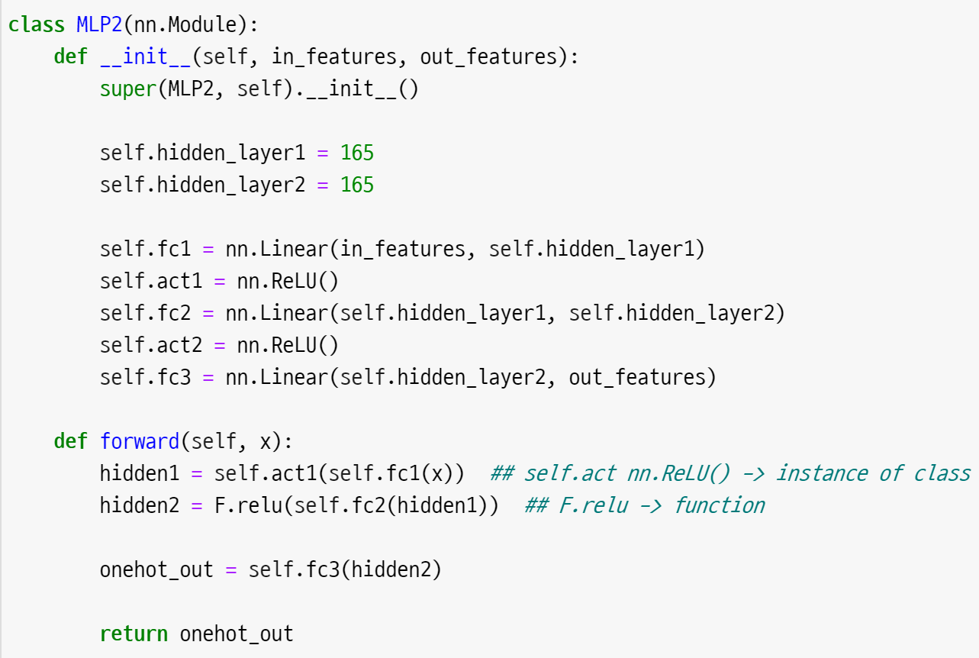

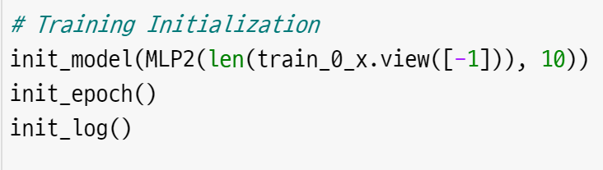
Make more Deep!
6-1. Training Iteration
& Test Result
(MLP2)

Slide 26
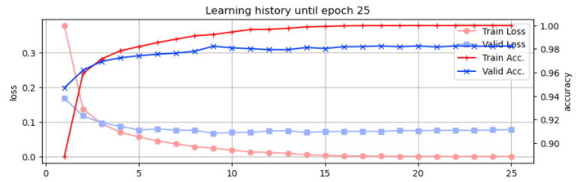

Make more Deep!
6-1. Training Iteration
& Test Result
(MLP2)
Test Acc. : 98.02 %
Test Acc. : 98.26 %

Slide 27
Reguralization
Batch Normalization & Drop out

Slide 28
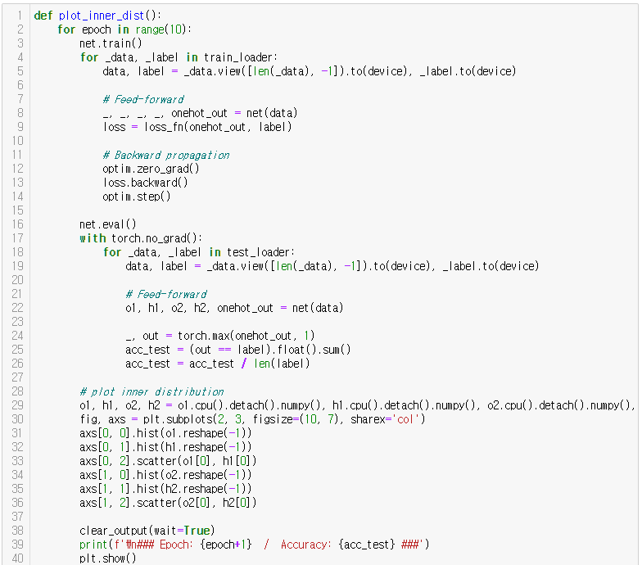
Batch Normalization – Look inside of network
Already prepared
for you

Slide 29
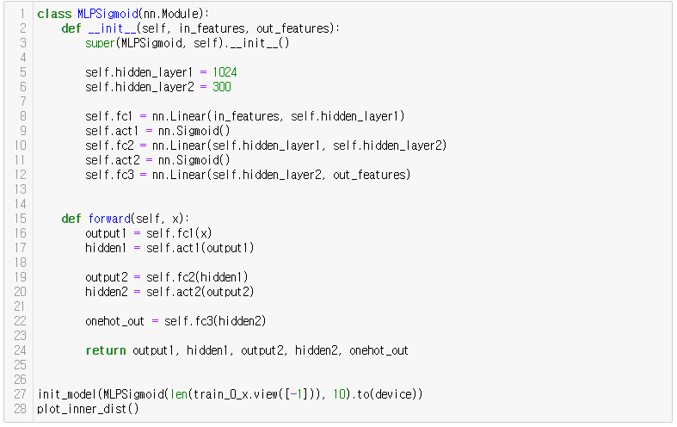
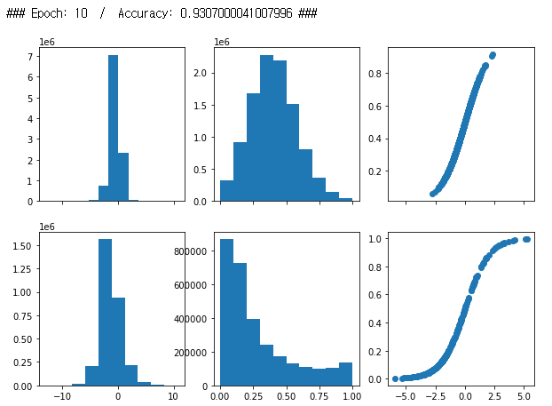
Batch Normalization – Look inside of network
Axis Y : count / Axis X : value

Slide 30
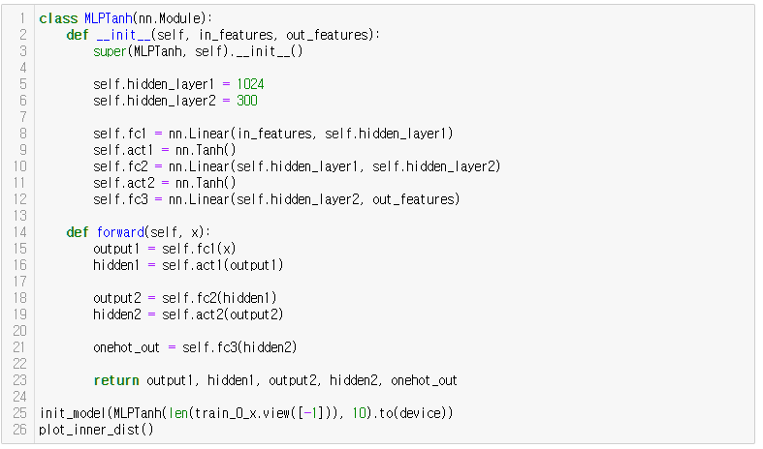
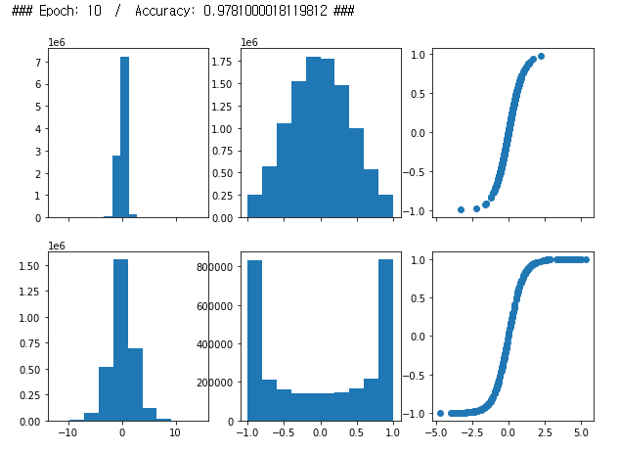
Batch Normalization – Look inside of network

Slide 31
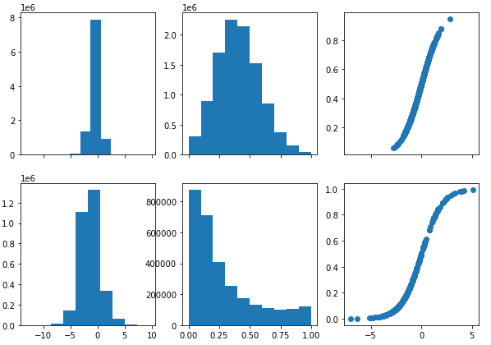
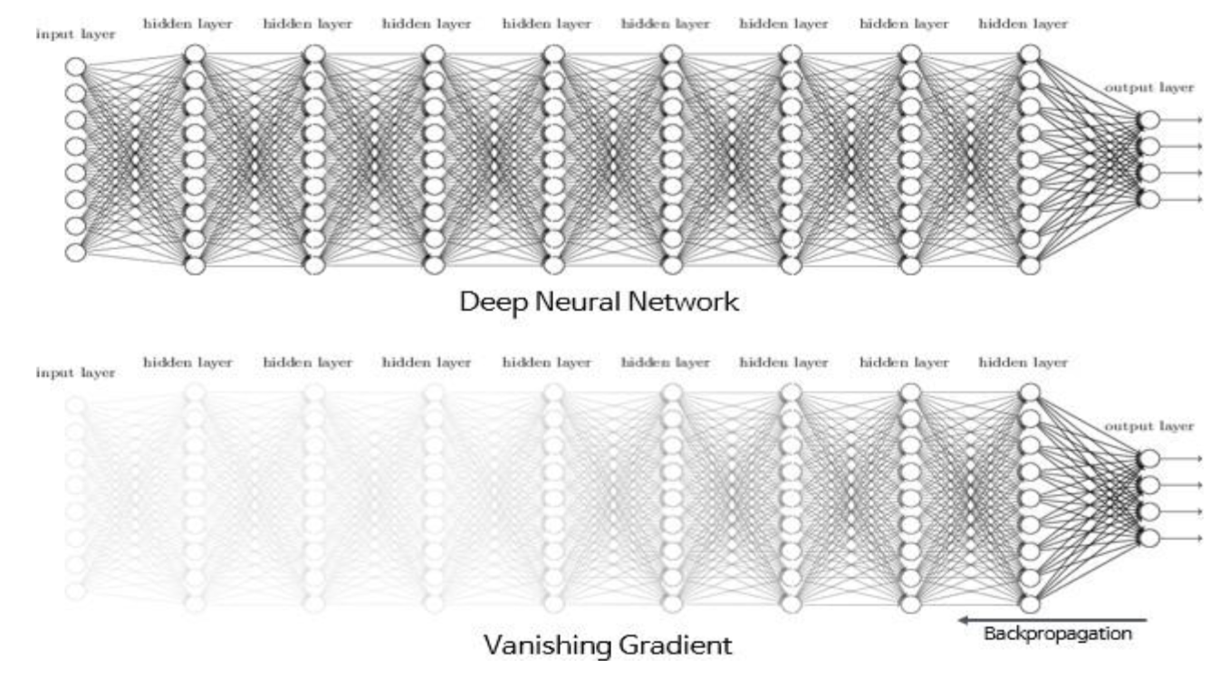
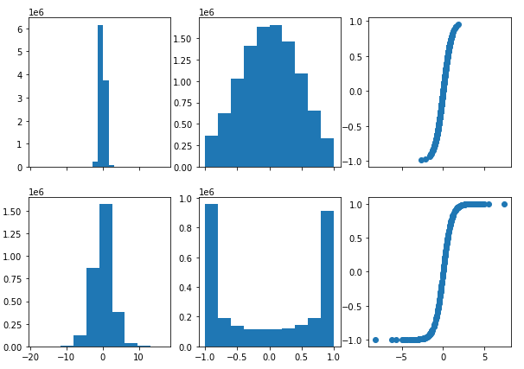
Batch Normalization – Look inside of network
Sigmoid
tanh

Slide 32
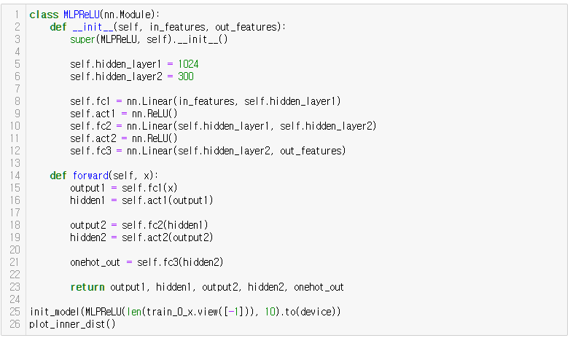
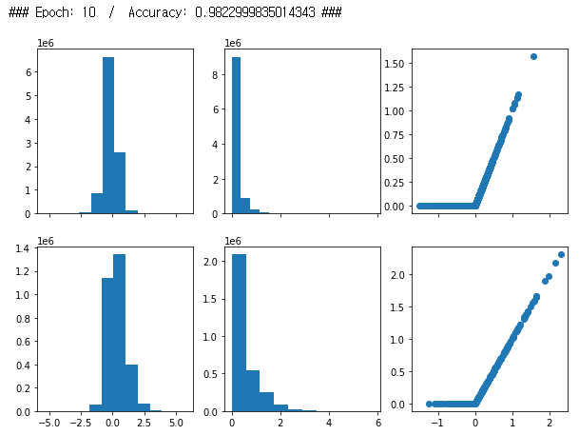
Batch Normalization – Look inside of network

Slide 33
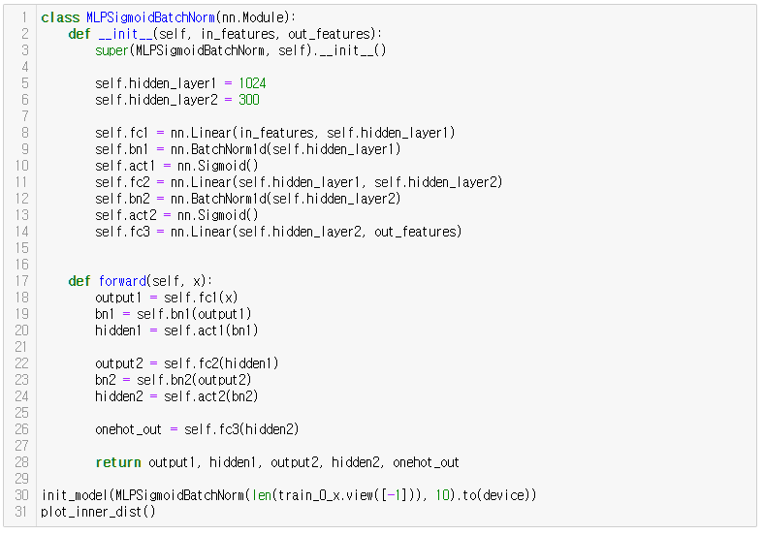
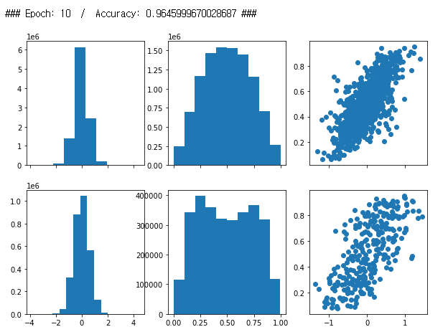
Batch Normalization
before activation

Slide 34
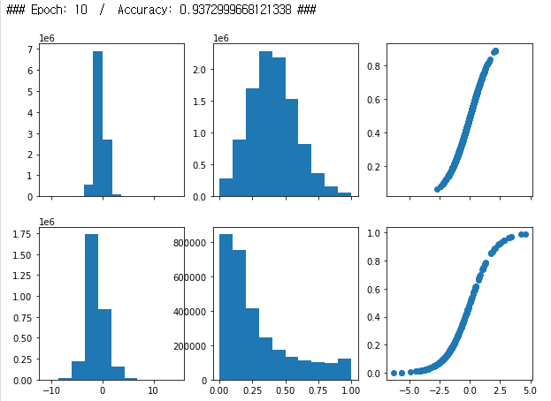
Batch Normalization

Slide 35
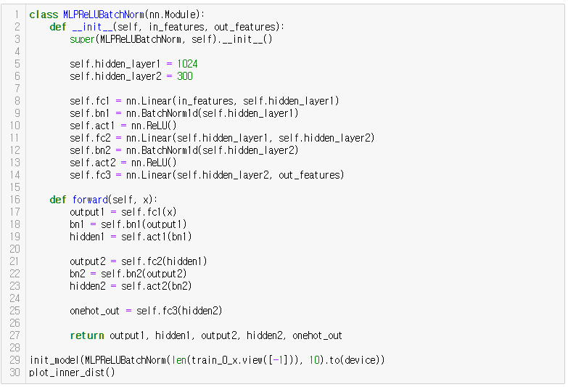
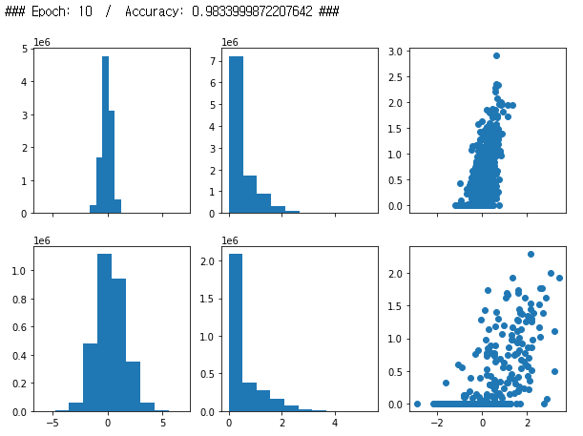
Batch Normalization

Slide 36
Batch Normalization

Slide 37
Batch Normalization
Accuracy Comparison
MLP Sigmoid : 93.07 % → 96.80 %
MLP Tanh : 97.81 %
MLP ReLU : 98.23 % → 98.34 %

Slide 38
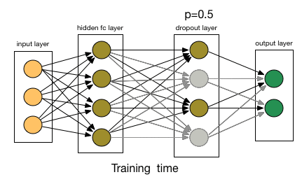
Dropout

Slide 39
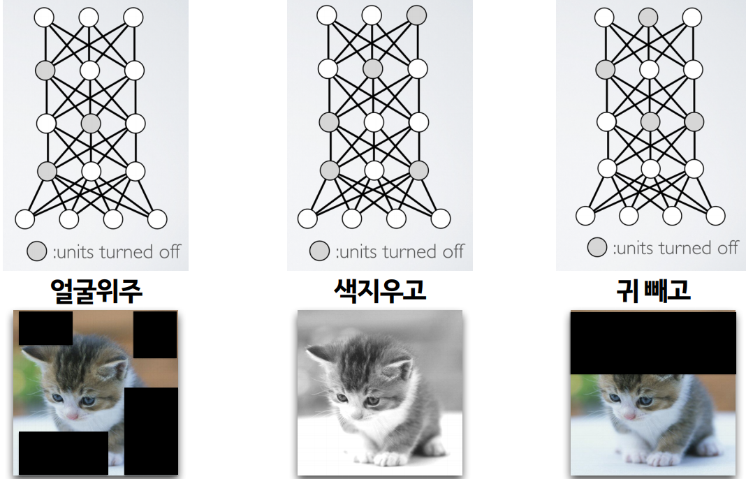
Dropout

Slide 40
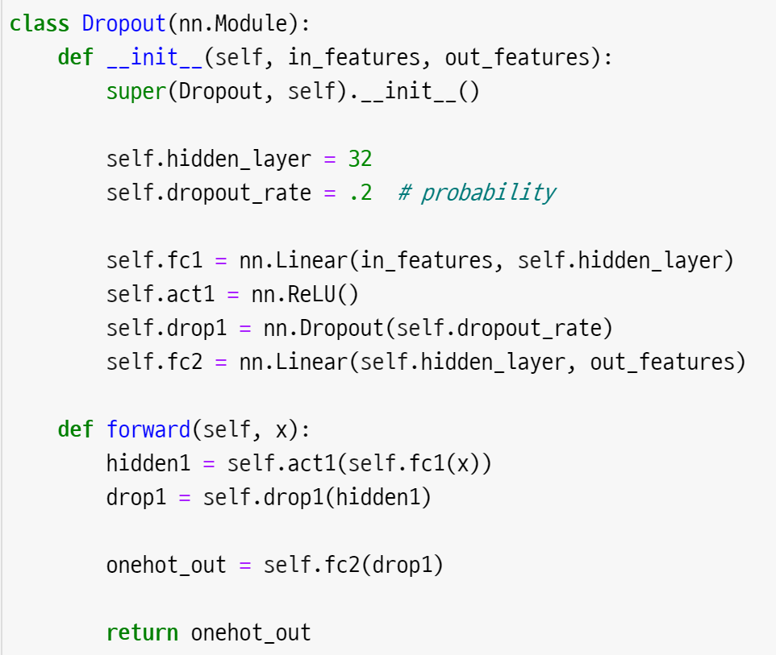
Dropout
after activation

Slide 41
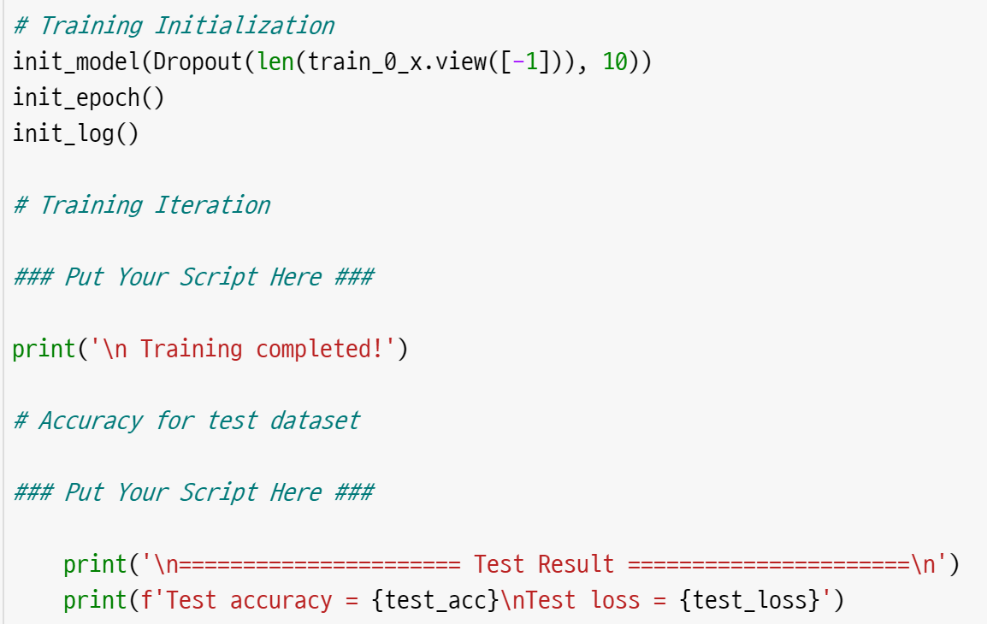
Dropout
Can you make this code by yourself?

Slide 42
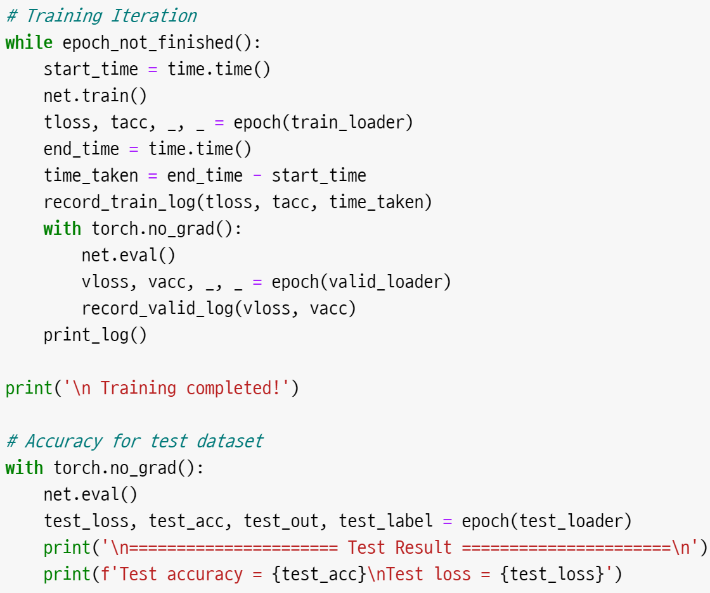
Dropout
POP-UP QUIZ!
What’s the difference with before?
and why?

Slide 43
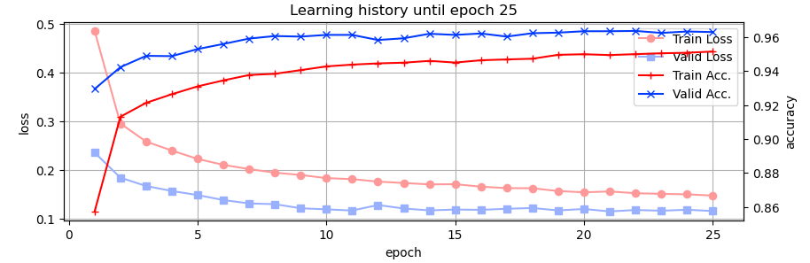
Dropout
Anything Strange?

Slide 44
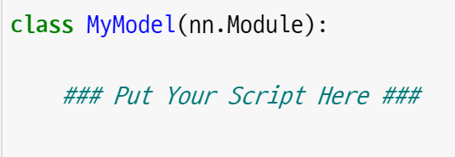
Batch Normalization + Dropout
Final Round !
Make your own model
2 hidden layers
add batch normalization
add dropout
you can add additional techniques if you want

Slide 45
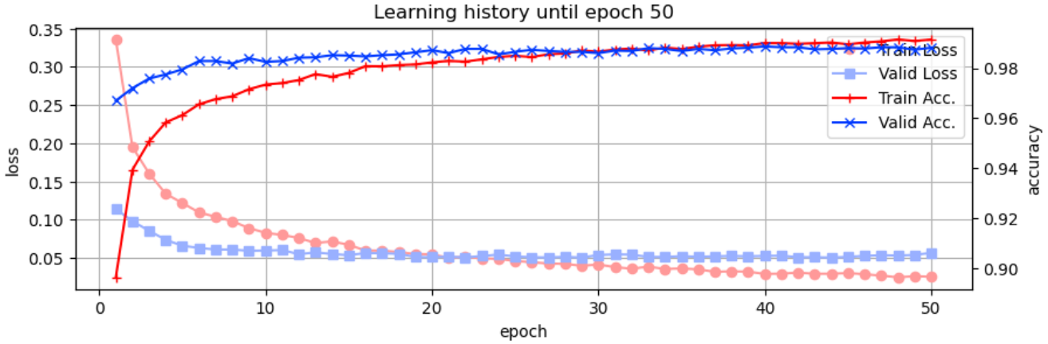

Batch Normalization + Dropout
“Beat the TA” competition

Slide 46
full code
full-day3.ipynb :
https://git.io/aibd-mlp-3-full

