Slide 1
Deep Neural Networks
Janghun Jo
Computer Graphics Lab.
jhjo432@postech.ac.kr

Slide 2
Contents
Classification
XOR problem
Regression
Non-linear regression with DNN
Robust regression

Slide 3
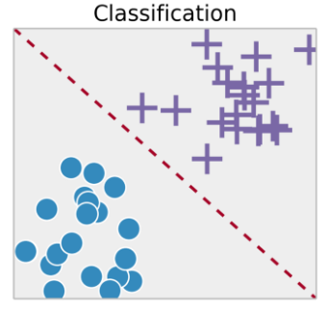
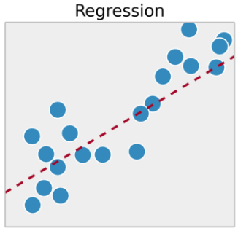
Classification and Regression
Machine learning tasks have two types
Classification : predict class with categorical data
Regression : predict continuous value

Slide 4
Classification
Classification: predict class with categorical data
Logistic regression
Single layer
Sigmoid activation function
Softmax regression (for multi class Classification)
Single layer
Softmax activation function
DNN classifier
Note: Logistic regression and Softmax regression are not regression algorithms.

Slide 5

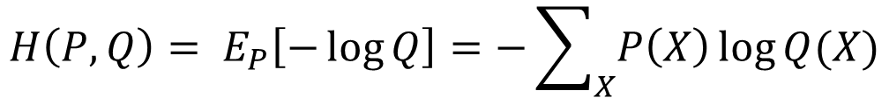
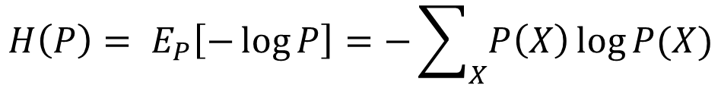
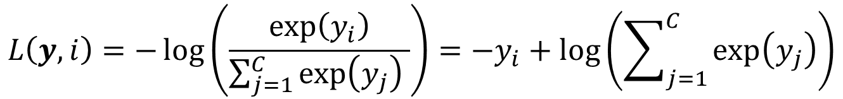
Loss function for Classification
Cross entropy loss (typically for classification)
Entropy of probability distribution $P$
Cross entropy between two probability distributions $P$ and $Q$
Cross entropy loss
$P$: Ground truth label distribution
$Q$: Predicted probability distribution
$$H\left(P\right)= E_{P}\left[−\log{P}\right]=−\sum_{X}{P\left(X\right)\log{P(X)}}$$
$$H\left(P,Q\right)= E_{P}\left[−\log{Q}\right]=−\sum_{X}{P\left(X\right)\log{Q(X)}}$$
$$L\left(y, i\right)=−\log\left(\frac{\exp\left(y_{i}\right)}{\sum_{j=1}^{C}{\exp\left(y_{j}\right)} }\right)=−y_{i}+\log\left(\sum_{j=1}^{C}{\exp\left(y_{j}\right)}\right)$$
Notes:
Entropy: a function of probability distribution (function of function = functional)

Slide 6











Multilayer Perceptron
Stacking layers of multiple perceptrons
Advantages
Nonlinear classification: More complex decision boundary can be defined using multiple layers.
Typically achieves better performance.
$$W_{1}$$
$$W_{2}$$
$$W_{3}$$
$$x_{1}$$
$$x_{2}$$
$$x_{d}$$

Slide 7
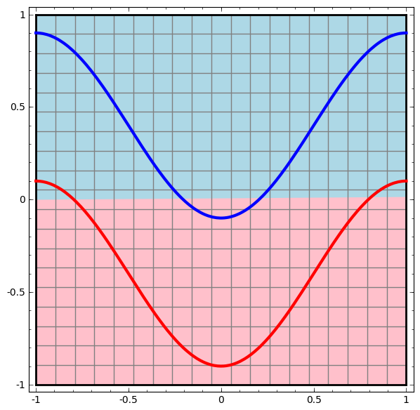
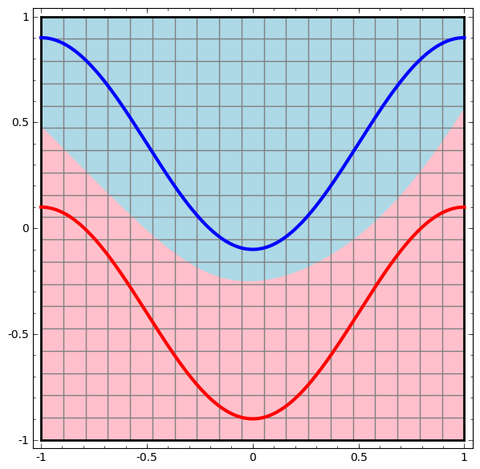





Multilayer Perceptron
Single Perceptron
Multi-layer perceptron
$$x_{1}$$
$$x_{1}$$
$$x_{2}$$
$$x_{2}$$
Data transformation
A new representation

Slide 8
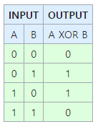
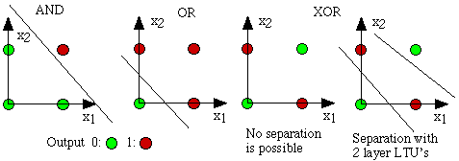
XOR Problem
What is the XOR operation?
Exclusive OR
XOR gives a True output when the number of True inputs is odd.
XOR problem: predict output of XOR operation using a neural network.
Single layer neural networks cannot solve the XOR problem
Data points are not linearly separable.
Deep Neural Networks can solve the XOR problem.

Slide 9
Quiz 1. Solving XOR problem
XOR 데이터 셋 구현
Network 구현
single layer network구현
Fully connected layer - in_features: 2, out_features: 1
DNN 구현
Fully connected layer - in_features: 2, out_features: 20
Fully connected layer - in_features: 20, out_features: 20
Fully connected layer - in_features: 84, out_features: 1
Note
Apply ReLU activation function for hidden layers.
Apply Sigmoid activation function for output layers.
Define a Loss function and optimizer
Cross-Entropy loss
SGD with learning rate 0.01 and momentum 0.5
Train the network on the training data
Test the network on the test data

Slide 10
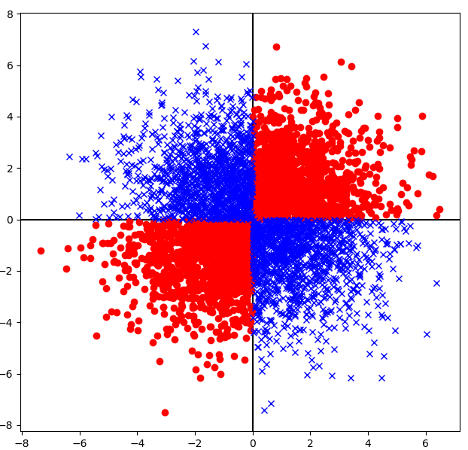
Creating XOR Dataset
We can make XOR dataset using torch.randn function
Generate random (x, y) using torch.randn function
if x * y < 0 then label should be 0
else (x * y >= 0) then label should be 1

Slide 11
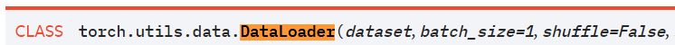
Recap: How to make datasets?
All datasets are subclass of torch.utils.data.Dataset
Make new class and inherit torch.utils.Dataset
It should have __len__(self) method and __getitem__(self, idx) method
__len__(self): returns size of dataset
__getitem__(self, idx): returns (idx)th data sample in Dataset
torch.utils.data.DataLoader reads datasets and make the batch
dataset – dataset from which to load the data. (torch.utils.data.Dataset)
batch_size – how many samples per batch to load (default: 1)
shuffle – set to True to have the data reshuffled at every epoch (default: False).
Usage: for batch_idx, data, label in enumerate(trainloader)

