Slide 1
Radiant Treasures
Your Radiance, Our Passion

Slide 2
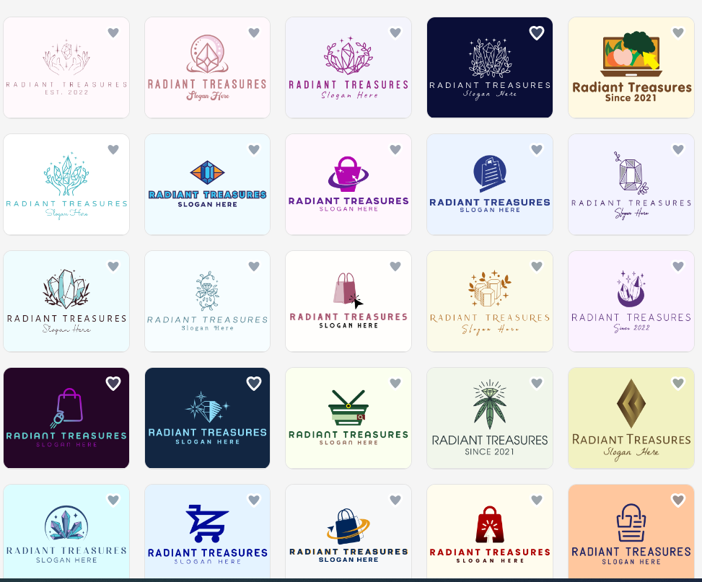
https://www.design.com/maker/logos/page1?Text=Radiant+Treasures&SearchText=jewerly,+gems,+precious+metals,+online+shop,+website&WasModalContinueClicked=true

