Slide 1
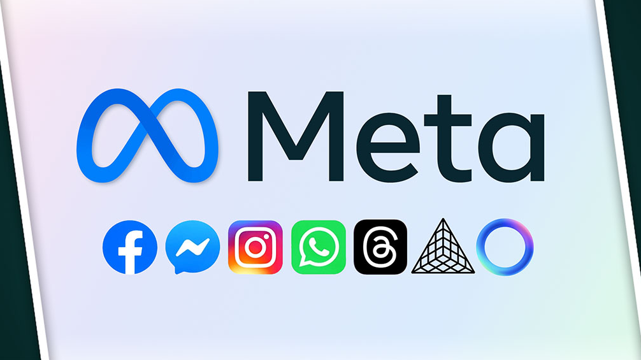
Majidov Nusratulloh
Sophomore student of Dong-A University Student ID:2417563
For the subject Managing Information Sytems

Slide 2
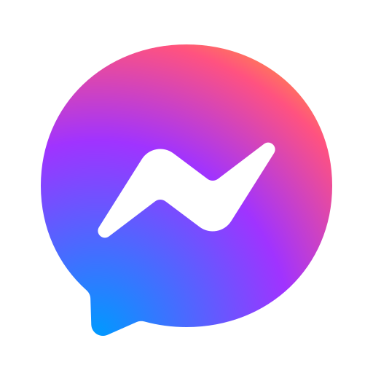




Slide 4
Instagram – IA tracking
Instagram is designed to keep you scrolling. Its Explore and reels pages are powered by algorithms that study your interactions and give you more of what you want The algorithms work so well by tracking what you like, share, save, watch, and even how long you pause on a post or a reel. Powered by machine learning models that continuously update based on user behavior.

Slide 5
Whatsapp – Metadata tracking
While messages are end-to-end encrypted, Whatsapp still collects and analyze metadata such as:
Who you talk to(contact info)
Frequency and timing of messages
Device info location, and app usage patterns
This all helps optimize performance and improve user engagement indirectly.

Slide 6
Facebook – personalized news feed
We mostly can use facebook in order to get news around the world. It uses:
Likes, comments, shares, video watch time, clicks, and even a pause time.
AI ranks posts passed on your behavior and predicted interest
Constantly updated to prioritize high-engagement content.

Slide 7
Messenger – assistant
This app is used to support engagement, monetization, and Data-driven decision-making:
MIS integrates Messenger with Facebook and Instagram DMs, enabling seamless messaging across platforms.
Tracks who you interact with, how often, and what media you share (images, voice, video messages).
Helps Meta understand and recommend your most relevant contacts.

Slide 8

Thank you!

