Slide 1
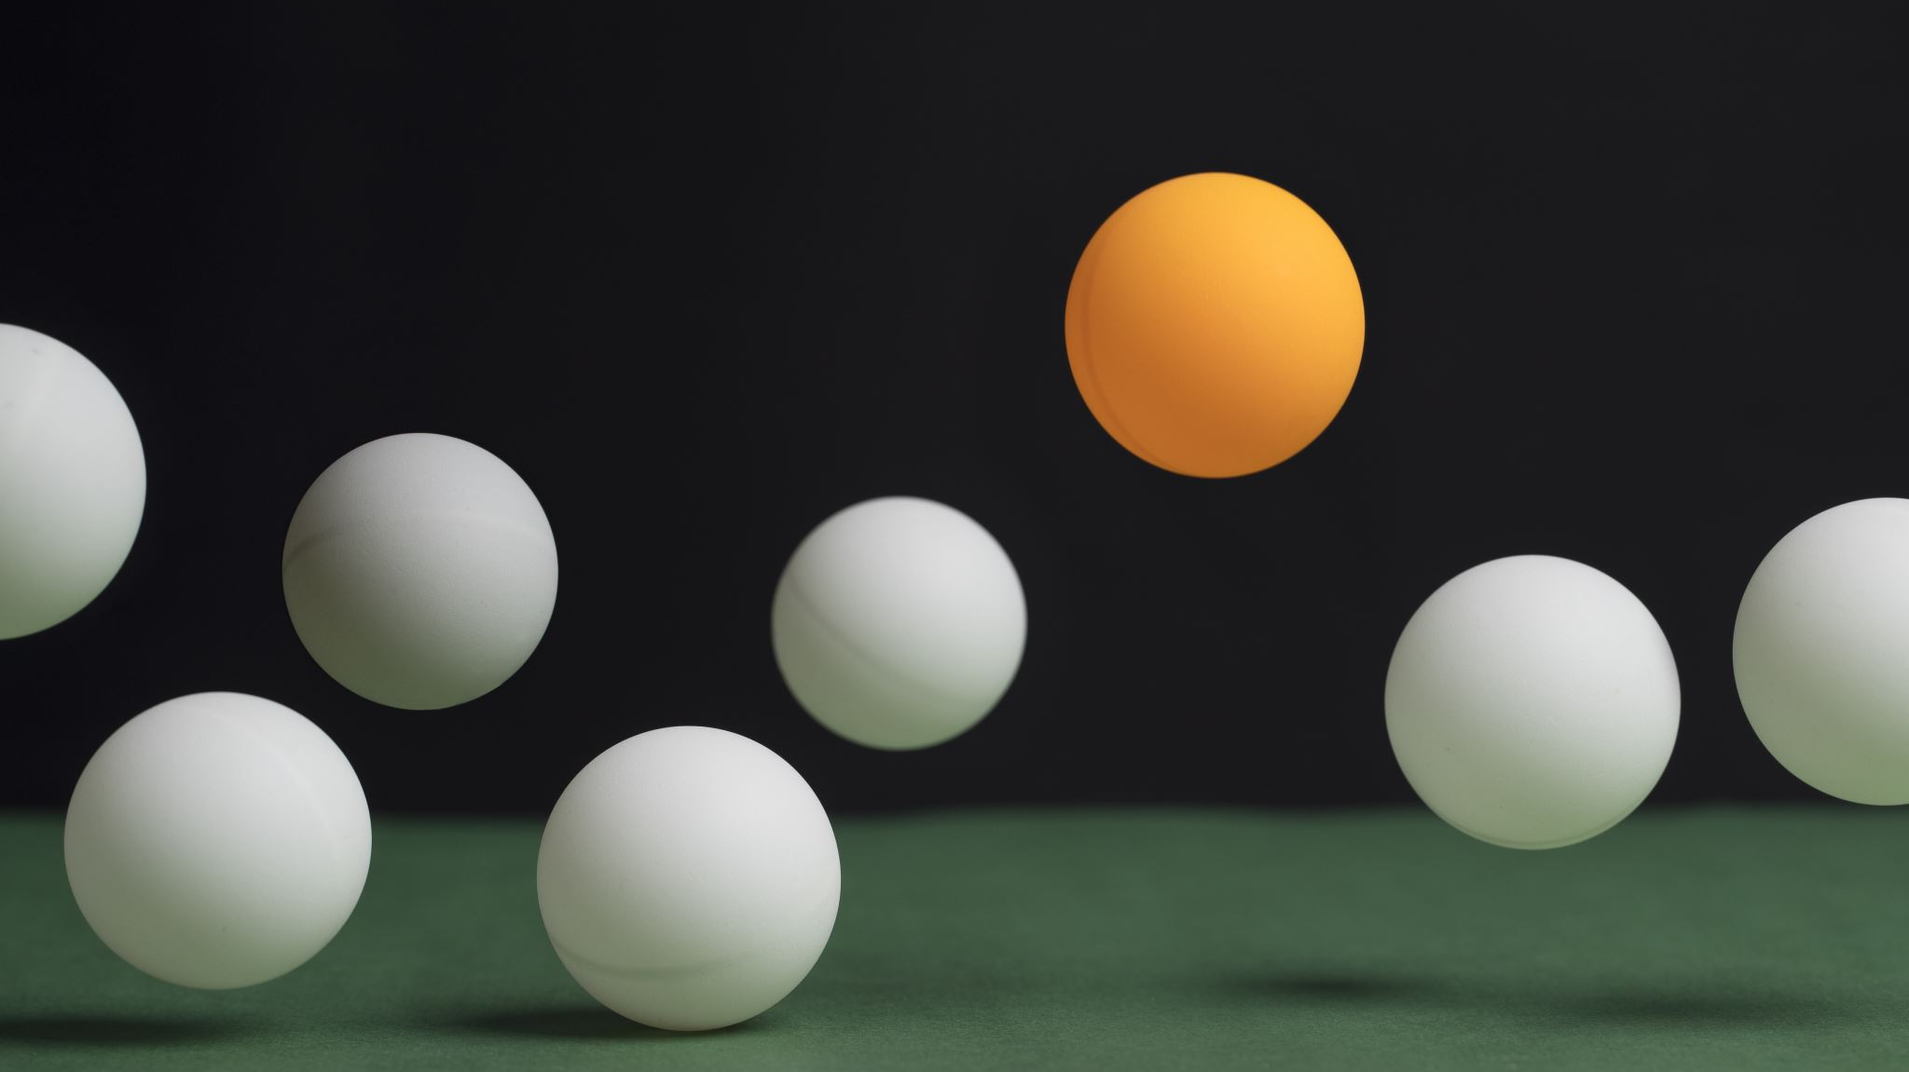
Project Pong
By: Sarah and Norman

Slide 2
Project Set-up
Goals
Small
Rapid development cycle
Provide machine learning insight
Minimal distractions
Project plan
Excel
Notes:
Small team (we adapted to the current environment of restricted engagement.)
Minimal distractions(for ex. avoiding AWS, cloud computing, multiple languages)
Excel(brainstormed, track progress and sculpt the project based on these steps. Separate needs from wants.)

Slide 3
Project Journey
Game sounds:
Simpleaudio and *wav
GUI: tkinter
Game Layout: matplotlib
Event Handling
Animation: FunAnimation
Database: sqlite
Machine Learning: sklearn

Slide 4
Why Pong?
Shopping at Sears
Make the generations meet
Simplicity because of shortage of time
Easy to explain and communicate
Common ground
Notes:
Simplicity because of shortage of time(included machine learning)

Slide 5
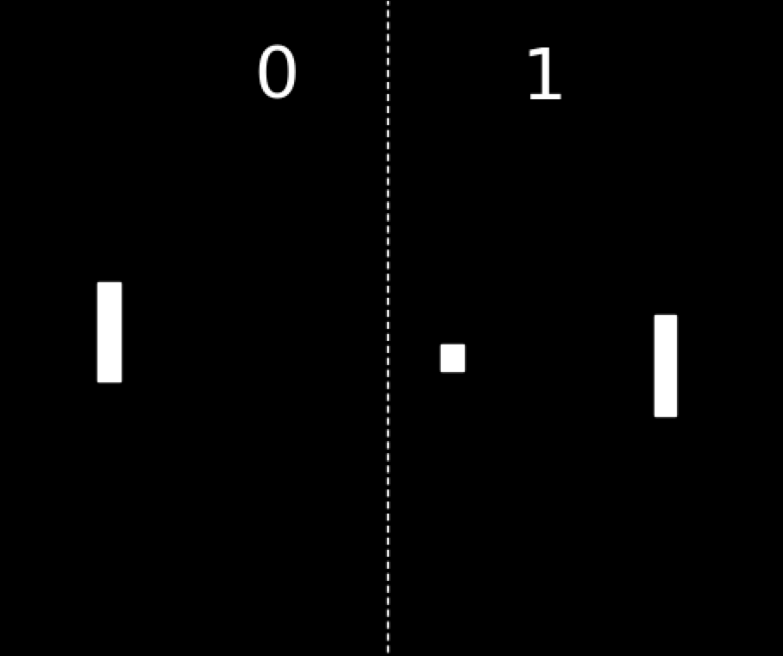
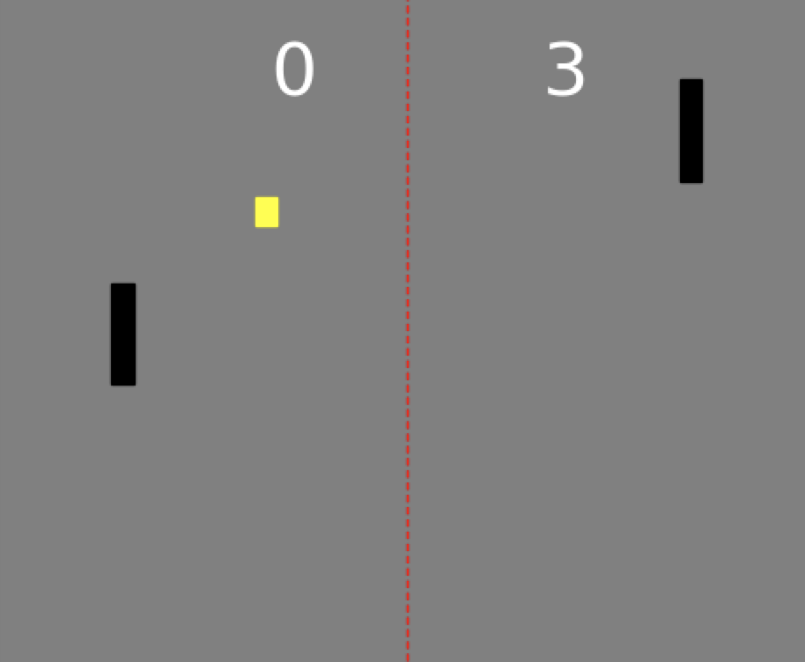
Visualizations
1972
2020

Slide 6
Purpose
Wanted to build a framework to interactively demonstrate machine learning.
Use the power of graphics to show learning.

Slide 7
GAME DEMO

Slide 8
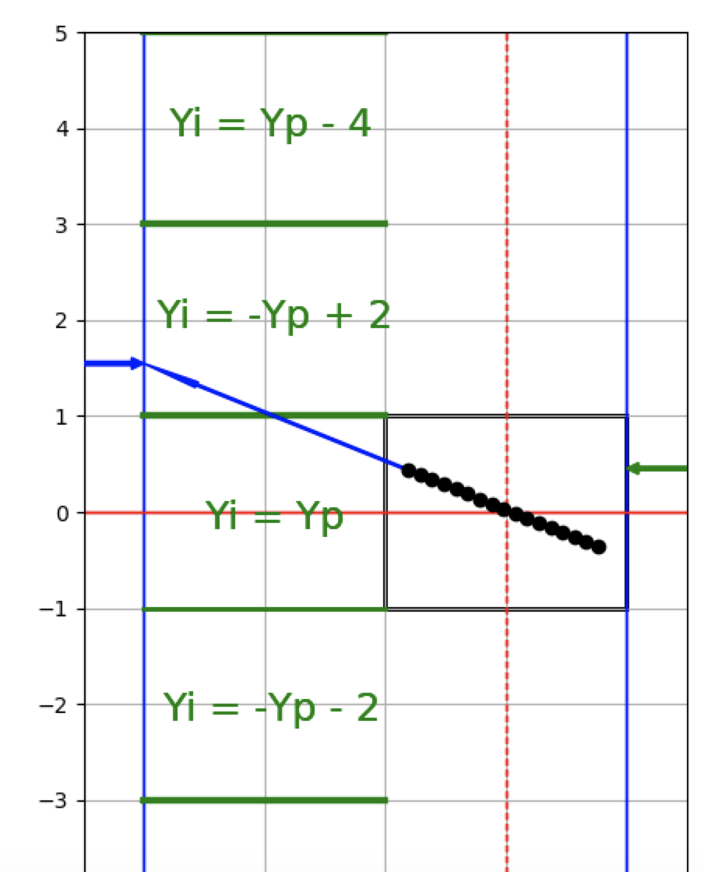
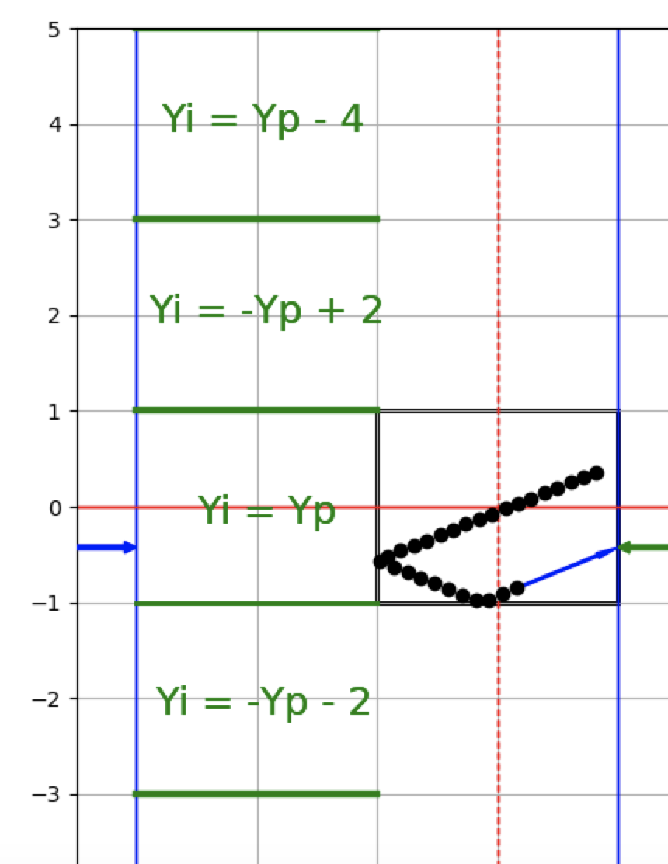
Machine Learning

Slide 9
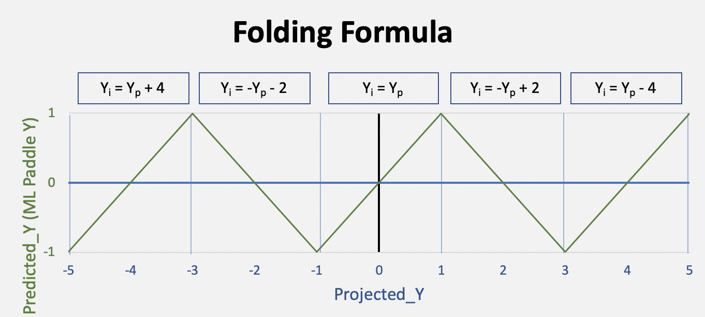

Slide 10

Challenges
Training mode for Pong animation
Ball paths recorded to database
Time, X, Y, Angle, Speed, Y-intercept
Applied Machine Learning
Linear regression
Multivariant linear regression with different combination of path attributes.
$R^{2}$ → 0

Slide 11
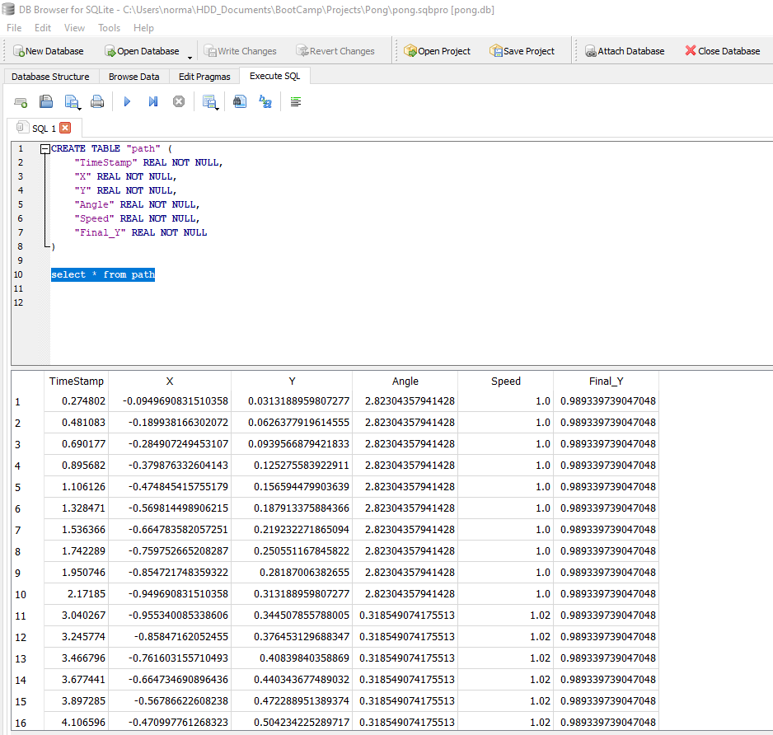
Recorded Ball Paths

Slide 12
Analysis
In Pong the ball travels in a linear fashion.
A collection of ball paths appears random to Machine Learning algorithms.
Our challenge was to present linear paths to the Machine Learning algorithm.
We mapped the reflective geometry of the Pong court into a larger linear space.
We applied Machine Learning in this larger linear space.
We mapped the solution back to the Pong court.
We ended with an extensible framework for experimenting with and demonstrating Machine Learning.

Slide 13
Extensible Class-Based Design
Game
Models the interaction of the pieces.
Court
Model the game geometry and colors.
Paddle
Extend with shaped faces, to alter ball paths.
Extend with energy usage, to encourage minimal movements.
Ball
Models the speed and interaction with walls and paddle.
Extend with spin, friction, and gravity.
Predictor
Encapsulates the machine learning.
Extend with the machine learning.

