Slide 1

Covid – 19
Rice university Data analytics bootcamP
Who will suffer the most ?
Group 1 - Project 1
Norman Gwinn | Panarat Duke | Michael Heitmann | Gini Arimbi

Slide 2
Background
Multiple pandemics in the past (Spanish Flu, Asian Flu, Swine Flu SARS)
Number of new cases throughout the world
Different health care facility
To check the health care preparedness for US states
Introduction
Project Methodology
Conclusion
Main Question and Project Objectives
Output
Limitation and Recommendation
Notes:
-The world has experience multiple pandemics throughout its history. The recent one is COVID 19
-Starting of early this year, it started in Wuhan and China. 3 months later, no one have predicted that it reaches almost all countries
-Every country is affected, but every country has different preparedness for this pandemic. One of the most crucial criteria is the healthcare facility

Slide 3
That’s why our team want to find out which US states will be the most vulnerable in facing COVID 19 cases.
This presentation will be divided into several steps.

Slide 4
Table of contents
Introduction
Objective and main question
Project Methodology
Output
Conclusion
Limitation and Recommendation

Slide 5
Project objectives
“Which US states will be the most vulnerable in facing Corona virus cases?”
To obtain growth rate for cases in global, selected countries, and US
Using linear and exponential plot
Comparing the growth rate to availability of health facility (hospital bed per 1000 person)
Using heat map and bubble map
Find correlation between infection cases with population density
Using scatter plot and linear regression
Introduction
Project Methodology
Conclusion
Main Question and Project Objectives
Output
Limitation and Recommendation

Slide 6
To obtain those results, these are the data we use and the steps we did.

Slide 7
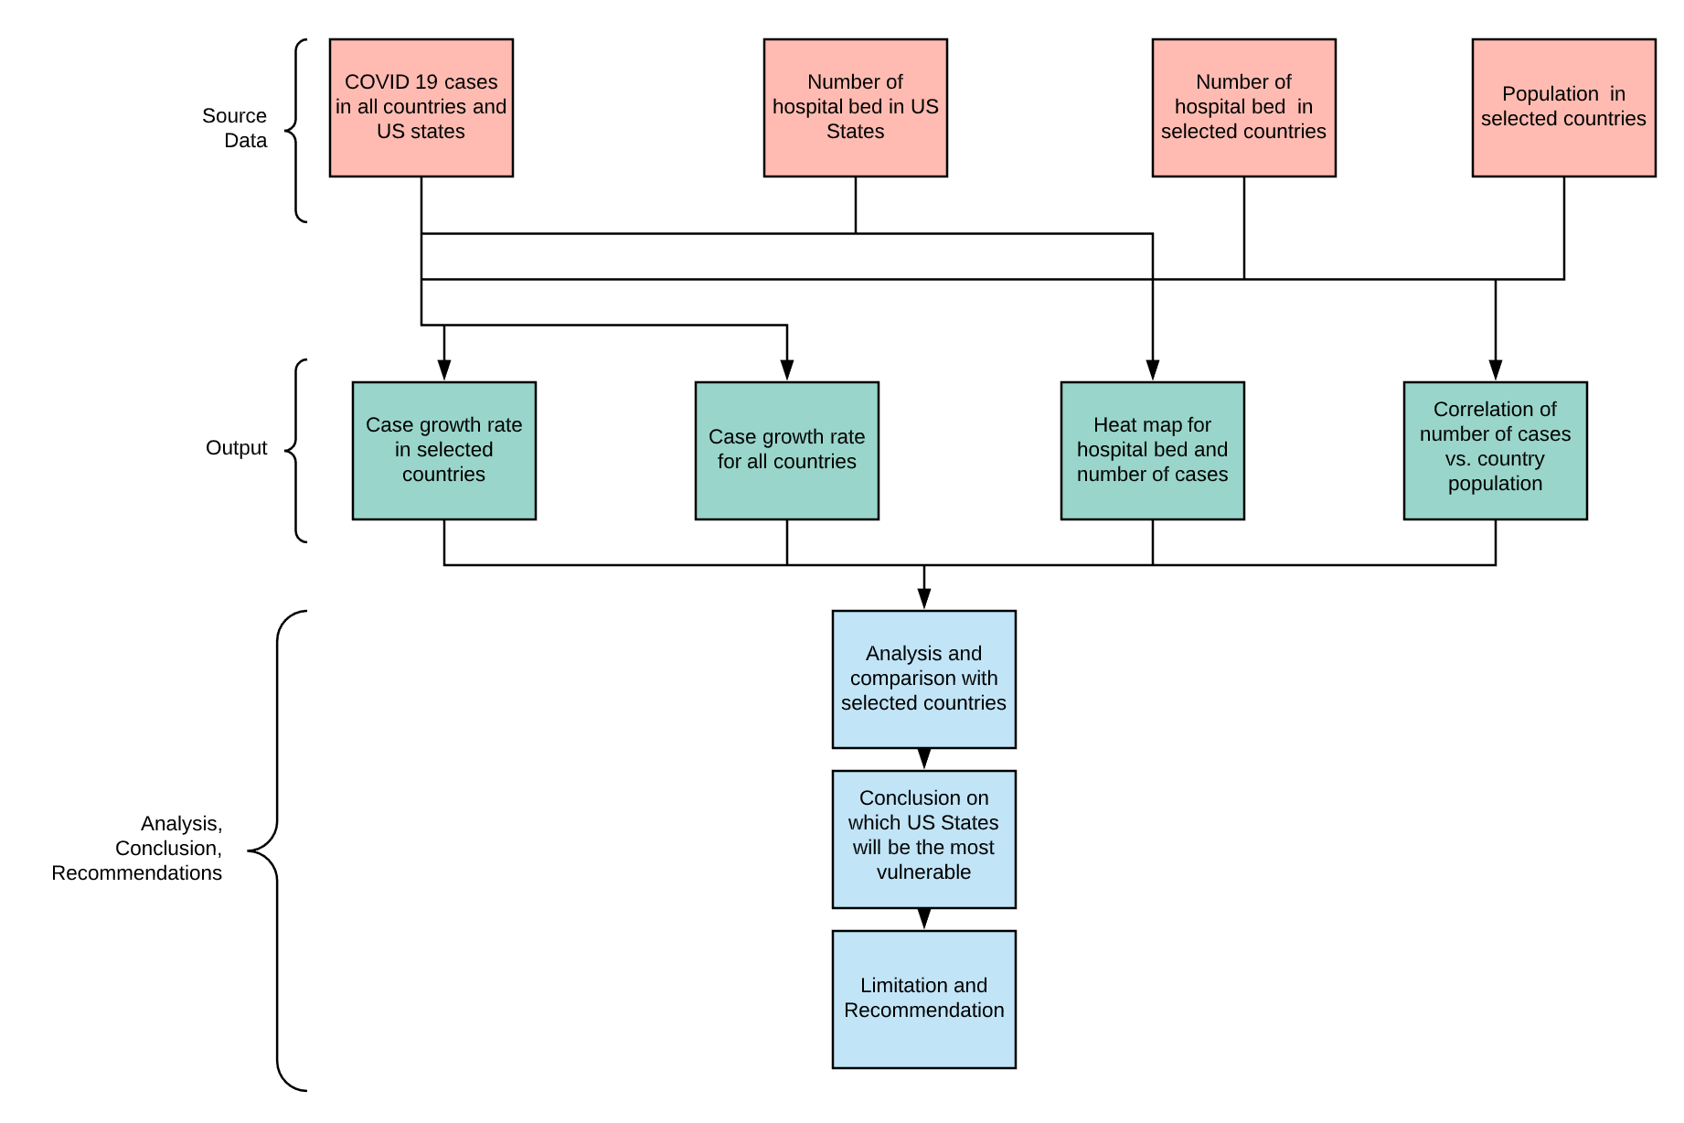
Project Methodology
Introduction
Project Methodology
Conclusion
Main Question and Project Objectives
Output
Limitation and Recommendation
Notes:
-We use source data from worldometer, World Bank, John Hopkins University
-From this data source, we use to plot several graphs to see different relationships and to predict the growth rate
-From there, we derive our analysis and conclusion

Slide 8
In the first part, we created a graph to see the increase in COVID 19 cases in “prominent” countries and globally.

Slide 9
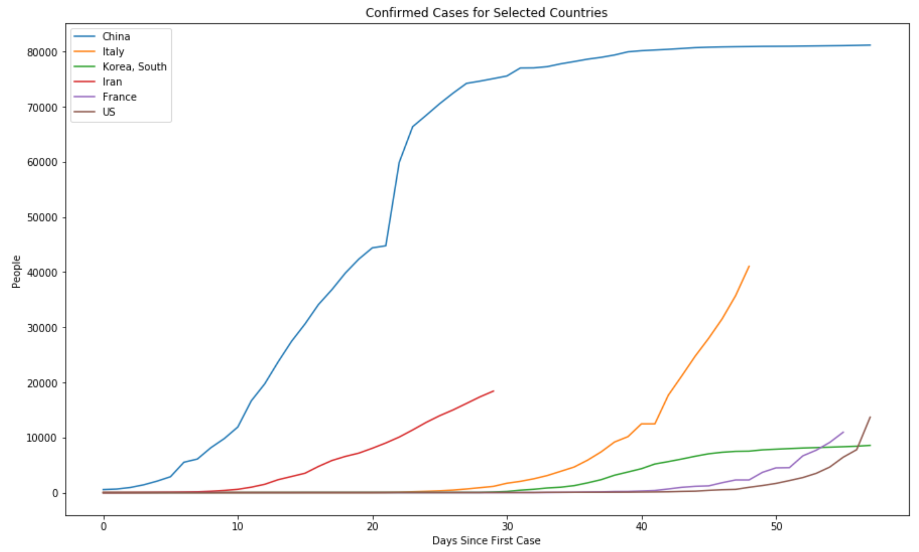
Looking for growth trends of COVID-19.
John Hopkins uses GitHub to distribute daily updates.
As of 19 March 2020: 58 days for 155 countries.
Coverage started on 22 Jan 2020. Few countries had cases on 22 Jan 2020.
We aligned the data, to express trends in each country, based on the date they announced their first case.
China exloded first, and flattened the curve first.
Could you have guessed the other countries? Of these countries, Iran is closest.
Italy grabbed headlines next. South Korea flattened quickly; most beds per capita.
France wobbled up. United States, now testing, is showing exponential growth.
Introduction
Project Methodology
Conclusion
Main Question and Project Objectives
Output
Limitation and Recommendation
Notes:
-this is the growth rate for selected countries. China and South Korea started to plateau
-Italy still has steep growth
-

Slide 10
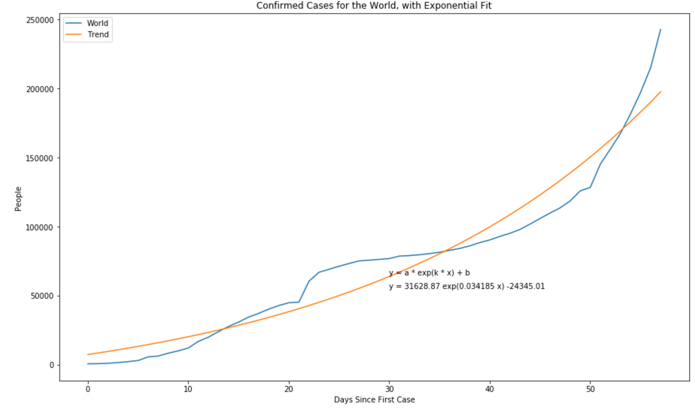
Looking to model the growth-rate for COVID 19.
World wide growth is a rich set.
No alignment of individual countries to a zero date. Most biological growth models are exponential.
The data appeared to grow exponentially. Chose to model the growth with an exponential. This approach could be applied to any city / state / country.
Introduction
Project Methodology
Conclusion
Main Question and Project Objectives
Output
Limitation and Recommendation
Notes:
Explain x, y axis
Blue is the plot of actual data set
Orange is for the exponential growth

Slide 11
And see if there is correlation between country population and average of new cases per day, both for all countries and for selected countries

Slide 12
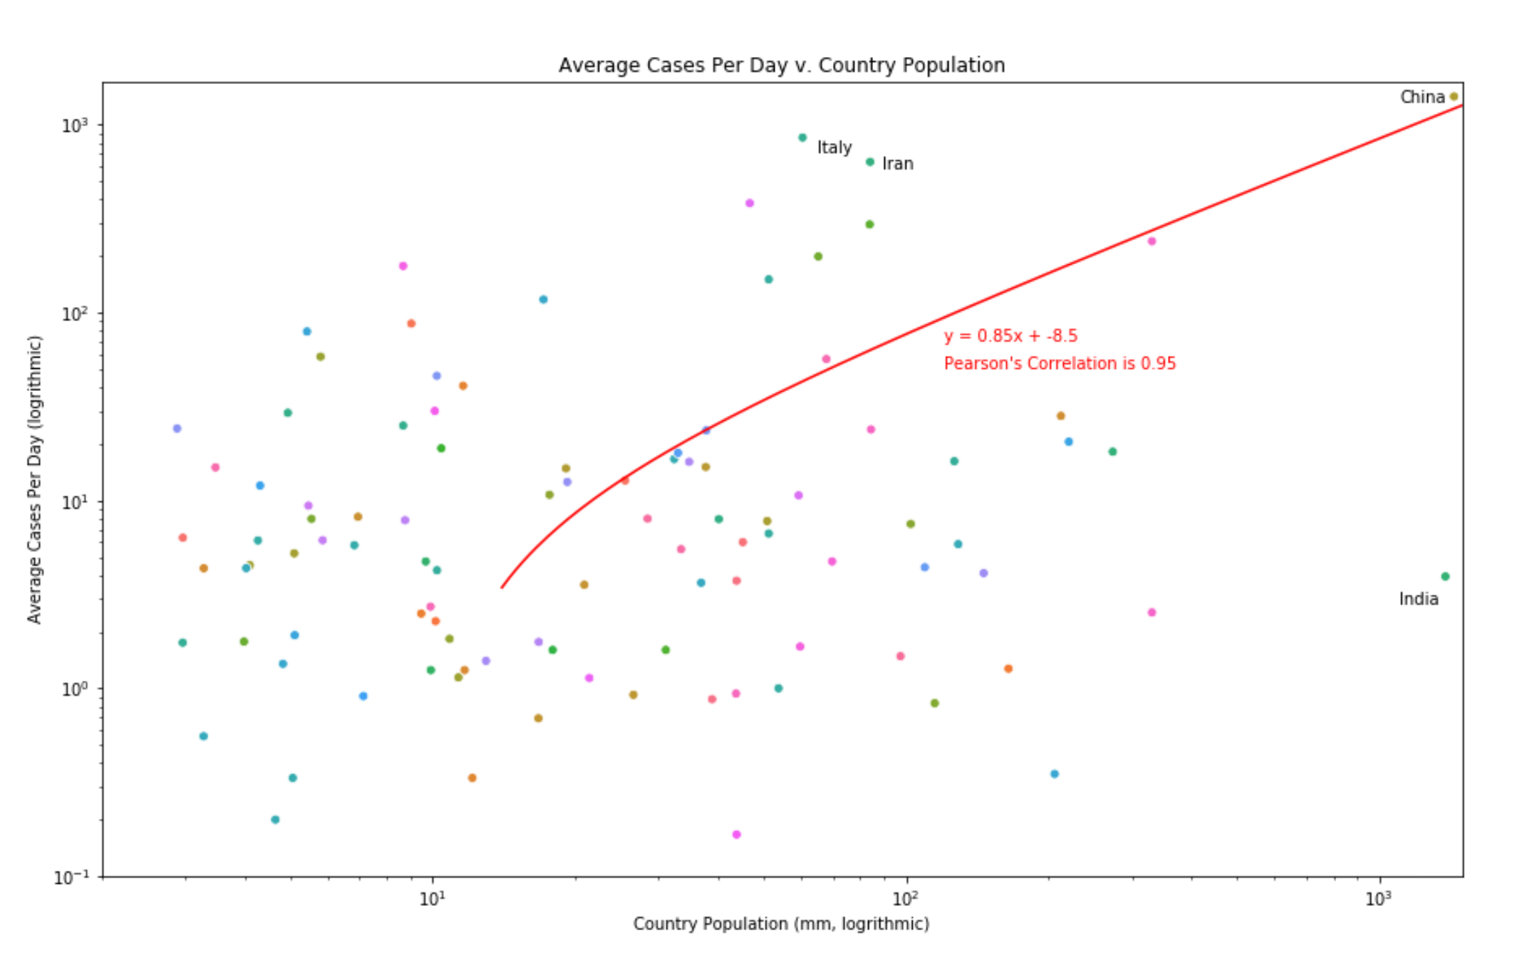
Introduction
Project Methodology
Conclusion
Main Question and Project Objectives
Output
Limitation and Recommendation

Slide 13
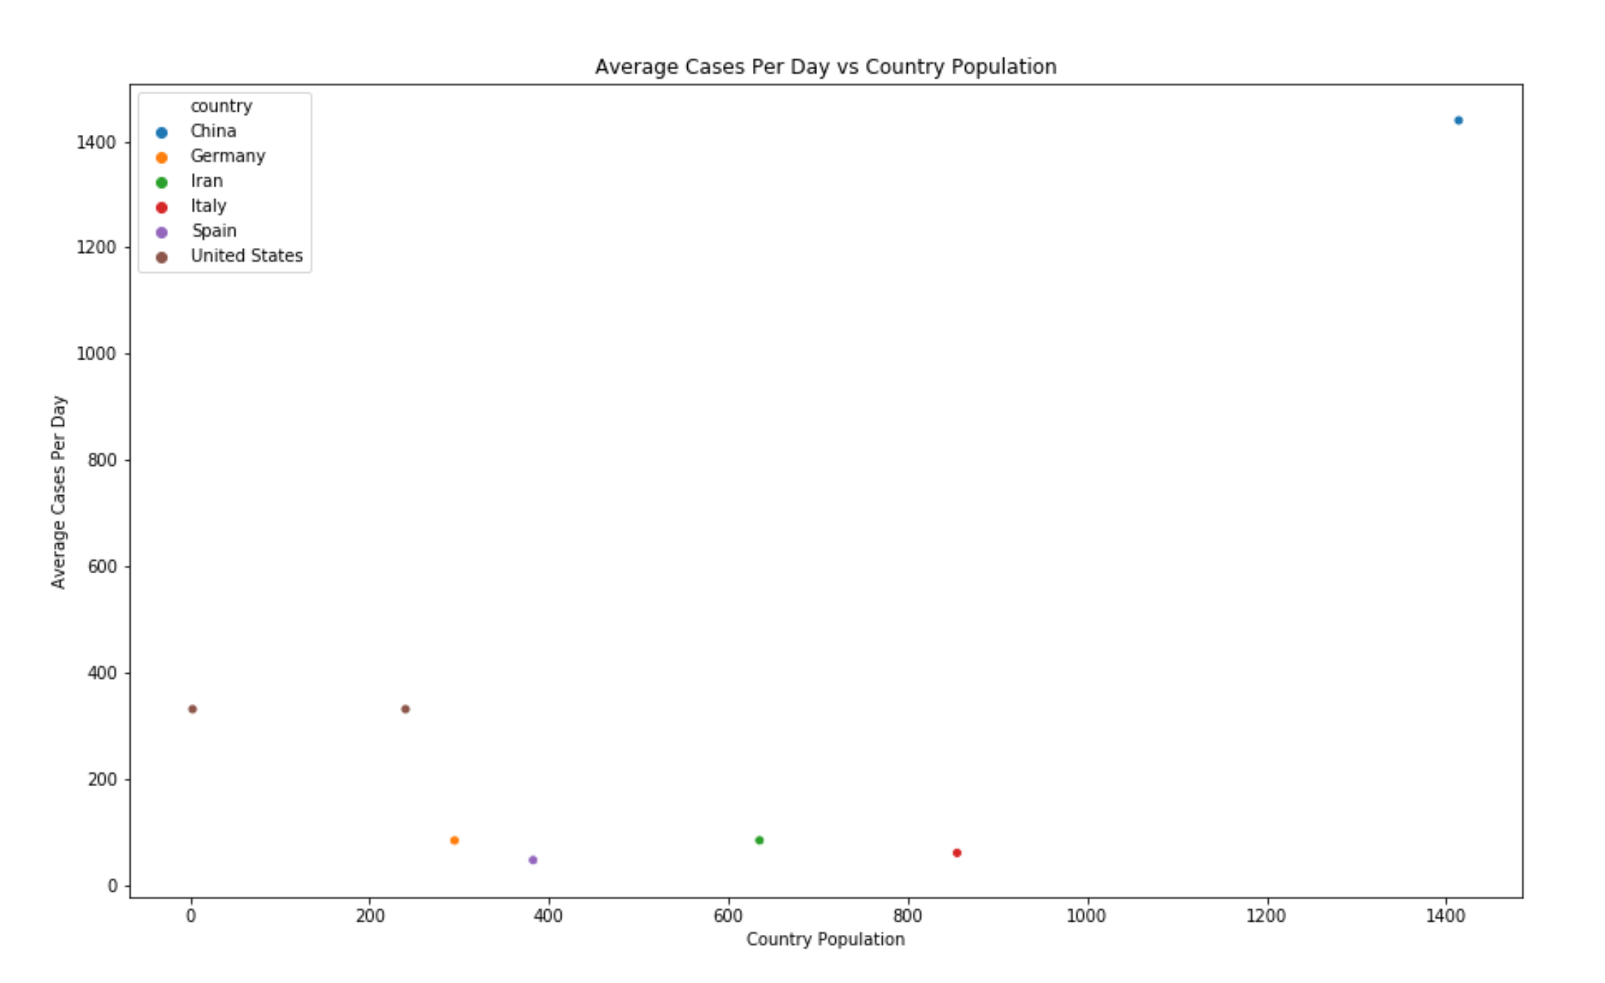

Slide 14
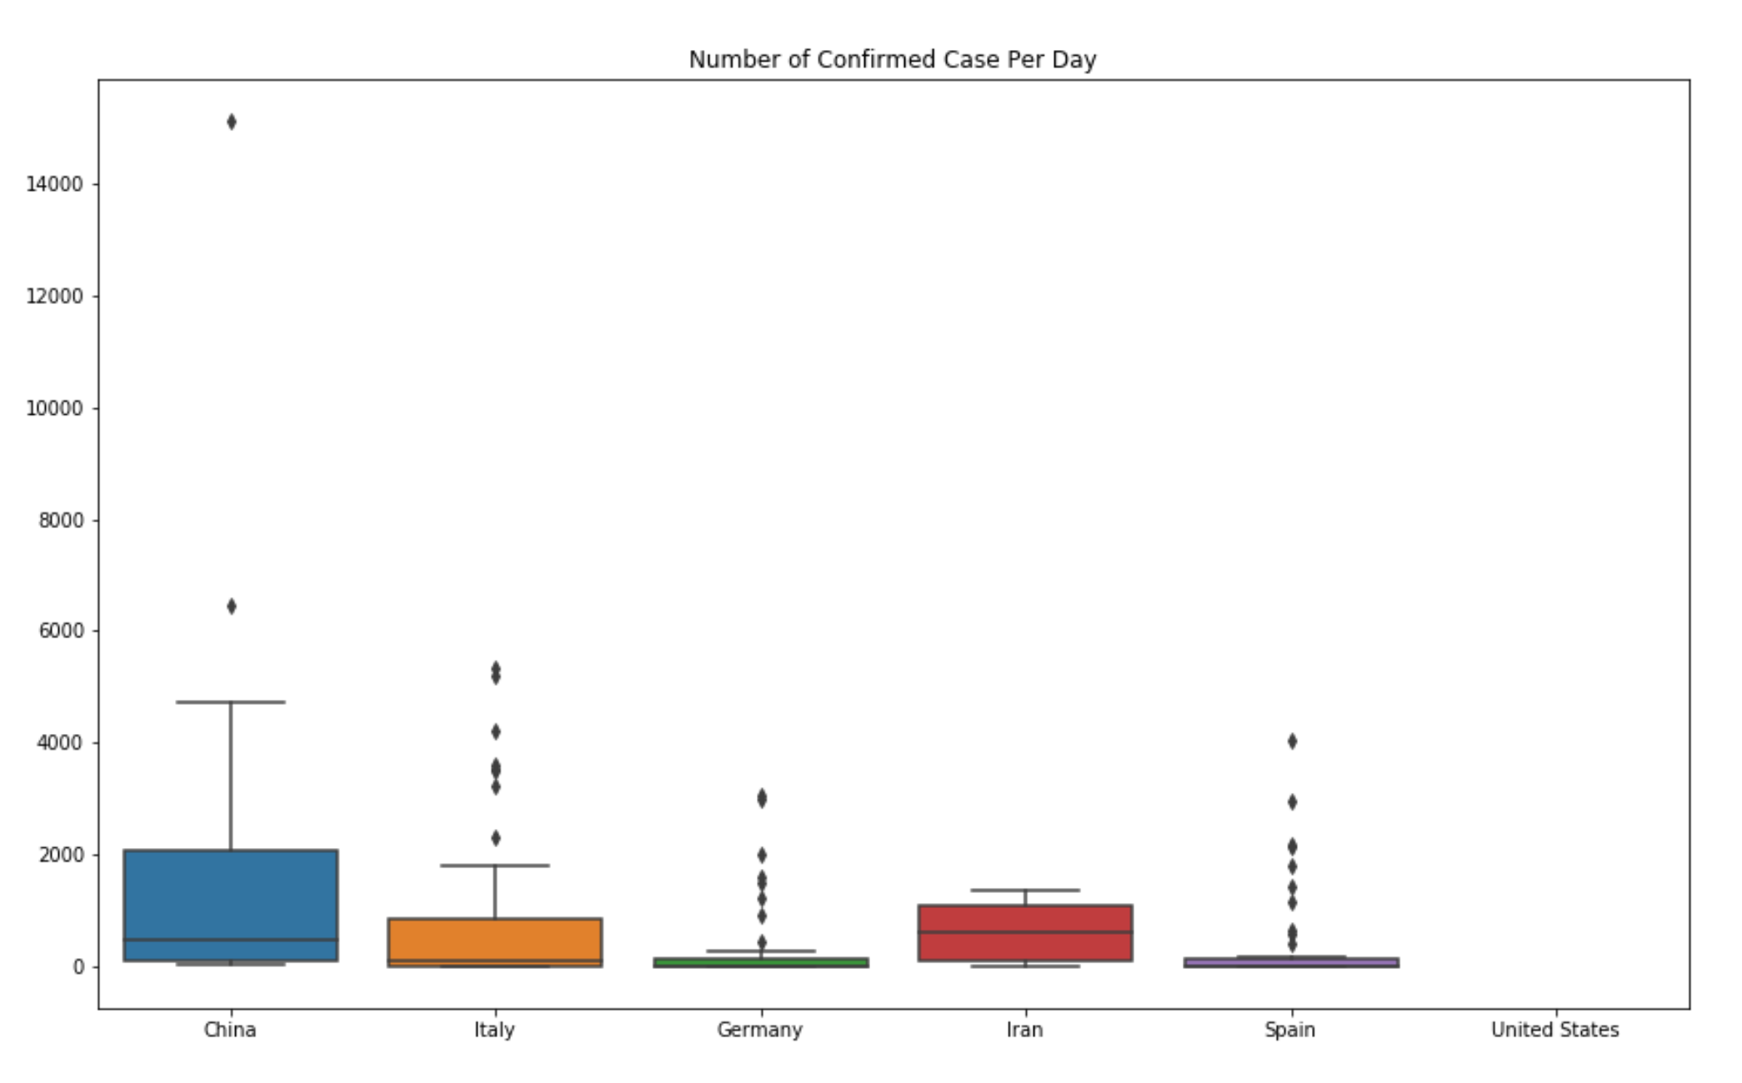
Introduction
Project Methodology
Conclusion
Main Question and Project Objectives
Output
Limitation and Recommendation

Slide 15
We’ve seen the graphs globally.
Now it is time to see the facilities in selected countries.

Slide 16
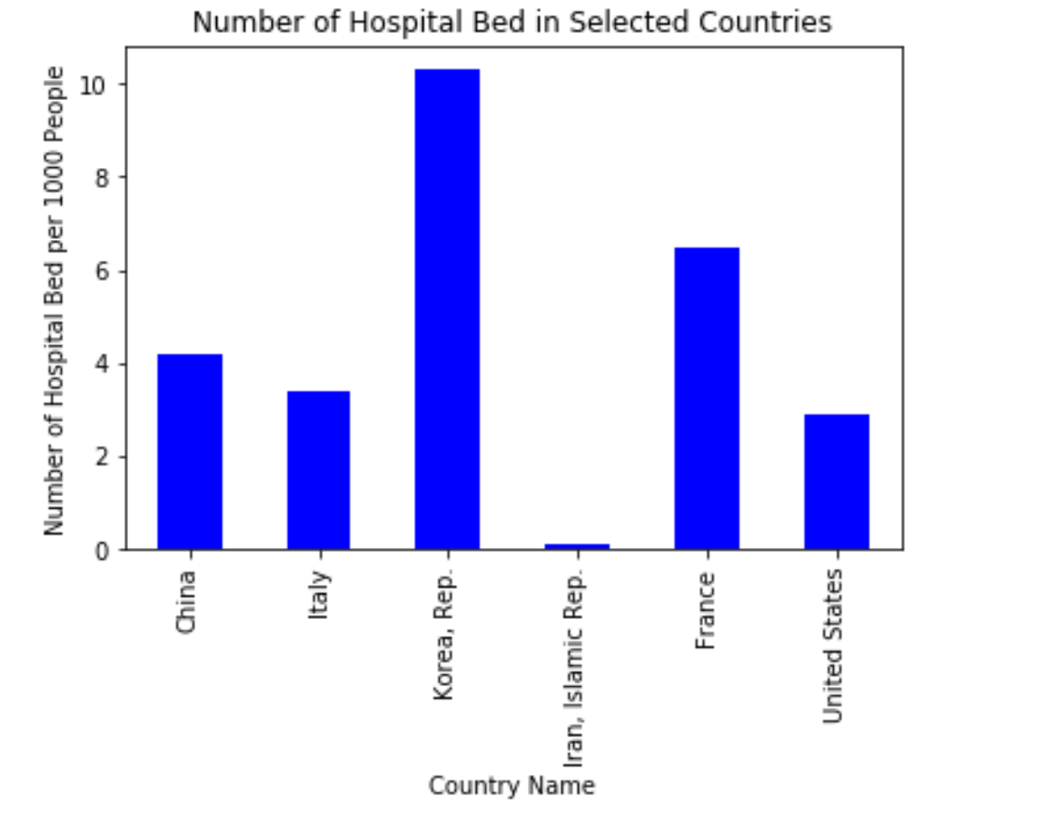
Data is from 2012
Average of world data: 3.8
Introduction
Project Methodology
Conclusion
Main Question and Project Objectives
Output
Limitation and Recommendation
Notes:
Comparison of number of hospital bed in selected countries

Slide 17
And now let’s take a look at the number in US states.
Let’s see the number of case for each states and hospital bed number.

Slide 18
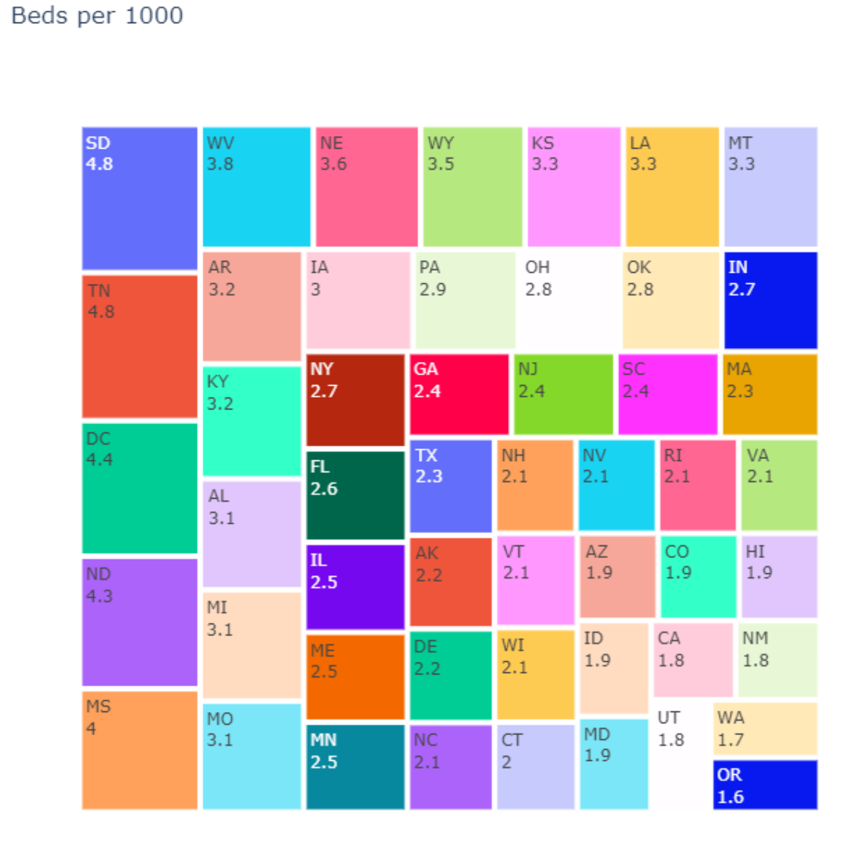
Treeplot for Hospital Bed in US States
Introduction
Project Methodology
Conclusion
Main Question and Project Objectives
Output
Limitation and Recommendation

Slide 19
Let’s visualize in a map what those number will look like..

Slide 20
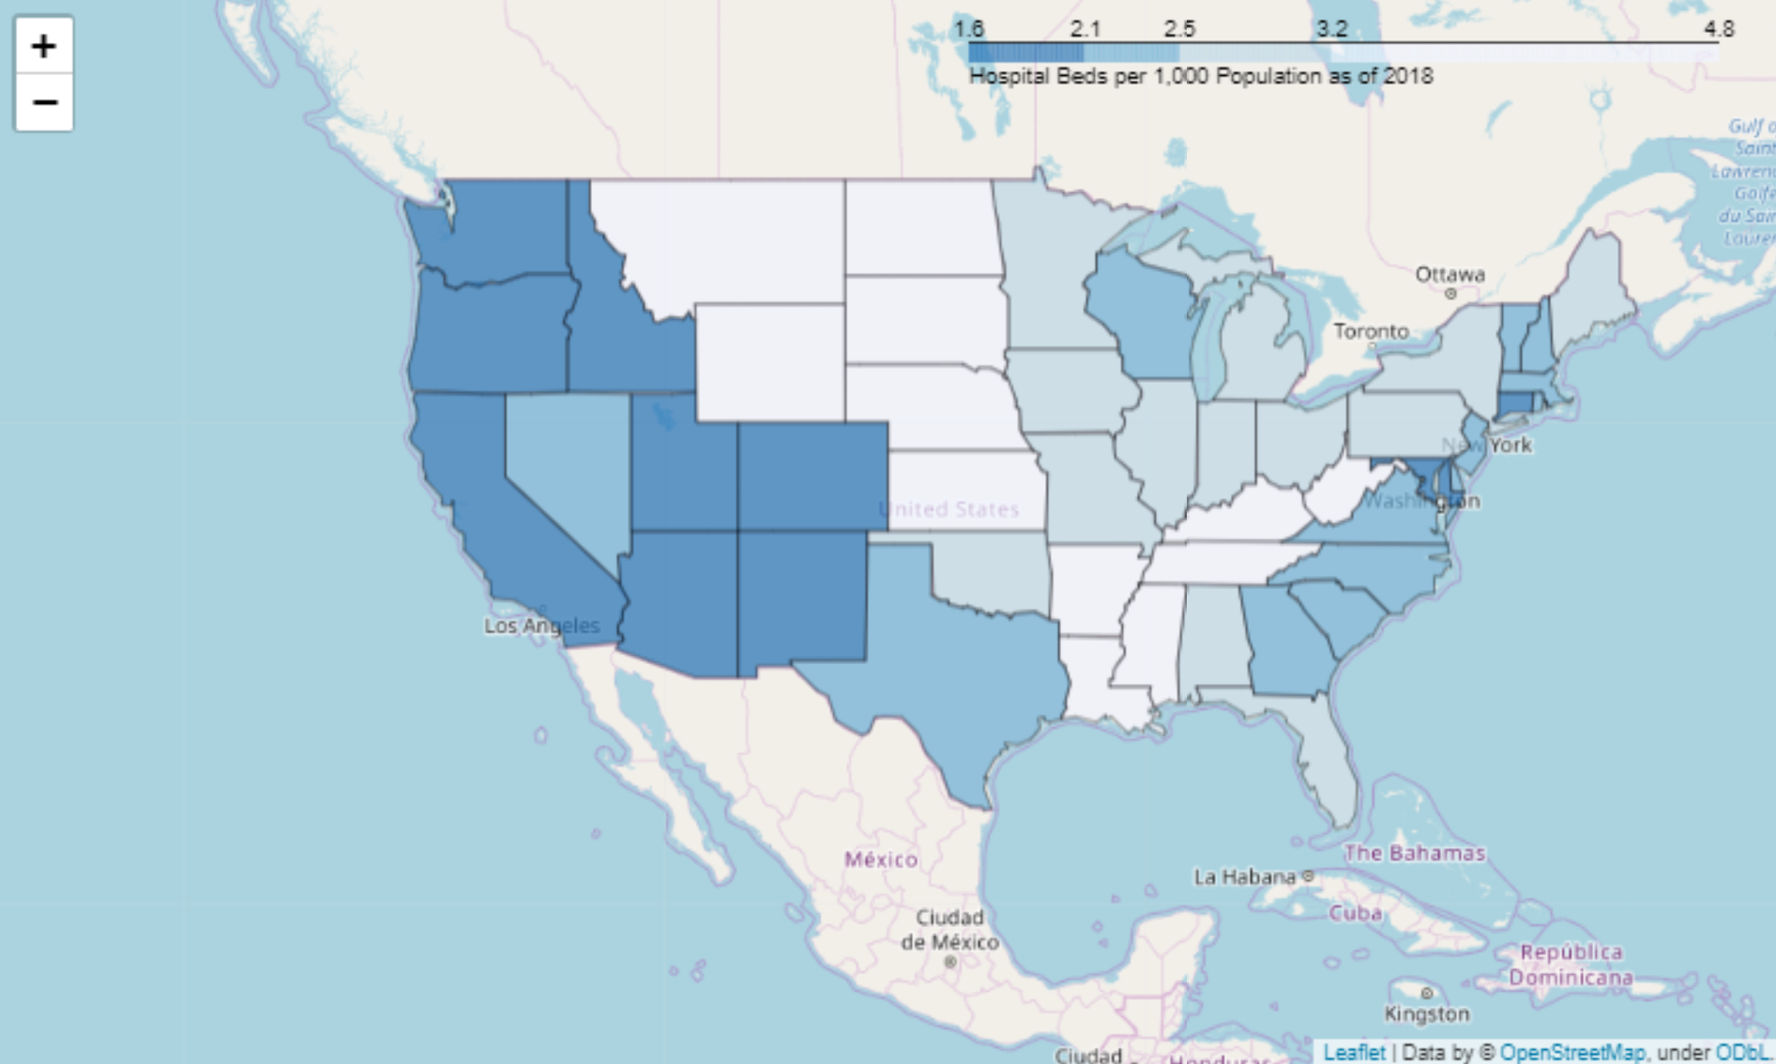
Heat Map for Confirmed Cases in US States
Introduction
Project Methodology
Conclusion
Main Question and Project Objectives
Output
Limitation and Recommendation
Notes:
Add legend

Slide 21
And to combine it with number of hospital bed, to see which states can accommodate more number of people.

Slide 22
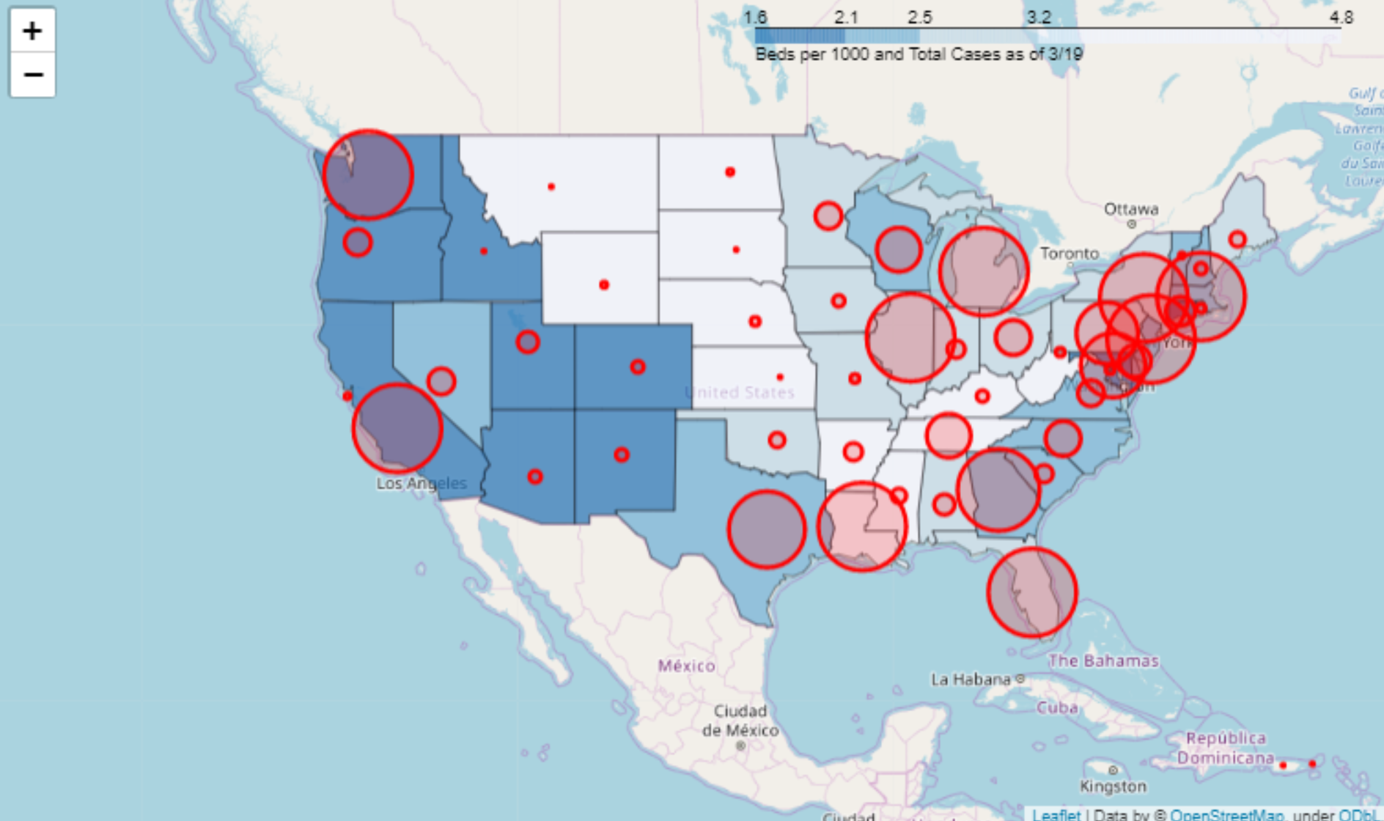
Heat Map for Confirmed Cases in US States vs. Hospital Bed
Introduction
Project Methodology
Conclusion
Main Question and Project Objectives
Output
Limitation and Recommendation
Notes:
Add legend

Slide 23
So, what conclusion we can obtain from the previous map?

Slide 24
Conclusion
The most vulnerable states in US are
States with(darker number of red) and (higher circle): Washington & California
Introduction
Project Methodology
Conclusion
Main Question and Project Objectives
Output
Limitation and Recommendation

Slide 25
Limitation and Recommendations
Limitation
Data limitation:
Number of duration days is still very limited
Number of hospital bed is from 2012
Recommendation of future project:
See other health care parameter (number of doctors, health care cost)
See other correlation from other factor (economic growth, hygiene level)
Introduction
Project Methodology
Conclusion
Main Question and Project Objectives
Output
Limitation and Recommendation

Slide 26
Any Questions?

