Slide 1
Fundamental Statistical Analysis
&
Machine Learning Concepts
Instructor: Norman Lo

Slide 2
Objectives:
// Statistical Modeling
// Robust Testing
// Fundamental Machine Learning
// ML Application

Slide 3
Statistical Analysis
Different types of sample data
Population
Observational
Survey
Experimental

Slide 4
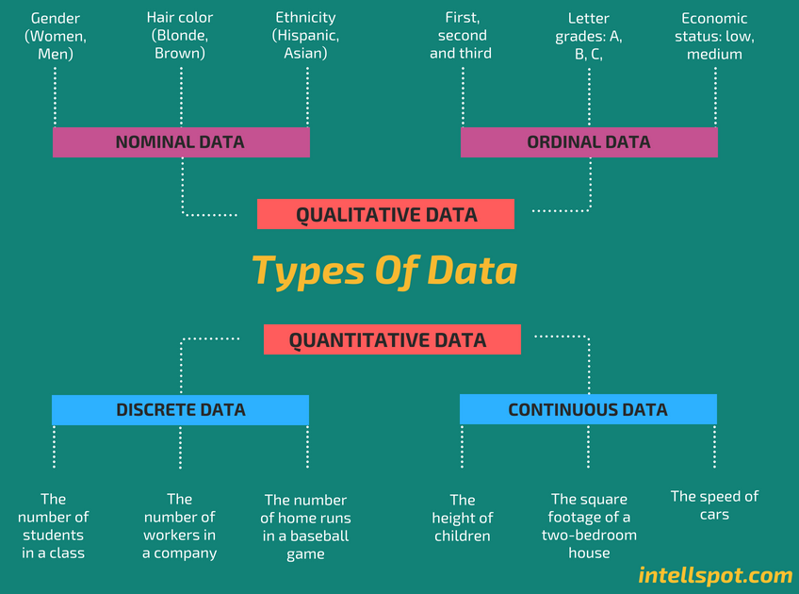
Statistical Analysis
Different types of data
Nominal
Ordinal
Discrete
Continuous
Time Series

Slide 5
Statistical Modeling
Econometrics:
Linear Regression
Generalize Least Squares
Logistic Regression
ARIMA Regression
Statistic:
Weighted Average Estimator
Hieratical Estimator

Slide 6
Robust Tests
One of the most challenging task to validate your model result. Knowing how to evaluate your model could be the key element differentiate you and other candidates in the job market.
RMSE, R-Square, p-value, t-stat, z-stat, F-stat
Type I Error, Type II Error, Precision, F1 score
White-test, auto-correlation, randomization test
Correlation test (VIF), QQ plot test of residual

Slide 7

Machine Learning
The general idea of Machine Learning is to build a statistical architecture which usually involves a set of very heavy computation tasks to optimze an objective function.
$$E(y−\hat{y})$$
Where y is the observed value and $\hat{y}$ is the estimated value.

Slide 8
What kind of problem to solve?
Regression problem
Dependent variable is continuous
II. Classification problem
- Dependent variable is discrete or categorical
Notes:
Operational Dashboard:
Social media dashboards show the amount of Twitter retweets, Facebook likes, followers, shares, etc. This dashboard is helpful for those businesses that want to see the analytics behind their social media activity.
Production dashboards that track and display the number of products that have been created, defects that have been observed, and products that have been shipped. This dashboard is seen as a helpful dashboard-type for marketing purposes.
Help desk or solution dashboards display the total number of tickets received per hour, tickets being resolved or reopened, and the average time it takes to fix a problem.
Strategic Data Dashboard:
An HR department might utilize a strategic dashboard to gleam insights concerning its employees. Employee retention is crucial to building a successful business and can be adjusted and improved based on employee metrics.
A manufacturing department could utilize a strategic dashboard to observe product return rates, then investigate trends as they develop. Using the reported data, the department could then lower or increase its rate of productivity.
Analytical Dashboard:
Analytical dashboards enable businesses to take a microscopic look at their data to reveal valuable patterns and trends. However, the data utilized and displayed by an analytical dashboard needs to be accurate and up-to-date and typically requires more training to use correctly than an operational dashboard

Slide 9
Performance
Machine learning models usually perform better to predict the dependent variable.
Most ML models require high volume training to search for the best set of hyperparameters
Most ML models lack of interpretability compares to traditional econometric and statistical approaches.
Notes:
Operational Dashboard:
Social media dashboards show the amount of Twitter retweets, Facebook likes, followers, shares, etc. This dashboard is helpful for those businesses that want to see the analytics behind their social media activity.
Production dashboards that track and display the number of products that have been created, defects that have been observed, and products that have been shipped. This dashboard is seen as a helpful dashboard-type for marketing purposes.
Help desk or solution dashboards display the total number of tickets received per hour, tickets being resolved or reopened, and the average time it takes to fix a problem.
Strategic Data Dashboard:
An HR department might utilize a strategic dashboard to gleam insights concerning its employees. Employee retention is crucial to building a successful business and can be adjusted and improved based on employee metrics.
A manufacturing department could utilize a strategic dashboard to observe product return rates, then investigate trends as they develop. Using the reported data, the department could then lower or increase its rate of productivity.
Analytical Dashboard:
Analytical dashboards enable businesses to take a microscopic look at their data to reveal valuable patterns and trends. However, the data utilized and displayed by an analytical dashboard needs to be accurate and up-to-date and typically requires more training to use correctly than an operational dashboard

Slide 10
ML Application
Asset valuation
Image classification
Audio classification
Production Lead Time
Forecast weather
Textual output
Notes:
Operational Dashboard:
Social media dashboards show the amount of Twitter retweets, Facebook likes, followers, shares, etc. This dashboard is helpful for those businesses that want to see the analytics behind their social media activity.
Production dashboards that track and display the number of products that have been created, defects that have been observed, and products that have been shipped. This dashboard is seen as a helpful dashboard-type for marketing purposes.
Help desk or solution dashboards display the total number of tickets received per hour, tickets being resolved or reopened, and the average time it takes to fix a problem.
Strategic Data Dashboard:
An HR department might utilize a strategic dashboard to gleam insights concerning its employees. Employee retention is crucial to building a successful business and can be adjusted and improved based on employee metrics.
A manufacturing department could utilize a strategic dashboard to observe product return rates, then investigate trends as they develop. Using the reported data, the department could then lower or increase its rate of productivity.
Analytical Dashboard:
Analytical dashboards enable businesses to take a microscopic look at their data to reveal valuable patterns and trends. However, the data utilized and displayed by an analytical dashboard needs to be accurate and up-to-date and typically requires more training to use correctly than an operational dashboard

