Slide 1
Too many fast food Restaurants around us?
Presented by Norman Lo

Slide 2
Policy Questions:
The Obesity Epidemic in the U.S. continues …
Fact:
Approximately 34% of adults and 15 – 20% of children in the U.S. are obese.
Obesity rates have continued to increase over the past 3 decades.
There are many factors contribute to the problem.
Should we blame fast food restaurants around us?
Resource: https://www.ncbi.nlm.nih.gov

Slide 3
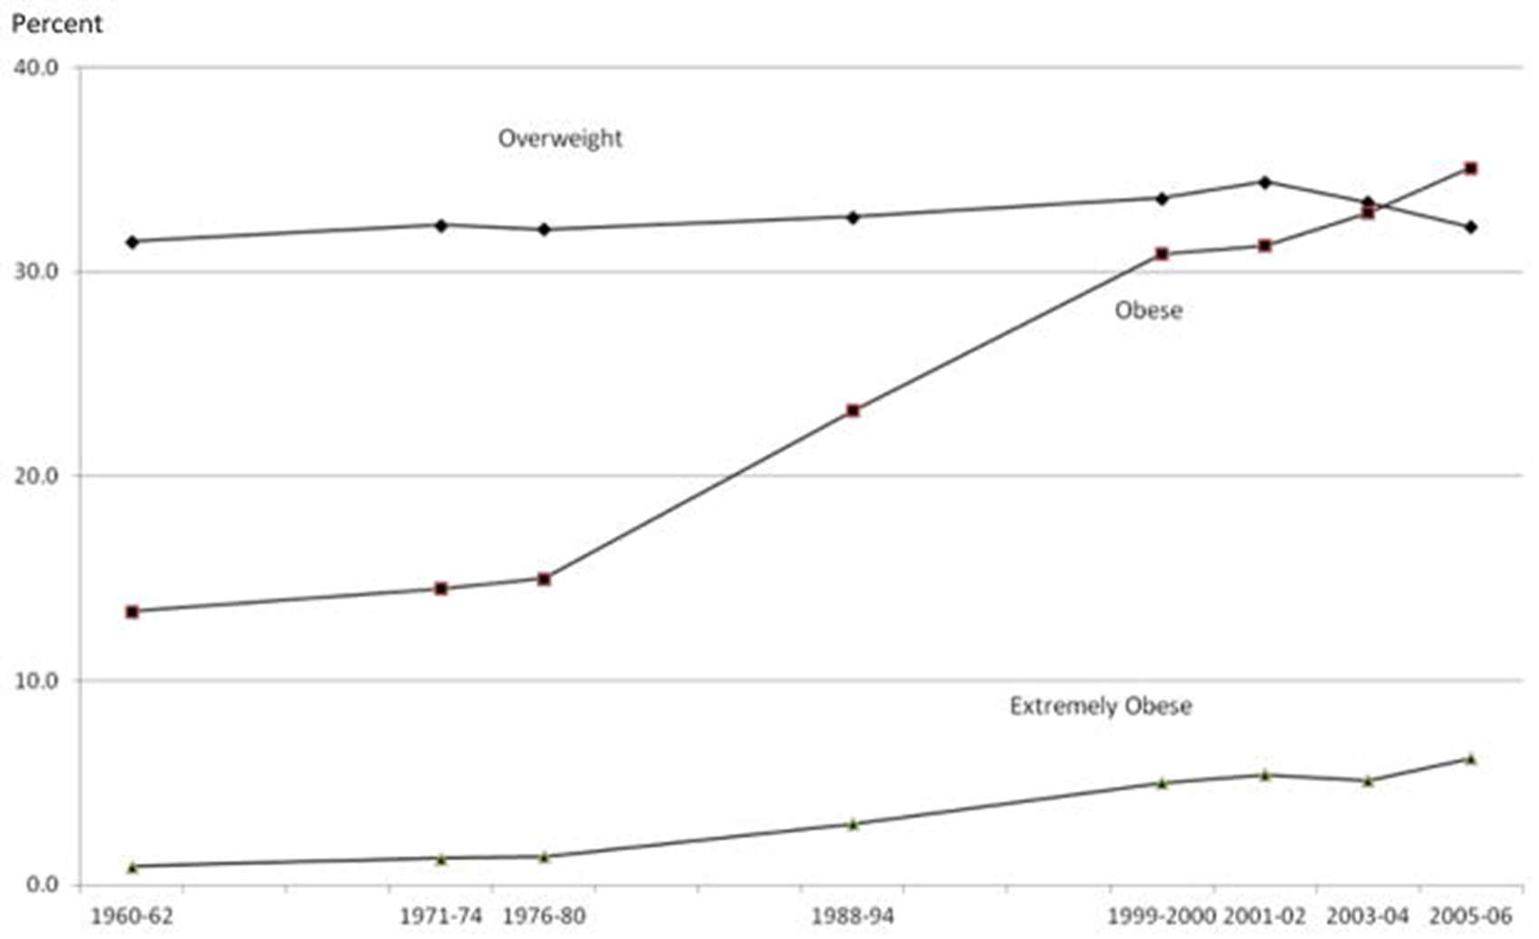
Obesity Trend in the US https://www.cdc.gov/obesity/data/prevalence-maps.html

Slide 4
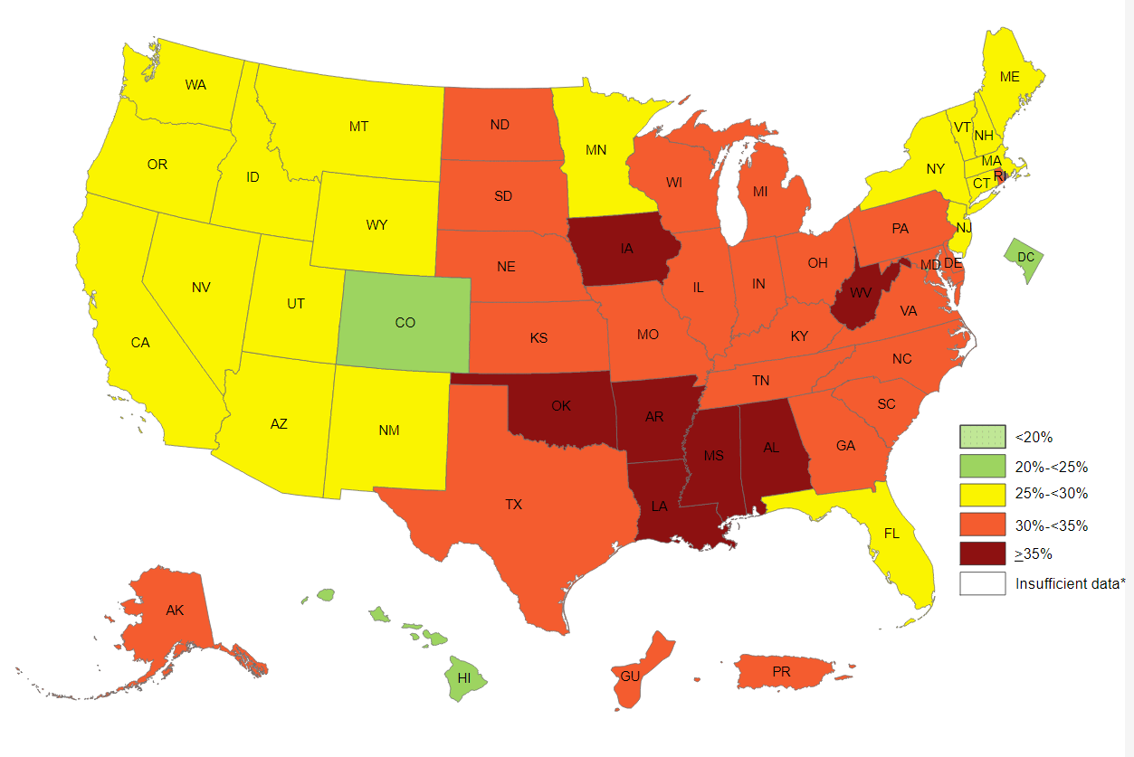
Obesity Prevalence in the U.S. (2017) https://www.cdc.gov/obesity/data/prevalence-maps.html

Slide 5
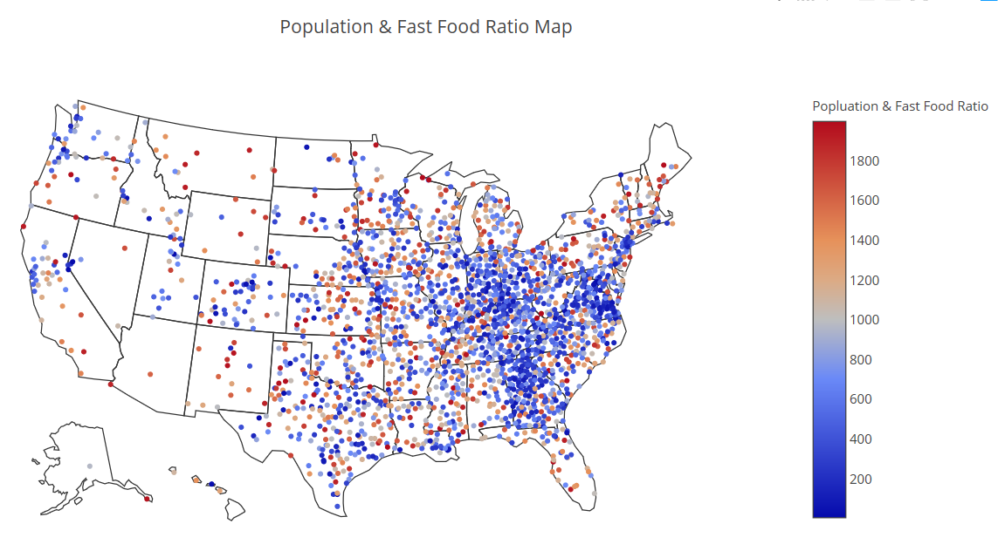
Population & FastFood Ratio (HeatMap)

Slide 6
Literature Review:
Examining the relationship between the food environment and adult diabetes prevalence by county economic and racial composition: an ecological study
(Haynes-Maslow & Leone, Aug 09, 2017)
Link: https://www.ncbi.nlm.nih.gov/pmc/articles/Pmc5551001/
Conclusion: The paper failed to find any statistically significant relationship between the density of fast food restaurants with obesity and diabetes rate, except for the low income counties.
The Epidemiology of Obesity: A Big Picture
(Hruby & Hu, Jul 01, 2016)
Link: https://www.ncbi.nlm.nih.gov/pmc/articles/PMC4859313/
Conclusion: The socioeconomic and sociocultural milieus have been shown to affect risk of obesity. Such factors include genetics, psychological condition, food consumption preference, education attainment, income, physical activity, and family environment.

Slide 7
Policy Question:
Is there any correlation we can find between density of fast food restaurants and obesity or diabetes rate at county level by using the API search on Yelp?
Suggested improvement compare to the previous study:
With the API search method, we can now be more accurate to measure the fast food restaurant density at the county level, instead of using the “U.S. Census Bureau’s County Business Patterns” .

Slide 8




Variables: (County Level, Year = 2013)
Obesity Rate – total obese population divided by total population (resource: CDC)
Diabetes Rate – total diabetes population divided by total population (resource: CDC)
Number of fast food restaurant – Total number of fast food restaurant (resource: Yelp API)
Population – Total population (resource: U.S. Census)
Latitude & Longitude – Location of the county (resource: simplemap.com)
Population & FastFood Ratio – number of fast food restaurant divided by the population
Ratio Rank – High (ratio < 500) , Mid (500 < ratio < 1500), Low (ratio > 1500)

Slide 9
Methodology
Level 1: Independence T-Test
Objective: Find any statistical significant difference between low density and high density counties.
Level 2: ANOVA
Objective: Find any statistical significant difference between low, medium, and high density counties.
Level 3: Single Variable Regression Model
Objective: Find any correlation between density and obesity rate or diabetes rate.

Slide 10
Data: (Year = 2013)
Diabetes Prevalence:
Obesity Prevalence:
Census County Population:
City Location Data:

Slide 11
Data Issues:
Duplicated county names in the data.
Solution: merge data sets by FIPS codes (unique)
2. Some of the counties do not have the obesity or diabetes data. Solution: those counties need to be dropped (total 85 counties)
3. The FIPS codes is not defined as integer.
Solution: needs to convert all FIPS codes to integer before merging

Slide 12
Final Data: (Merged)
FIPS Codes | Age-Adjusted Percent Diabetes | Age-Adjusted Percent Obesity | County Name | State Name | lat | lng | Zip_Code | Population | fast_food
1001 | 11.9 | 33.8 | Autauga | Alabama | 32.4321 | -86.6582 | 36003 | 54695 | 41
1003 | 8.8 | 27.2 | Baldwin | Alabama | 30.3555 | -87.5041 | 36530 | 194736 | 180
1005 | 16.9 | 44.7 | Barbour | Alabama | 31.7085 | -85.6109 | 36017 | 26947 | 13
1007 | 13.8 | 40.3 | Bibb | Alabama | 33.1468 | -87.0030 | 35115 | 22503 | 268
1009 | 12.3 | 34.9 | Blount | Alabama | 33.9064 | -86.5178 | 35013 35121 | 57623 | 122

Slide 13
Summary Statistics: n = 3139 (Before Cleaning)
 | Age-Adjusted Percent Diabetes | Age-Adjusted Percent Obesity | fast_food | pop_ff_ratio
count | 3139.000000 | 3139.000000 | 3139.000000 | 3139.000000
mean | 9.618127 | 30.840395 | 137.829882 | inf
std | 2.182928 | 4.638937 | 388.669906 | NaN
min | 3.800000 | 11.800000 | 0.000000 | 5.590000
25% | 8.100000 | 28.000000 | 9.000000 | 499.713837
50% | 9.300000 | 31.000000 | 30.000000 | 1079.941176
75% | 11.100000 | 33.700000 | 93.000000 | 2120.446970
max | 20.800000 | 47.900000 | 7100.000000 | inf

Slide 14
Summary Statistics: n = 2906 (After dropping “0”)
 | Age-Adjusted Percent Diabetes | Age-Adjusted Percent Obesity | fast_food | pop_ff_ratio
count | 2906.000000 | 2906.000000 | 2906.000000 | 2906.000000
mean | 9.733964 | 30.945699 | 148.880936 | 1984.016126
std | 2.164388 | 4.638958 | 401.913899 | 9612.109975
min | 3.800000 | 11.800000 | 1.000000 | 5.590000
25% | 8.200000 | 28.100000 | 13.000000 | 458.969695
50% | 9.400000 | 31.100000 | 36.000000 | 982.936914
75% | 11.200000 | 33.900000 | 102.000000 | 1779.595734
max | 20.800000 | 47.900000 | 7100.000000 | 432373.000000

Slide 15
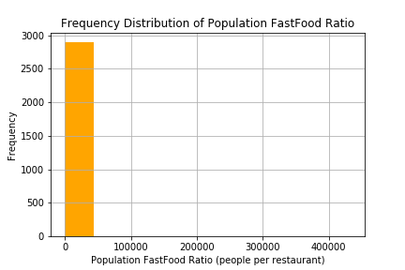
Frequency Distribution: (Before)
Data is extreme skewed to the left, which identifies the outliners in the data for Population FastFood Ratio.

Slide 16
Summary Statistics: n = 2302 (After dropping pop_ff_ratio > 2000)
 | Age-Adjusted Percent Diabetes | Age-Adjusted Percent Obesity | fast_food | pop_ff_ratio
count | 2302.000000 | 2302.000000 | 2302.000000 | 2302.000000
mean | 9.876759 | 31.015899 | 179.766290 | 824.835123
std | 2.102624 | 4.579583 | 442.031244 | 527.838440
min | 3.800000 | 11.800000 | 1.000000 | 5.590000
25% | 8.400000 | 28.200000 | 21.000000 | 372.594979
50% | 9.600000 | 31.200000 | 48.500000 | 728.027432
75% | 11.300000 | 33.975000 | 131.000000 | 1224.617908
max | 20.800000 | 46.400000 | 7100.000000 | 1997.769231

Slide 17
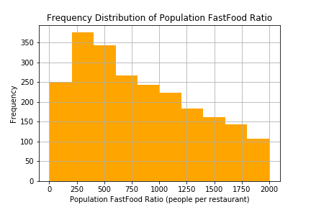
Frequency Distribution: (After)
The data is more spread out after cleaning. The study will focus on the counties that has population fastfood ratio equal or less that 2000.

Slide 18
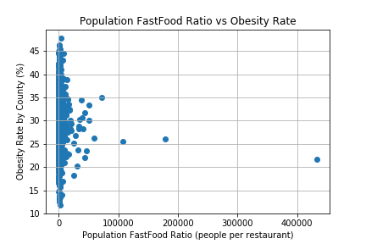
Obesity vs Population FastFood Ratio: (Before)

Slide 19
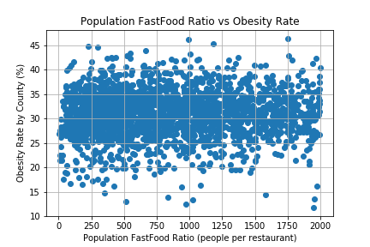
Obesity vs Population FastFood Ratio: (After)

Slide 20
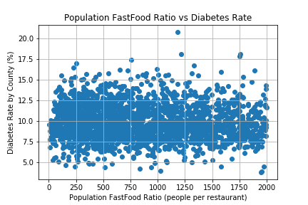
Diabetes vs Population FastFood Ratio: (After)

Slide 21
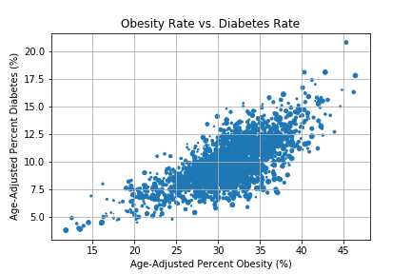
Obesity Rate & Diabetes Rate:

Slide 22
Population FastFood Ratio Rank:
For the hypothesis testing, counties were defined by the population fastfood ratio rank.
High Ratio Counties: pop_ff_ratio < 500
Mid Ratio Counties: 500 < pop_ff_ratio < 1500
Low Ratio Counties: 1500 < pop_ff_ratio < 2000

Slide 23
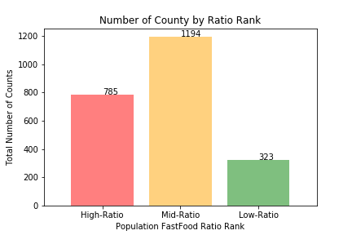
Number of County by Ratio Rank

Slide 24
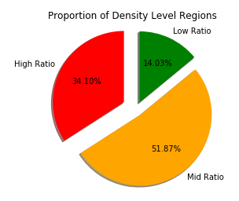
Proportion of Each County by Ratio Rank

Slide 25
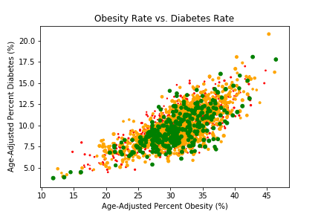
Obesity Rate & Diabetes Rate: (by Rank)

Slide 26
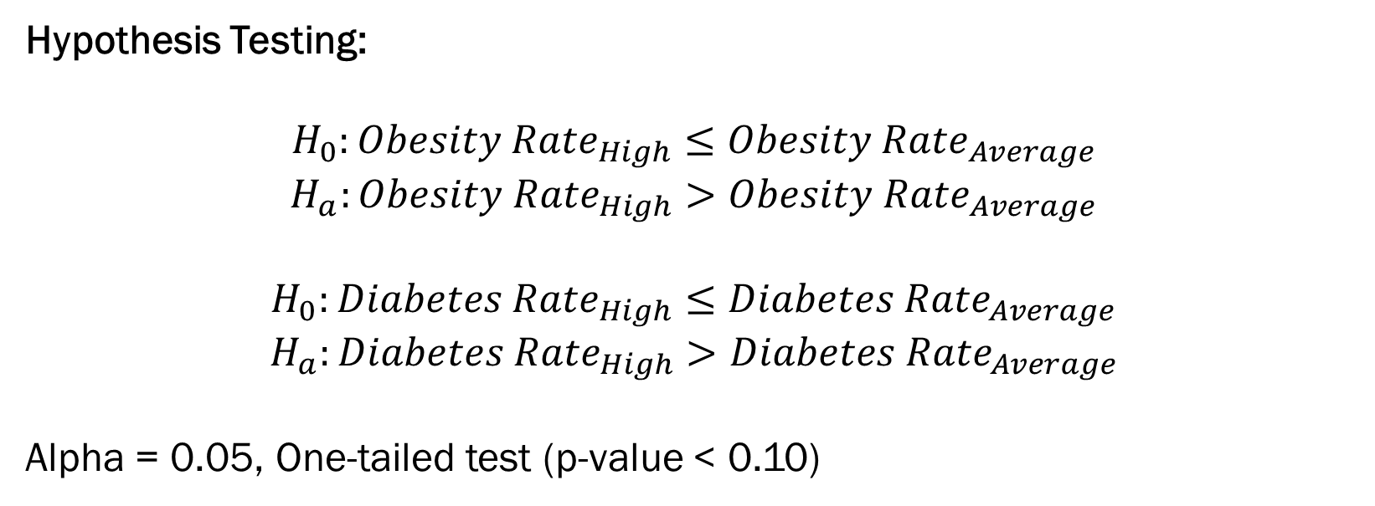
T-Test Results:
Hypothesis Testing:
$$H_{0}:{Obesity Rate}_{High}≤{Obesity Rate}_{Average}$$
$$H_{a}:{Obesity Rate}_{High}>{Obesity Rate}_{Average}$$
$$H_{0}:{Diabetes Rate}_{High}≤{Diabetes Rate}_{Average}$$
$$H_{a}:{Diabetes Rate}_{High}>{Diabetes Rate}_{Average}$$
Alpha = 0.05, One-tailed test (p-value < 0.10)
Test | T-Statistic | P-Value
Obesity | 1.359692 | 0.174027
Diabetes | -1.058995 | 0.289685

Slide 27
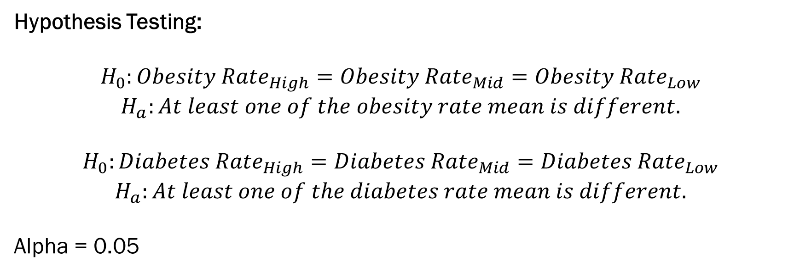
ANOVA Results:
Hypothesis Testing:
$$H_{0}:{Obesity Rate}_{High}={Obesity Rate}_{Mid}={Obesity Rate}_{Low}$$
$$H_{a}:At least one of the obesity rate mean is different.$$
$$H_{0}:{Diabetes Rate}_{High}={Diabetes Rate}_{Mid}={Diabetes Rate}_{Low}$$
$$H_{a}:At least one of the diabetes rate mean is different.$$
Alpha = 0.05
Test | F-Statistic | P-Value
Obesity | 2.165380 | 0.114940
Diabetes | 3.682622 | 0.025305

Slide 28
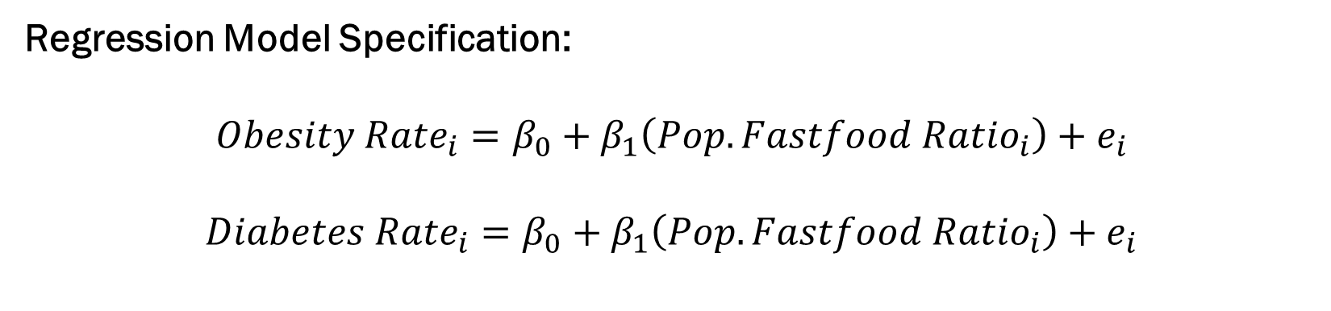
OLS Regression Results:
Regression Model Specification:
$${Obesity Rate}_{i}=β_{0}+β_{1}\left({Pop. Fastfood Ratio}_{i}\right)+e_{i}$$
$${Diabetes Rate}_{i}=β_{0}+β_{1}\left({Pop. Fastfood Ratio}_{i}\right)+e_{i}$$
Results | Obesity | Diabetes
Coeffecient | 0.000202 | -0.000251
Intercept | 30.849403 | 10.084108
R^2 | 0.023265 | -0.063106
P-Value | 0.264507 | 0.002452
Standard Error | 0.000181 | 0.000083

Slide 29
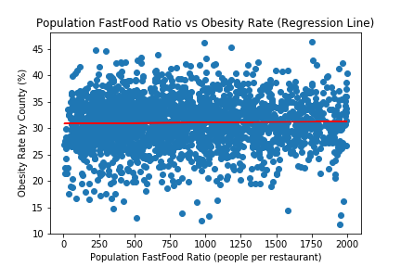
Plotting the Regression Line: (Obesity)

Slide 30
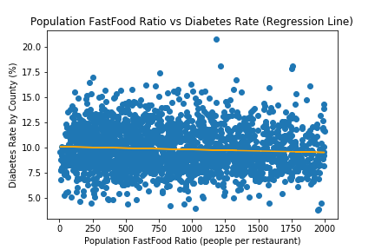
Plotting the Regression Line: (Diabetes)

Slide 31

Conclusion:
T-Test Result:
High ratio counties does not have a higher obesity or diabetes rate compare to an average county.
ANOVA Result:
The obesity rate does not vary across different ratio ranking counties. On the other hand, diabetes rate is statistically different in the three ratio ranking counties, but not knowing which one has a higher or lower rate.
Regression Result:
The two OLS models failed to explained the variation of the obesity and diabetes rate in the 2302 counties.

Slide 32
Moving Forward:
The regression model is expected to fail to explain the variation of the obesity and diabetes rate because many other factors are not controlled in the model, such as income, education attainment, food consumption behavior, ethnicity, job market (type of job), etc.
According to the CDC report, at least we know which part of the country is the most prevalence regions in the country, so that we focus our study in those counties.
Obesity Epidemic is a very complex social issue in the U.S., just like problems we due with everyday. Using the big data will help us understand the problem. However, isn’t this problem just as simple as caloric intake and output?
My Final suggestion to you all is to eat healthily and exercise more!

Slide 33
Q & A
Thank you!

