Slide 1
Too many fast food Restaurants around you?
Presented by Norman Lo

Slide 2
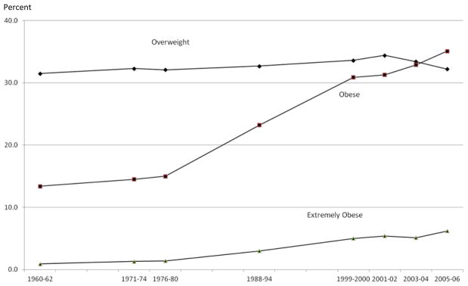
Policy Questions:
The Obesity Epidemic in the U.S. continues …
Fact:
Approximately 34% of adults and 15 – 20% of children in the U.S. are obese.
Obesity rates have continued to increase over the past 3 decades.
There are many factors contribute to the problems.
Should we blame fast food restaurants around us?
Resource: https://www.ncbi.nlm.nih.gov

Slide 3
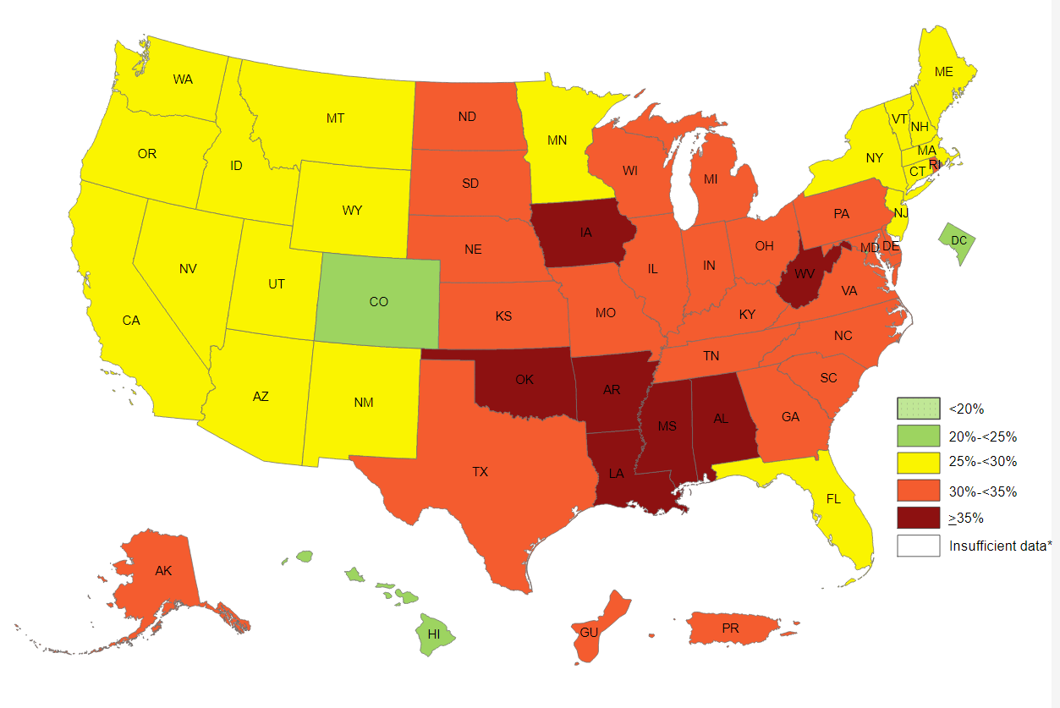
Obesity Prevalence in the U.S. (2017) https://www.cdc.gov/obesity/data/prevalence-maps.html

Slide 4
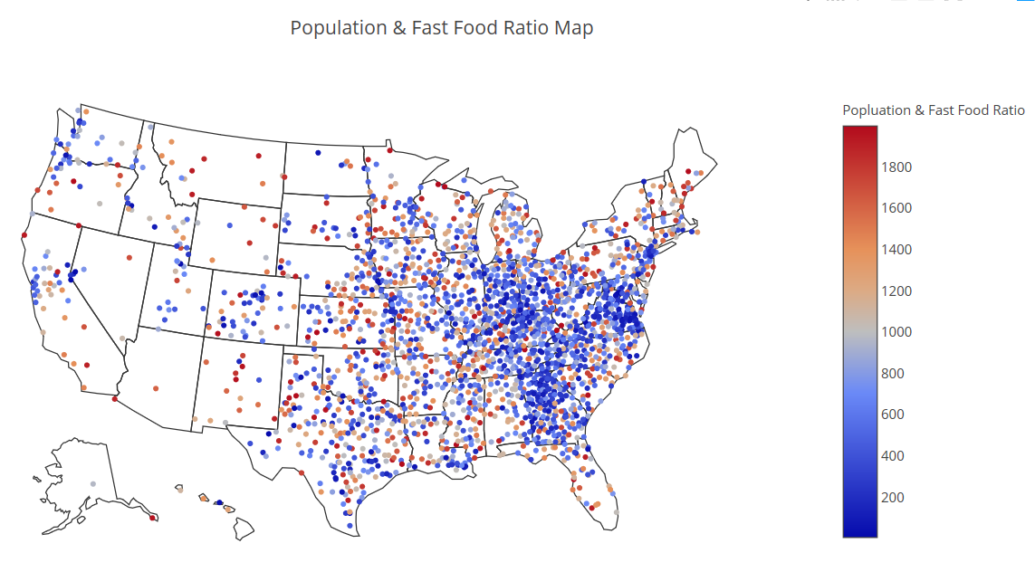
Population & FastFood Ratio (HeatMap)

Slide 5
Literature Review:

Slide 6
Methodology
Level 1: Independence T-Test
Objective: Find any statistical significant difference between low density and high density counties.
Level 2: ANOVA
Objective: Find any statistical significant difference between low, medium, and high density counties.
Level 3: Single Variable Regression Model
Objective: Find any correlation between density and obesity rate or diabetes rate.

Slide 7




Variables: (County Level)
Obesity Rate – total obese population divided by total population (resource: CDC)
Diabetes Rate – total diabetes population divided by total population (resource: CDC)
Number of fast food restaurant – Total number of fast food restaurant (resource: Yelp API)
Population – Total population (resource: U.S. Census)
Latitude & Longitude – Location of the county (resource: simplemap.com)
Population & FastFood Ratio – number of fast food restaurant divided by the population
Ratio Rank – High (ratio < 500) , Mid (500 < ratio < 1500), Low (ratio > 1500)

Slide 8
Data:
Diabetes Prevalence:
Obesity Prevalence:
Census County Population:
City Location Data:

Slide 9
Data Issues:
Duplicated county names in the data.
Solution: merge data sets by FIPS codes (unique)
2. Some of the counties do not have the obesity or diabetes data. Solution: those counties need to be dropped (total 85 counties)
3. The FIPS codes is not defined as integer.
Solution: needs to convert all FIPS codes to integer before merging

Slide 10
Final Data: (Merged)
FIPS Codes | Age-Adjusted Percent Diabetes | Age-Adjusted Percent Obesity | County Name | State Name | lat | lng | Zip_Code | Population | fast_food
1001 | 11.9 | 33.8 | Autauga | Alabama | 32.4321 | -86.6582 | 36003 | 54695 | 41
1003 | 8.8 | 27.2 | Baldwin | Alabama | 30.3555 | -87.5041 | 36530 | 194736 | 180
1005 | 16.9 | 44.7 | Barbour | Alabama | 31.7085 | -85.6109 | 36017 | 26947 | 13
1007 | 13.8 | 40.3 | Bibb | Alabama | 33.1468 | -87.0030 | 35115 | 22503 | 268
1009 | 12.3 | 34.9 | Blount | Alabama | 33.9064 | -86.5178 | 35013 35121 | 57623 | 122

Slide 11
Summary Statistics: n = 3139 (Before Cleaning)
 | Age-Adjusted Percent Diabetes | Age-Adjusted Percent Obesity | fast_food | pop_ff_ratio
count | 3139.000000 | 3139.000000 | 3139.000000 | 3139.000000
mean | 9.618127 | 30.840395 | 137.829882 | inf
std | 2.182928 | 4.638937 | 388.669906 | NaN
min | 3.800000 | 11.800000 | 0.000000 | 5.590000
25% | 8.100000 | 28.000000 | 9.000000 | 499.713837
50% | 9.300000 | 31.000000 | 30.000000 | 1079.941176
75% | 11.100000 | 33.700000 | 93.000000 | 2120.446970
max | 20.800000 | 47.900000 | 7100.000000 | inf

Slide 12
Summary Statistics: n = 2906 (After dropping “0”)
 | Age-Adjusted Percent Diabetes | Age-Adjusted Percent Obesity | fast_food | pop_ff_ratio
count | 2906.000000 | 2906.000000 | 2906.000000 | 2906.000000
mean | 9.733964 | 30.945699 | 148.880936 | 1984.016126
std | 2.164388 | 4.638958 | 401.913899 | 9612.109975
min | 3.800000 | 11.800000 | 1.000000 | 5.590000
25% | 8.200000 | 28.100000 | 13.000000 | 458.969695
50% | 9.400000 | 31.100000 | 36.000000 | 982.936914
75% | 11.200000 | 33.900000 | 102.000000 | 1779.595734
max | 20.800000 | 47.900000 | 7100.000000 | 432373.000000

Slide 13
Summary Statistics: n = 2302 (After dropping pop_ff_ratio > 2000)
 | Age-Adjusted Percent Diabetes | Age-Adjusted Percent Obesity | fast_food | pop_ff_ratio
count | 2302.000000 | 2302.000000 | 2302.000000 | 2302.000000
mean | 9.876759 | 31.015899 | 179.766290 | 824.835123
std | 2.102624 | 4.579583 | 442.031244 | 527.838440
min | 3.800000 | 11.800000 | 1.000000 | 5.590000
25% | 8.400000 | 28.200000 | 21.000000 | 372.594979
50% | 9.600000 | 31.200000 | 48.500000 | 728.027432
75% | 11.300000 | 33.975000 | 131.000000 | 1224.617908
max | 20.800000 | 46.400000 | 7100.000000 | 1997.769231

Slide 14
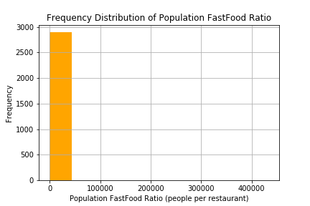
Frequency Distribution: (Before)
Data is extreme skewed to the left, which identifies the outliners in the data for Population FastFood Ratio.

Slide 15
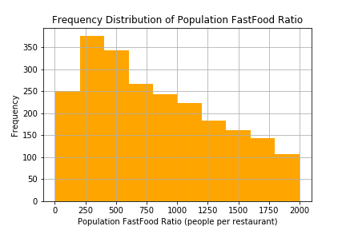
Frequency Distribution: (After)
The data is more spread out after cleaning the data. The study will focus on the counties that has population fastfood ratio equal or less that 2000.

Slide 16
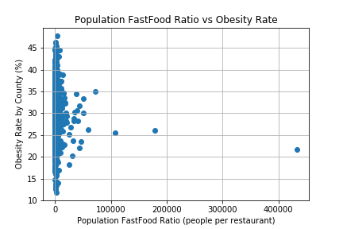
Obesity vs Population FastFood Ratio: (Before)

Slide 17
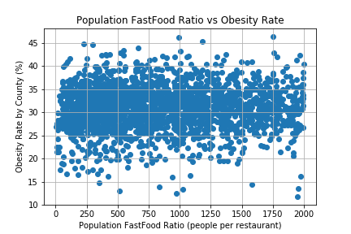
Obesity vs Population FastFood Ratio: (After)

Slide 18
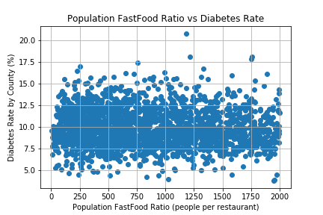
Diabetes vs Population FastFood Ratio: (After)

Slide 19
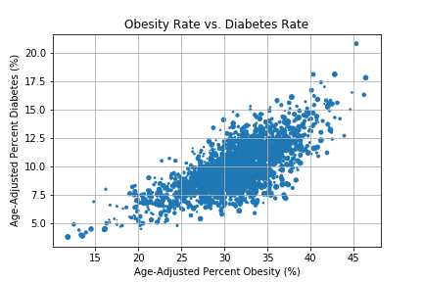
Obesity Rate & Diabetes Rate:

Slide 20
Population FastFood Ratio Rank:
For the hypothesis testing, counties were defined by the population fastfood ratio rank.
High Ratio Counties: pop_ff_ratio < 500
Mid Ratio Counties: 500 < pop_ff_ratio < 1500
Low Ratio Counties: 1500 < pop_ff_ratio < 2000

Slide 21
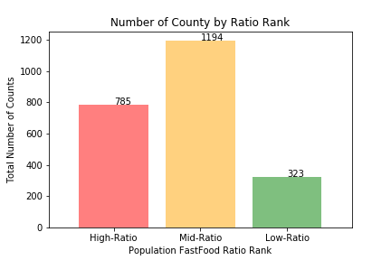
Number of County by Ratio Rank

Slide 22
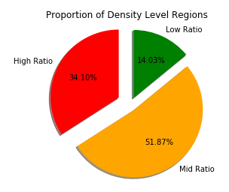
Proportion of Each County by Ratio Rank

Slide 23
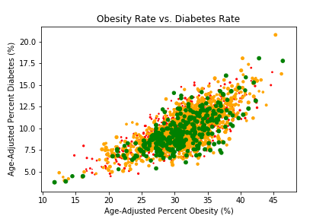
Obesity Rate & Diabetes Rate: (by Rank)

Slide 24
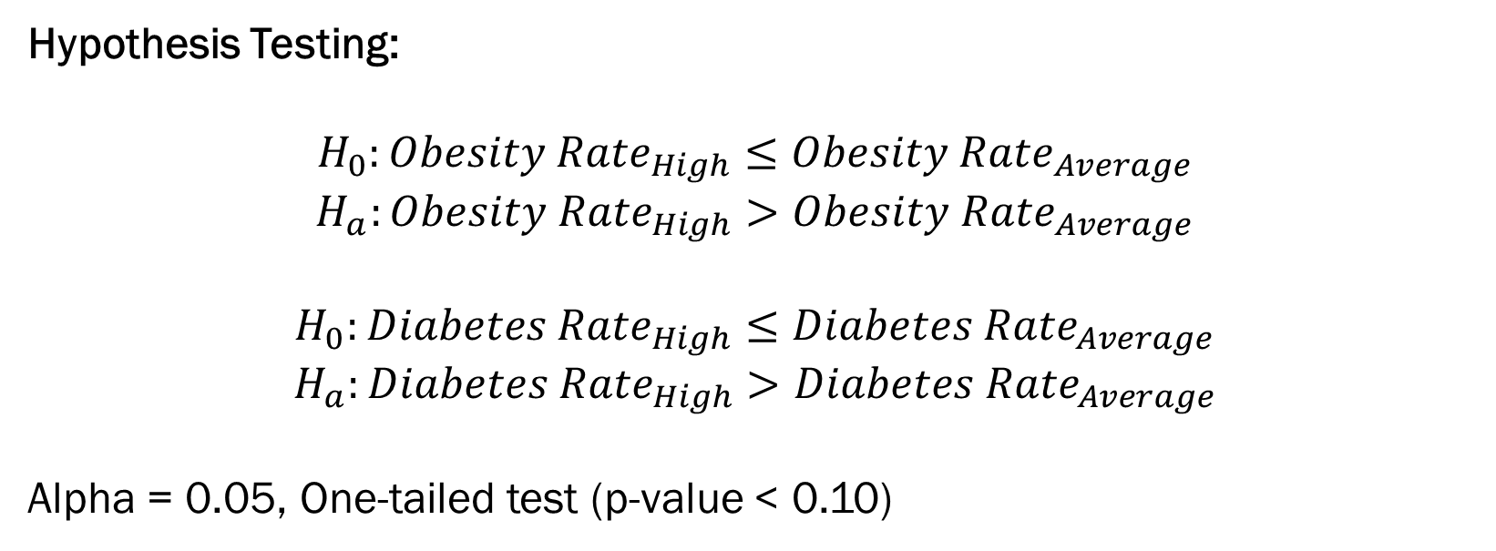
T-Test Results:
Hypothesis Testing:
$$H_{0}:{Obesity Rate}_{High}≤{Obesity Rate}_{Average}$$
$$H_{a}:{Obesity Rate}_{High}>{Obesity Rate}_{Average}$$
$$H_{0}:{Diabetes Rate}_{High}≤{Diabetes Rate}_{Average}$$
$$H_{a}:{Diabetes Rate}_{High}>{Diabetes Rate}_{Average}$$
Alpha = 0.05, One-tailed test (p-value < 0.10)
Test | T-Statistic | P-Value
Obesity | 1.359692 | 0.174027
Diabetes | -1.058995 | 0.289685

Slide 25
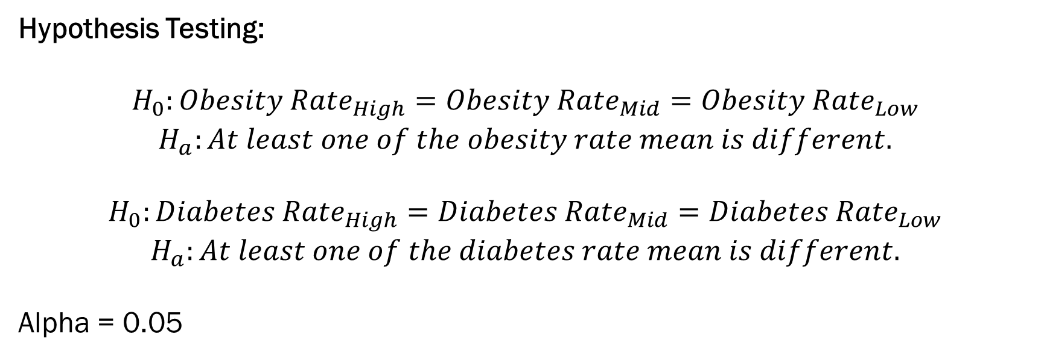
ANOVA Results:
Hypothesis Testing:
$$H_{0}:{Obesity Rate}_{High}={Obesity Rate}_{Mid}={Obesity Rate}_{Low}$$
$$H_{a}:At least one of the obesity rate mean is different.$$
$$H_{0}:{Diabetes Rate}_{High}={Diabetes Rate}_{Mid}={Diabetes Rate}_{Low}$$
$$H_{a}:At least one of the diabetes rate mean is different.$$
Alpha = 0.05
Test | F-Statistic | P-Value
Obesity | 2.165380 | 0.114940
Diabetes | 3.682622 | 0.025305

Slide 26
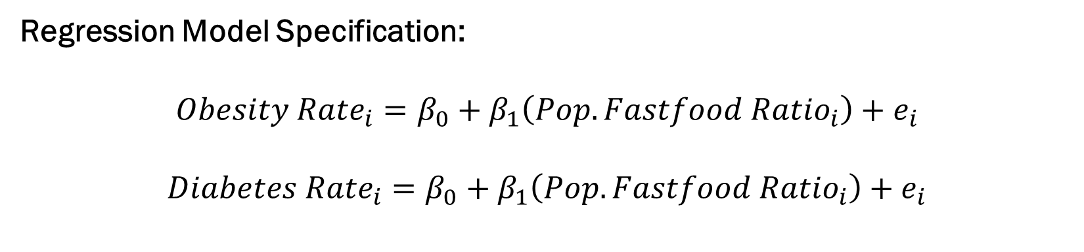
OLS Regression Results:
Regression Model Specification:
$${Obesity Rate}_{i}=β_{0}+β_{1}\left({Pop. Fastfood Ratio}_{i}\right)+e_{i}$$
$${Diabetes Rate}_{i}=β_{0}+β_{1}\left({Pop. Fastfood Ratio}_{i}\right)+e_{i}$$
Results | Obesity | Diabetes
Coeffecient | 0.000202 | -0.000251
Intercept | 30.849403 | 10.084108
R^2 | 0.023265 | -0.063106
P-Value | 0.264507 | 0.002452
Standard Error | 0.000181 | 0.000083

Slide 27
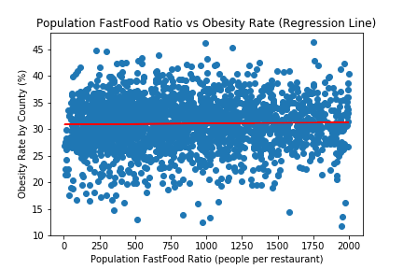
Plotting the Regression Line: (Obesity)

Slide 28
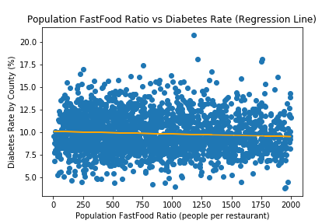
Plotting the Regression Line: (Diabetes)

Slide 29

Conclusion:
T-Test Result:
High ratio counties does not have a higher obesity or diabetes rate compare to an average county.
ANOVA Result:
The obesity rate does not vary across different ratio ranking counties. On the other hand, diabetes rate is statistically different in the three ratio ranking counties, but not knowing which one has a higher or lower rate.
Regression Result:
The two OLS models failed to explained the variation of the obesity and diabetes rate in the 2302 counties.

Slide 30
Moving Forward:
The regression model is expected to fail to explain the variation of the obesity and diabetes rate because many other factors are not controlled in the model, such as income, education attainment, food consumption behavior, ethnicity, job market (type of job), etc.
According to the CDC report, at least we know which part of the country is most prevalence regions in the country and focus on studying the causes of the high prevalence rate.

Slide 31
Q & A
Thank you!

