Slide 1
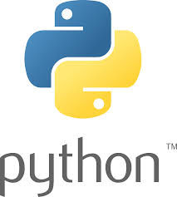
Welcome Python Workshop
Learn about Python with some basic setup today

Slide 2
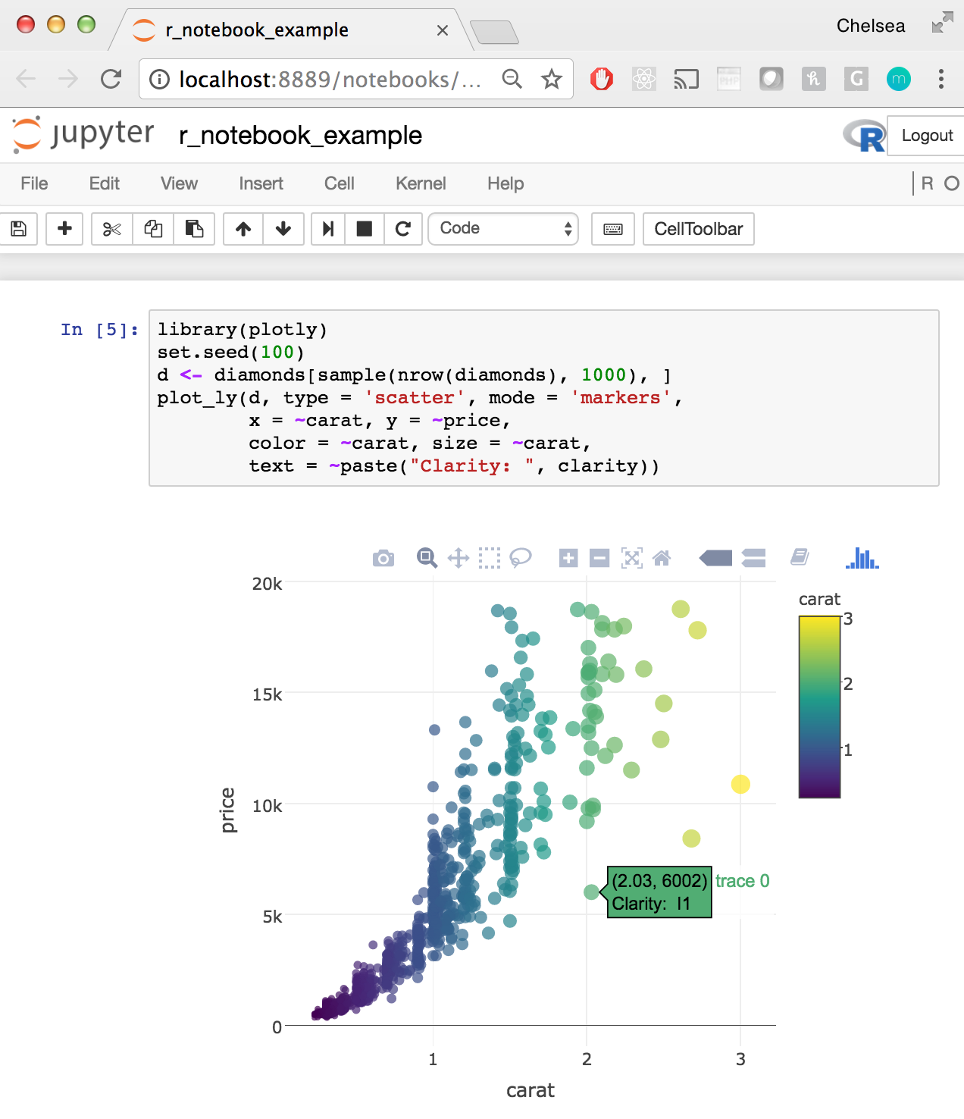
Why Python?
Python is the industry standard in data analysis, data engineering, data science, and data mining. Most importantly, it is an open-source programming language.
According to Northeastern University, Python is one of the most popular programming language in 2021 in the job market.
The big five giant tech companies, FAAMG (Facebook, Amazon, Apple, Microsoft, and Google), offer Python coding problem in their interview for most of the data related positions.
Unlike other programming language, such as C, C++, Java, Python offers simple logical syntax, a large library of packages, and integration with other popular programming languages.
Python offers excellent documentation, and it has a super active community from around the world.
Other programming language you should also be learning toward data related fields: SQL, R, Stata, MatLab, SPSS, SAS, Tableau, PowerBI, VBA, etc …

Slide 3

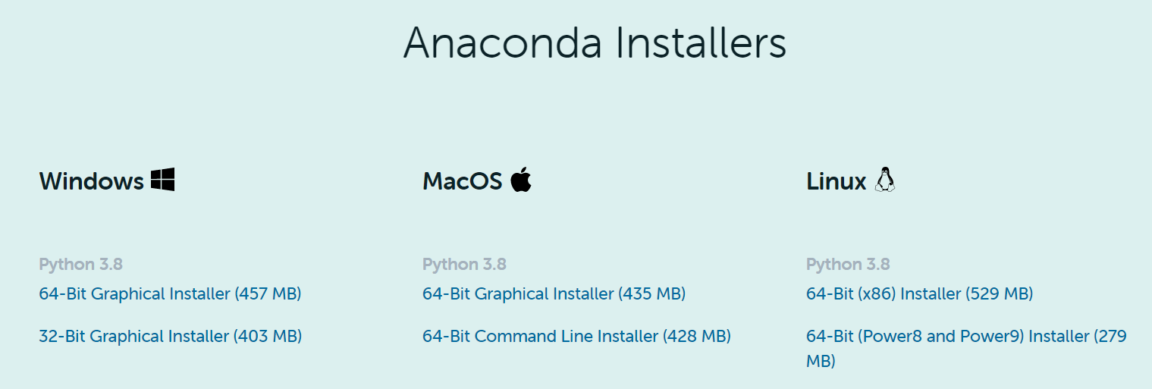
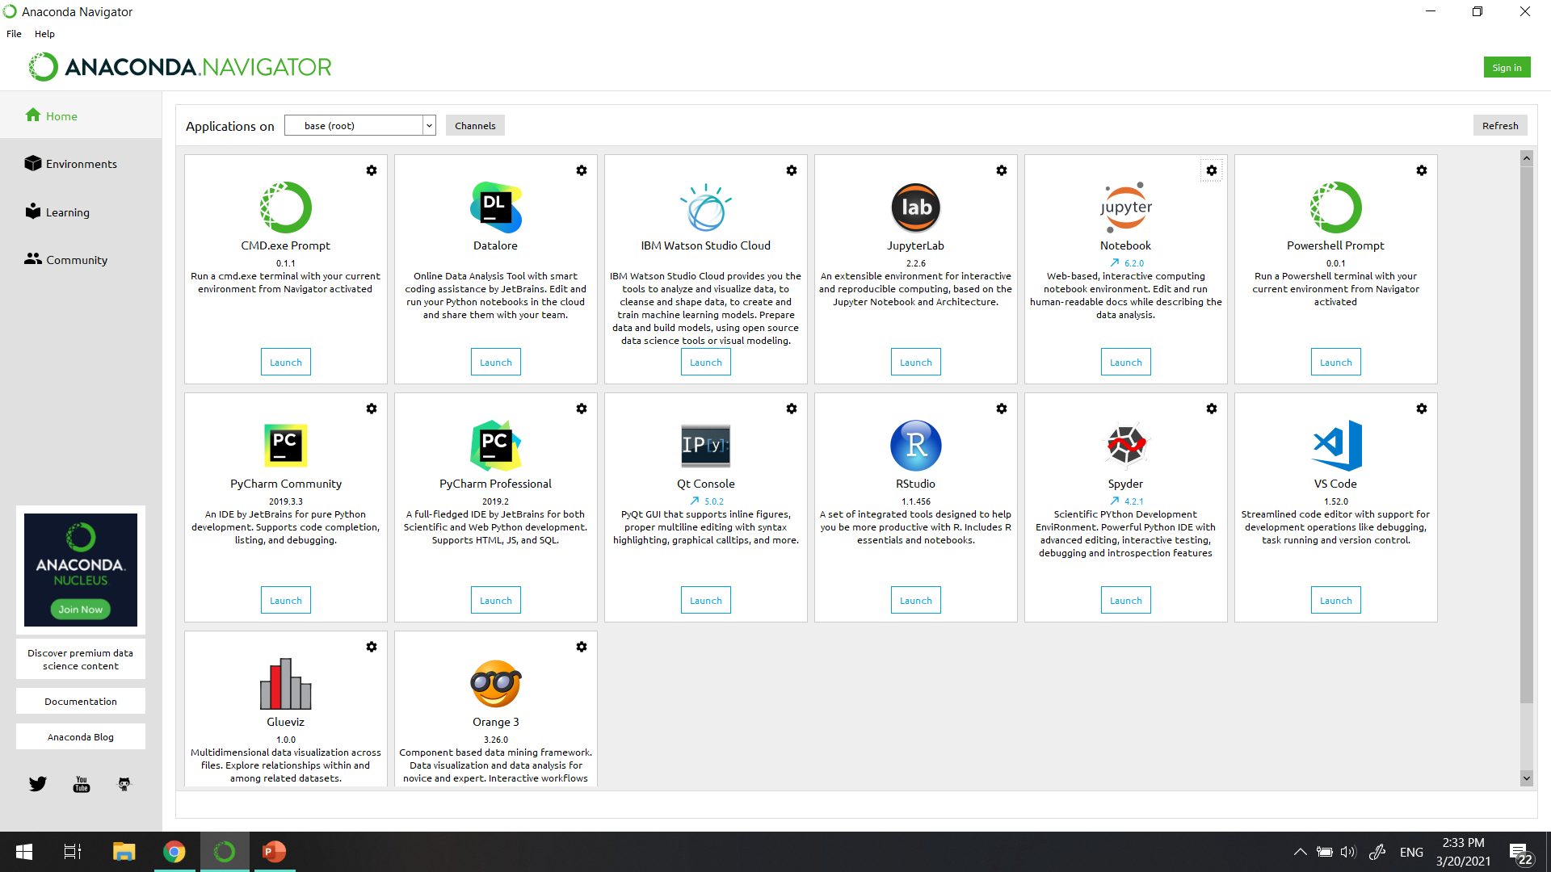
How to setup Python to start programming?
Setup Jupyter Notebook:
1
Go to Anaconda and find Anaconda Installers.
2
Install the most updated version (Python 3.8, by the time I am writing this document).
3
Follow the installation steps to complete the installation.
4
Launch the Anaconda Navigator on your machine.
Note: There are many IDE for Python, such as PyCharm, Visual Studio Code, R Studio, etc. We are using Jupyter Notebook mainly because it is one of the most popular IDE for data science and we can write markdown in the same document with our code.

Slide 4
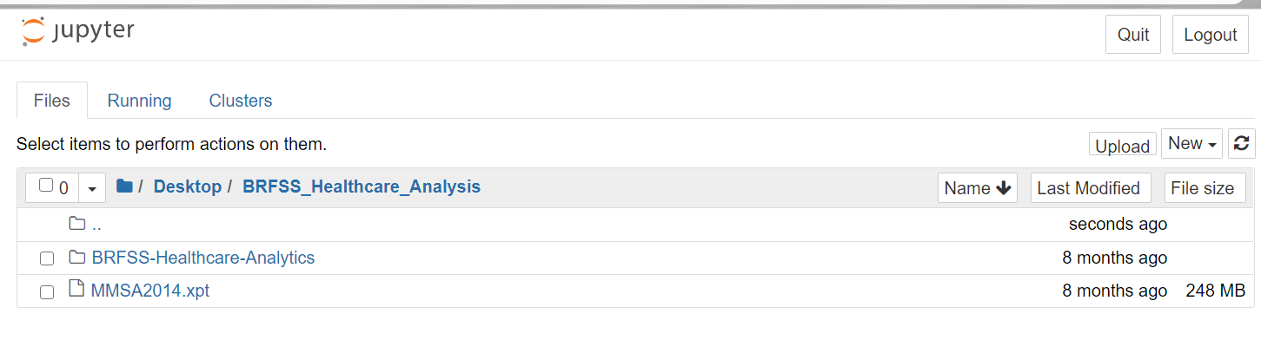
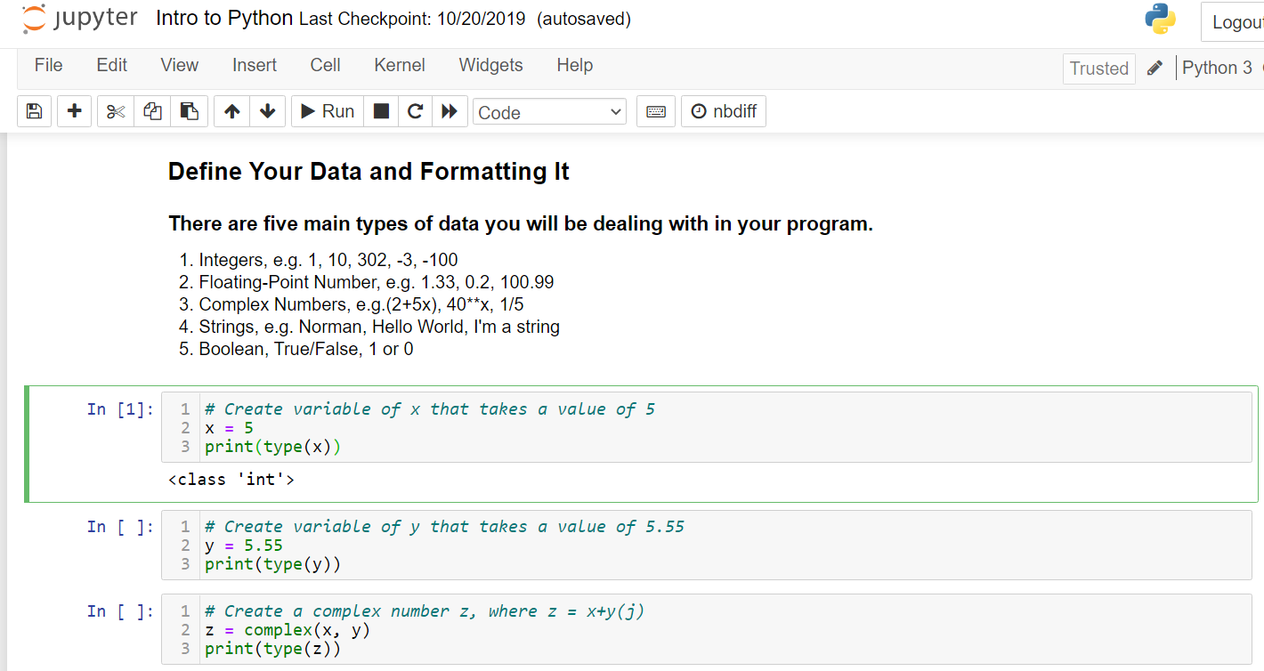
Jupyter Notebook
Once you launched the Jupyter Notebook, you are able to navigate in your machine to locate the project directory.
The list below the navigate bar shows all the files within the directory.
To start a Jupyter Notebook to program in Python, we click on the “New” button and select Python3 to launch the notebook to start writing and running your code in the notebook.

Slide 5
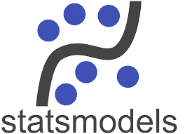
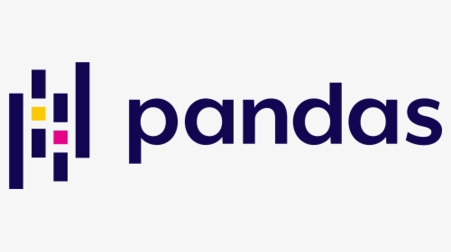
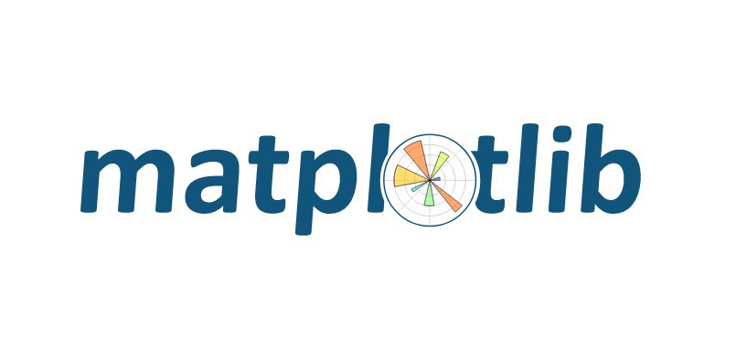
Let’s get started!
In this demo, we are going to explore the use of Python and a few key libraries for data manipulation, visualization, and building statistical model.
1
Using Pandas to read in data from directory to Python, cleaning the data for visualization and modeling, and create summary statistic of the data.
2
Using Matplotlib and seaborn to create visualizations to describe the data and identify any trends in the data.
3
Using Numpy and StatsModels to build a simple regression model and summarize the model parameters and statistics.

Slide 6
Q&A Section:
There are some additional resources about learning Python. Norman’s GitHub Repository
Python Official Documentation
Jupyter Notebook Markdown
StackOverflow
Notes:
In Slide Show mode, select the arrows to visit links.

