Slide 1
The development of asanAI
Things I learned about about Machine Learning, Stability, Data Integrity, Testing, Software Development and Philosophy

Slide 2


Motivation
I am an avid fan of the-computer-doing-the-work („laziness“)
  One of the 3 virtues of a great programmer according to Perl-Inventor Larry Wall:
    Laziness (the computer should do the work)
    Impatience (it should do it fast)
    Hubris („the current solution sucks, I can do better“ and then doing it better)
I was always interested in the mind-body-problem, i.e. the question: „How does experience arise from matter?“, „Could we understand consciousness by re-creating an ‚articial brain‘?“
Both of these lead me to Artificial Intelligence, which lead me to Machine Learning

Slide 3

My learning style
I need to start with practical stuff, not theory, to learn something
This is why most AI introductions have not helped me. There, you have to read through lots of theory to get started
I want to get started right now, and then learn theory by exploring the themes in a practical manner first, and only when I need it
When I can see results soon, its much easier for me to follow through with the theory
This is important, because it influenced how I always wished to learn ML, but there was no tool available that could do it for me that way

Slide 4
Motivation
Getting into ML was not easy, because you have to master a lot of complex topics at once, before you can do anything useful
  What is data? How to load it into memory?
    → What are tensors? (Basically a multidimensional array)
  How does the network train?
  What do the layers do? How to combine them?
  What are activation functions? Which one to chose?
  What is the Learning Rate? Which one to chose?
  adam, adamax, SGD, …? Which one to chose? How do they work?
  …
  How to meld that all into code?

Slide 5
Motivation
I wanted to simplify this process of learning for myself
I think the key to ML is not to learn how to write the code, but to understand the concepts. It doesn’t matter if you do it in Python with TensorFlow or Pytorch, TFJS, or ONNX, or whatever library; the concepts are always the same.
The most basic core concepts are fairly easy to understand, once you strip away the concrete code
So, why the need to learn to code first for these concepts?

Slide 6
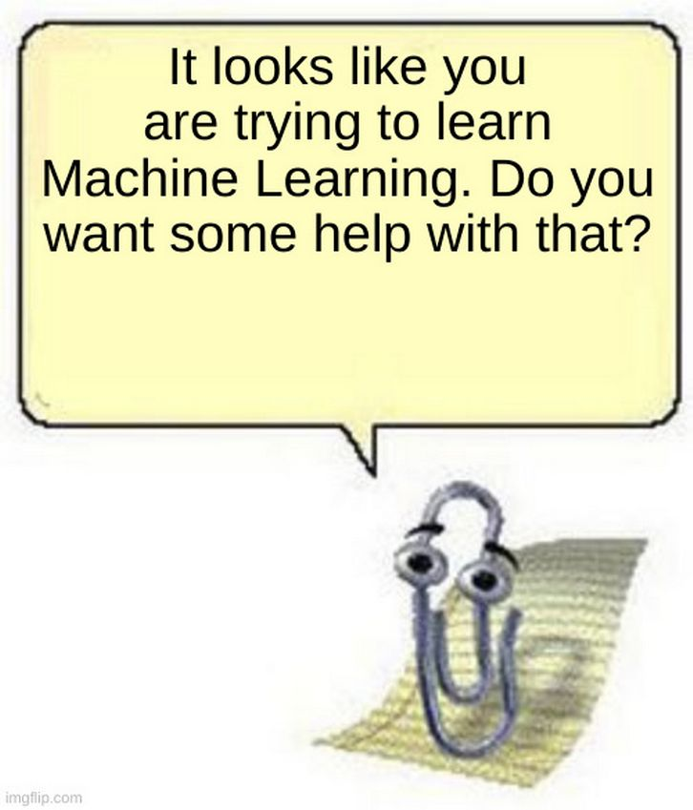
Motivation
The idea was to create a relatively simple GUI that offers sane defaults for most use cases, but can be changed at will by people who know what they want to do
It should invite you to experiment,
offering assistance whereever possible.

Slide 7
Challenges
As far as I could find, nobody ever tried to create such a tool, so there was no reference to go by
  All available tools are just very, very limited toys, like TensorFlow Playground. It only allows limited useless data sets that I don’t care about. It doesn’t allow you to play around on your own data, and it only has very small Dense Layers
A lot of basic technical concepts were, for me, at least the beginning, missing, so I had to learn all of it basically from scratch
The idea I had of such a tool was very, very complex. It allows an endless combination of settings and data (endless because you can always just add another layer on top), and everything has to work nicely with everything else

Slide 8

GUI “Theory”
Only show what the user can use. Hide everything that is of no use for the user or that cannot be set
Do multiple modes, like beginner and expert, so that, in the beginner mode you can use defaults that work 90% of the time, but let people who know what they do set them anyway
Show as little stuff as possible, but let experts find what they want!
Set everything to sane defaults.
Do not allow beginner users to change settings such that the program does not work anymore.
Make wrong settings clear, by, for example marking them red, and disallow everything that can break the application with those wrong settings
For experts: add keyboard shortcuts
  E.g. in asanAI, ctrl comma starts and stops training
Epochs must be an integer. If it’s not, it is marked red and the „start training“-button is disabled

Slide 9
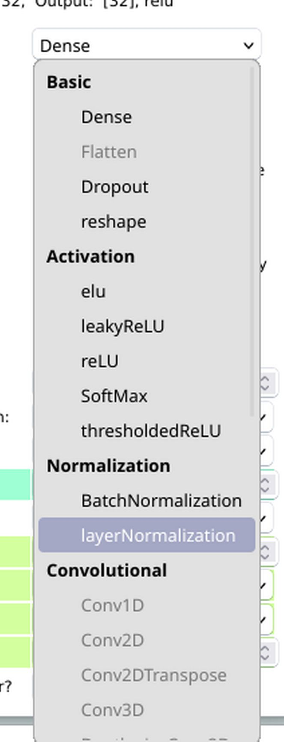
Hiding Elements
Key part of GUI is hiding elements that you do not need or that do not work.
One example for this is that, in beginner mode, layer types that have incompatible shapes (i.e. input [2], but conv1d needs [a, b]) are disabled for the user.
  This way, one cannot set anything that destroys the functionality of the program, unless you are in expert mode and know what you’re doing
  This is achieved in a 2-step-progress. Step one runs a heuristic that filters for input shape only (very easy and quick to test), and step 2 creates a temporary auxillary model, compiles it and checks if input- and output shapes of the whole network stay the same
    If not, the layer type is disabled

Slide 10
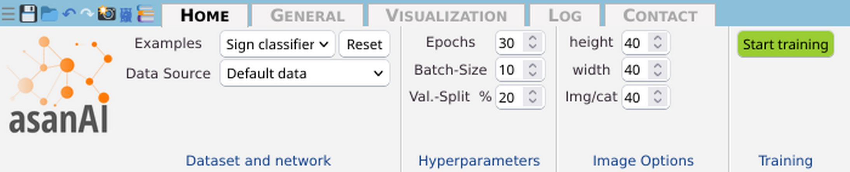
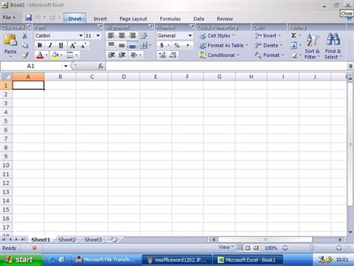
Basic GUI-Elements
The Ribbon, a bar at at the top that is always visible and contains tab groups, which contain the general options
This is based on Microsoft Office, which also uses a Ribbon since Version 2007 (Codename „Office 12“), which I really fascinated me when I was younger in terms of usability

Slide 11


Guide your user
Use colors to guide your users. Color things accordingly, for example, “Start Training” in green and “Stop training” in red
Make things as unobstructive as possible, so the thing the user most likely clearly looks different than the rest

Slide 12
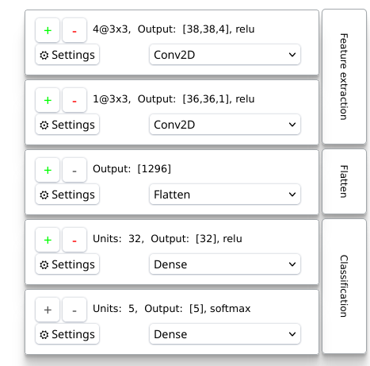
Basic GUI-Elements
The layers panel:
  It should, at a glance, provide the basic structure of the model (layer types, order, number of units/filters/…, output-shapes, and what the layers are (probably) doing in a very abstract sense (Classification, Feature Extraction, …)
  You can drag&drop the layers around to change order
  You can simple duplicate or remove a layer by clicking the „+“ or „-“ buttons

Slide 13
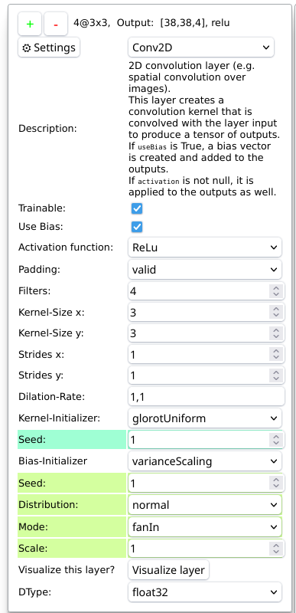
Basic GUI-Elements
The layers panel:
  Each layers’ settings are set to a more or less reasonable default by the beginning, but you can change every single one of them
  Changes here trigger the „updated_page“ function onchange; this function reads the page, creates an abstract model representation and this is then fed to the create_model function, which creates JS code for the layer generations and adds them with an eval
  Eval is often considered eval, and often it is. But here the user can only harm himself, and if a Virus does anything here, it doesn’t need eval for malicious activities when the user already has it installed
  Still, every input is validated thoroughly, i.e. variable types, array sizes, …, before it’s fed to eval(“model.add(“ + code + “);“)

Slide 14
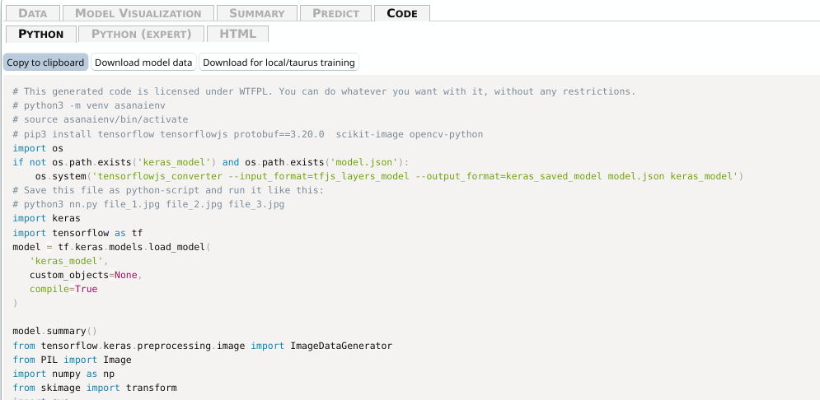
Code Generation
asanAI offers you python code so you can run the model locally, inside, for example, shell scripts, and basically do whatever you want with it.
This code is not internally run, but just strings being joined together that look like python-code and that runs as python code. But nowhere in the code, python is actually called, unless you do so yourself.

Slide 15
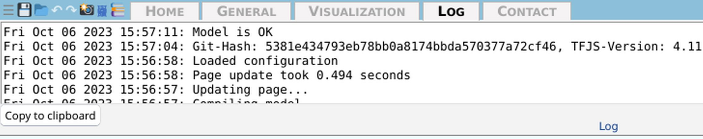
Show logs somewhere
Make logs accessible, either by writing them to files or if you do a GUI application, have a log tab somewhere. Also, it has been immensely useful to follow the program flow to have a status bar at the bottom which always displays the latest warning, error or log message.
Also, show the git hash of the current program. This has proved very useful many times.
This is also where I show the number of allocated tensors and how much RAM/GPU they take up, so while using I can see when there are memory leaks somewhere

Slide 16

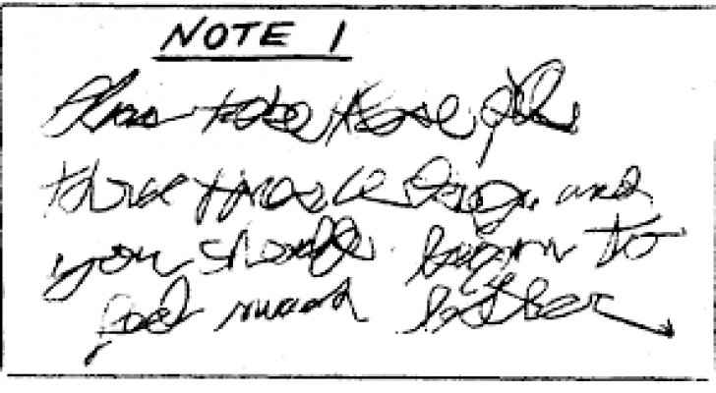
Typography
Read some books on typography; I can recommend the TeX-books by Donald Knuth, and “Alphabetgeschichten” by Hermann Zapf
These can “open your eyes” on what effects good typography can have, at least they did so for me
I have terrible handwriting myself, and could never design a font
  But there’s lots of things you can use, not only italics and bold, but also old-style-numbers, petite-caps, initials, and things like kerning (spaces) and soft-hyphens for guiding the wordbreaking-algorithm and the layout itself (like text-justification) and endless number of microtypographic improvements like gray value

Slide 17
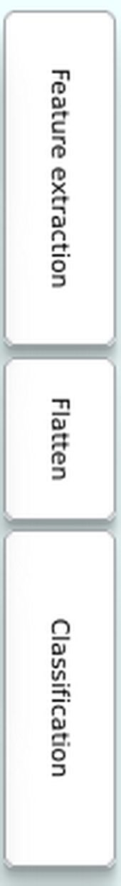
Regular Expressions
Regular Expressions. You can use them in many cases, even where you don’t expect them at first.
  For example, the layer-group-type-descriptions are found by concatenating all layer types into a string and search it with different regular expressions for repeating patterns
  Regex for the „Feature extraction“ group:
    (((?:(?:batch|layer)Normalization;?)+)*(?:(?:(?:depthwise|separable)?conv.d(?:transpose)?;?)+;?(?:(?:batch|layer)Normalization;)*;?(?:[^;]+Pooling.d;?)*))
    I.e. 0 or more normalization layers, then one or more (depthwise or seperable or simple) convolution layer, then again 0 or more normalization layers and, after that, 0 or more Pooling layers
    Layer configurations that suffice that regex will be grouped into the category „Feature extraction“
    After that, repeating groups are, again, grouped together
  I map every single character and it’s match group to a vector, and every character to a layer, so that this regex gives me all layers that do some feature extraction

Slide 18
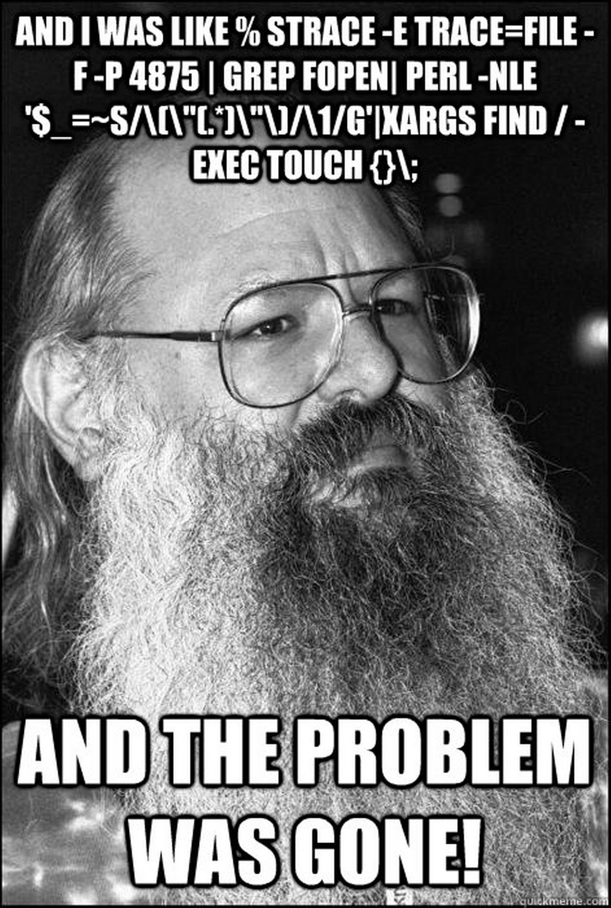
Regular Expressions, Bash
You can also use regular expressions to find stuff. For example, this bash-script finds unawaited asynchronous functions. An error that often lead to bugs, because I treated the return value as a normal variable instead of a Promise
  for i in $(grep "^async\s*function " *.js *.php | sed -e "s#.*async\s*function\s*##" | sed -e "s#\s*(.*##"); do
  egrep "\s$i\s*\(" *.js *.php;
  done | grep -v async | grep -v await | sort | grep -v "+=" | grep -v ":\s*//\s*"
It is, admittidly, not easy to read. But it works. And writing it is much easier than reading it afterwards.
When “await” is not possible, just write “// await not possible” as a comment behind it, and it will be filtered out automatically just as if it was used.
And, once written, you can just simply use it from there on to find new bugs
Learning bash programming is a very useful tool in general. You will be able to do things with very few lines that others cannot solve in complex programs.

Slide 19
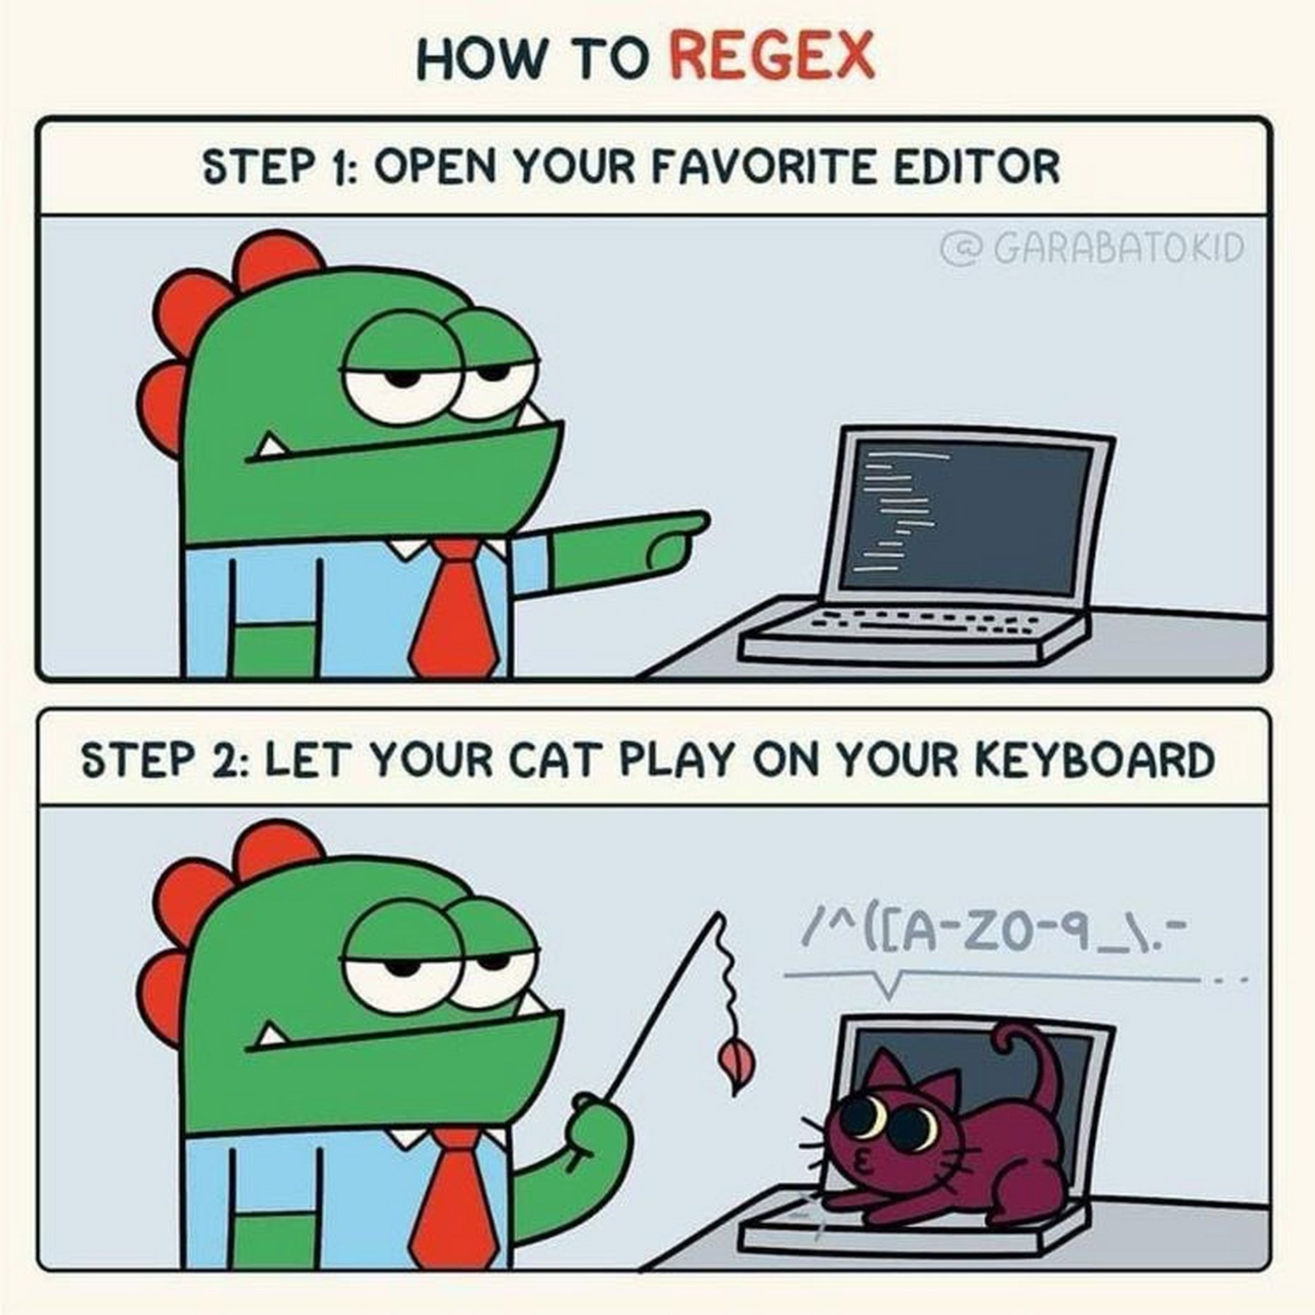

Slide 20

But no, for real:
Start learning Regex today. It can solve MANY problems in a very efficient way once you know a few basics.

Slide 21
Auto-generate similiar code
In most languages, functions are basically (global) variables
In JS, these are equivalent:
  var fn = function () {}
  function fn () {}
This, together with functions like $.globalEval(), which evaluates strings in a global context, allows you to iterate functions (as elements of window) and create new ones.
  This also allows you to create arrays of functions or dictionaries as functions, so you can organize them and call them at will
This way, you can write code once and generate many functions from it automatically that are the same except a few parameters.
This allows creating data structures that contain lots of information for many places to use, and it easily allows adding tons of assertions by just writing it in one place only.
Also, you can write code automatically and evaluate with eval. Be careful about filtering user-inputs properly though! (If you don’t know what that means, better don’t attempt eval)

Slide 22
Use md5 and UUIDs
For saving current states of complex software, you can stringify the variable’s content’s and md5 or sha256 them. You have a tiny chance of collision, but its acceptable (in most cases).
  This way, you can also invalidate caches or memoize functions
When you dynamically created elements and need to give them IDs, use UUIDs, which are random strings that have a basically 0 chance of collisions

Slide 23
How you can implement a very simple multi-language system
My choice was to give each text a key, and, instead of writing the element, I write:
<span class=”TRANSLATEME_key”></span>
When I called the function “update_lang()”, it searches all span’s whose class start with “TRANSLATEME_”, takes the rest as a key and looks it up in the languages table, which is an associative array like this:
array(
'en' => array(
key => “English text”,
...
),
’de’ => array(
key => “Deutscher Text”,
…
)
)
The update_lang() function then looks at which language is chosen (either by parameter, or, if null, by cookie, or, by default, english) and goes through all TRANSLATEME_-<span>s and puts the text inside of them
This is done live to the GUI, without reloading; the time it takes is basically imperceptible.
This is not without problems, like printing the plural of words for non-1-entries, like “1 screenshot”, “2 screenshots”. But its very quickly done, and allows me to translate asanAI with chatGPT into any language within minutes. I did arabic and hebrew just to test UTF8, and latin just out of curiosity, in just under 10 minutes (though I haven’t published anything, since I cannot proofread any of them)

Slide 24
Memoize time-intensive functions
Memoization trades memory for speed by caching results
var memoized = {};
function memoized_fibonacci (n) {
var cache_key = md5(JSON.stringify(n))
if (cache_key in memoized) {
return memoized[cache_key];
}
if(n < 2) {
return $n;
}
return memoized_fibonnaci(n – 1) + memoized_fibonnaci(n – 2);
}
Without memoization, you need to run the fibonnaci-function 1200 times for n = 14
With memoization, you need to only call it 15 times
This gives a speedup of about 150% (since larger numbers are harder to calculcate). Landau-notation of the run time turns from exponential into something linear that way.
Requirements for memoization:
  No side effects
  Everything is only dependent on the parameters given in the function header (i.e. no global states are involved), or you include those in your hash-key
  You do not expect the out to be different each time (memoizing a function that returns the current time is useless, because then the time will stay the same for all future calls)
Also remember that memozation and table lookups also take time. So not every function should be memoized! Same for memory. It’s a tradeoff, not a magic bullet!

Slide 25
File structure
Split your code into several files early, group functions that are loosely tied by topic into one single file (like gui.js, data.js, training.js, model.js, …)
Use the include or import function of your language to import parts of the code that are seperated into several files. This way, you can think in an abstract way of them when moving them around.
Think of functions as stuff, and the structure of them in organizational units like in cardboard boxes. When you then move them around or search for them, you can more easily find them, and its much easier to move a single organizational unit than thousands of very small items.
Make functions as small as possible. Make every function do one and only one thing.
If you want to write modules, namespaces are also important. But for code that is not used as a module somewhere, I prefer working in the same workspace all throughout the project (except for libraries)
For own code, always writing the namespace in front of the functions has basically 0 worth

Slide 26
Object orientiation vs. functional code
There are situations, where object oriented code is reasonable, but most of the time it’s used because of dogma (“OO is better”) than out of technical reasons
I, in like 99% of cases, prefer functional code, since it’s easier to get an overview.
The ~1% is when you CAN really abstract something that far and clearly and concisely that it can be used as a class, but this, in the reality of programming, is rare outside of things like games, where “Player” is a perfectly reasonable class to have, because “Player” has options (like skill level, money or health)
In 99% of cases, using OO makes the code less readable, especially when it’s forced upon you from languages like Java.
This is personal opinion and debatable though

Slide 27
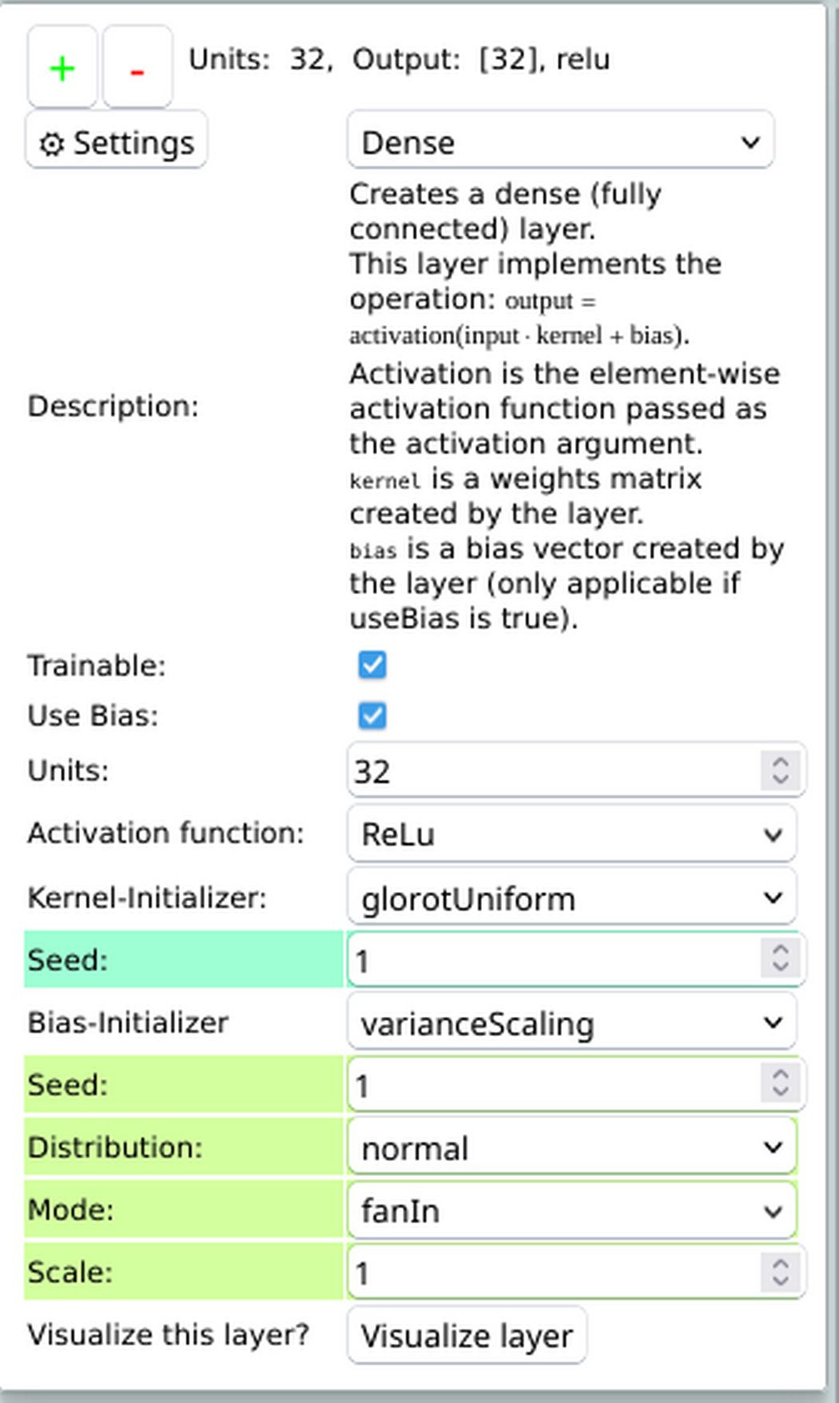
Data structures
Intelligent data structures are way better than intelligent code.
For example, this is code from the global layer_options variable:
"dense": {
"description": "<span class=\"TRANSLATEME_dense_description\" \/>",
"options": [
"trainable",
"use_bias",
"units",
"activation",
"kernel_initializer",
"bias_initializer",
"visualize"
],
"category": "Basic"
}
This contains all the information needed for that layer type in a very abstract and easy-to-edit-form.
This also allows for testing if all needed functions (e.g. get_trainable_tr() to add the trainable-option-description and checkbox) exist and have been initialized properly from their automatic code initialization.
From this, everything where this info is needed is automatically and dynamically created

Slide 28
Environment
When running software, the environment is often overlooked. Environment means all prerequisities that a function needs to do it’s job. That is, the parameter’s it gets passend, the global variables it uses, the software it runs in (for example Firefox) and the OS it runs on.
For running a normal program, a lot of things are necessary. And each one may fail.
Check properly, if things in the environment are as you expect them to be. Be aware of the fact that the environment is like 90+% of everything most of your programs do (like, in libraries).

Slide 29
Environment
In bash scripts, always check for the existance of what you use and auto-install whatever you need for your program to run. Expect errors. Use exit-codes to communicate what is wrong to the scripts on the outside. Also, encapsulate as good as you can. You WILL reinstall it, either on a new machine or your one, so the effort taken here to make sure it works will be payed off soon.
if ! command -v python3 2>&1 >/dev/null; then
echo “python3 not found”;
exit 1;
fi
if [[ ! -d ~/.your_environment ]]; then
pip install venv || exit 2
python3 -mvenv ~/.your_environment || exit 3
source ~/.your_environment/bin/activate || exit 4
pip3 install -r requirements.txt || exit 5
fi
source ~/.your_environment/ || exit 6
python3 your_script.py $*
exit $?

Slide 30
Libraries
Whereever possible, do not reinvent the wheel, for like 90% of tasks someone has already written a module, so use that
Use well-tested, free&open-source libraries where, when there IS an error, you can fix it
  Go great lengths to avoid proprietory software when there is any chance to do so, since you make yourself dependent on the author’s bugs if you use them and cannot fix anything in them (legally), and they lock you in within their solution
If you do not find good-enough solutions though, don’t hesitate to edit existing free ones and add what you want, or create new ones from scratch.

Slide 31
Wrappers
For every function you use from a library, write a small wrapper. You can easily do that in JS like this with variadic parameters:
  function tf_tensor (...args) {
  return tf.tensor(...args);
  }
This receives an arbitrary number of parameters and just passes them to the function you really want to use and return that.
From the outside, it acts like the normal function, but you can test for stuff here without altering any library, and you can log things like, for example, the stack trace of the function call
I use this to track where tensors have been allocated, to detect memory leaks and bugs, where, for example, base functions like „parseInt“ return „NaN“; this is result of an undefined or array or object element being the parameter, and in my wrapper there’s a function to print the stacktrace when that happens.
Here, you can also add a generalized check for return values, where return values indicating an error throw an Exception, which you can handle in the code later.

Slide 32
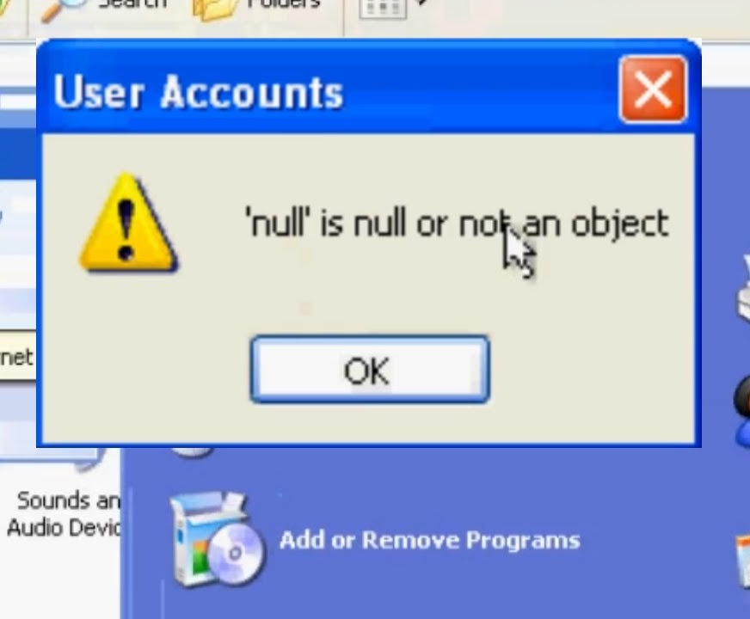
Data types
Even in non-strictly typed languages, try to enforce data types. WEIRD things can happen when you use a string where an integer is expected or things like that
Those bugs are often very subtle and hard to debug, so don’t make your life harder than it is
assert() every variable to have a specific data type if you expect it to be

Slide 33
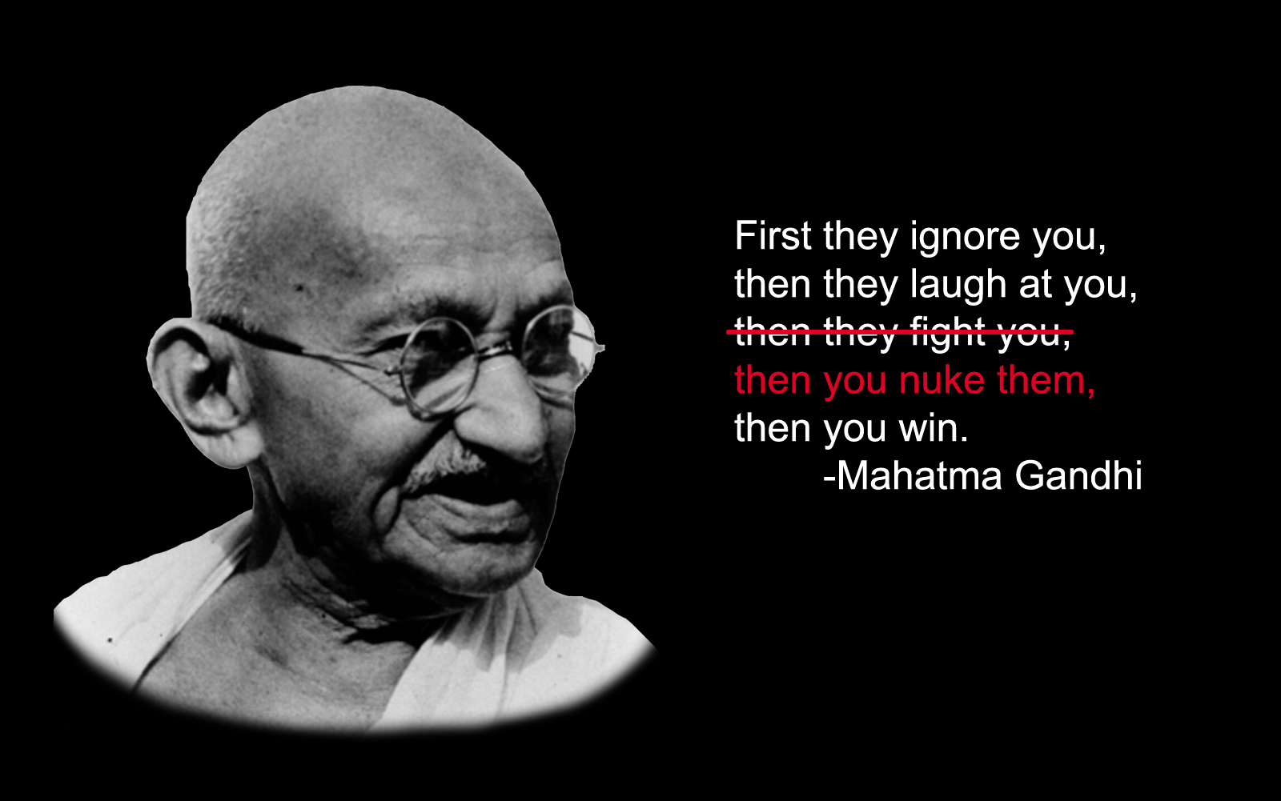
Keep in mind floating point errors
In the game “Civilizations”, due to a floating point error, Ghandis aggression level can turn up to the maximum of ~4.7 Billion, so he randomly starts nuking all other civilizations without any provocations.
I’d consider this a bug, since it’s not very historically accurate.
This was bug could have been avoided by proper type choice (integer) for such a value, or by keeping limitations in mind, or even by asserting that the value cannot be higher than let’s say 10000
In programming, sometimes 1/3 + 1/3 + 1/3 is not 1, but 0.9997 or 1.0001 or something like that. And these errors add up quickly to large numbers. Every float calculation has an an interval in which it may be correct, and with each further calculations, it can differ more and more from the real value!
We treat float like real numbers, but they are not. They are an approximation of real numbers!

Slide 34
Coding style
I prefer this coding style:
  function name_with_underscore (parameter_with_underscore) {
  if(parameter_with_underscore) {
  ...
  } else {
  ...
  }
  }
There are people who do camelCase and put each { on a new line and any combination of those. I find those to be ugly to read and wasting screen space.
If code is nested too deeply, it is often, but not always, a sign that it should be splitted into smaller chunks
Do not use things like hungarian notation. It makes the code look too complex and barely has any use information. Worst idea is to cut away vocals to make “kernel32.dll” look like “krnl32.dll”. Thats useless, and we do not live in the 8.3-filename time anymore. Name things by what they do and what they represent in human-readable terms.
Reading a good program should be like reading a good book

Slide 35
Use guard clauses instead of nested ifs
Instead of writing
if(condition_one) {
if(condition_two) {
if(condition_three) {
…
Write:
if(!condition_one) {
debug(“condition 1 not fulfilled”);
return;
}
if(!condition_two) {
debug(“condition 2 not fulfilled”);
return;
}
…
Thats much easier to manage for many such conditions!

Slide 36
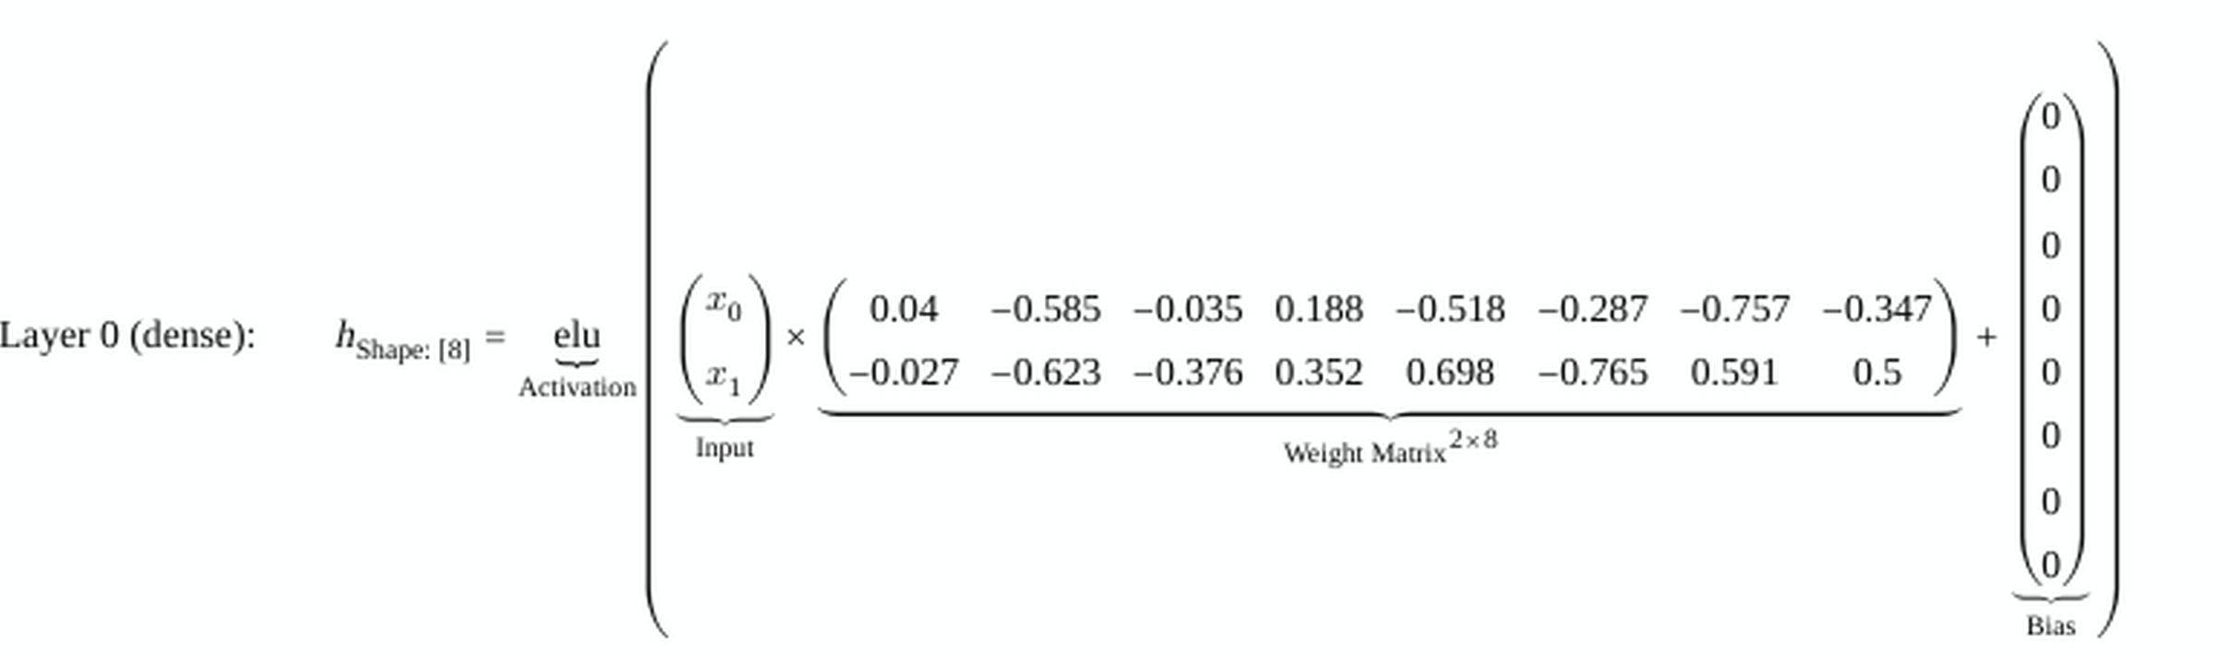
Using standard exchange formats
For Math Mode, in the beginning I used MathJax to render matrices, vectors and so on. The site generated LaTeX-Code for these equations, and MathJax rendered them
Later I saw that this rendering with MathJax is very slow, so I wanted to switch to another solution, in my case temml, which also renders LaTeX to HTML from JS, but is much faster, because it uses MathML instead of SVG for rendering
Luckily, since I used LaTeX, an accepted standard, there were many libraries to chose from any barely any code needed to be changed to switch

Slide 37
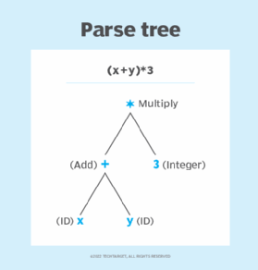
Parsing
Parsing means reading in a string and converting it into a data structure
There are several ways of parsing stuff, you can use BNF or stuff like that for complicated parsers, but often enough, the stuff that needs to be parsed is simple
The tab page that shows model.summary directly gets it’s text from the tfjs-model.summary() function, as this is authoritative on the state of the model, which is similar to the python function in output
First, I split it by lines, filter lines like “===”, then split by /\s+/ to get column values, and push the splitted columns into an array representing the lines’ columns.
The ability to write simple parsers is invaluable when writing complex programs, because many times, it can solve problems that you don’t expect it can solve

Slide 38
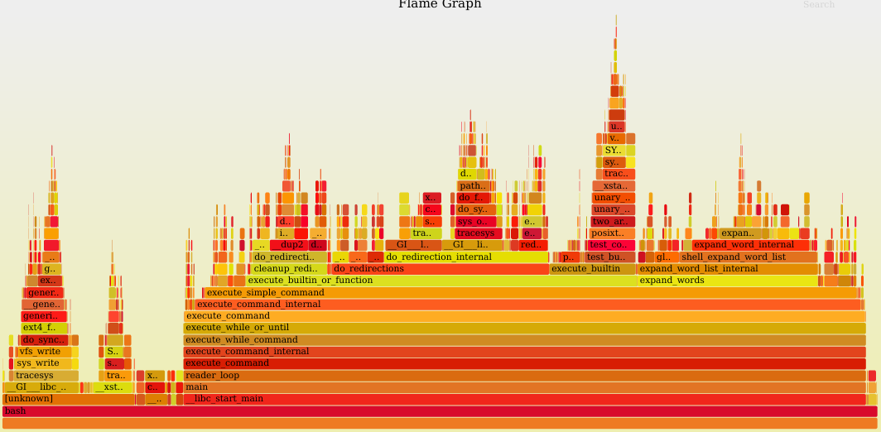
Profiling
Sometimes, weird things take time. In the beginning of asanAI, more than 95% of time during training was used to plot the training graphs. It took hours to do something where the training without training graph only took a minute.
Never assume time is spent anywhere; always measure!
Use the tools of your language to create flame graphs and the like
You can see which function calls which on the y-axis (main is at the bottom), and how long each function took (x-axis)
This way you can see where small optimizations could have great impacts and where time is really spent

Slide 39

Detecting bugs
„Compile code at pickiest warning level and fix all the picky compiler warning“
— Steve McConnell (Code Complete 2)
The compiler, runtime environment, …, all offer you some clues about the quality of your code. Use that. The people who wrote the compiler know their language best, and when they think you may have done something wrong, you most probably have.
Throw an Exception at EVERY warning, that you, in the stack, later on turn to a warning again by catching it properly after you verified that it is harmless.
Never ever hide errors or warnings unless you really understand why they occur and that they are harmless!

Slide 40

Detecting bugs
Bugs are unavoidable, especially in Software that allows such complex interactions as asanAI does
Key is to find as many of them as possible with as little additional code as possible, and fixing them at the root rather than applying a “quickfix“ at every function where the problems may occur.
Sometimes, bugs pile up and you don’t notice them
  At first, I have confused [width, height] and [height, width] in Parameters, which I never noticed, until, through a cascade of other bugs, an image was suddenly rotated 90°
    I was puzzled by that, and tried to follow the whole data trace up to the points where something was not as I expected it, and fixed it in every case, and then wrote a test for it

Slide 41
Detecting bugs
Avoid debuggers. They are slow and annoying and most often do not help at all (exceptions are basically only low-level-debuggers like IDA Pro).
Use assertions, so the code tests itself while running, and printf-debugging, i.e. printing out function names, parameters, variable names and states while running to follow.

Slide 42
Detecting bugs
The first thing you should do when you are about to create a large project is to define the following functions:
    def log(msg):
      print(msg)
    error(msg) # same code
    warn(msg) # same code
    info(msg) # same code
    debug(msg) # same code
  They all just take a single message and print it.
  This allows you to write different types of messages, and, in a global place, log them properly, and you directly have the different types!
  You WILL use these functions in any complex project, so write them first to make usage as easy as possible as early as possible.
  Use them often, you can always, if they are too much, just disable the print in the log functions themselves, but keep the log-statements. You will, some day, need them
  When your program gets more complex, you can log these messages in a file easily, and group them later on when you need it and started with these messages from the beginning, with only very few changes in the code in very few places

Slide 43
Detecting Bugs
Use exceptions, and try/catch, around everything that can fail.
Why? When something goes wrong and you just „return false“, you can simply ignore that. You cannot ignore exceptions. They make everything crash if not handled properly, and they propagate through the whole call stack, so you can react at every function that uses a function that had an error. It’s as simple as:
function x () {
throw new Error(„something went wrong“);
}
function y () {
try {
x();
} catch (e) {
error(e.message);
}
}
Care about return values. For example, in C, when fork() fails (which rarely happens, but it can), it returns -1. If you use this as the pid for, for example, the kill -9 signal, it massacres EVERY process except init and spawns a new login shell. In your wrapper functions, check them and throw an Error if they indicate an error.

Slide 44
Detecting Bugs
Assertions are very simple programmatically:
function assert (condition, message) {
if(!condition) {
throw new Error(message);
}
}
They are used to check that certain things are as you expected. For example, that a variable really contains an integer. If not, the program exits.
Its better for the program to crash than to calculcate on with wrong data.
  This is ESPECIALLY true for production code for real data, so never remove assertions!

Slide 45
Detecting Bugs
They are as simple as that to write (example in JS):
var variable = „10“;
assert(typeof(variable) == „number“, „variable is not a number“)
The first parameter gets evaluated to:
typeof(10) == „number“
which gets evaluated to:
“number“ == „number“
which gets evaluated to
assert(true, „variable is not a number“)
which does cause the assertion to throw an Exception with the message „variable is not a number“
Whenever the function that receives variable as a parameter receives it as a string, you instantly know that you have a programming error
Leave assertions in production code. CPUs are fast enough. We as programmers spend thousands of CPU cycles for calculating drop shadows in a GUI, that means, we can spend 10 cycles more for correctness. Assertions are almost never the reason why a program is slow.
Also, it matters only in production if it spills out garbage. In a test environment, you kind of expect that. But for the end user, its important that it works as expected.
Every failed assertion should print a giant large red error message, that the user CANNOT ignore, also print and save a stack trace. This is of course annoying to the user, but when you yourself test the program, you need to find it annoying. And then fix it, so the user doesn’t see these messages.
A program is worth nothing, if it can spit out garbage 10 times faster than a correct program.

Slide 46
Detecting Bugs
Automatic bug reports are a blessing!
When you have used the log, print, debug and so on functions a lot, and you encounter an error, just send the error to a server so you can see what errors real users are seeing
In JavaScript it’s even possible to do screenshots from the website and send them as well (but keep in mind privacy and disable screenshots when they may taint privacy)
You’ll find much more bugs on more diverse systems than you can test

Slide 47
Detecting bugs
In programs that run asynchronically or in parallel with shared memory, keep in mind race conditions.
For avoiding race conditions, the best way is not using complex algorithms like Dekkers or Szymanskis Algorithm, but simply blocking by queuing and awaiting the release of the block (when the queue is empty), which you can store in a global state in FIFO

Slide 48
Refactoring Code
When you have code in front of you you want to refactor, this way has worked for me:
  Find all instances of, for example, arrays with indices, and move them into a single variable. For example:
    var calculated_value = some_data[i][j][k] * some_data[aa][bb][cc]
    →
    var var_one = some_data[i][j][k];
    var var_two = some_data[aa][bb][cc];
    var calculated_value = var_one * var_two;
  At the beginnings, the variable names do not even matter. Just chose any.
  Then try to figure out what the code is supposed to do, and update the variable names accordingly.

Slide 49
Refactoring Code
When, while reading the code, you understand what a part of it does, move it to a seperate smaller function with an appropriate name.
Just cut&paste it there, and re-create the function environment via function parameters
Whereever possible, try to generalize the function as much as possible
  For example: when your function creates a tensor of the shape [1, height, width, 3], why not, when possible, generalize it, such that it can create any tensor shape, including the one earlier used as a special case
  More abstract is always better!

Slide 50
Refactoring Code
Refactor early, and refactor often
And, when during refactoring you encounter an error and fix it, write a warning for that error and an explanation of why it may appear (for so long as you still understand it while refactoring)
  Best write an assertion that checks for the absense of that specific bug, so the whole program crashes immidiately, when it goes there again
When this or a similiar error or bug happens again, you’ll notice it much earlier then, and immidiately have an idea of why it happened

Slide 51
Testing code
Automated testing is very useful. There are many ways of doing it.
There are unit-tests, i.e. you have a function that does simple things without side effects, and just check whether the output does what it should:
  function test_is_equal (name, real_result, expected_result)
  It should print an error if real_result and expected_result are not equal, and nothing if they are
  function add (x, y) { return x + y; }
  test_is_equal(„add(5, 5)“, add(5, 5), 10);
This should print an error, when the function does not return what it’s supposed to do. This does not detect all bugs, but it detects many, when used properly for the base functions

Slide 52
Testing code
Another method of testing code, especially to find unhandled exceptions, is to run all available functions in the global scope inside a try/catch block with random parameters, consisting of random arrays or objects of strings, integers and whatever.
Running a script that does this many times will uncover many scenarios where there are Exceptions which you did not think of previously

Slide 53
Testing code
Then, there’s end-to-end-Testing. That means a script clicks in the GUI (or uses the CLI-program) like a normal user does, and looks for errors and checks the results the real user really sees
If the results are as you specified they should be, the test succeeds. Otherwise, it fails.
Especially this saves a lot of time since you don’t need to click around manually anymore and test stuff, and once codified, you don’t miss any bugs in that area anymore

Slide 54
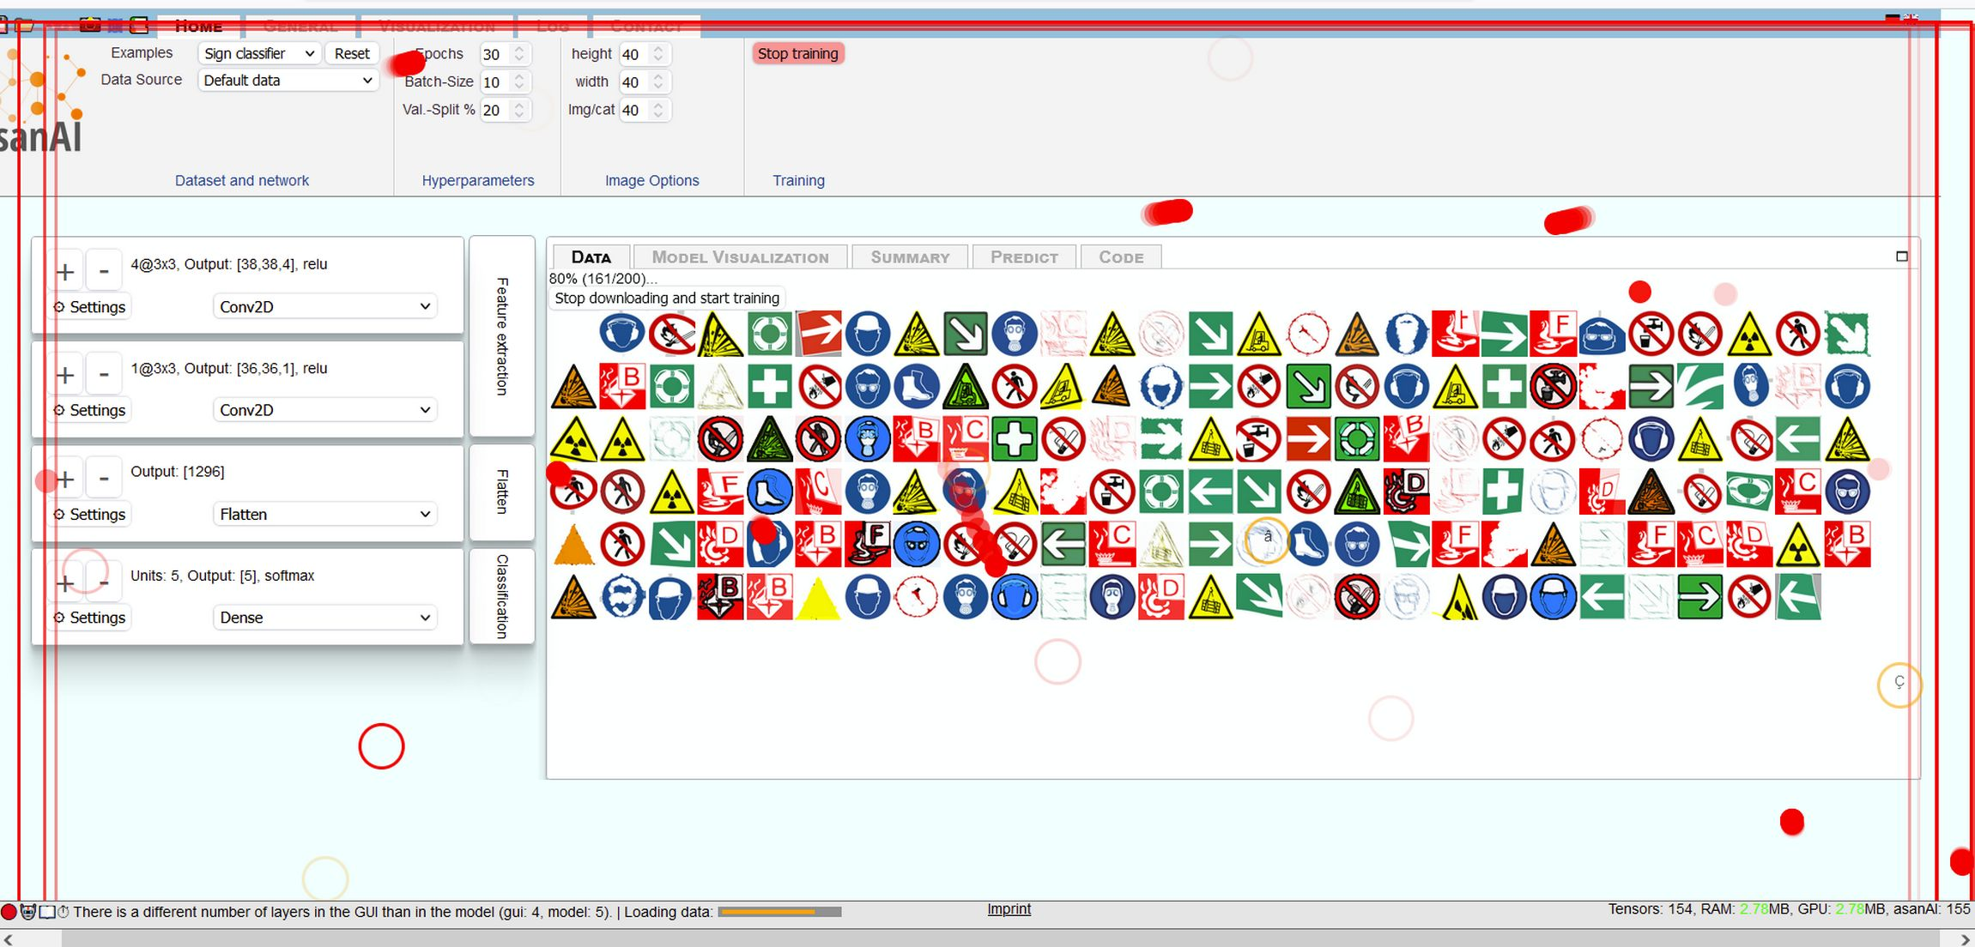
Testing code
Then, there’s „monkey-testing“. This means, a script randomly and without any understanding of the program randomly and wildly clicks anywhere, types in anything at random, all in very fast succession and often with many simulated keyboards, mice and touch events at the same time
It has no clue about the program, has very unclear motivations, knows nothing internals or what it does and what workflows are intended
  Just like real users

Slide 55
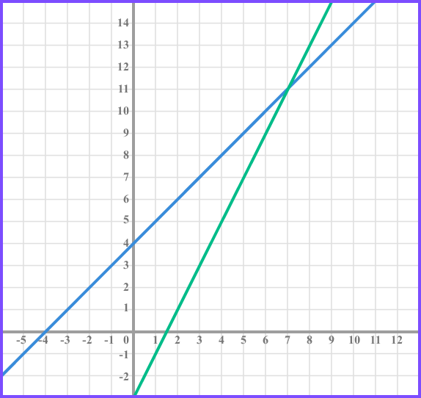
Testing code
For code that can run on many different machines of different speeds, testing if a function is “fast enough” is hard, because you cannot just measure time and if its over a simple threshold call it done, unless you use absurdly large thresholds that will not detect timing bugs
I chose to do it that way:
  Do a few times of the test on my machine and manually see if it’s “fast enough”, measure all times
  approximate a landau notation of the function from that data, using method of least squares, define those as starting parameters for an acceptable system
  Run the code on the target machines and approximate it’s landau as well. You now have only 2 thresholds which are relative to the speed of that system, and not the time alone
  Then you need only to compare 2 straight lines

Slide 56
Testing code
Testing the speed of things is also very important. Often, there are very simple bugs, like double-iterations, which make things slower than they need to be
So, when something like that occurs, you want to find it. So really, test for that as well. And always, by default, measure times of time intensive stuff, and log them, visible to the user.
Flamegraphing tests is also a great idea!

Slide 57
Do a „Power on self Test“
At the beginning of your computer’s boot process, it checks it’s own basics, if there is a hard disk available, memory and so on. If not, it beeps so you know something very basic is wrong.
These tests are quite simplistic, as they do not, for example, check the file system. But they are fast.
Write such tests at the start of your program that checks prerequisites
  For example, in the translations file, I have an array of translations with „de“ and „en“ as subkeys
    At the start, it checks whether each german translation has an english one and vice versa. If not, it cancels the program immidiately with an error message.
    This way, I never miss to translate one. If I do, the program immidiately stops working when testing.
  Test for all simple things at the start, i.e. the existance of programs, and exit with a descriptive error of what’s missing and how to fix it, or, even better, fix it automatically and just continue after it’s being fixed.
  Die loudly! You MUST see these errors. And it’s better if the user sees them as well, since otherwise, things may go wrong without the user noticing
Just like with assertions, speed is not an issue here. It’s more important than the program functions correctly.
You can also use this to install databases and so on. Try using a database in a try/catch block, and when it fails, run a script that executes the SQL commands you need so that the database runs, then reconnect and continue as if nothing has happened.
  That way, the site installs itself, when needed.

Slide 58
Deployment
At first, I didn’t use docker for deployment, but set up apache on a machine myself. But later on, after people wanted to install it on their own machines, I deployed it via docker.
This makes life much, much easier. Time spent on dockerisation is always very well-spent. Because at some point, you will need to re-install it, or install it somewhere else.
Docker then is just like a setup.exe on Windows, “double click” it and it simply runs
I wrote docker.sh, a bash script, that installs asanAI via docker, and also installs docker when it’s not there already (on debianlike systems only)
Also: use git, and use it early. Learn the basic commands if you don’t know them. Learning only like 5 commands (init, clone, commit, push, pull) will give you huge advantages, and you can use it to deploy it to a server over ssh and make sure it is always the latest version

Slide 59
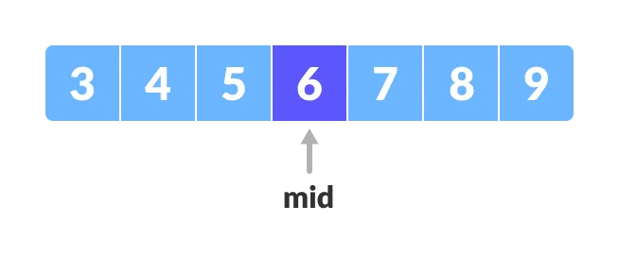
Git Bisections
Bisections allow you to define a certain commit as bad (i.e. containing a bug), and another one as good, and then tries out the middle one to see if the bug is still present. If yes, it was introduced in the first half, if not, in the second
It then goes to the middle commit of the first or second half of commits and so on
After each “git bisect good” or “bad”, you need to test if the bug is present.
But that way, you can find the exact commit and often, if you commit small enough packages, the exact line which caused a bug
In long-running complex projects, this is an immense help, when new bugs sometimes appear, as you can find them within O(log(n)/log(2)) time (basically)
Searching the whole asanAI commit history (with ~5000 commits) only takes roughly 13 tests to see where any bug was introduced
This has, many times, saved me from very complex bugs that arose somewhere, when I didn’t notice at first

Slide 60
Licensing
asanAI itself is under the MIT License, meaning, everyone can view, fork and edit the source code. This, I believe, is good, since it allows the program to be modified and bettered, without hiding anything from anyone.
The python code it produces though, is under WTFPL (“do what the f*ck you want public license”, which is “do wtf you want, I am not responsible for anything you do with it”). This is also good, since the small programs it produces can be used for anything you like. You could relicense them, or sell them, or use them privately or in a company, doesn’t matter. That way, it is as useful as possible without any annoying legal hinderances.

Slide 61
What I learnt from users
Users sometimes try to find a button or anything where you didn’t expect them to search for it
If you see that, add it where users expect it.
Listen to users, try to do it as intuitive as possible, by doing it the way users really try to use it

Slide 62
Some stats
asanAI consists of 29,914 lines of code written by me (excluding libraries)
4,930 commits
Its ~92% JavaScript, ~4% PHP and ~2% pure HTML, also 0.7% CSS and 0.1% shell-code. There are python and some other script types as well, but they don’t get executed during the normal workflow.
There have been 965 unique visitors since in the last 10 days, which is basically 100 new visitors a day, 213 of the 1000 new ones of which came to the site at least twice (22%) and 150 at least 3 times (16%) and 14% 4 or more times

Slide 63
Philosophical results
No, „AI“ does not bring us any closer to understand how the mind works.
Sure, in some areas we may see some progress, like Image Classification or Language Models, but nothing that brings us significantly new information on the problem of Qualia, i.e. how subjective experience arises or what it is consists of or how it works
How consciousness arises is one of the greatest mysteries in the universe, only en par with the question of why there is anything instead at all.
  And we are not a single step closer to answering those questions at all

Slide 64
Thanks
I learned quite a lot in this project, many very different things that I could have learnt and done nowhere else
I am quite grateful for that, especially to Siavash, René and Ralph for “just letting me do” what I want to do, and Christoph and Taras for the Feedback they gave me, and Jan for always listening to my long and meandering rants about JavaScript and often provided solutions that I could not see
Also for Claudia for her her help with parts of the code, and everyone else who helped, tried it, had suggestions and so on
This would not have been possible in the way it currently is without those who helped

Slide 65
Any comments? Questions? Critique?

