Slide 1
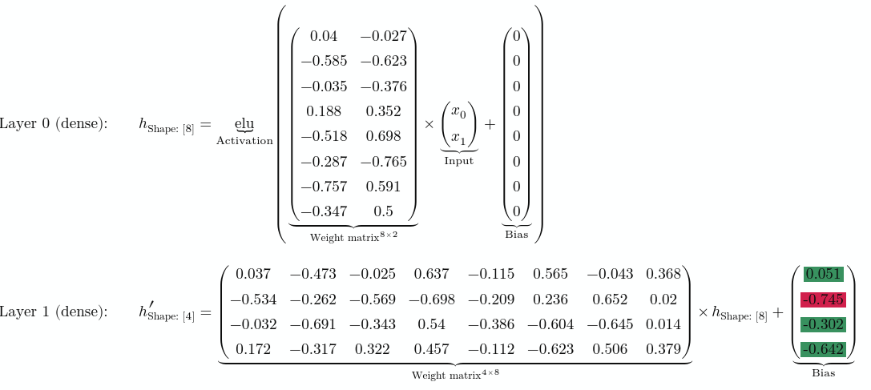

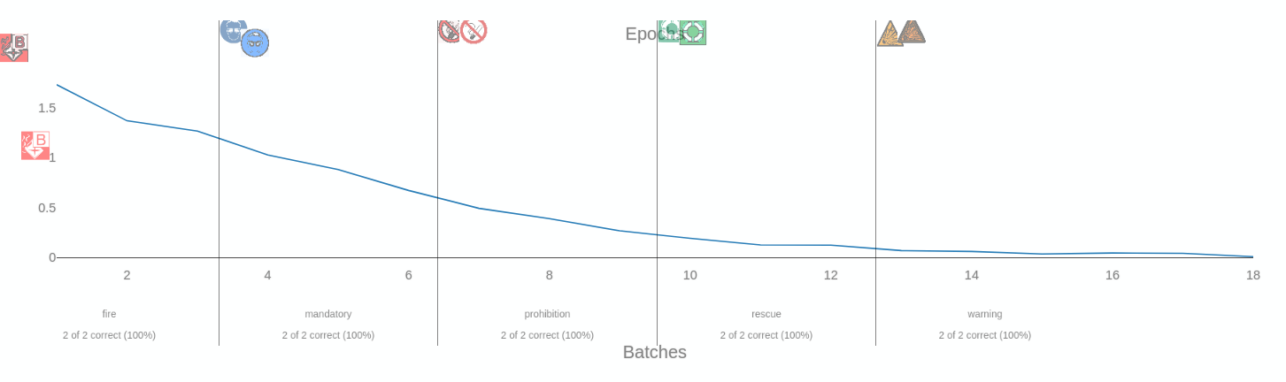
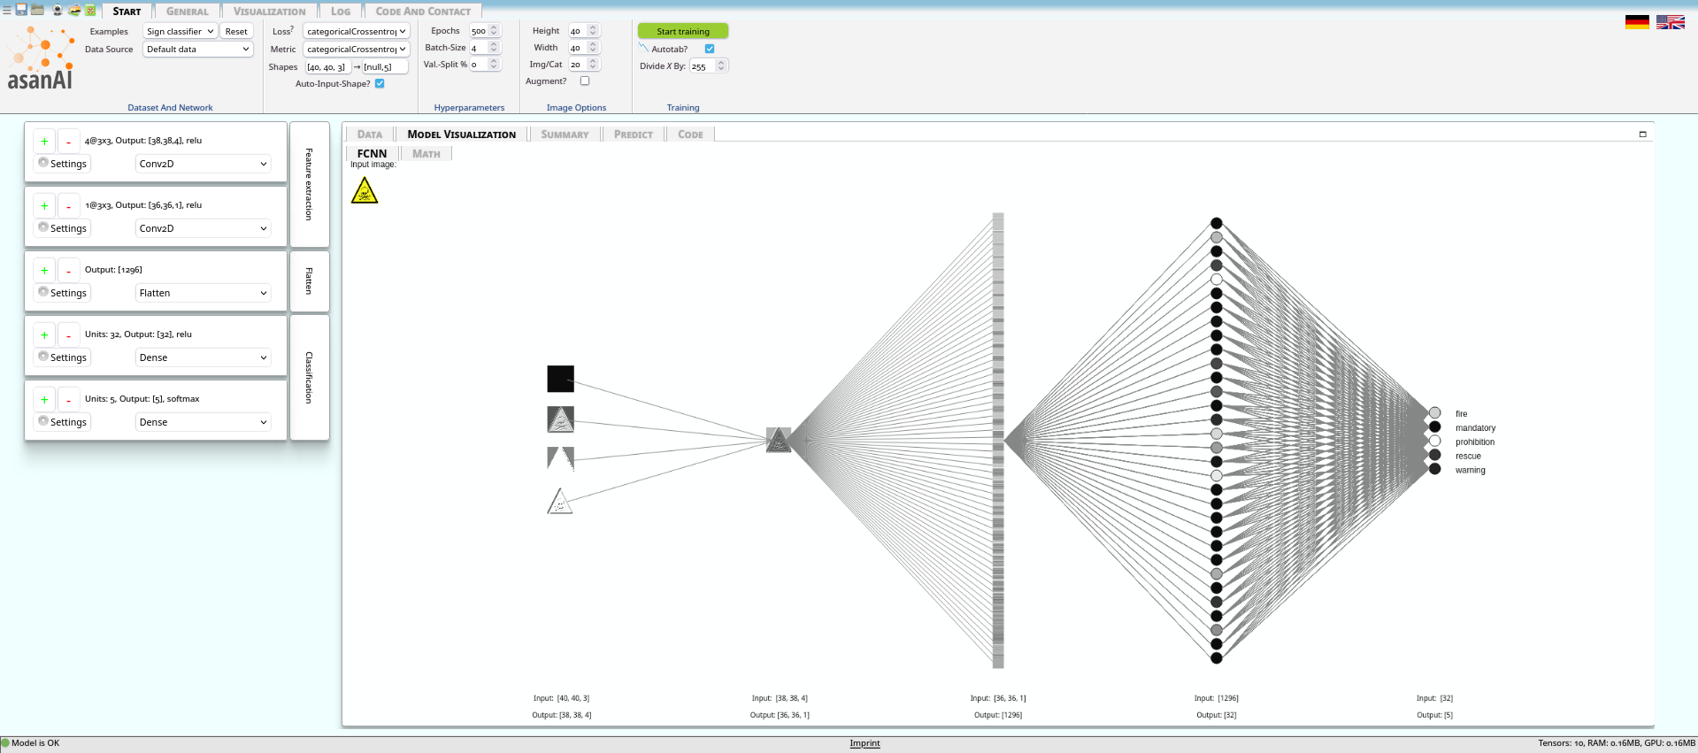
asanAI
Machine Learning made easy
Norman Koch
What is asanAI?
Demo and Code
asanAI is a browser-based, open-source toolkit that allows users to intuitively design, train, and visualize small sequential neural networks entirely offline. It empowers both beginners and experts to experiment with neural networks on example or personal data, without requiring any coding skills.
Machine learning is often complex and inaccessible to non-experts. asanAI simplifies the workflow by providing an interactive UI built on TensorFlow.js, enabling users to create sequential models with layers such as Conv1D, Conv2D, Conv3D, Dense, and Flatten, all in-browser. The toolkit runs on all modern operating systems (Windows, Mac, Linux) and keeps all data local, ensuring privacy.
Users construct models via drag-and-drop interfaces, set all hyperparameters, and select the loss function (default: categoricalCrossentropy for images). Models can be trained directly in the browser using WebGL acceleration if available. After training, models can be exported to Python for local deployment. Visualization tools include simple plots, network diagrams, neuron activation views, and LaTeX-exportable equations for detailed analysis.
asanAI enables safe experimentation with neural networks, making it ideal for learning, prototyping, and testing small models. Users can explore hundreds of thousands of parameters without risk of misconfiguration. Its zero-code approach supports educational and experimental purposes.
While optimized for smaller networks, asanAI demonstrates that machine learning can be made accessible without compromising privacy or flexibility. The offline-first approach ensures that sensitive data never leaves the user’s machine.
asanAI lowers the barrier to entry for machine learning, enabling hands-on exploration and rapid experimentation for users ranging from novices to experienced practitioners.
AsanAI is freely accessible to researchers and practitioners worldwide and can be used directly via the following link: https://asanai.scads.ai
The source code is available at https://github.com/NormanTUD/asanAI and is released under the MIT License.
Norman Koch
norman.koch@tu-dresden.de

