Slide 1





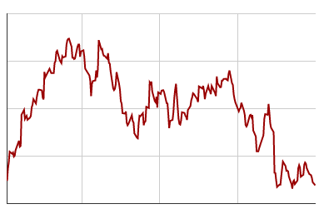
Ratings
EU
US
AUS
Eluded
Master knight | 2000
Gold archer | 1500
Peasant builder | 1000
TRUTH Joan of Arc
Master knight
Match History
Activity
VICTORY
1 day ago
EU
Eluded
11
vs.
Basea
3
+30
VICTORY
1 day ago
EU
Eluded
11
vs.
Basea
3
+30
Stats
VICTORY
1 day ago
EU
Eluded
11
vs.
Basea
3
+30
DEFEAT
1 day ago
EU
Deynarde
11
vs.
Eluded
5
-12
DEFEAT
1 day ago
EU
Deynarde
11
vs.
Eluded
5
-12
DEFEAT
1 day ago
EU
Deynarde
11
vs.
Eluded
5
-12

Slide 2
VS.
Eluded
Cohen
TRUTH Joan of Arc
MIST deynarde
Master knight
Master knight
Region: EU
Date: 31/01/2018 12:32
Round 1
WINNER: Eluded
Eluded jabbed Cohen
Cohen’s slash missed
Eluded shield bashed Cohen
Eluded threw a bomb
Round 2
WINNER: Cohen
Eluded jabbed Cohen
Cohen’s slash missed
Eluded shield bashed Cohen
Eluded threw a bomb
Summary
Winner
Eluded
11
Rating +15
TRUTH Joan of Arc
Loser
Eluded
5
Rating -15
TRUTH Joan of Arc

Slide 3



Eluded
Joan of Arc
Ratings
EU | Knight | 2000
 | Archer | 1500
 | Builder | 1000
US | Knight | 1800
 | Archer | 600
AUS | Builder | 1100

