Slide 1
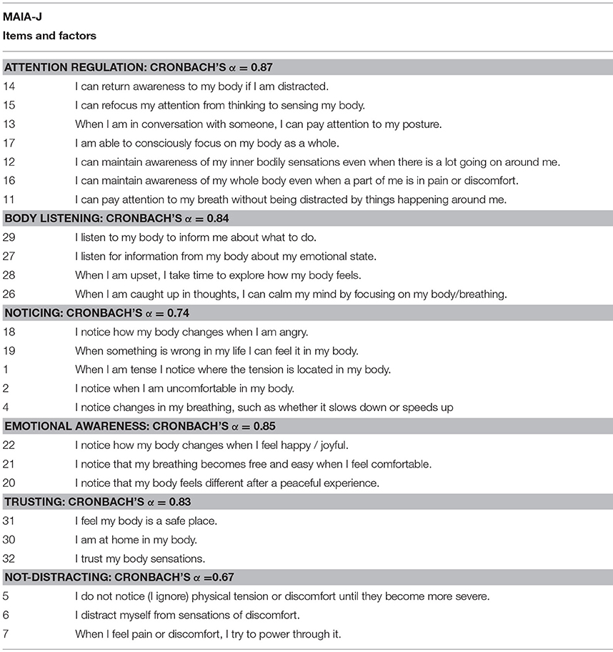

What About Sensation Predicts Flourishing?
Multidimensional Assessment of Interoceptive Awareness
Wolf Mehling
(Author of the MAIA)

Slide 2
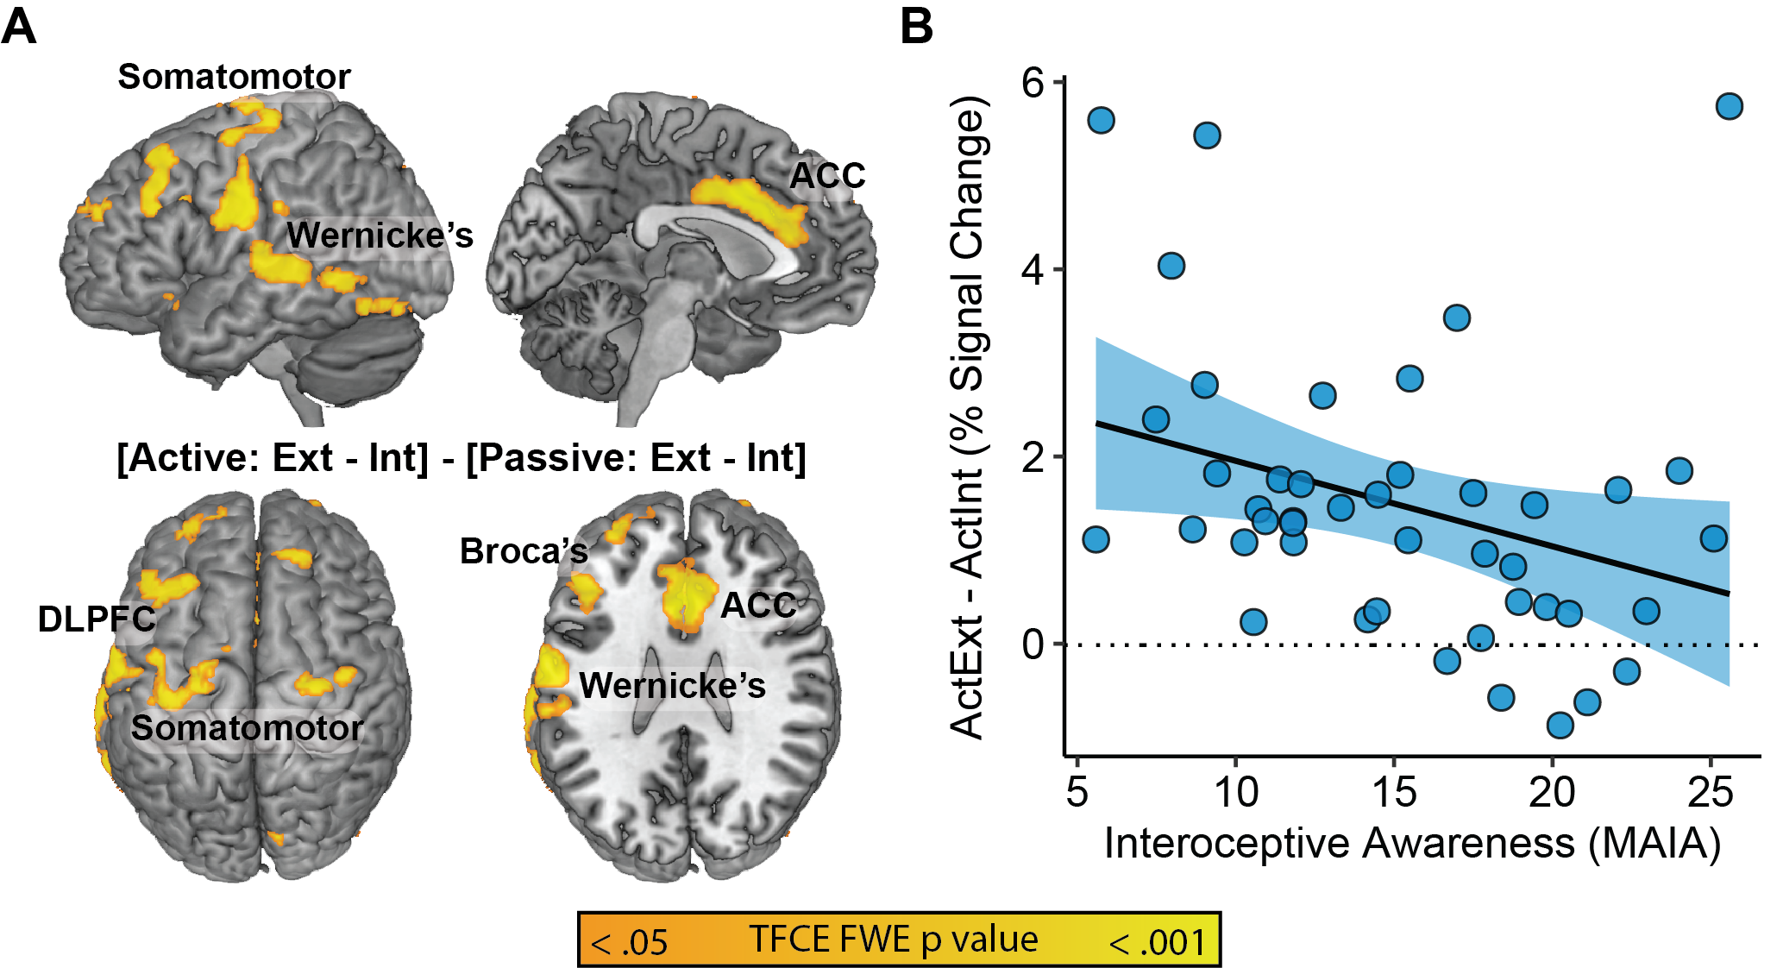
Greater Awareness: Selectively Spared Inhibition
r(42) = -.32, p = .03
Farb, Zuo, & Price, eNeuro, 2023

Slide 3
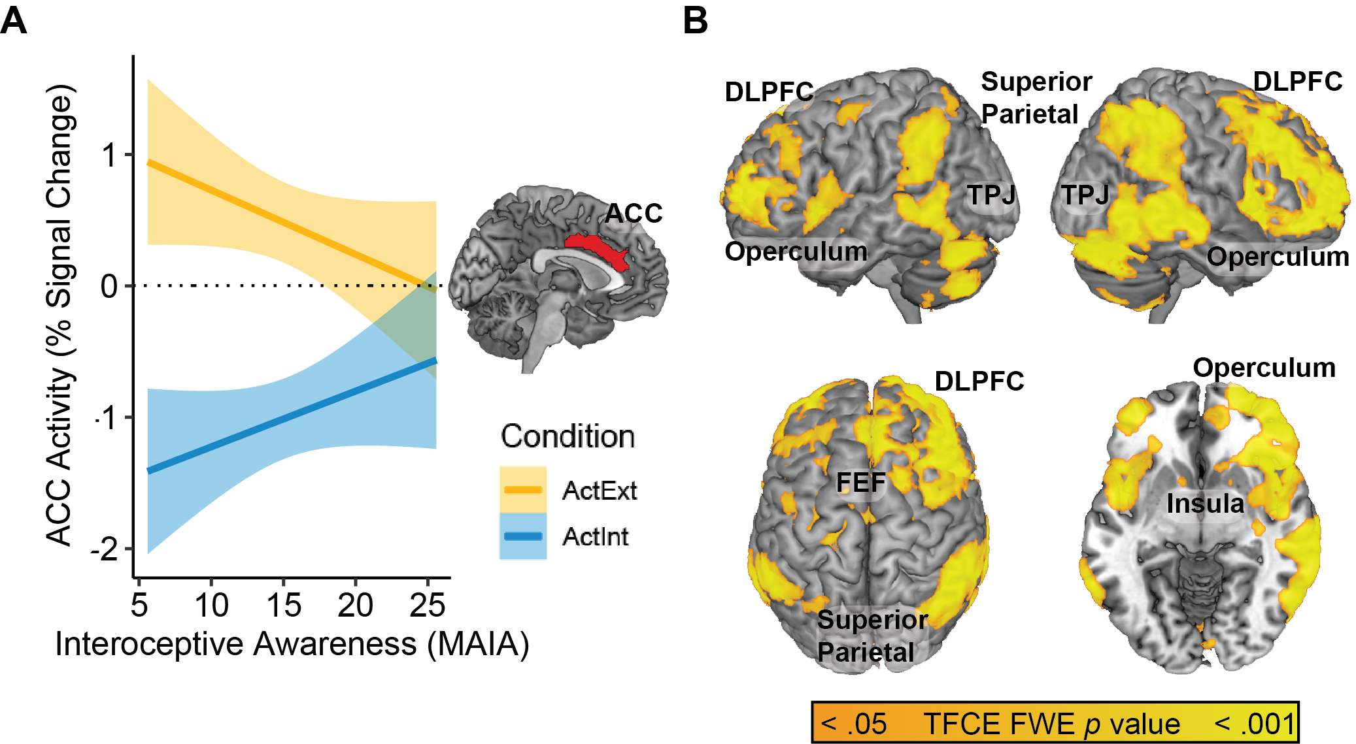
Greater Connections with Executive Network and Language Regions
Farb, Zuo, & Price, eNeuro, 2023

Slide 4
