Slide 1
Expyro 🐉
Limit food waste through smart meal suggestions

Slide 2
🔥 The idea in short
Offer a platform that suggest meals based on what’s expiring in your fridge to reduce food waste in your home.

Slide 3
🍟 How?
By connecting with Mathem, Linas matkasse and other online food stores, users will smoothly sync their food purchases in the Expyro app.
Using this data, Expyro will suggest nutritious meals based on what’s expiring.
The user can always add any food items bought in a physical store by swiftly scanning its receipt or adding it manually.

Slide 4
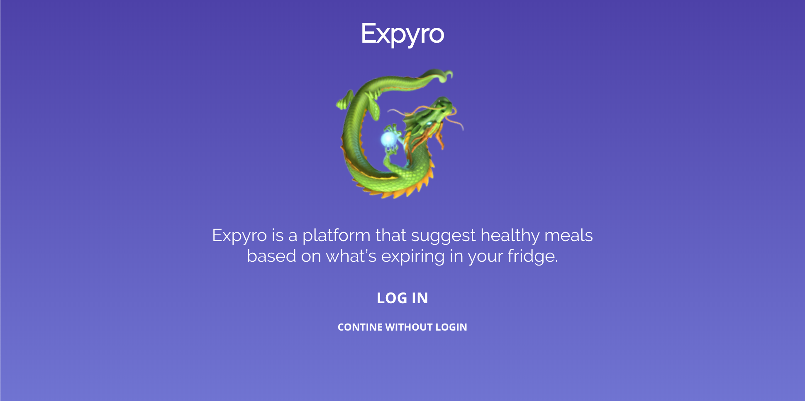

Slide 5
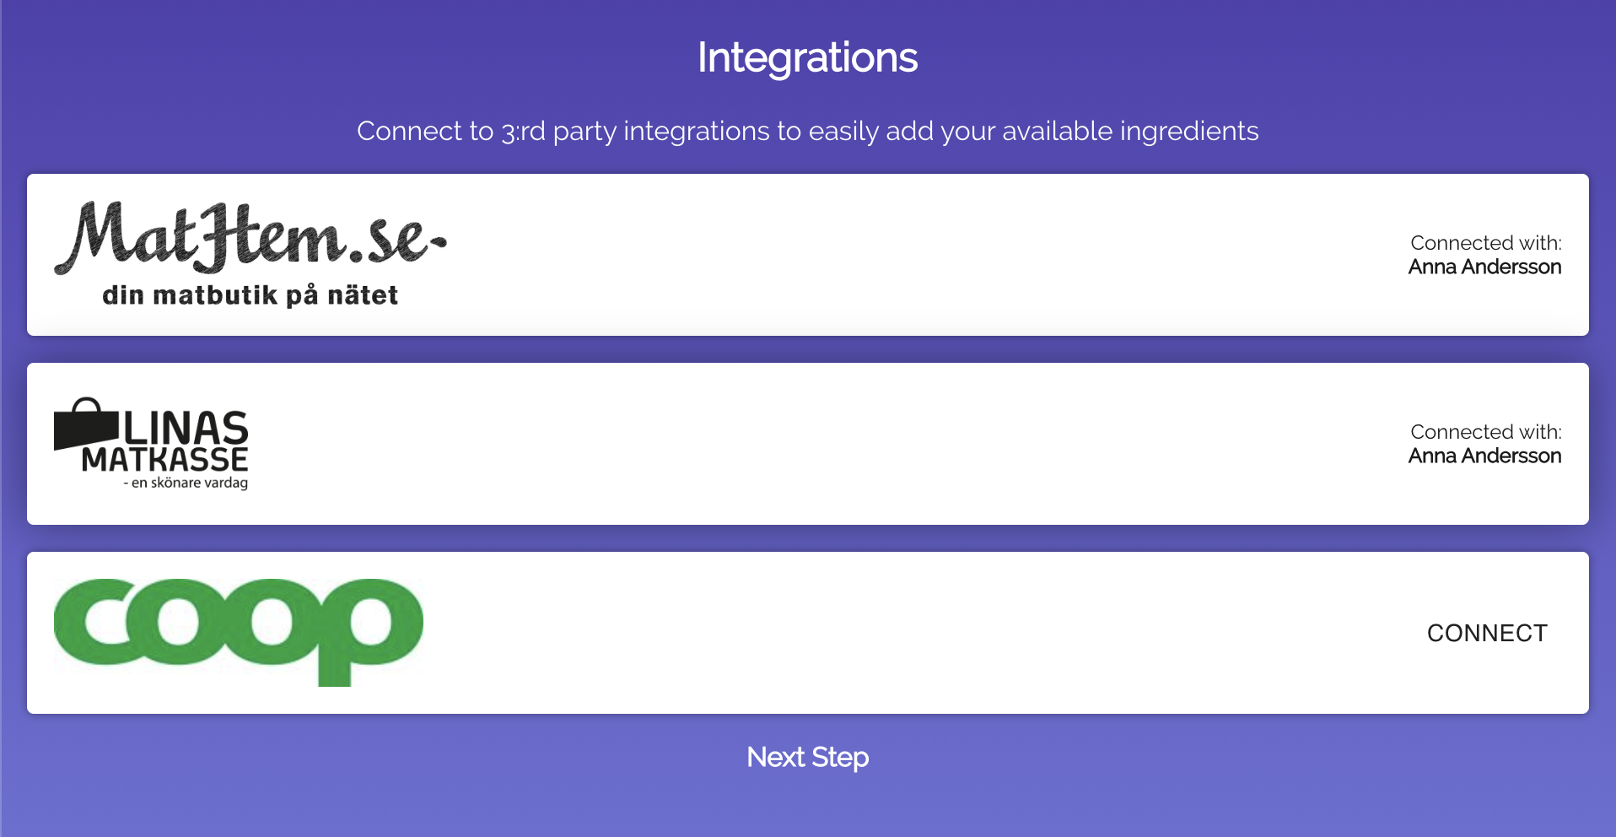

Slide 6
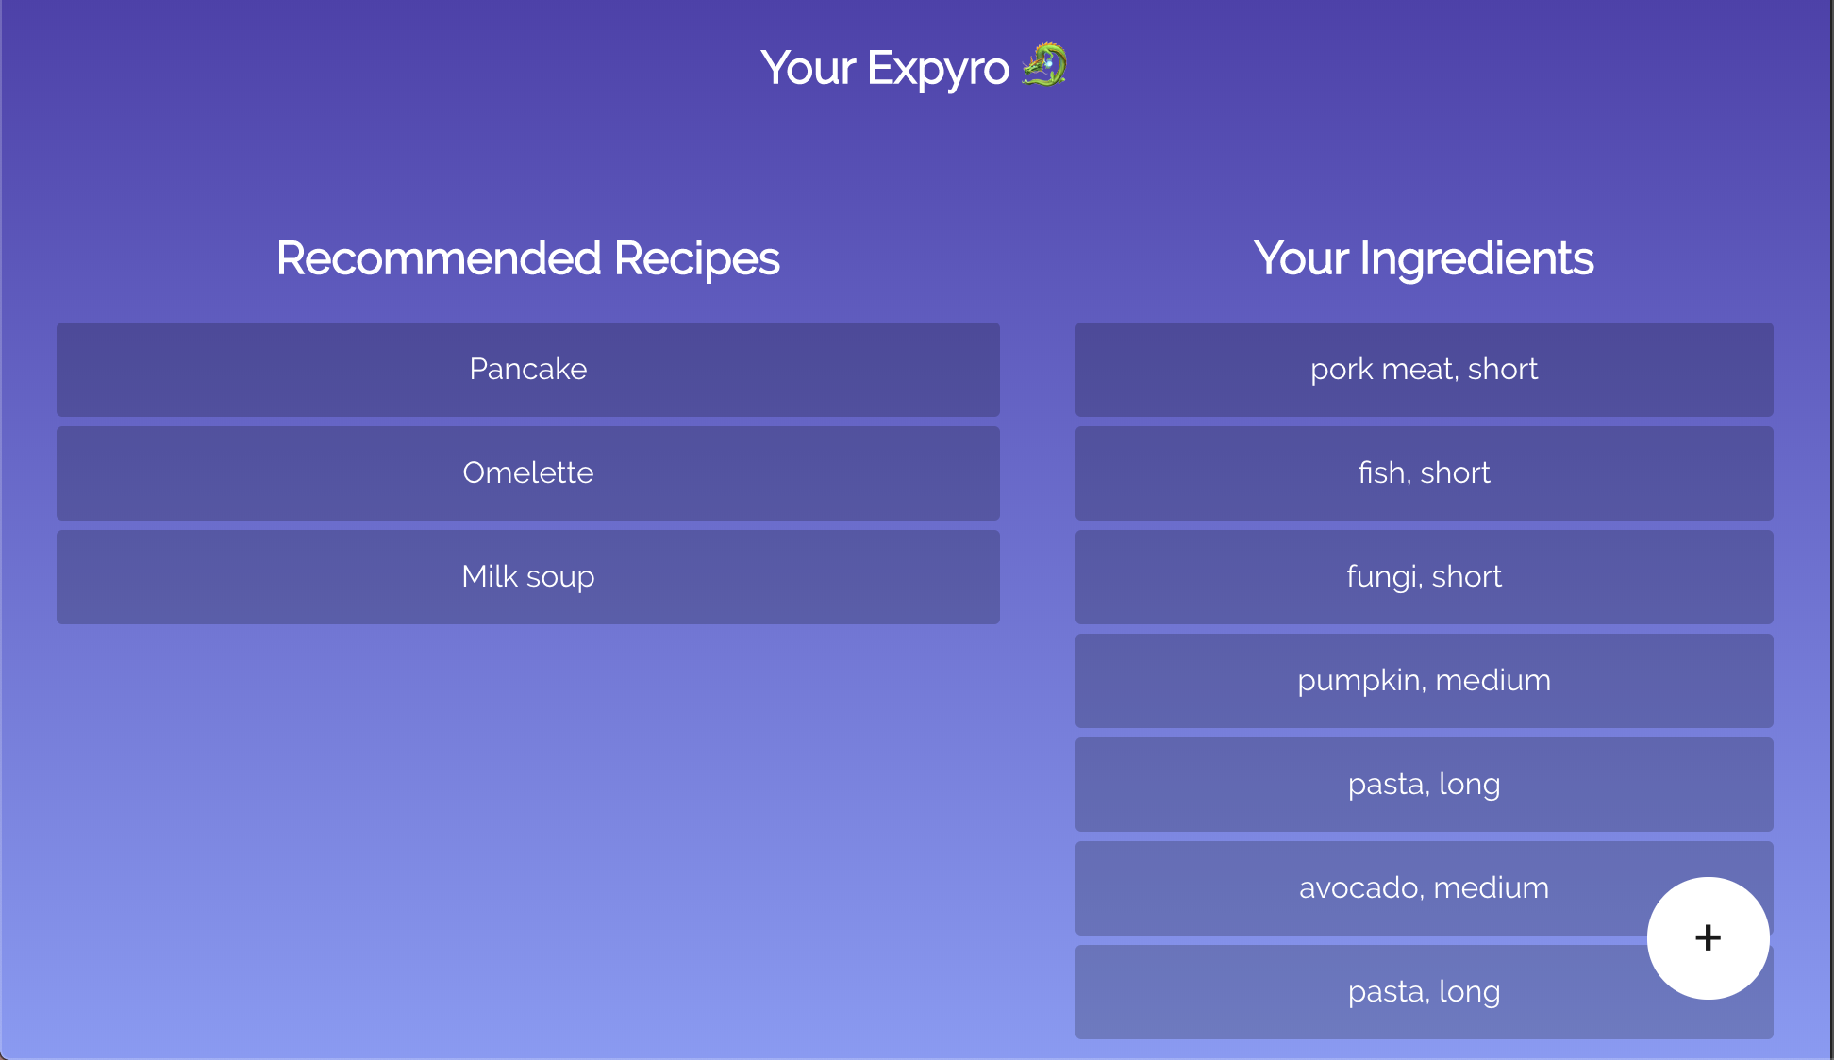

Slide 7
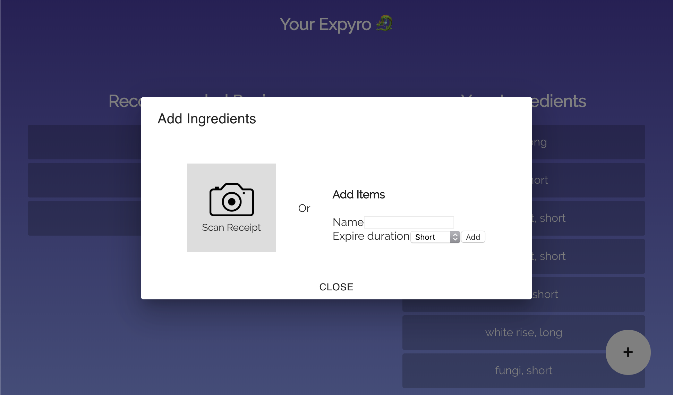

Slide 8
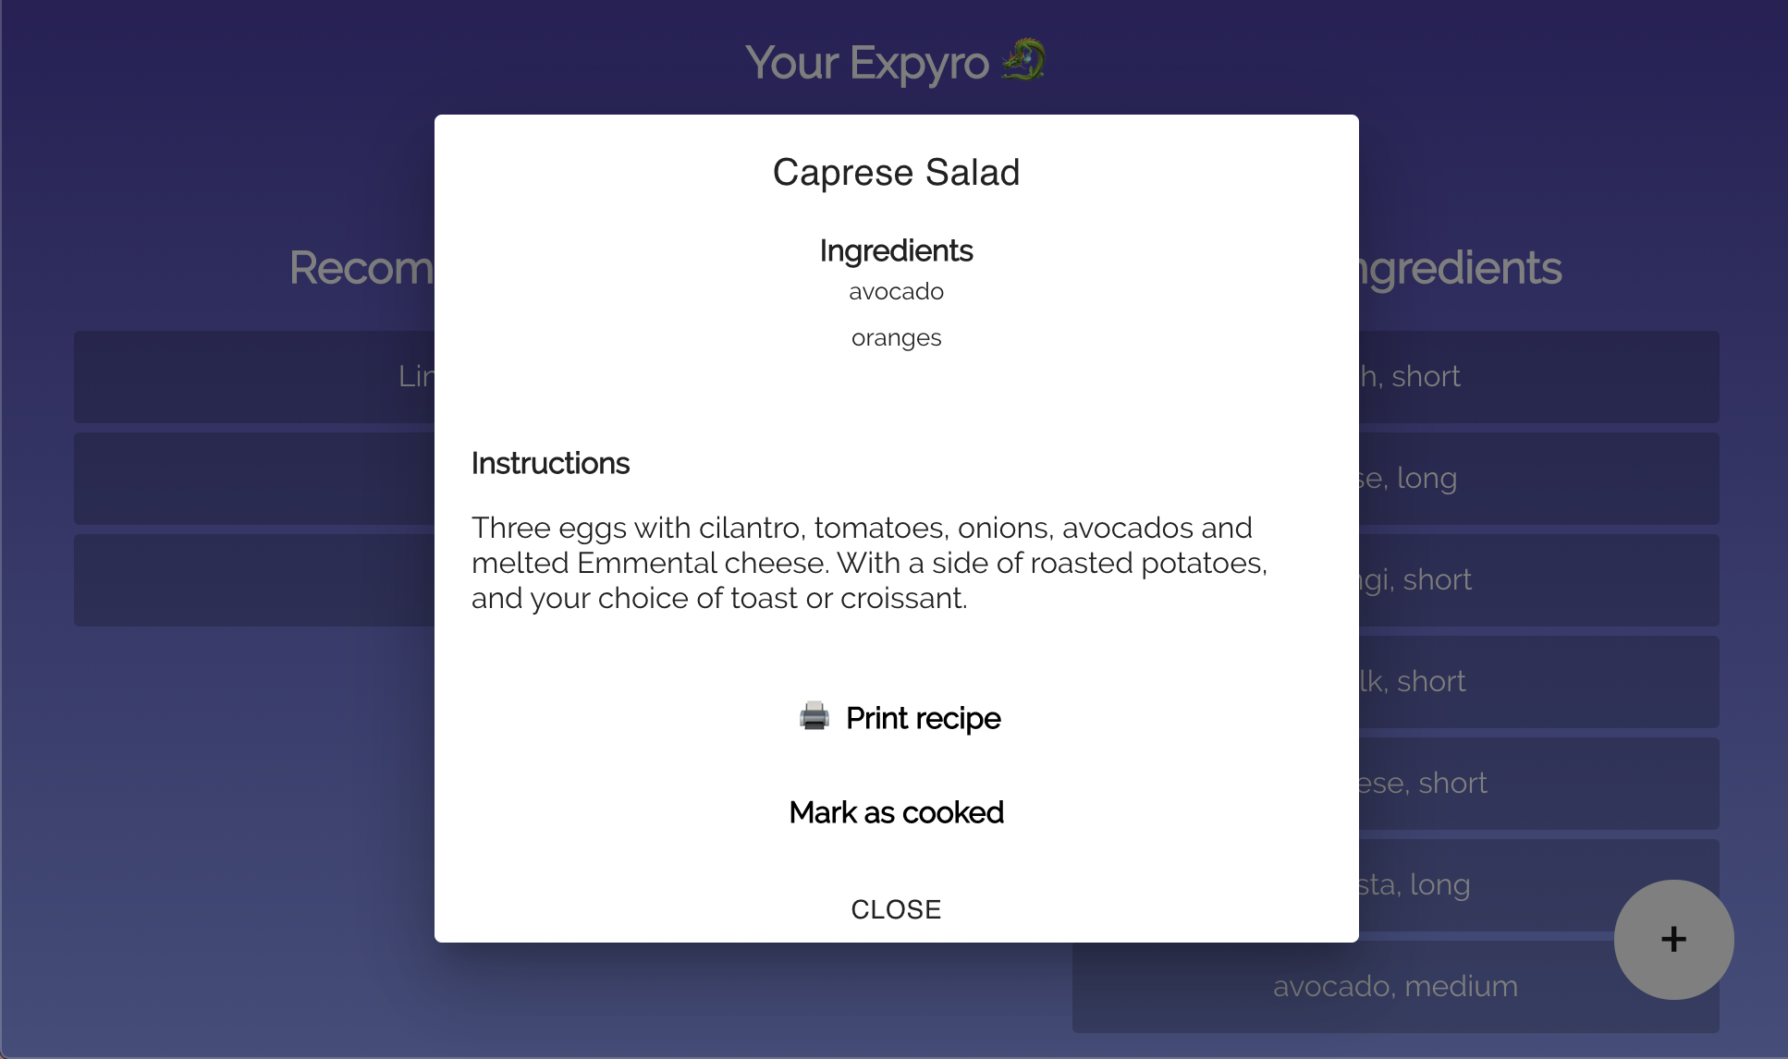

Slide 9
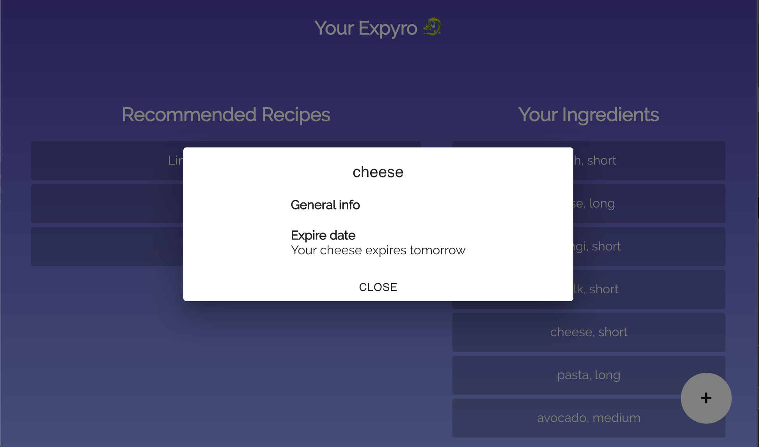

Slide 10
Future work
Remind users about expiring foods
Suggest shopping list to complement expiring food items
Smart suggestions based on user preferences
Connect with your neighbours for sustainable dinner parties

