Slide 1
XSAM course
Running XSAM
Sondre Aanes
IMR, Bergen
15 - 17/1-2017

Slide 2
Install R and TMB
For TMB: Follow instructions at:
https://github.com/kaskr/adcomp/wiki

Slide 3
Setting up and running XSAM
The model: XSAM.cpp
Attempt of a generic code with swithces to turn on or off effects (parameters)
The R-function TMB::MakeADFun passes data and parameters to the C-code.
Mismatch in data and settings will cause R to terminate with rather meaningless messages (attend a C and TMB course)!!

Slide 4
Options for running XSAM
Manually set the data object and parameter object:
Requires detailed knowledge about the model and code.
Difficult and easy to do mistakes
Use the R utility functions (‘XSAMutils.R’) to create data and parameterobject
Settings determining configuration can be read from a .txt file

Slide 5
Current documentation in
‘…Docs/Documentation.pdf’

Slide 6
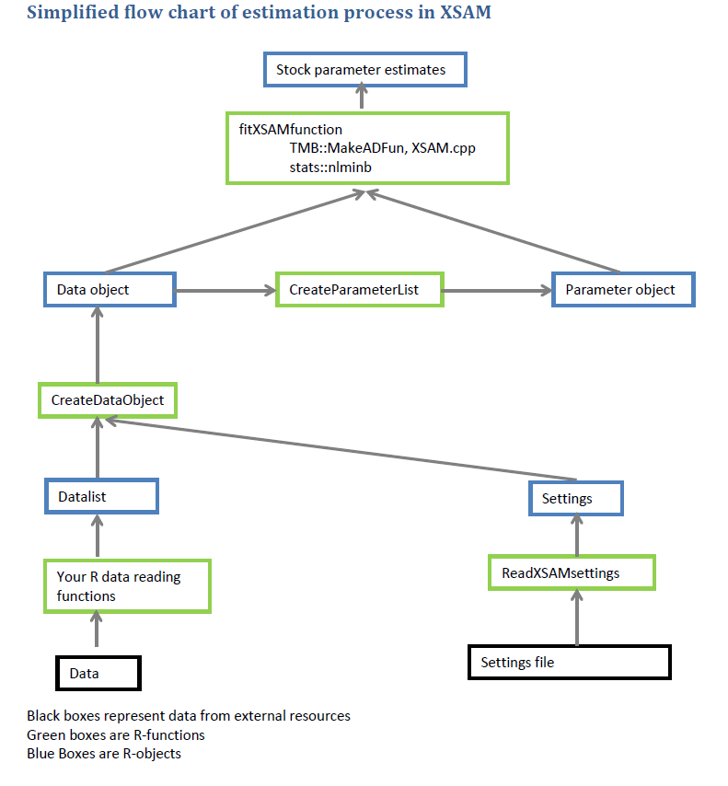

Slide 7
Steps
Read data
Create the R-object ‘datalist’. Manual procedure due to lack of ‘universal format’. See ‘Documentation’ for format of ‘datalist’
Configure and set up model
Read settings file (in a specific format)
Combine settings and data
Fit
Diagnostics
Forecast

Slide 8
R-functions
‘…/XSAMcode/XSAMutils.R’
Partly documented
Key functions
ReadXSAMsettings: Read model configuration specified in a txt file
CreateDataObject: Creates a dataset prepared for input to the C-template (see TMB::MakeADFun)
CreateParameterList: Creates the parameters with starting values needed for the C-template (see TMB::MakeADFun)
FitXSAMFunction: Do optimization, create parameter reports, extracts some diagnostics
+Many utility functions for visualizing results and creating reports

Slide 9
Objects
R-object: Datalist
C-code: XSAM.cpp
Settings file: Configuration
R-object: Dataobject
R-object: Parameters

Slide 10
Datalist
A specific format documented p. 6 and 7 in ‘Documentation’
‘…Examples/ReadHerringData.R’ produces a valid ‘datalist’

Slide 11
The C-template
XSAM.cpp
Variables documented in ‘Documentation’ pp 1-4.
Provided the R-objects ‘settings’ and ‘datalist’ the R function ‘CreateDataObject’ creates a dataobject that can be passed to the C-template.

Slide 12
Model configuration
The setup file: see ‘…XSAMsetup/XSAMsetupNSSherring.txt’ for an example.
Read the file using the R-function ‘ReadXSAMsettings’

Slide 13
Parameters
A combination of data and settings
The R-function ‘CreateParameterList’ takes the ‘XSAMdatalist’ and creates the parameters and sets starting values!

Slide 14
Note on observation errors
‘CreateDataObject’ creates a dataobject containing the error structures of each data input:
These are set with standard errors=1 and zero correlation
To inform error structures: these must be replaced with external values!! See examples how to achieve that!

Slide 15
The herring example
See code in ‘…Examples/XSAM_herring_example.R’

Slide 16
Excercises
Run through the herring example. Stop at diagnostics
Fit the model as in XSAM_herring_example.R; but assume iid errors for each dataset and estimate the variances for each dataset. Compare with the first fit.
Remove one dataset and fit the model
Do a ‘leave out’ run and compare results
Change settings and compare results:
Change q plateu
Fix observation error
Change plus group

