Slide 1
XSAM course
Diagnostics and model selection
Sondre Aanes
IMR, Bergen
15 - 17/1-2017

Slide 2
Diagnostics
Difficult with a simple recipe…
Should include the following
Start with empirical data analysis before fitting the model
Ensure convergence!
Plot/write parameters
Likelihood values
Evaluate data weights
Residuals
Profiles
Retrospective plots
Precision of key parameters
Leave out runs
Cross validation (not implemented, but should be)

Slide 3
Model selection
In combination with diagnostics model selection can be aided by AIC.

Slide 4
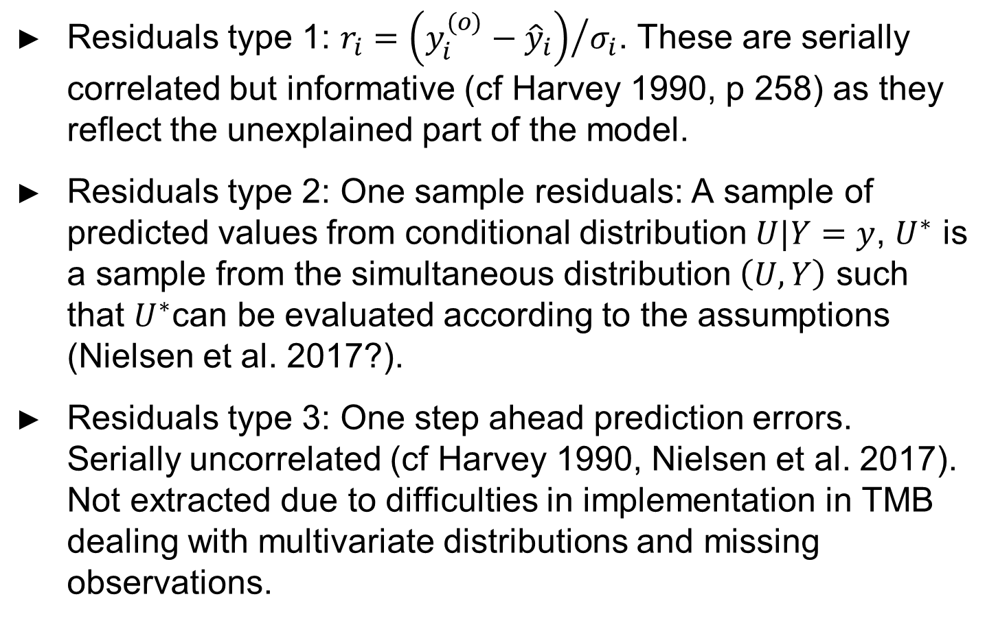
A note on residuals
Residuals type 1: $r_{i}={\left(y_{i}^{(o)}−{\hat{y}}_{i}\right)}/{σ_{i}}$. These are serially correlated but informative (cf Harvey 1990, p 258) as they reflect the unexplained part of the model.
Residuals type 2: One sample residuals: A sample of predicted values from conditional distribution $U|Y=y$, $U^{∗}$ is a sample from the simultaneous distribution $\left(U,Y\right)$ such that $U^{∗}$can be evaluated according to the assumptions (Nielsen et al. 2017?).
Residuals type 3: One step ahead prediction errors. Serially uncorrelated (cf Harvey 1990, Nielsen et al. 2017). Not extracted due to difficulties in implementation in TMB dealing with multivariate distributions and missing observations.

Slide 5
Diagnostics
Use the example in ‘XSAM_herring_example.R’

