Slide 1
XSAM course
Background
Sondre Aanes
IMR, Bergen
15 - 17/1-2017

Slide 2
Putting things in perspective…

Slide 3
Overall objective – efficient use of data
Collect and use the available data as efficient as possible
Identify sufficient amount of sampling data to meet the requirements by
Quantifying risk and uncertainty such that
sampling programmes can be monitored and improved
→ Being cost effective

Slide 4
Background XSAM
XSAM is a framework that aims at providing a link for
Cost effective sampling for management advice
XSAM is work in progress
Aanes, Vølstad, Subbey, Hirst, Aldrin, Storvik et al.

Slide 5
Background for development

Slide 6





From data to management advice a «bottom up» example description
Reference fleet
Surveillance fleet
+Others
Data/sampling
programmes:
Coastguard
Scientific surveys
Fishery induced mortality: Catch at age, bycatch, discards,…
Stock status: Index of abundance at age,…
Input:
Model:
Assessment model
Stock status + HCR→
Management advice
SSB,…,+HCR → Quota advice

Slide 7
Assessment – schematic description
INPUT DATA
-Catch@age
-Abundance indices@age
-Weight@age
-Proportion mature@age
-…
-…
-…
MODEL
-XSA
-SAM
-TASACS
-…
-…
-…
ESTIMATE/
PREDICT
Stock parameters:
-SSB
-Fishing mortality
-…
-…
-…
+
=
Sample surveys
→uncertainty
Is the model correct?
→uncertainty
Uncertainty?

Slide 8
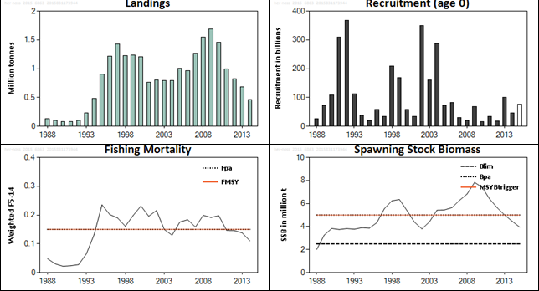
Traditionally: Management advice based on management plan in relation to:
Uncertainty?
Figure 7.6.2.3.1. Norwegian spring-spawning herring. Standard plots from final assessment (TASACS VPA) in 2015.
From ICES. 2015. Report of the Working Group on Widely Distributed Stocks (WGWIDE), 25 August - 31 August 2015, Pasaia, Spain. ICES CM 2015/ACOM:15. 588 pp.

Slide 9
Traditional assessments
Many methods does not provide measures of uncertainty
Quantifying risks is difficult
Some do
Are uncertainty measures realistic?
Input data from sample surveys
Uses point estimates as input data (catch at age, indices at age) while they in reality are uncertain (they are estimates)
Is valuable information thrown away?
Data points are sometimes given subjective weights
Weights are related to uncertainty
Lack of objective and reproduceable procedures to provide data weights

Slide 10
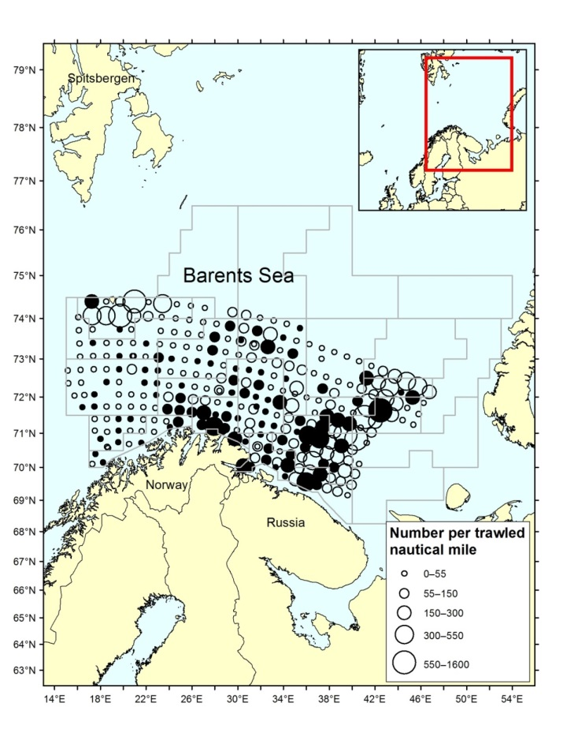



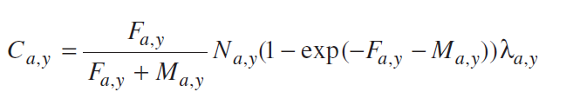

Input data: Data from sample surveys
…Only a small proportion is sampled…
→ uncertainty
Uncertainy depends on:
Sampling design (target population, where, when)
A well defined survey sampling design is necessary to enable correct quantification of uncertainty!
Sampling effort (sample with what intensity)
Design and effort determines accuracy (precision and bias)
Survey data combined with population models
Assessment model applied on imprecise data
Each of these steps has a cost!

Slide 11
Sample survey data
Monitoring programs are expensive
It should be of greatest interest that data is used appropriately
A well performed survey resulting in precise estimates should improve the assessment (or vice versa). The assessment should reflect this

Slide 12
Example of uncertainty in input data
Estimates of Norwegian catch at age of cod in 2003

Slide 13
Norwegian Catch at age of NEA cod 2003; could be

Slide 14
Or…

Slide 15
Or…

Slide 16
Or…

Slide 17
Represented as credibility sets (confidence intervals)
And point estimates are used in the assessment

Slide 18
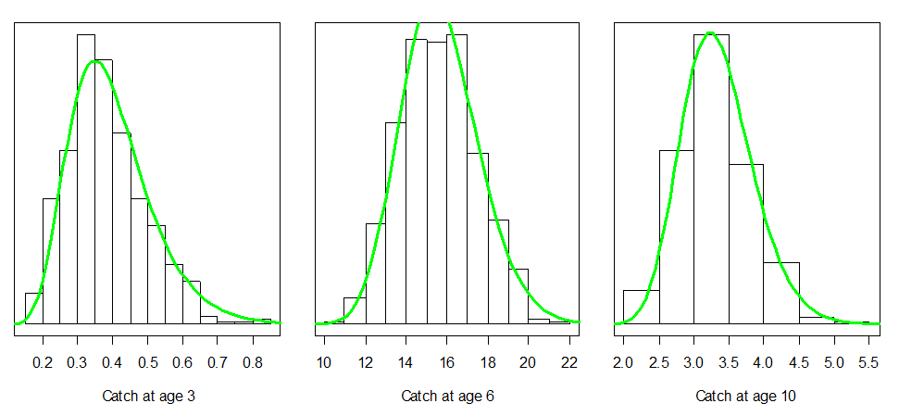
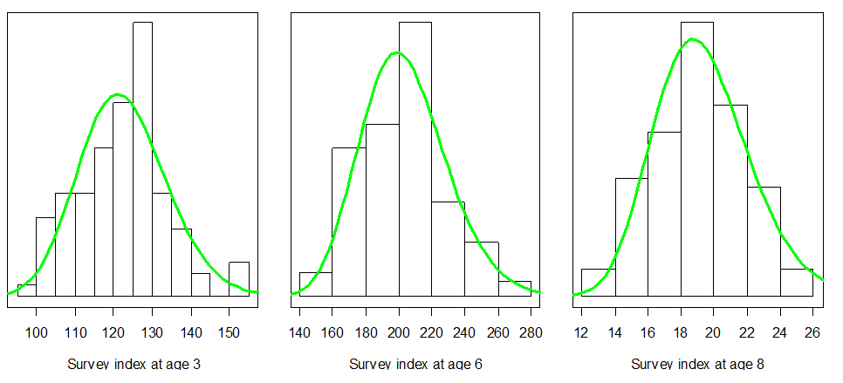
What is the effect of uncertainty on stock assessment?
ECA +StoX→ enables finding out…
Based on methods such as
Hirst et al. 2012
Stenevik et al. 2016
Aanes and Vølstad, 2015
Requires an assessment model allowing for uncertainty in input data
Assessment model
?

Slide 19
What is the abundance of 7+?
1000
800
-6
600
Example:
NEA cod
10
×
N
400
200
0
2001
2003
2005
2007
2009
2011
2013
2015
Year

Slide 20
What is the abundance of 7+?
Reasonable levels of precision in input data
-6
Example:
NEA cod
10
×
N

Slide 21
What is the abundance of 7+?
Reasonable lower levels of precision in input data
-6
Example:
NEA cod
10
×
N

Slide 22
Uncertainty in estimated stock parameters depend on uncertainty in input!

Slide 23
A trade off between fisheries and survey data
Work in progress by Aanes and Vølstad
RSE: Relative standard error

Slide 24
A trade off between fisheries and survey data
A defined level of precision
may be achieved by
Imprecise catch and precise survey estimates
Or; with precise catch and imprecise survey estimates

Slide 25
Questions
The cost of a survey is determined by sampling design and effort
How do we balance sampling (and cost) of multiple data sources if the objective is to provide a TAC and minimize risk of overfishing?
Harvesting strategies
Objectives:
maximize a constant catch with a specified risk of collapse
Maximize long term yield
What is the cost of improving estimates of stock parameters by X%?
What is the effect of conducting surveys every second year?
What is the effect of increasing sampling effort on stock assessment?

Slide 26
Summary
Stock assessment models integrates multiple datasources to estimate and predict stock status
Uncertainty in stock assessment depend on uncertainty in input data
If the results of a survey is really good, the assessment should improve or vice versa. That should be known and shown!
It is necessary with knowledge about quality in input data to avoid bias in inference (e.g. point estimates and variance)
Complex error structures can not be estimated based on point estimates alone
Are costly data used the correct way?

Slide 27
NOTE:
The ICES advice framework is not ready to explicitly account for uncertainty:
Dankel et al. 2016 proposed one simple approach to adapt the framework to account for uncertainty
Higher precision result in higher quotas and vice versa resulting in lower risk of depletion
Dankel, D.J., Vølstad, J.H., and Aanes S. 2016. Communicating uncertainty in quota advice: the case for Confidence Interval Harvest Control Rules (CI-HCRs) for fisheries. Canadian Journal of fisheries and Marine Science 73 (2): 309-317.

Slide 28
The XSAM concept is a response to this
XSAM – objectives
The XSAM framework intends to link sampling – assessment – uncertainty
Provide better estimates of uncertainty
Quantifying the effect of multiple data sources with different quality
Need to turn focus to data
Concept developed by: Aanes, Vølstad, Subbey, Hirst, Aldrin, Storvik,++ et al.

Slide 29
XSAM – status
Candidate model at benchmark for NSS herring ICES WKPELA 2016
The operational model for NSS herring since 2016
A version of the model was implemented and partly examined for NEA cod at IBPArcticCod in 2017
Will be used for evaluation of reference points and management plan for NSS herring in 2018
Will be used as one of the tools to meet objectives in REDUS
Work in progress…

Slide 30
Current XSAM version
Implemented in R and TMB, but not yet an R-library
Advice for developers: use Rstudio and create a library for your project once you start the work!
Requires good knowledge about input data
Requires good knowledge of the current model and R
Various aspects can be significantly improved and a more user friendly interface could be considered!
Technical documentation should be improved
… not a ‘press the button’ implementation…

Slide 31
This course
The course provides a basic introduction to the use of the fish stock assessment model XSAM. XSAM takes into account the uncertainty of the data included in the model so that input data with high uncertainty has less impact on the result. It is a prerequisite that the participants have experience in R and have some knowledge of TMB (Template Model Builder). It is also a significant advantage to know how to calculate survey indices and how to estimate a catch matrix. The course lasts three days and starts with a review of the theory behind the model and ends with practical exercises.

Slide 32
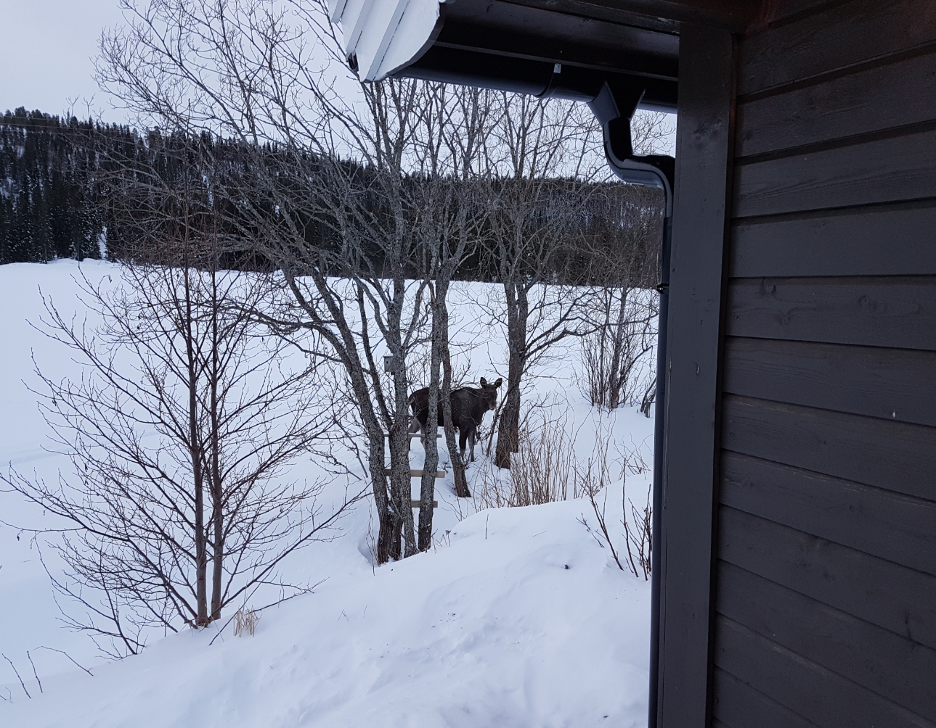
Break!

