Slide 1
XSAM course
The XSAM model/framework
Sondre Aanes
IMR, Bergen
15 - 17/1-2017

Slide 2
Status
Adopted as operating model by ICES for NSS-herring
Not published (high priority)
Reviewed through benchmark
Documentation by working documents
Code is partly documented (needs improvement)
Work in progress linked to REDUS
Concept:
Aanes, Vølstad, Subbey, Hirst, Aldrin, Storvik et al.
The herring version
+ Stenevik, Salthaug, et. al

Slide 3
XSAM
A hidden dynamical process with noisy observations
– sounds like a state space model
XSAM is a state space model with
Flexible dynamical model
Flexible Observation model

Slide 4
XSAM
The goal was to build a framework to improve the way errors are handled
Less focus on the dynamical model: Builds on the most complete model (?) within this class (Aanes, pers. com.): Gudmundsson 1994
Mechanisticly built model where each part follows justified logic
More focus on the observation model: Determines how data is used (to inform the underlying process)
Gudmundsson, G., 1994. Time series analysis of catch-at-age observations. Jour-nal of the Royal Statistical Society: Series C (Applied Statistics) 43, 117–126.

Slide 5
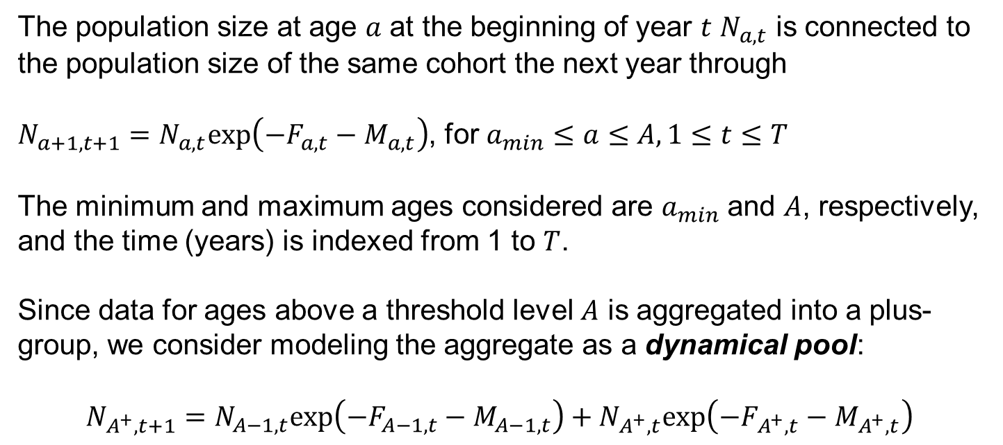
Dynamical model – cohorts
The population size at age $a$ at the beginning of year $t$ $N_{a,t}$ is connected to the population size of the same cohort the next year through
$N_{a+1,t+1}=N_{a,t}exp\left(−F_{a,t}−M_{a,t}\right)$, for $a_{min}≤a≤A, 1≤t≤T$
The minimum and maximum ages considered are $a_{min}$ and $A$, respectively, and the time (years) is indexed from 1 to $T$.
Since data for ages above a threshold level $A$ is aggregated into a plus-group, we consider modeling the aggregate as a dynamical pool:
$$N_{A^{+},t+1}=N_{A−1,t}exp\left(−F_{A−1,t}−M_{A−1,t}\right)+N_{A^{+},t}exp\left(−F_{A^{+},t}−M_{A^{+},t}\right)$$

Slide 6
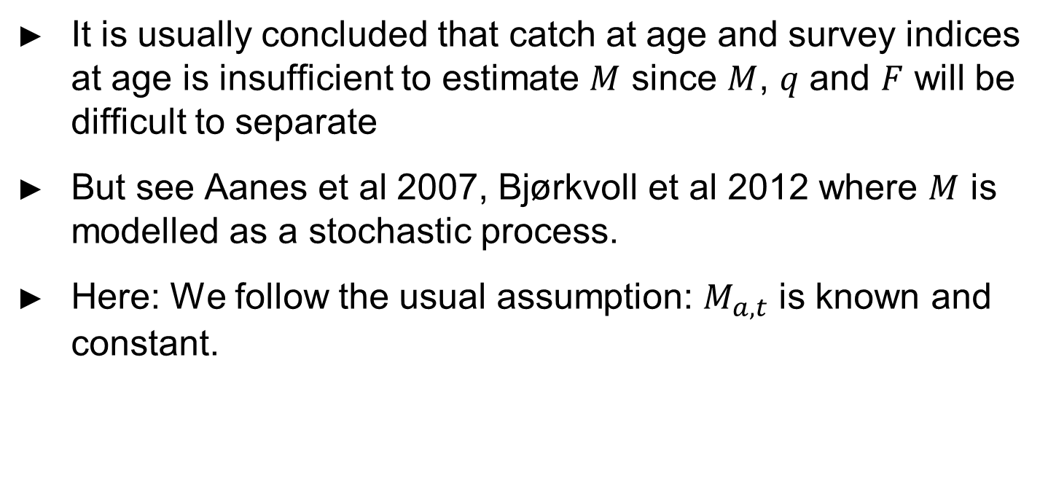
Dynamical model – natural mortality
It is usually concluded that catch at age and survey indices at age is insufficient to estimate $M$ since $M$, $q$ and $F$ will be difficult to separate
But see Aanes et al 2007, Bjørkvoll et al 2012 where $M$ is modelled as a stochastic process.
Here: We follow the usual assumption: $M_{a,t}$ is known and constant.
Aanes, S., Engen, S, Sæther, B.-E. and Aanes, R. 2007. Estimation of fish stock dynamical parameters from catch-at-age data and indices of abundance: can natural and fishing mortality be separated? Canadian journal of fisheries and aquatic sciences, 64: 1130-1142.
Bjørkvoll, E., Grøtan, V., Aanes S., Sæther, B.-E., Engen, S. and Aanes, R. 2012. Stochastic Population Dynamics and Life-History Variation in Marine Fish Species. The American Naturalist, Vol. 180, No. 3 (September 2012): 372-387.

Slide 7
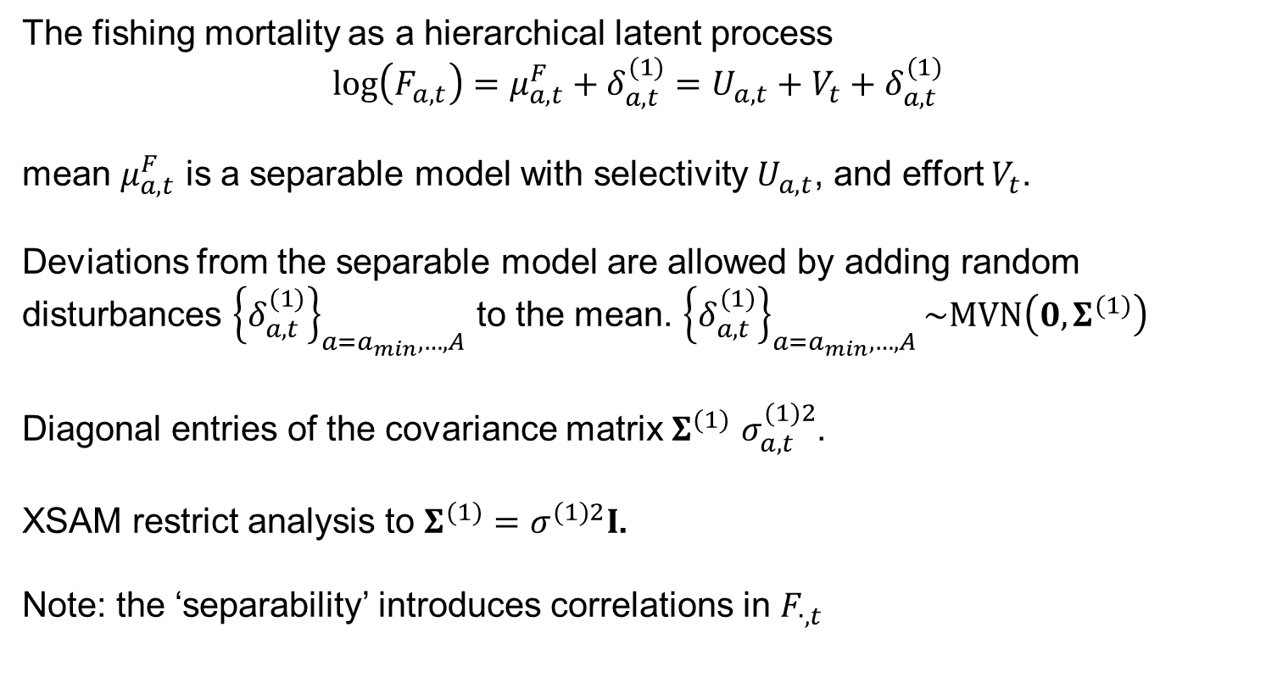
Dynamical model for F: F is modelled as a structural time series model
The fishing mortality as a hierarchical latent process
$$log\left(F_{a,t}\right)=μ_{a,t}^{F}+δ_{a,t}^{(1)}=U_{a,t}+V_{t}+δ_{a,t}^{(1)}$$
mean $μ_{a,t}^{F}$ is a separable model with selectivity $U_{a,t}$, and effort $V_{t}$.
Deviations from the separable model are allowed by adding random disturbances ${\left\{δ_{a,t}^{(1)}\right\}}_{a=a_{min},…,A}$ to the mean. ${\left\{δ_{a,t}^{(1)}\right\}}_{a=a_{min},…,A}\sim MVN\left(0,Σ^{(1)}\right)$
Diagonal entries of the covariance matrix $Σ^{(1)}$ $σ_{a,t}^{(1)2}$.
XSAM restrict analysis to $Σ^{(1)}=σ_{}^{(1)2}I$.
Note: the ‘separability’ introduces correlations in $F_{∙,t}$

Slide 8
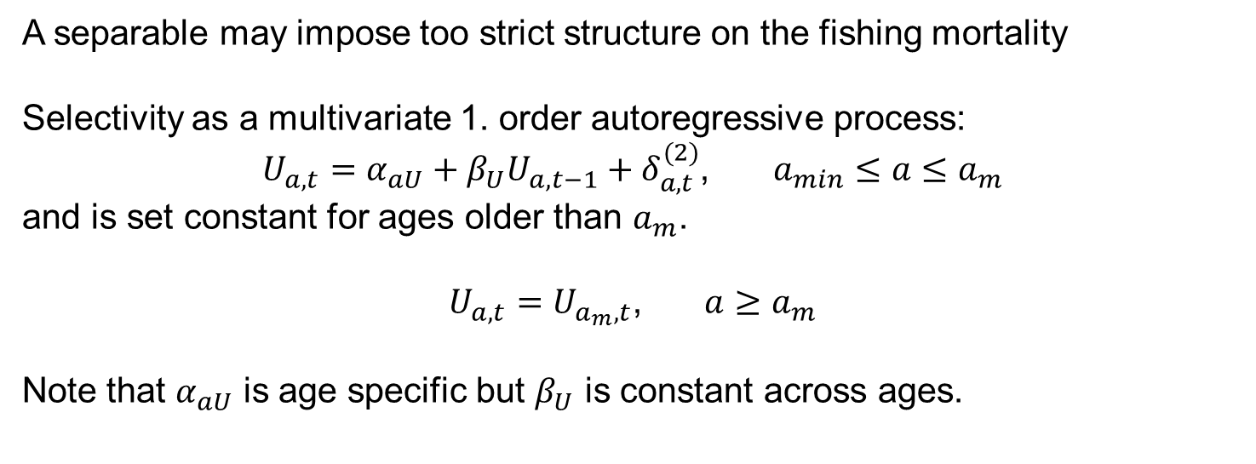
Dynamical model for F: Time varying selectivity
A separable may impose too strict structure on the fishing mortality
Selectivity as a multivariate 1. order autoregressive process:
$U_{a,t}=α_{aU}+β_{U}U_{a,t−1}+δ_{a,t}^{(2)}$, $a_{min}≤a≤a_{m}$
and is set constant for ages older than $a_{m}$.
$U_{a,t}=U_{a_{m},t}$, $a≥a_{m}$
Note that $α_{aU}$ is age specific but $β_{U}$ is constant across ages.

Slide 9
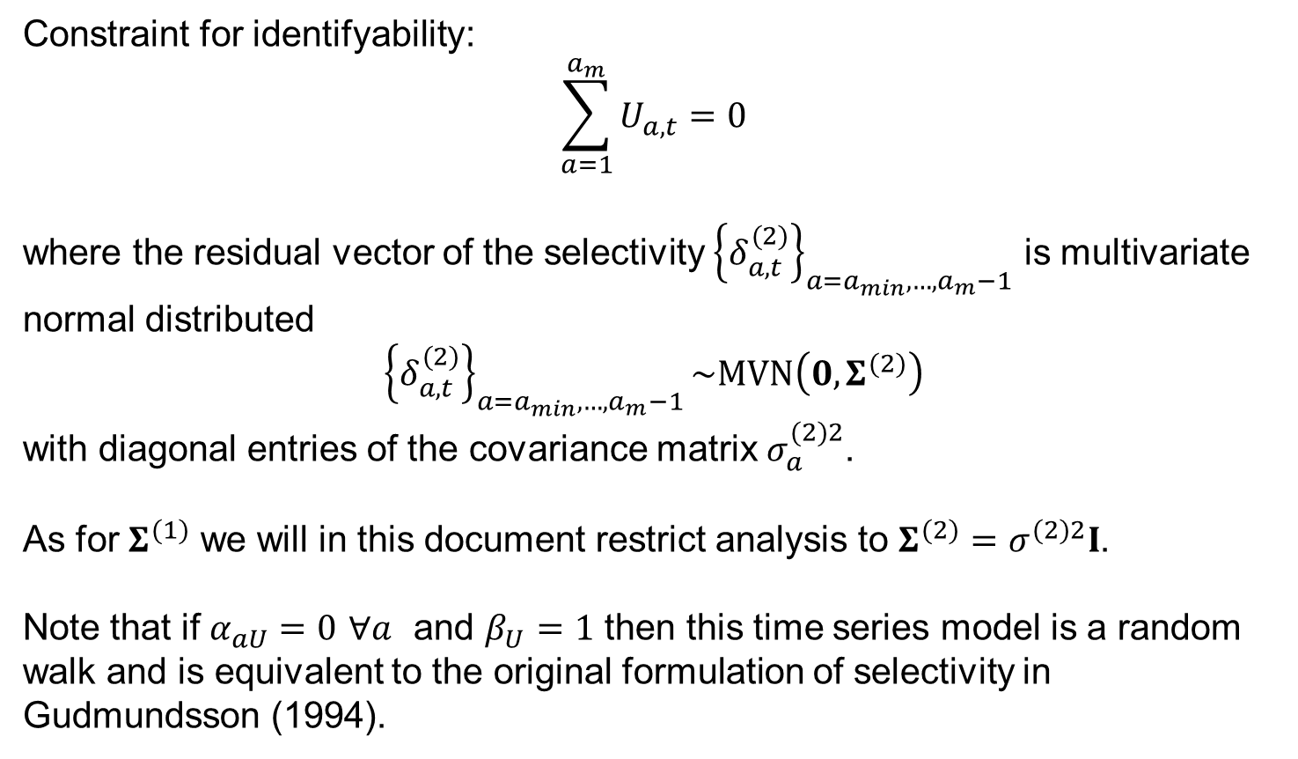
Dynamical model for F: Time varying selectivity
Constraint for identifyability:
$$\sum_{a=1}^{a_{m}}{U_{a,t}}=0$$
where the residual vector of the selectivity ${\left\{δ_{a,t}^{(2)}\right\}}_{a=a_{min},…,a_{m}−1}$ is multivariate normal distributed
$${\left\{δ_{a,t}^{(2)}\right\}}_{a=a_{min},…,a_{m}−1}\sim MVN\left(0,Σ^{(2)}\right)$$
with diagonal entries of the covariance matrix $σ_{a}^{(2)2}$.
As for $Σ^{(1)}$ we will in this document restrict analysis to $Σ^{(2)}=σ_{}^{(2)2}I$.
Note that if $α_{aU}=0$ $∀a$ and $β_{U}=1$ then this time series model is a random walk and is equivalent to the original formulation of selectivity in Gudmundsson (1994).

Slide 10
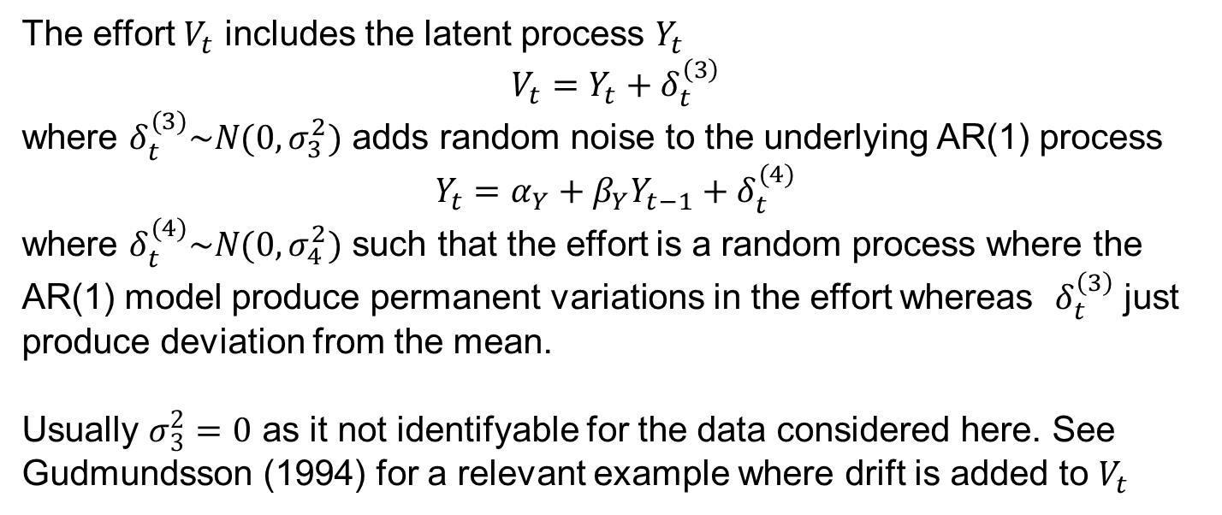
Dynamical model for F: Time varying selectivity
The effort $V_{t}$ includes the latent process $Y_{t}$
$$V_{t}=Y_{t}+δ_{t}^{\left(3\right)}$$
where $δ_{t}^{(3)}\sim N(0,σ_{3}^{2})$ adds random noise to the underlying AR(1) process
$$Y_{t}=α_{Y}+β_{Y}Y_{t−1}+δ_{t}^{(4)}$$
where $δ_{t}^{(4)}\sim N(0,σ_{4}^{2})$ such that the effort is a random process where the AR(1) model produce permanent variations in the effort whereas $δ_{t}^{\left(3\right)}$ just produce deviation from the mean.
Usually $σ_{3}^{2}=0$ as it not identifyable for the data considered here. See Gudmundsson (1994) for a relevant example where drift is added to $V_{t}$

Slide 11
Summary Dynamical model for F
Very flexible formulation
In practice somewhat simplified
Some special cases worth noticing:

Slide 12
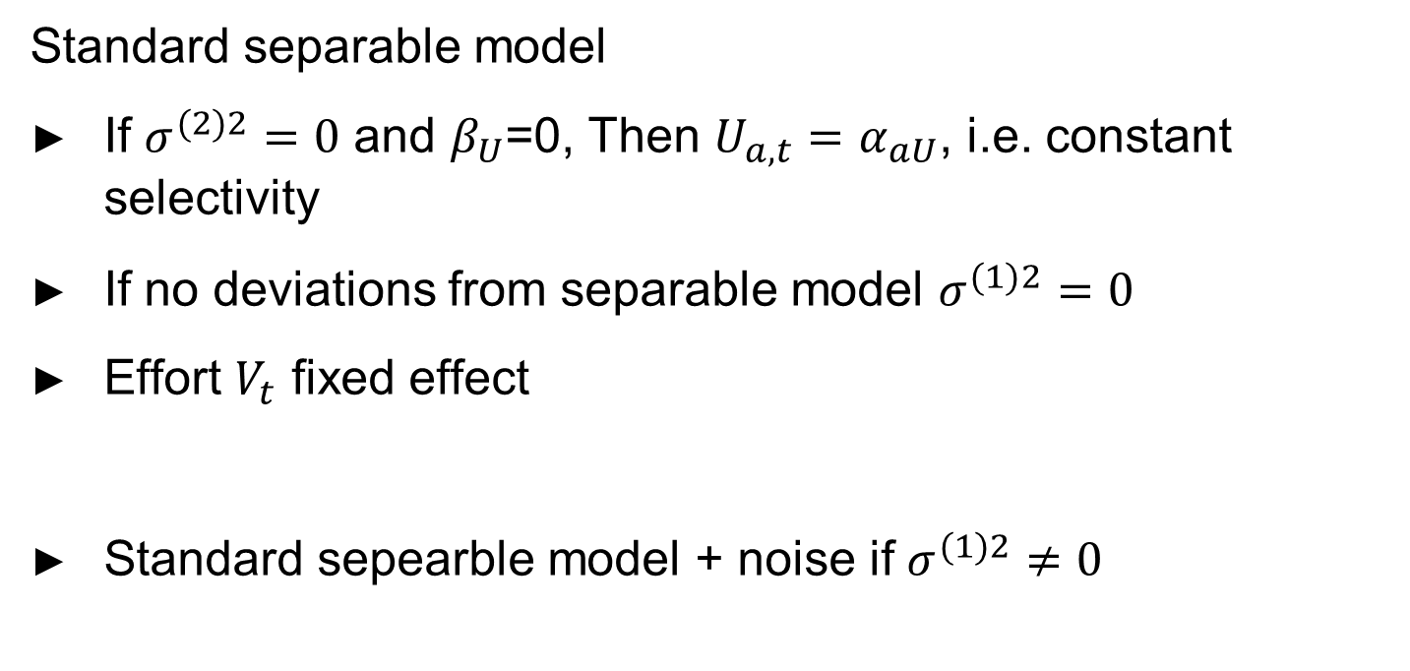
Dynamical model – special cases
Standard separable model
If $σ_{}^{(2)2}=0$ and $β_{U}$=0, Then $U_{a,t}=α_{aU}$, i.e. constant selectivity
If no deviations from separable model $σ_{}^{(1)2}=0$
Effort $V_{t}$ fixed effect
Standard sepearble model + noise if $σ_{}^{(1)2}≠0$

Slide 13
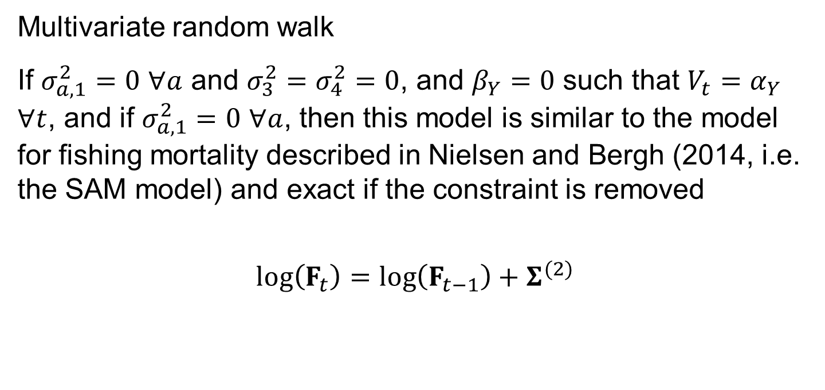
Dynamical model – special cases
Multivariate random walk
If $σ_{a,1}^{2}=0$ $∀a$ and $σ_{3}^{2}=σ_{4}^{2}=0$, and $β_{Y}=0$ such that $V_{t}=α_{Y}$ $∀t$, and if $σ_{a,1}^{2}=0$ $∀a$, then this model is similar to the model for fishing mortality described in Nielsen and Bergh (2014, i.e. the SAM model) and exact if the constraint is removed
$$log\left(F_{t}\right)=log\left(F_{t−1}\right)+Σ^{(2)}$$

Slide 14
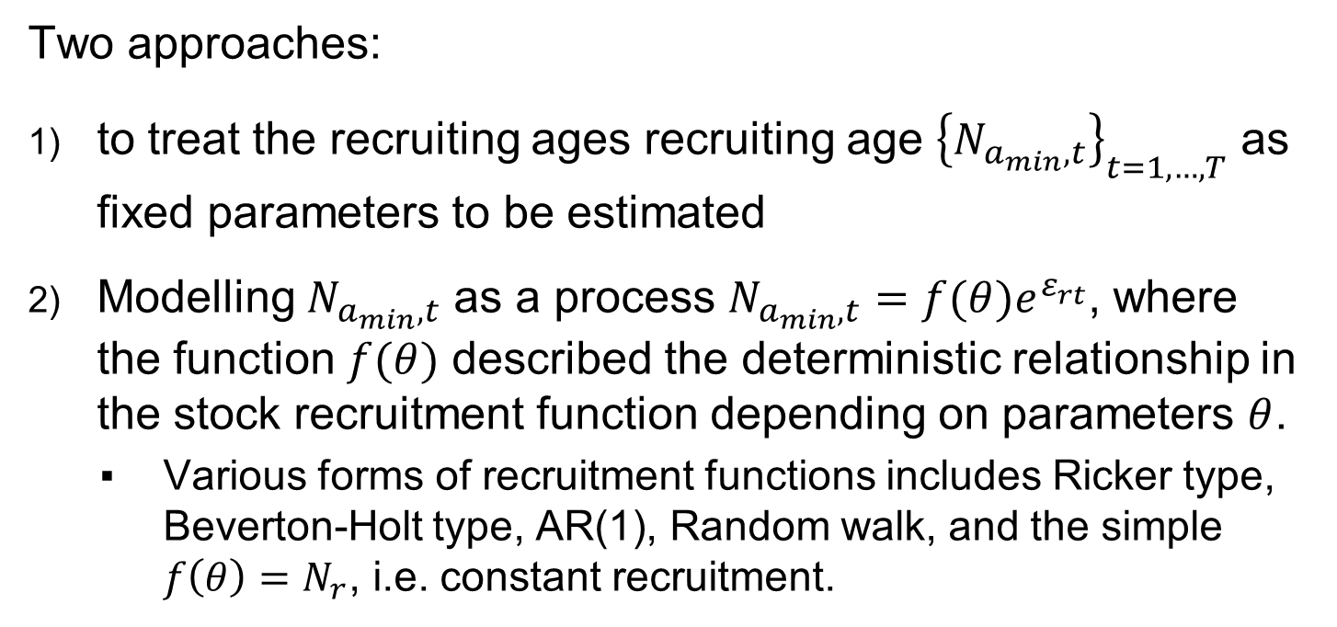
Recruits
Two approaches:
to treat the recruiting ages recruiting age ${\left\{N_{a_{min},t}\right\}}_{t=1,…,T}$ as fixed parameters to be estimated
Modelling $N_{a_{min},t}$ as a process $N_{a_{min},t}=f(θ)e^{ε_{rt}^{}}$, where the function $f(θ)$ described the deterministic relationship in the stock recruitment function depending on parameters $θ$.
Various forms of recruitment functions includes Ricker type, Beverton-Holt type, AR(1), Random walk, and the simple $f\left(θ\right)=N_{r}$, i.e. constant recruitment.

Slide 15
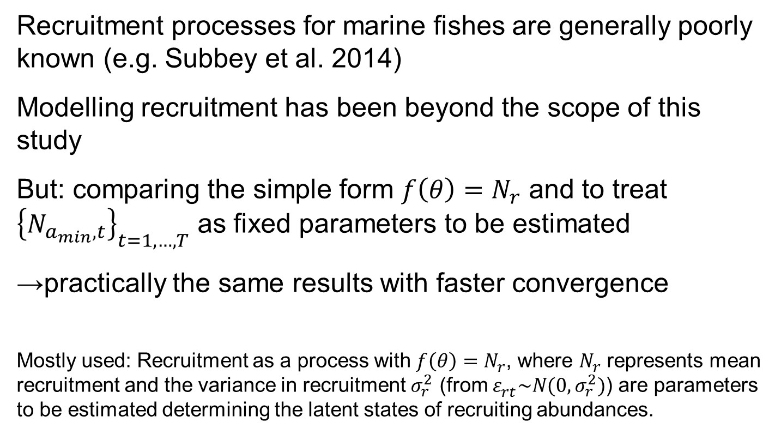
Recruits
Recruitment processes for marine fishes are generally poorly known (e.g. Subbey et al. 2014)
Modelling recruitment has been beyond the scope of this study
But: comparing the simple form $f\left(θ\right)=N_{r}$ and to treat ${\left\{N_{a_{min},t}\right\}}_{t=1,…,T}$ as fixed parameters to be estimated
→practically the same results with faster convergence
Mostly used: Recruitment as a process with $f\left(θ\right)=N_{r}$, where $N_{r}$ represents mean recruitment and the variance in recruitment $σ_{r}^{2}$ (from $ε_{rt}^{}\sim N(0,σ_{r}^{2})$) are parameters to be estimated determining the latent states of recruiting abundances.

Slide 16
Observation model – overview

Slide 17
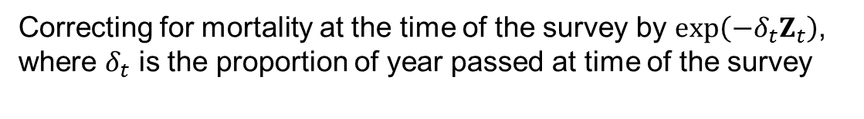

Observation models
Catch at age
$${\hat{C}}_{t}=C_{t}exp\left(ε_{t}^{c}\right)$$
$$ε_{t}^{c}\sim MVN\left(0,Σ_{t}^{c}\right)$$
Abundance at age
$$I_{t}= qN_{t}exp\left(−δ_{t}Z_{t}\right)exp\left(ε_{t}^{I}\right)$$
$$ε_{t}^{I}\sim MVN\left(0,Σ_{t}^{I}\right)$$
Observation error
Correcting for mortality at the time of the survey by $exp\left(−δ_{t}Z_{t}\right)$, where $δ_{t}$ is the proportion of year passed at time of the survey

Slide 18
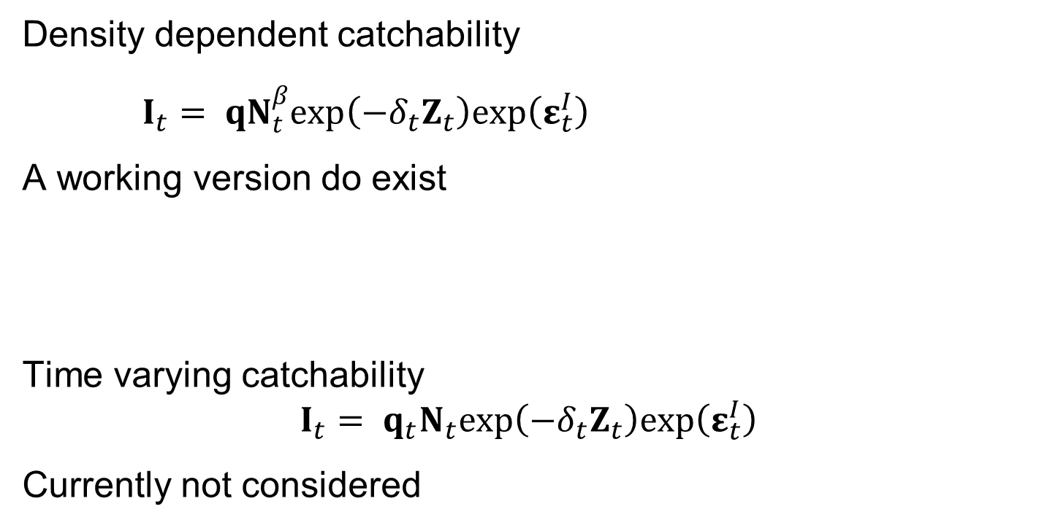
Alternative formulations beyond the scope now
Density dependent catchability
$I_{t}= qN_{t}^{β}exp\left(−δ_{t}Z_{t}\right)exp\left(ε_{t}^{I}\right)$
A working version do exist
Time varying catchability
$$I_{t}= q_{t}N_{t}exp\left(−δ_{t}Z_{t}\right)exp\left(ε_{t}^{I}\right)$$
Currently not considered

Slide 19
Observation model – interpretation
Is observation error = sampling error?
Yes if the model is correctly specified
If not:
Misspecification will force variability to other parts of the model
Confounded with observation error!
See e.g. Newman et al. 2014 for discussions on this topic.
Newman, Buckland, Morgan et. al. 2014. Modeling Population Dynamics. Model Formulation, Fitting and Assessment using State-Space Methods. Springer.

Slide 20
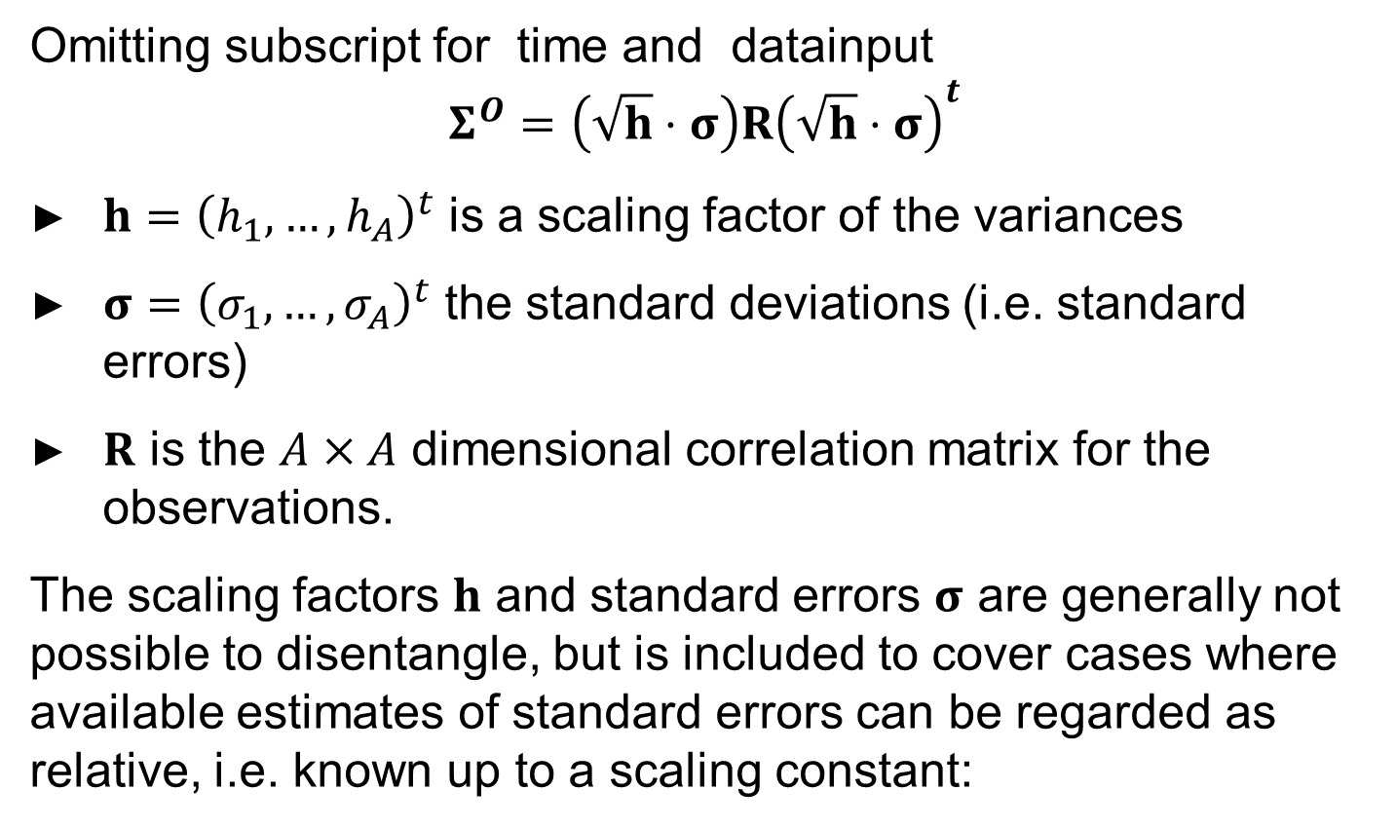
Observation error
Omitting subscript for time and datainput
$$Σ^{O}=\left(\sqrt{h}⋅σ\right)R{\left(\sqrt{h}⋅σ\right)}^{t}$$
$h={\left(h_{1},…,h_{A}\right)}^{t}$ is a scaling factor of the variances
$σ={\left(σ_{1},…,σ_{A}\right)}^{t}$ the standard deviations (i.e. standard errors)
$R$ is the $A×A$ dimensional correlation matrix for the observations.
The scaling factors $h$ and standard errors $σ$ are generally not possible to disentangle, but is included to cover cases where available estimates of standard errors can be regarded as relative, i.e. known up to a scaling constant:

Slide 21
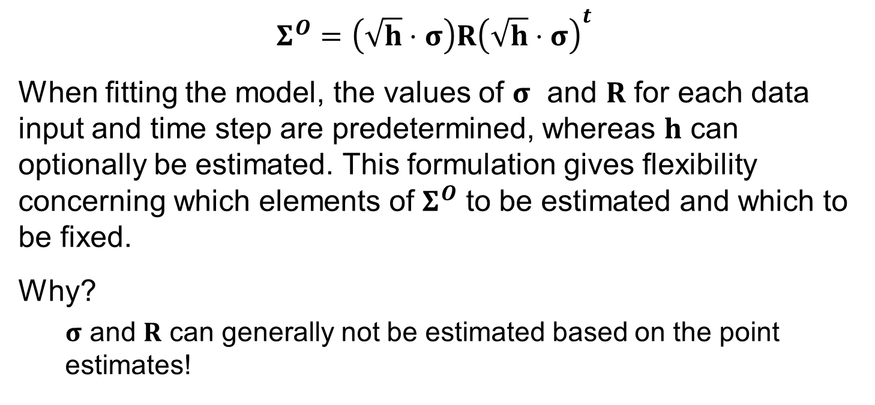
Observation error
$$Σ^{O}=\left(\sqrt{h}⋅σ\right)R{\left(\sqrt{h}⋅σ\right)}^{t}$$
When fitting the model, the values of $σ$ and $R$ for each data input and time step are predetermined, whereas $h$ can optionally be estimated. This formulation gives flexibility concerning which elements of $Σ^{O}$ to be estimated and which to be fixed.
Why?
$σ$ and $R$ can generally not be estimated based on the point estimates!

Slide 22
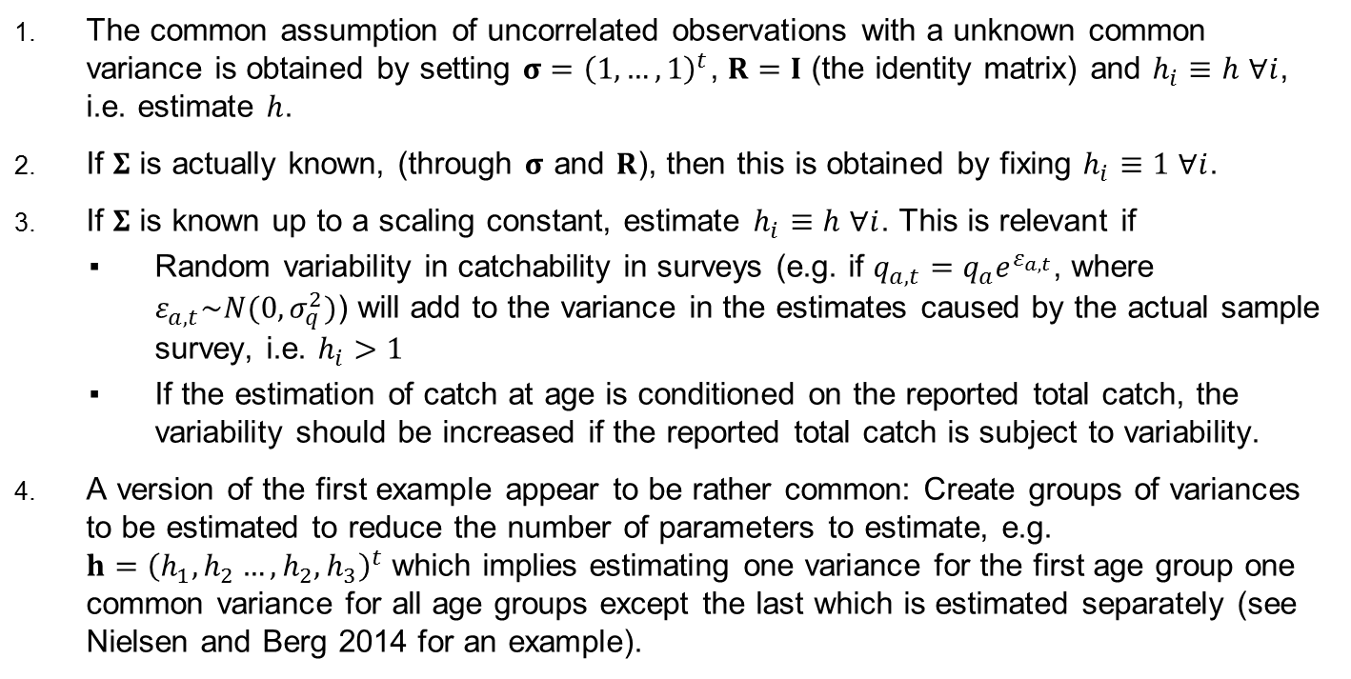
Observation model – Cases
The common assumption of uncorrelated observations with a unknown common variance is obtained by setting $σ={\left(1,…,1\right)}^{t}$, $R=I$ (the identity matrix) and $h_{i}≡h$ $∀i$, i.e. estimate $h$.
If $Σ$ is actually known, (through $σ$ and $R$), then this is obtained by fixing $h_{i}≡1$ $∀i$.
If $Σ$ is known up to a scaling constant, estimate $h_{i}≡h$ $∀i$. This is relevant if
Random variability in catchability in surveys (e.g. if $q_{a,t}=q_{a}e^{ε_{a,t}}$, where $ε_{a,t}\sim N(0,σ_{q}^{2})$) will add to the variance in the estimates caused by the actual sample survey, i.e. $h_{i}>1$
If the estimation of catch at age is conditioned on the reported total catch, the variability should be increased if the reported total catch is subject to variability.
A version of the first example appear to be rather common: Create groups of variances to be estimated to reduce the number of parameters to estimate, e.g. $h={\left(h_{1},h_{2}…,h_{2},h_{3}\right)}^{t}$ which implies estimating one variance for the first age group one common variance for all age groups except the last which is estimated separately (see Nielsen and Berg 2014 for an example).

Slide 23

Observation model
Current implementation for NSS herring
Set a common $h$ across all data sources and estimate $h$
This means that one parameter is estimated for all observation errors

Slide 24
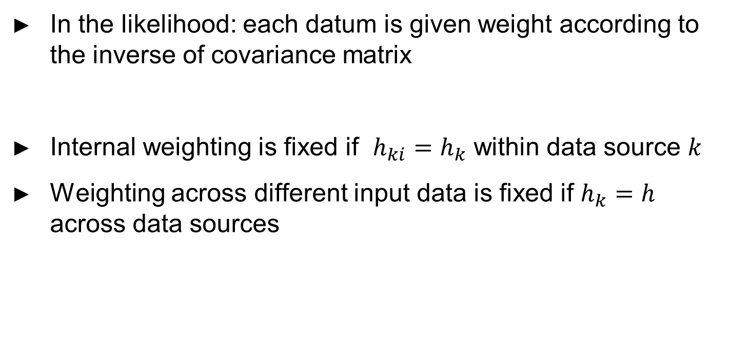
Relation to data weights
In the likelihood: each datum is given weight according to the inverse of covariance matrix
Internal weighting is fixed if $h_{ki}=h_{k}$ within data source $k$
Weighting across different input data is fixed if $h_{k}=h$ across data sources

Slide 25
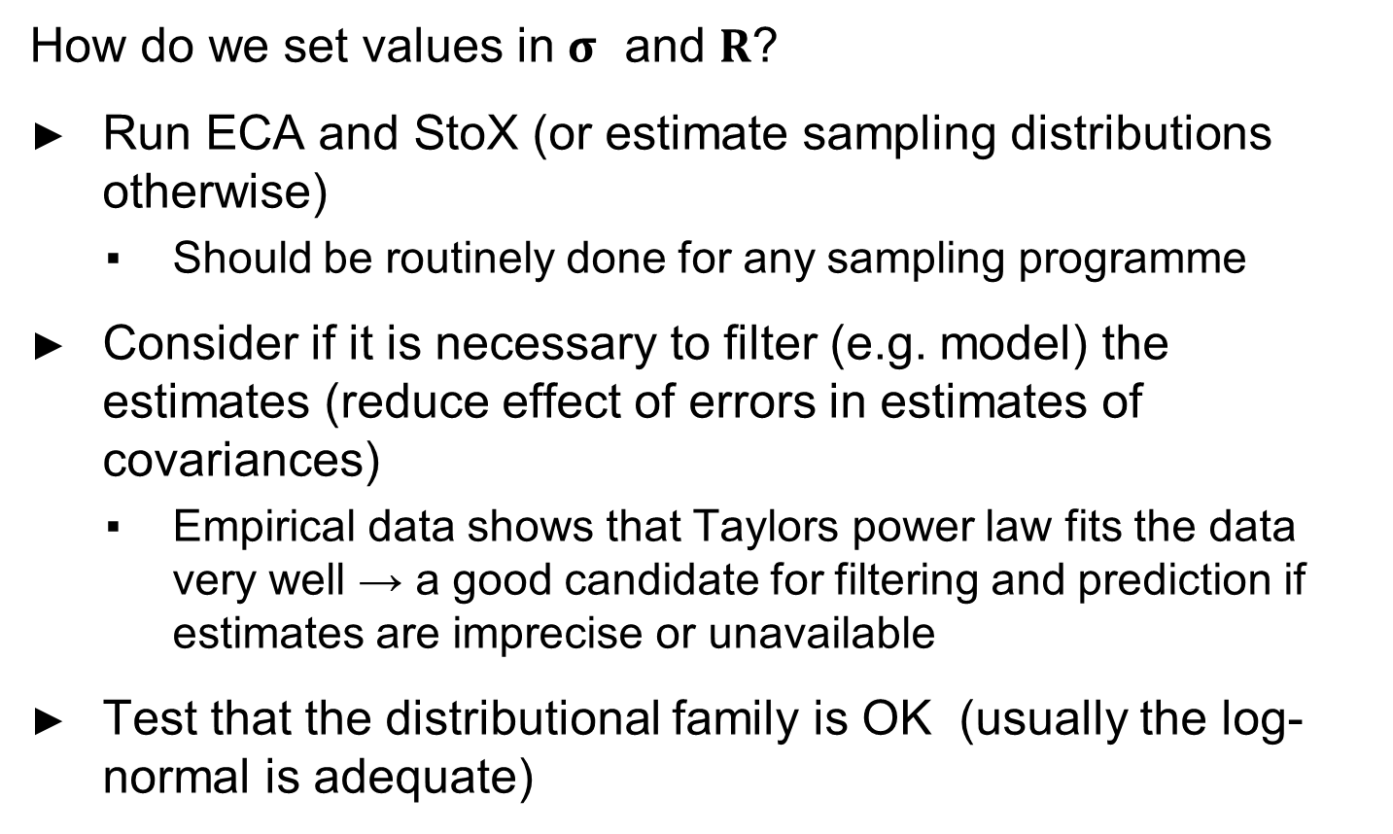
Specifying covariance matrices
How do we set values in $σ$ and $R$?
Run ECA and StoX (or estimate sampling distributions otherwise)
Should be routinely done for any sampling programme
Consider if it is necessary to filter (e.g. model) the estimates (reduce effect of errors in estimates of covariances)
Empirical data shows that Taylors power law fits the data very well → a good candidate for filtering and prediction if estimates are imprecise or unavailable
Test that the distributional family is OK (usually the log-normal is adequate)

Slide 26
Specifying covariance matrices
What if error structures for catch at age is only known for a subset of catch at age (typically for Norwegian catch, but not for other countries)
Reason to believe that the structure holds?
Reason to believe that it is known up to a scaling constant
Justify case 3 on previous slide?

Slide 27
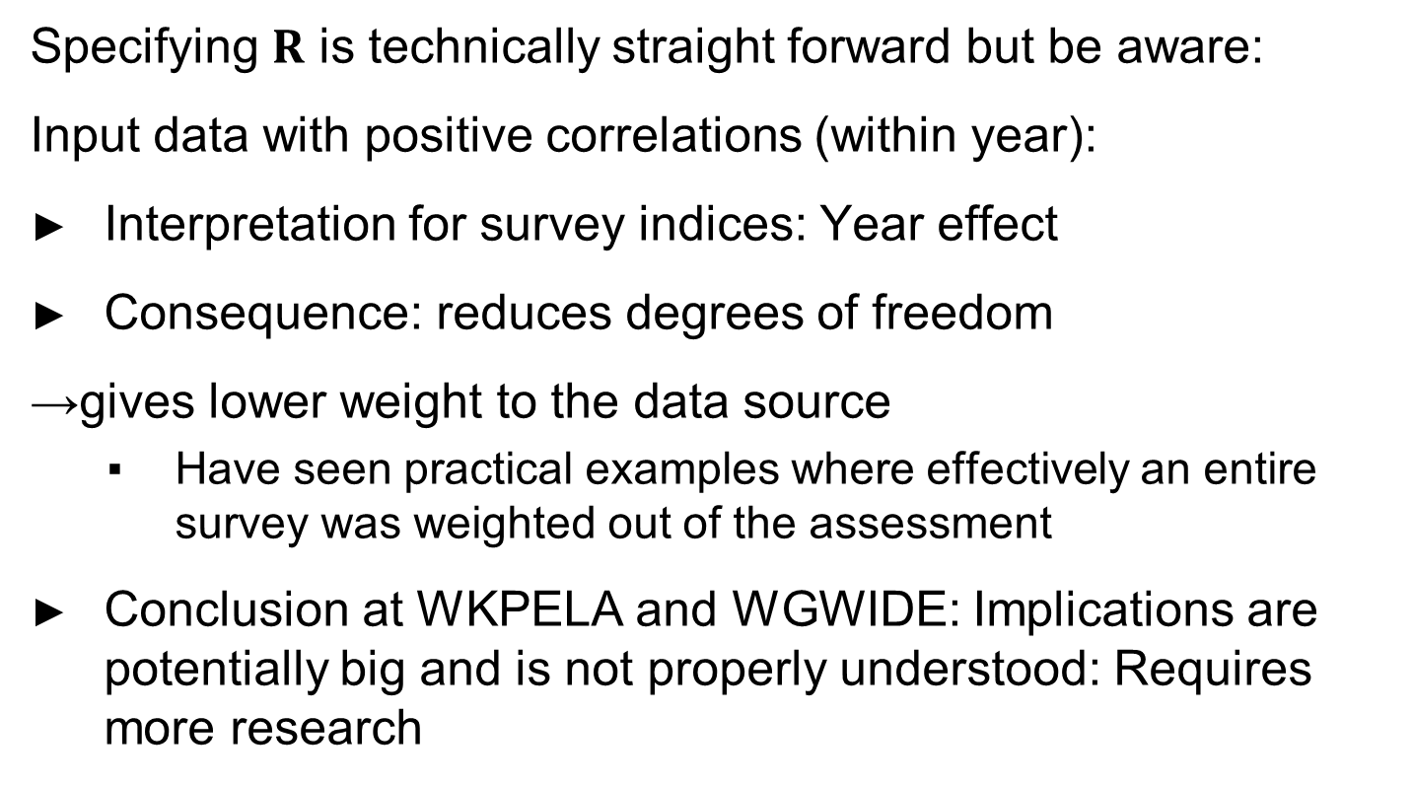
Specifying covariance matrices
Specifying $R$ is technically straight forward but be aware:
Input data with positive correlations (within year):
Interpretation for survey indices: Year effect
Consequence: reduces degrees of freedom
→gives lower weight to the data source
Have seen practical examples where effectively an entire survey was weighted out of the assessment
Conclusion at WKPELA and WGWIDE: Implications are potentially big and is not properly understood: Requires more research

Slide 28
Summary model
Many options for configuration of dynamical model
Takes time and experience
Many options for configuration of observation models
Requires knowledge about input data
Note: Can be run without informing error structures… A more conventional approach. The current version does not allow estimation of correlated errors, but can technically be ‘easily’ included..

Slide 29
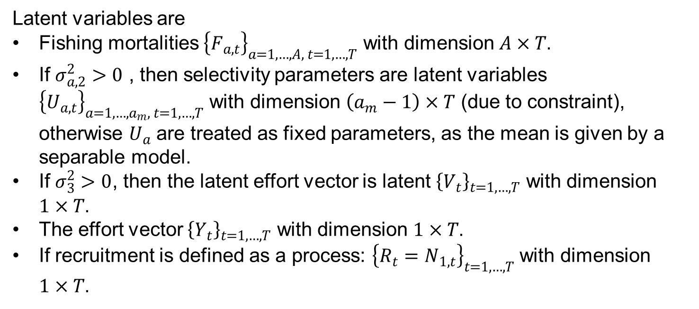
Summary parameters
Latent variables are
Fishing mortalities ${\left\{F_{a,t}\right\}}_{a=1,…,A, t=1,…,T}$ with dimension $A×T$.
If $σ_{a,2}^{2}>0$ , then selectivity parameters are latent variables ${\left\{U_{a,t}\right\}}_{a=1,…,a_{m}, t=1,…,T}$ with dimension $\left(a_{m}−1\right)×T$ (due to constraint), otherwise $U_{a}$ are treated as fixed parameters, as the mean is given by a separable model.
If $σ_{3}^{2}>0$, then the latent effort vector is latent ${\left\{V_{t}\right\}}_{t=1,…,T}$ with dimension $1×T$.
The effort vector ${\left\{Y_{t}\right\}}_{t=1,…,T}$ with dimension $1×T$.
If recruitment is defined as a process: ${\left\{R_{t}=N_{1,t}\right\}}_{t=1,…,T}$ with dimension $1×T$.

Slide 30
Summary parameters
Fixed parameters:
initial values (abundances first year)
Optionally recruits
Age specific selectivity
AR parameters for selectivity and/or effort (except for random walks in which they are predetermined)
All variances are fixed parameters to be estimated including ‘scaling constants’ for observation errors

Slide 31
NOTE
Also XSAM ignores variability in point estimates of
weight@age in stock
weight@age in catch
P(mature@age) in stock
and uses these as fixed and known
Estimates of biomasses such as SSB does not account for this additional variability!

Slide 32
Fitting the model to data
Situation:
Lots of latent variables
Gudmundsson used a linearized Kalman Filter
Could have used a Bayesian approach
Marginal likelihood approach: Must integrate out the latent variables
ADMB/TMB
Filter methods
INLA?
Other methods?

Slide 33
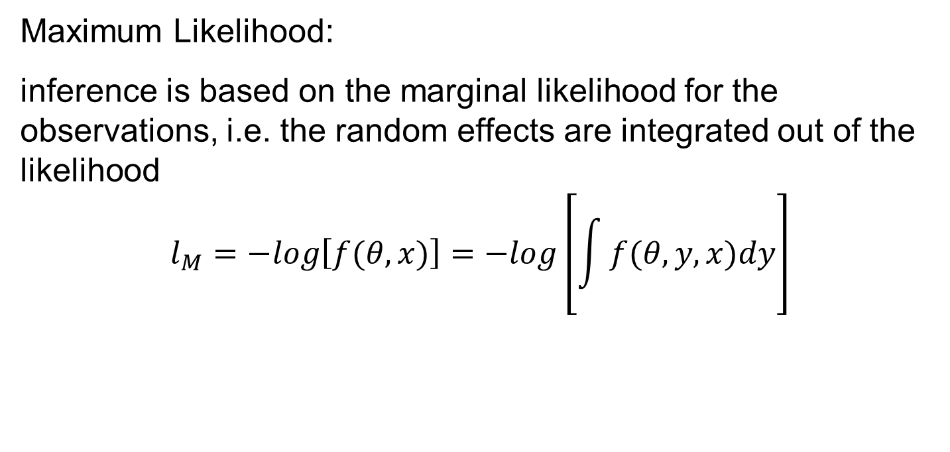
Fitting the model to data using TMB
Maximum Likelihood:
inference is based on the marginal likelihood for the observations, i.e. the random effects are integrated out of the likelihood
$$l_{M}=−log\left[f(θ,x)\right]=−log\left[\int{f(θ,y,x)dy}\right]$$
Fixed parameters
Data
Random effects
Achieved by TMB (Template Model Builder, Kristensen 2014, https://github.com/kaskr/adcomp/wiki), which approximates the integral by LaPlace approximation such that the marginal likelihood can be maximized

Slide 34
The likelihood
See documentation for details

Slide 35
Evaluation of model
Evaluation by ‘standard’ diagnostics (residuals, likelihood componenets and profiles, etc)
Evaluation by simulation
Simulate process
Simulate data
Check performance
Some conclusions:
Difficult to estimate structure of observation error, variance components are confounded
Utilizing prior information on errors improves inference
Not sensitive to small errors in covariances (due to estimation)
Level of uncertainty in data is closely linked to level of uncertainty of parameters
Explains why we propose to predetermine parts of the covariance structure (see also comments in Gudmundsson 1994 concerning predetermining parameter values)!

Slide 36
Note
The idea of informing error structures based on sampling errors is not new
For example:
ADAPT: propose to use sampling errors to objectively provide weight to data
Stock synthesis: Operates with effective sample sizes to control weighting and variability
Discussed in Newman et al. 2014

Slide 37
Being critical : food for thought
The implemenation of a HCR may justify a time series model for F. What if the HCR (or the implementation) changes?
Flexible model for C (through F)
Not so flexible model for I
Consequences
Is the model too flexible?
Parsimonious?
Overparameterised?
What is really needed for good advice?
We can estimate lots of parameters in complex models because of numercially efficient techniques. Are we really estimating relevant parameters? Does that mean it should be done?

